Slide 1
Year 10 History Trip to Berlin
Monday 10 March 2025 – Thursday 13 March 2025

Slide 2
Tour basics
Why are we going?
We’re on our way!
What will we see & do?
About our travel company

Slide 3
Tour basics
Getting there
We will depart from Stewards Academy by coach on Monday 10 March, arriving at Heathrow Airport to check in by 5:15am.
Please drop your child off at Stewards Academy at 3:00am to depart as soon as possible.
Departing flight: British Airways BA992 – Departs 08:15, arrives 11:10 (local)
Returning home
We will leave Berlin at 10:00 on Thursday 13 March, heading to Berlin Brandenburg Airport by coach.
Returning flight: British Airways BA983 – Departs 14:00, arrives 15:10 (local)
Please collect your child from Stewards Academy at approximately 6:30pm.

Slide 4
Tour basics
Our accommodation
We will stay at aletto Hotel Kudamm in
Berlin for 3 nights.
Full address:
aletto Kudamm
Hardenbergstrasse 21
10623 Berlin
This accommodation is on a half board basis.
Rooms will be allocated based on the students' preferences. Rooms have either 4, 5, or 6 beds and are single-sex.
The hotel has fully equipped rooms with ensuite bathrooms, WiFi, and buffet breakfast.

Slide 5
Tour basics
Meal arrangements
Breakfast – buffet breakfast in hotel each morning.
Lunch – students will buy lunch each day in various areas of Berlin depending on where we are. They will be able to choose where they eat and will need to bring money for this.
Dinner – evening meal in hotel each evening except for Tuesday where we will have a German 3 course meal at Der Alte Fritz Restaurant.

Slide 6
Tour basics
Travel tips – money
The currency in Berlin is the Euro.
We recommend that students take €100-200
with them on the visit in either cash, a fee-free debit card or a fee-free prepaid card.
Examples of fee-free debit cards with current accounts:
Monzo
Starling
Examples of Fee-Free Prepaid Cards
Caxton
FairFX
HyperJar
Revolut

Slide 7
Tour basics
Travel tips – packing
The weather in Berlin at this time of year is mild to cold, similar or slightly colder to the UK in March. We recommend that students pack the following essential items for their tour:
Comfortable shoes – we would recommend walking shoes over fashion trainers as there will be a lot of walking!
Jumpers
Jackets
Coats
Glove and scarfs (check weather nearer the time)
Suncream – we will be outside for most of each day!

Slide 8
Tour basics
Why are we going?
We’re on our way!
What will we see & do?
About our travel company

Slide 9
Why are we going?
Subject enrichment
Greater understanding of GCSE material – Weimar and Nazi Germany & Cold War
Success of last years’ trip

Slide 10
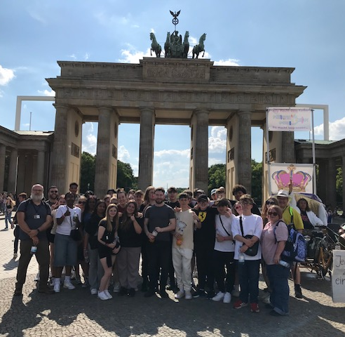
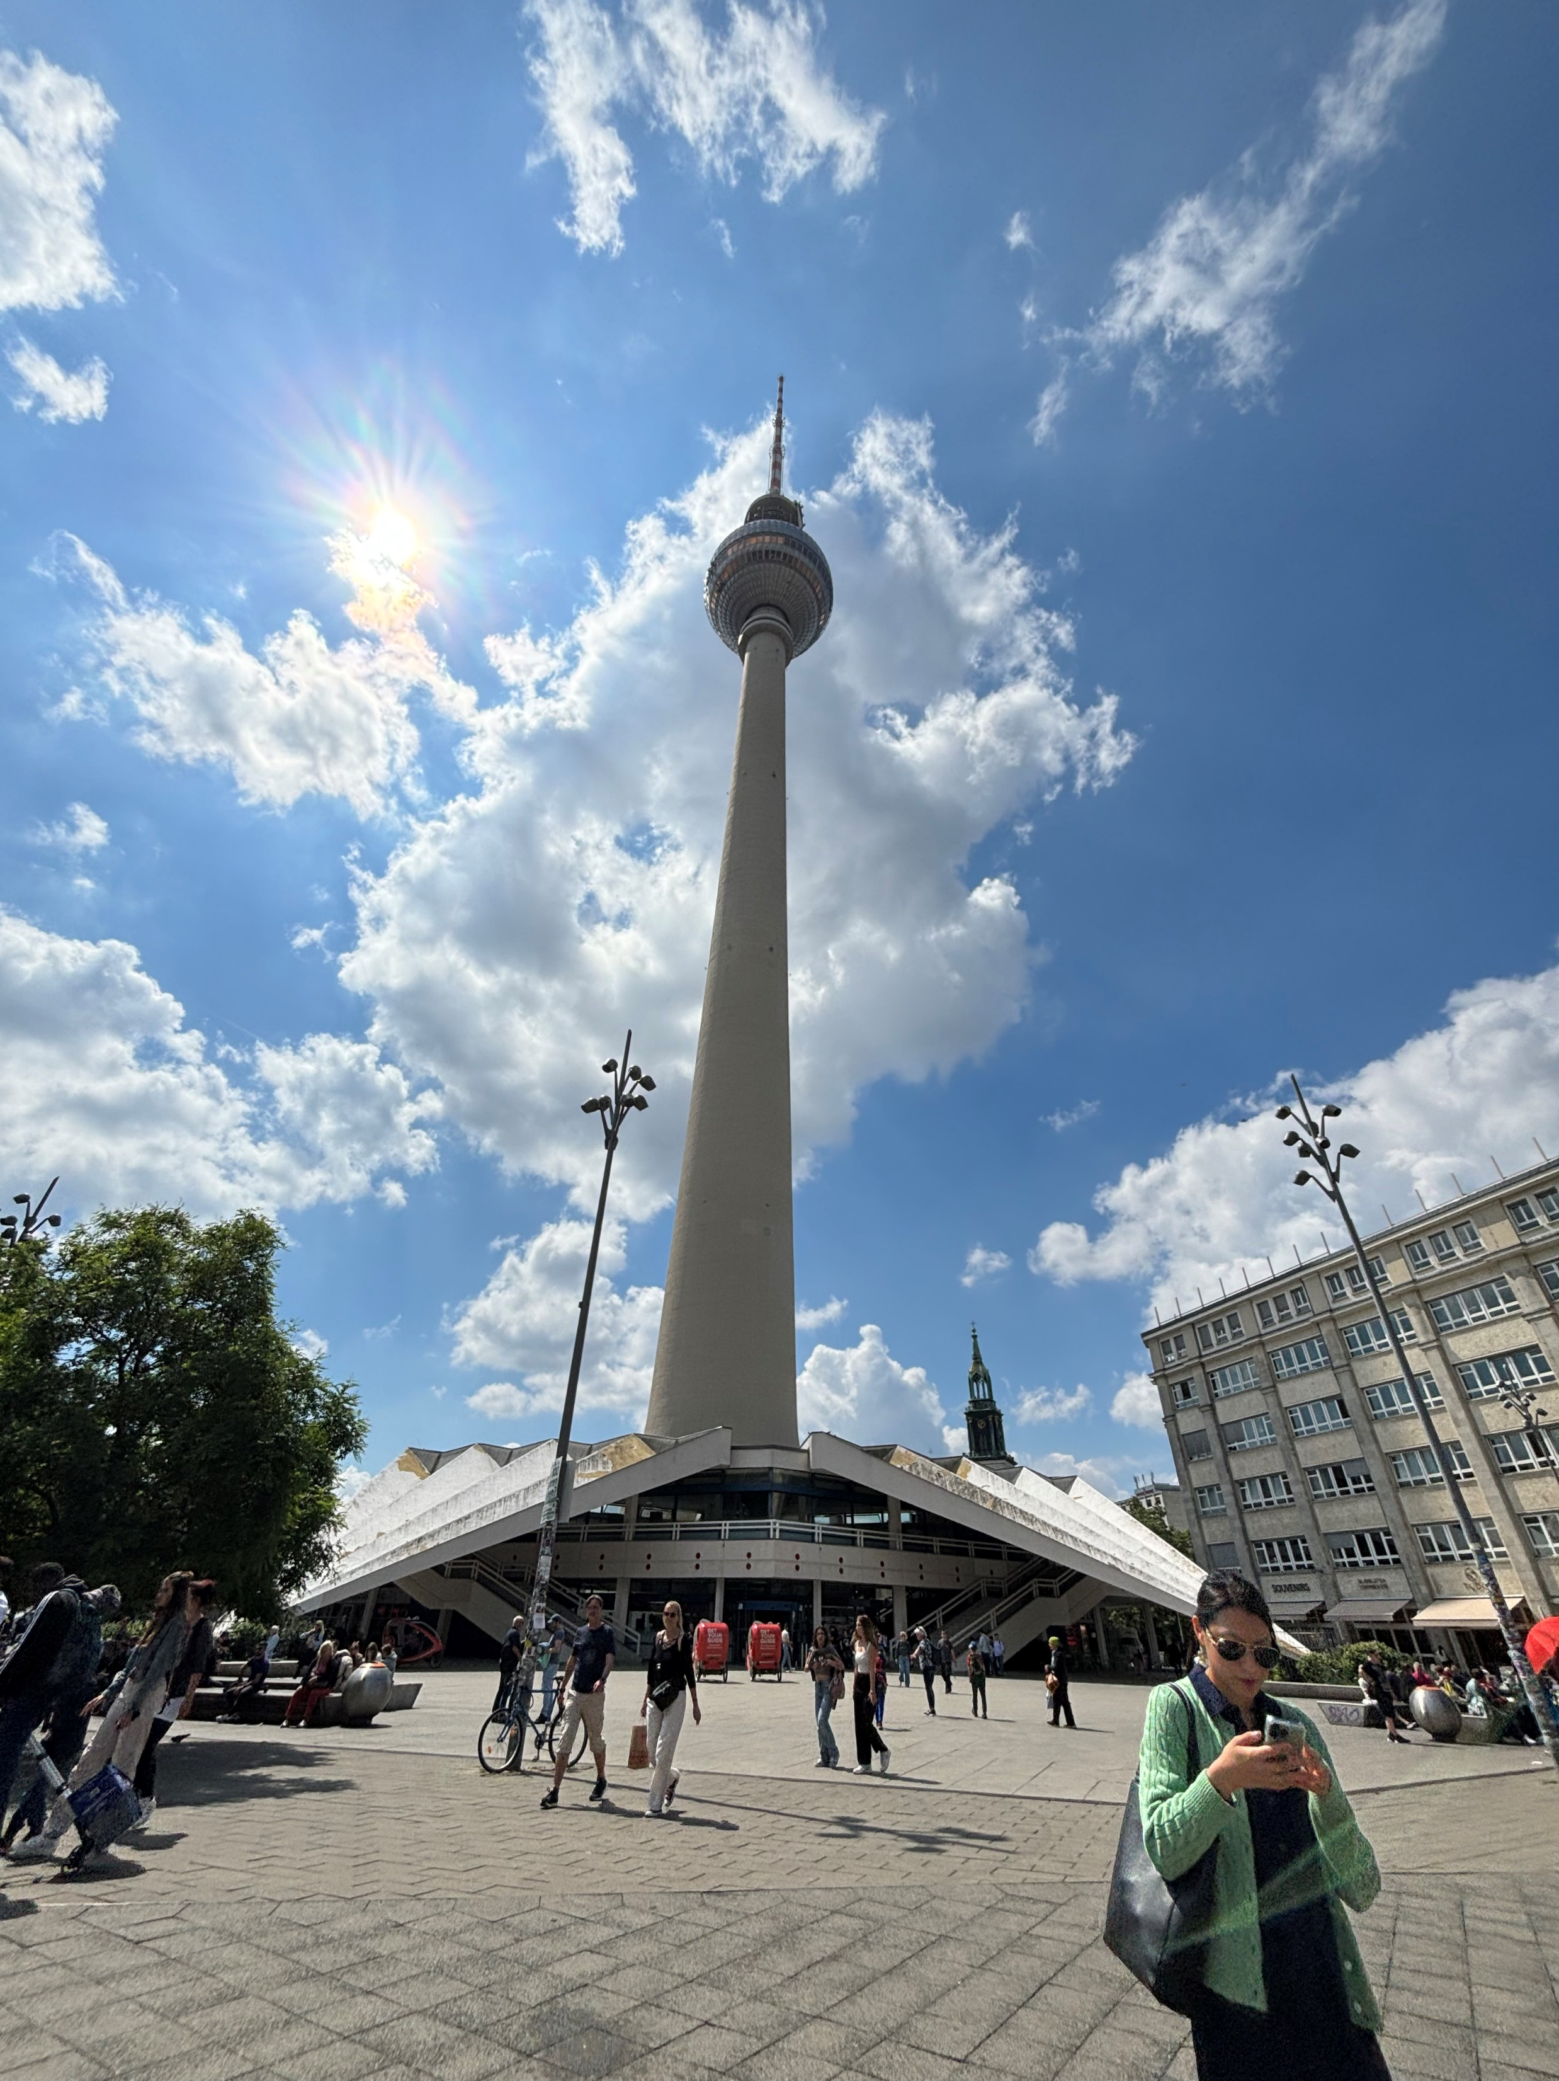

Slide 11
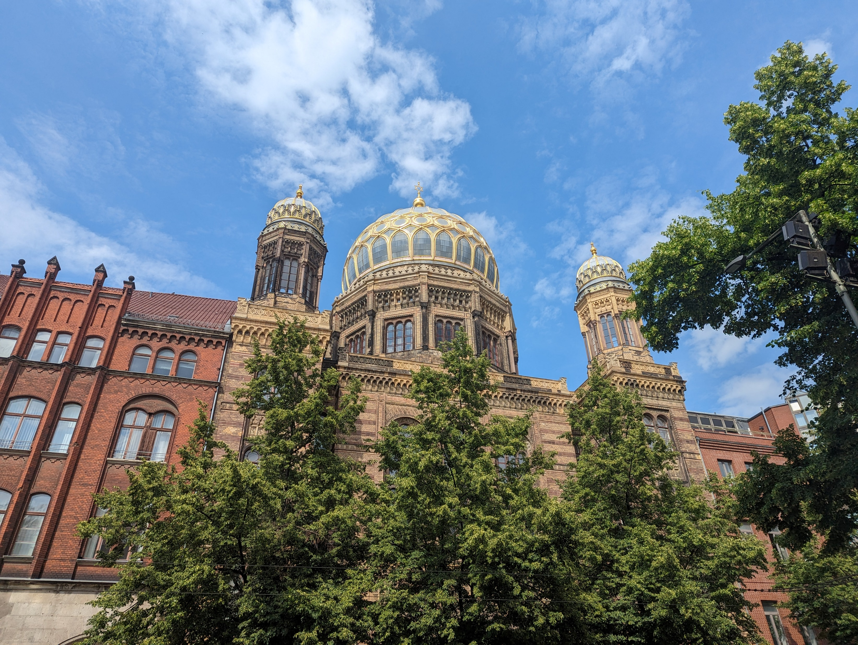
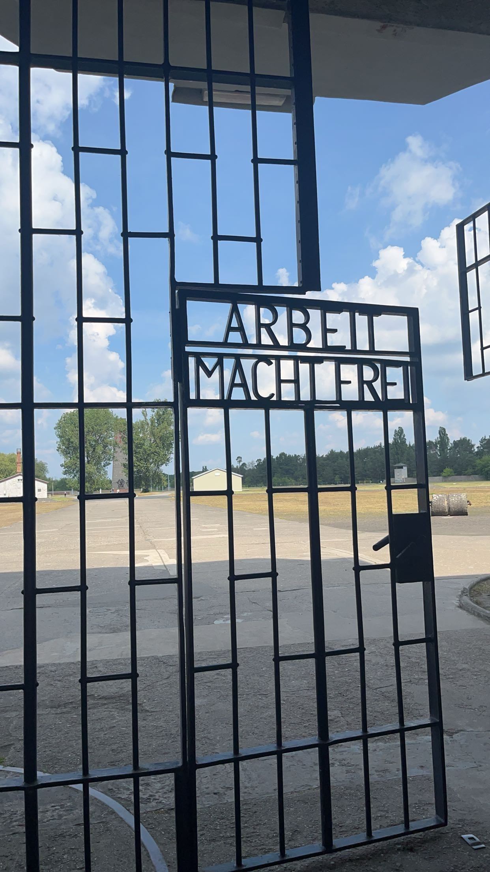
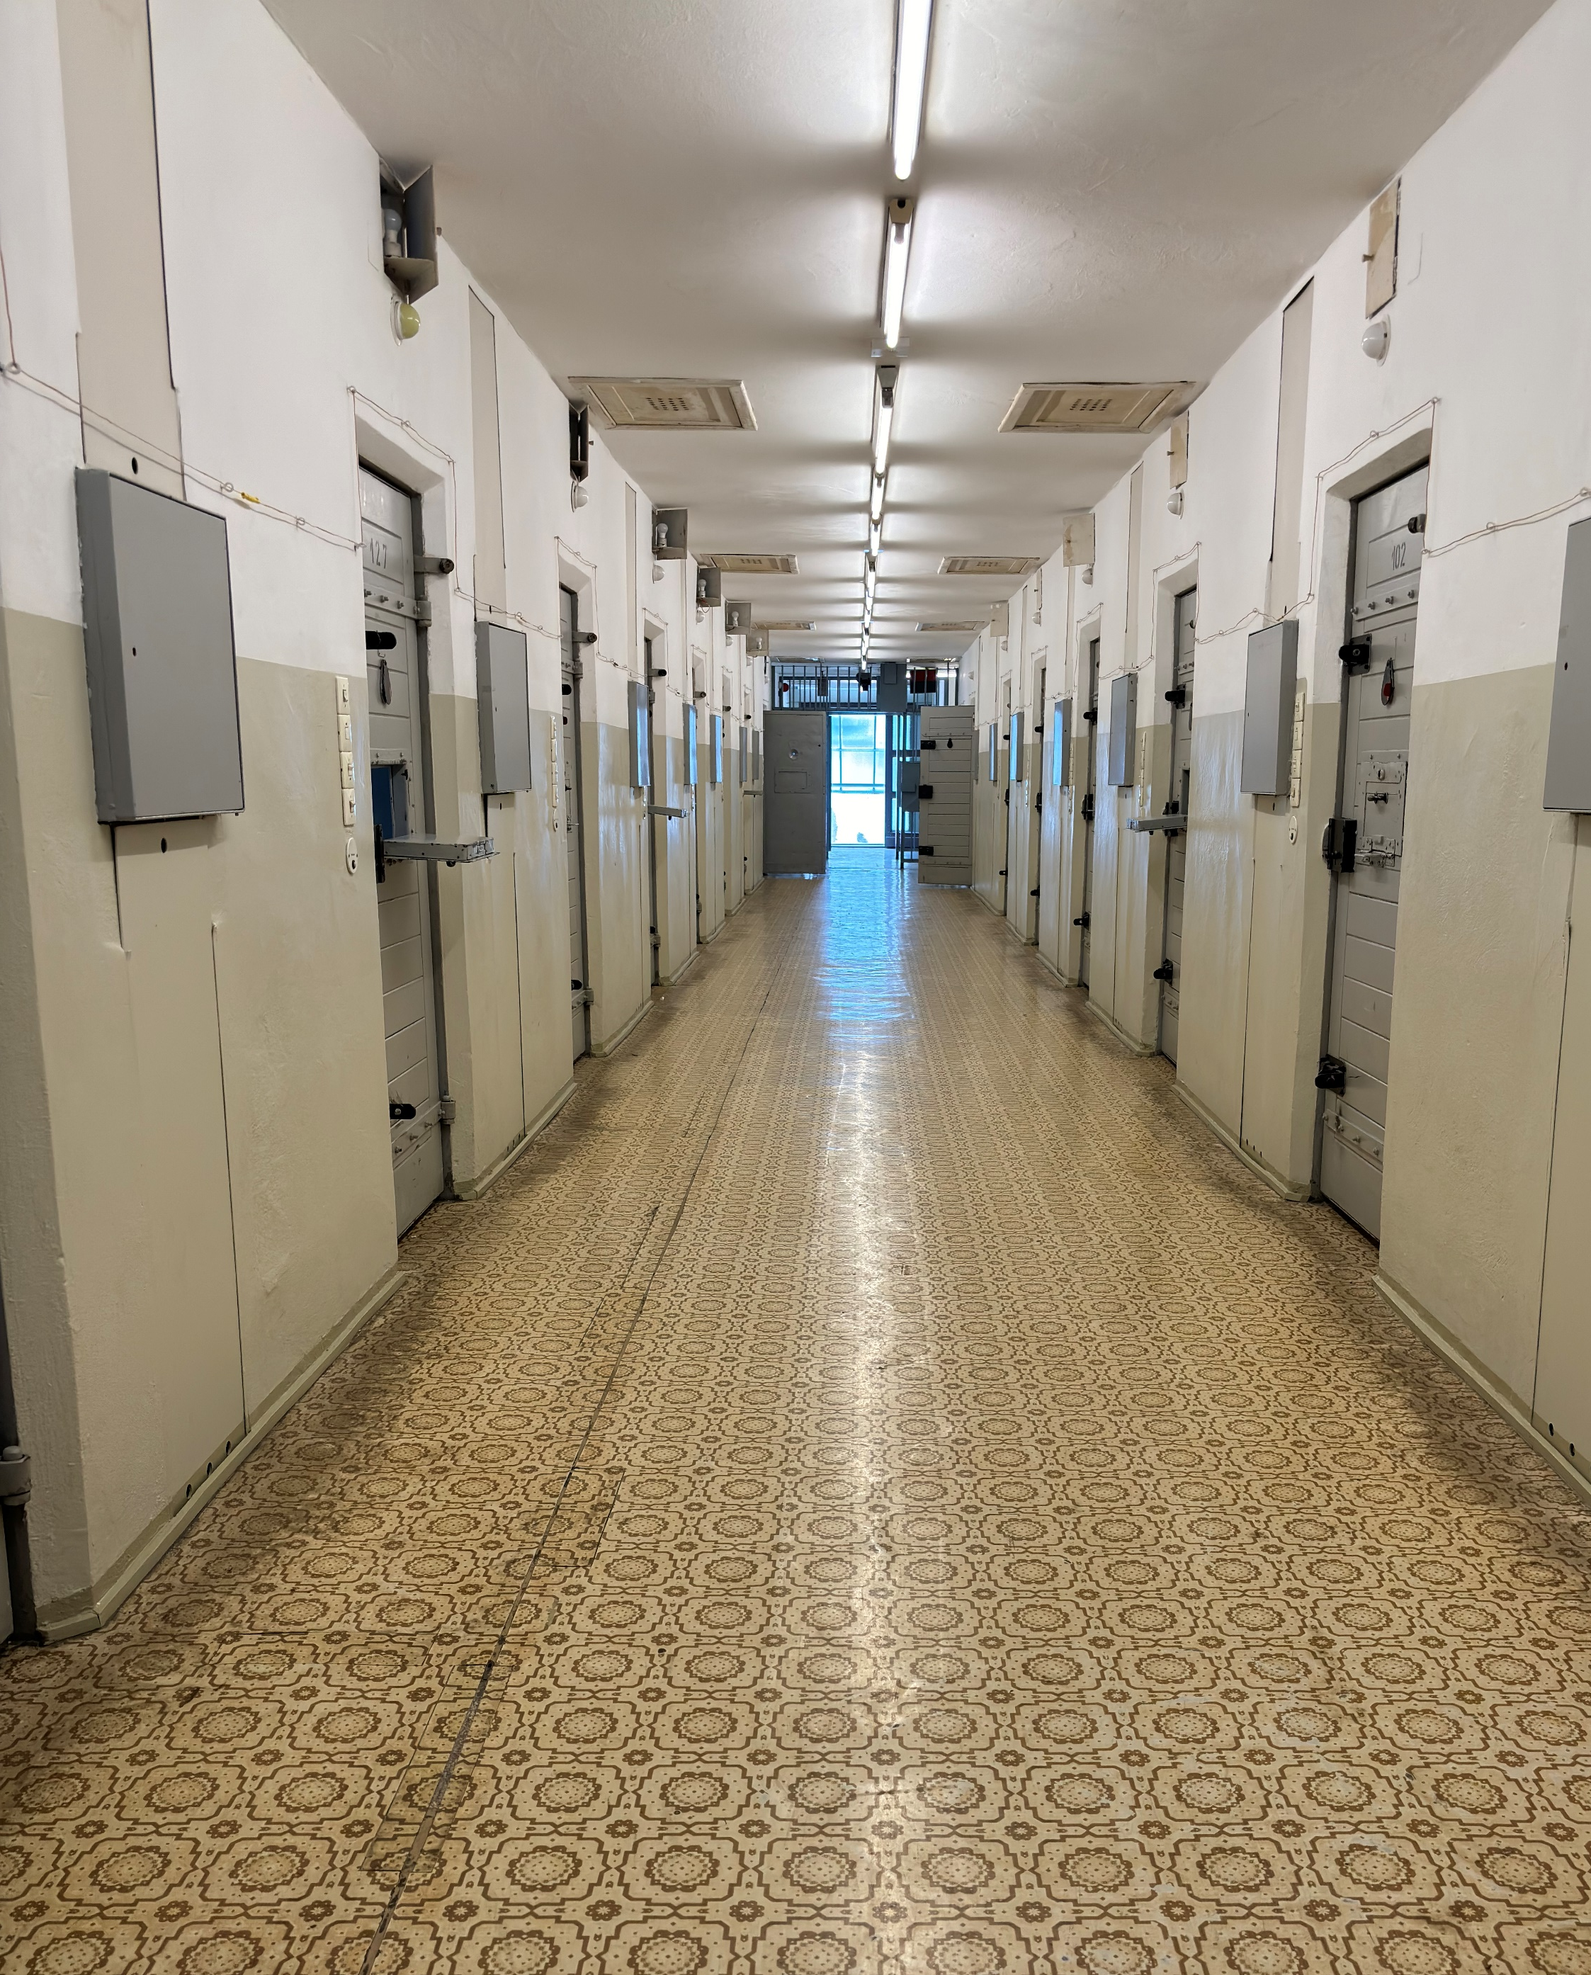
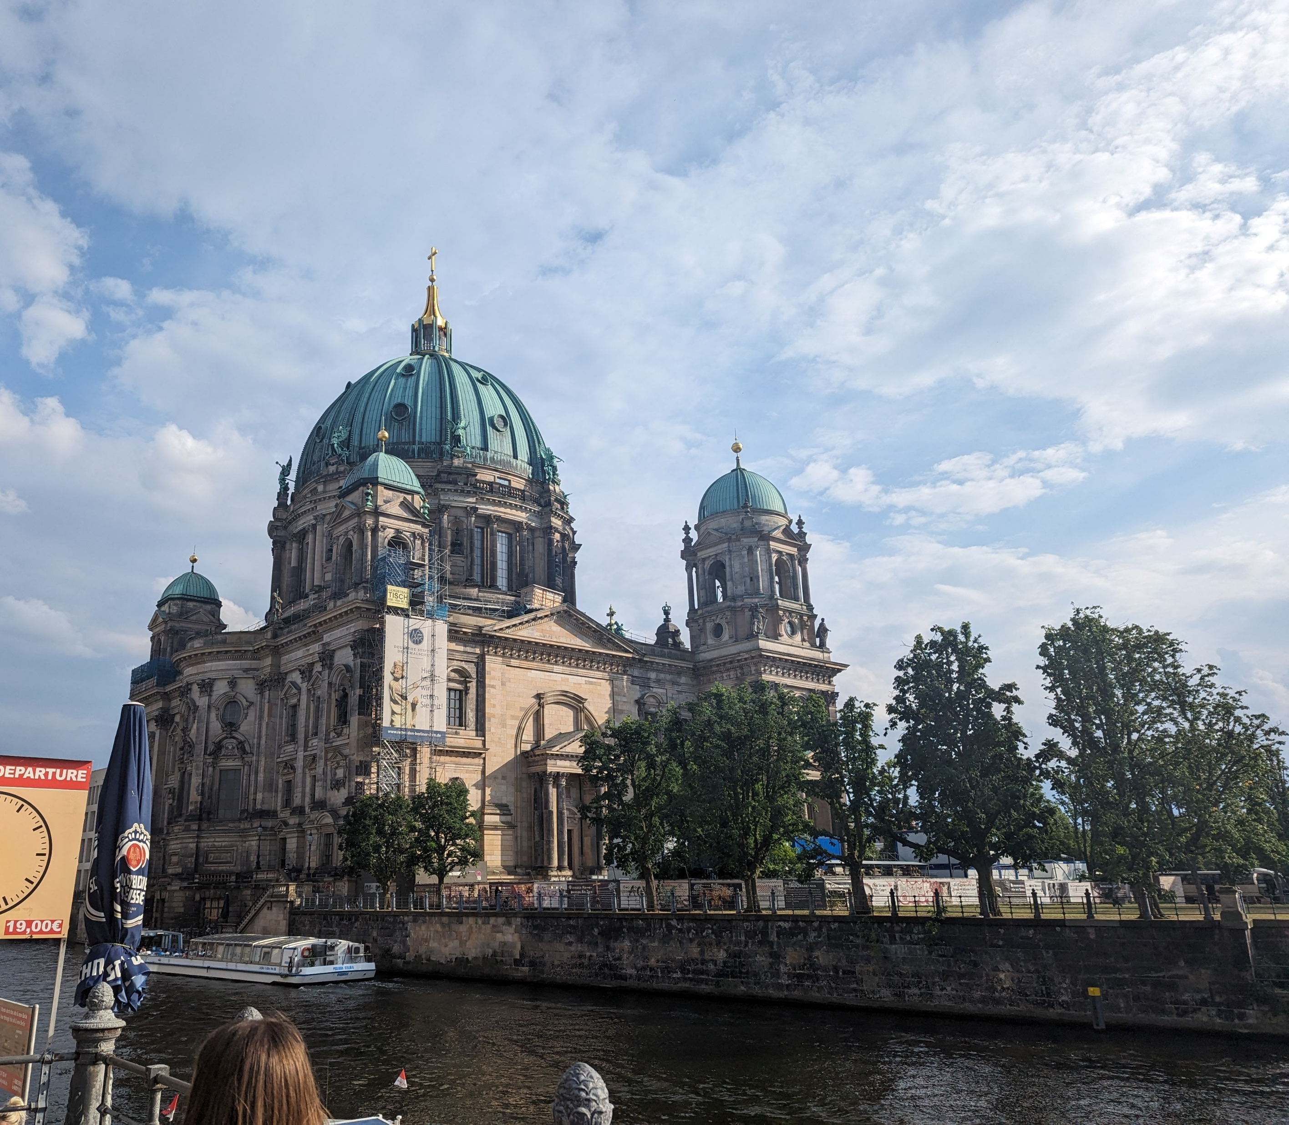

Slide 12
Tour basics
Why are we going?
We’re on our way!
What will we see & do?
About our travel company

Slide 13
What will we see & do?
Monday
Walking tour from Mall of Berlin along Unter den Linden e.g. Brandenburg Gate, Holocaust Memorials, Reichstag etc.
Tuesday
Sachsenhausen concentration camp
Walking tour of Hackeshermarkt e.g. New Synagogue, Otto Weidt museum etc.
TV Tower
Wednesday
Palace of Tears
DDR Museum
Stasi prison
Berlin Wall Memorial
Thursday
Home!

Slide 14
Tour basics
Why are we going?
We’re on our way!
What will we see & do?
About our travel company

Slide 15

Established 1967 - over 55 years’ experience
Government recommended health and safety policy
ABTA and ATOL protected - your payments are insured
Insurance cover and 24-hour medical assistance cover
About our travel company

Slide 16

Locate my trip - live updates on your group’s tour location with NST’s trip tracker
Locate My Trip is the easy, convenient way for your school to follow your group’s location whilst on tour, and has been specifically designed to provide reassurance to both parents and teachers.
Watch our short Locate My Trip video here – https://www.nstgroup.co.uk/locate-my-trip-app
About our travel company

Slide 17
Tour basics
Why are we going?
We’re on our way!
What will we see & do?
About our travel company

Slide 18
Don’t forget…
Passports, GHIC card, cash and/or cards for spending.
Drop your child off at Stewards at 3:00am on Monday 10 March.
Collect your child at Stewards at 6:30pm on Thursday 13 March.
If you have any questions or emergencies whilst your child is away, please call 07833204407
.
We’re on our way!

Slide 19
Trip Behaviour Expectations

Slide 20
Any questions?

