Slide 1


GCSE Geography
AQA - 8035

Slide 2
What will I study for GCSE Geography?
Geography is a respected academic subject and is studied at many of the UK’s most prestigious universities. It also allows pupils to develop many important work-related skills which are valued by employers.
At Stewards Academy we follow the AQA syllabus. The course runs throughout years 10 and 11. The course is graded using grades 9-1 and is 100% exam based.
Geography is split into 3 main components, each with a 90-minute exam:
Physical Geography (35% of total marks)
Human Geography (35% of total marks)
Geographical Applications (30% of total marks)

Slide 3
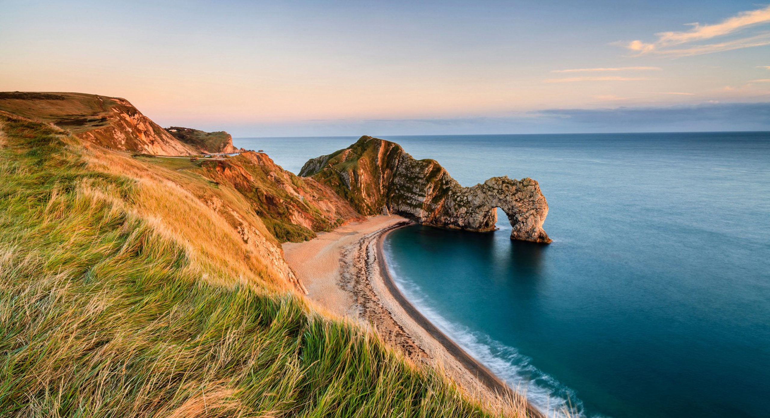
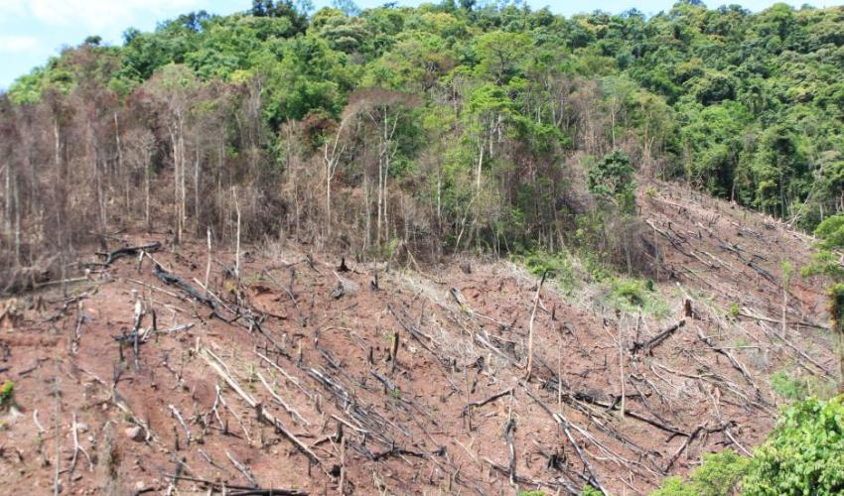
Living with the Physical environment
The challenge of natural hazards
(earthquakes & tropical storms)
Physical landscapes of the UK
(coasts & rivers)
Living World (rainforests and hot deserts)

Slide 4


Challenges in the human environment
Urban issues and challenges
(cities in developed and developing countries)
The changing economic world
(UK & global economy)
The challenge of resource management
(water & UK resources)

Slide 5


Geographical applications
Pre-released exam material (extended casestudy) & 2 local fieldworks

Slide 6
What can I do with Geography?
Work based skills
Data analysis
Literacy & numeracy
Research skills
Problem solving
Forming evidence-based arguments
Jobs with Geography
Banking / Finance
Business analyst
Accounting
Urban planning
Climate scientist
Surveyor
Source: Complete University Guide 2024

Slide 7
Geography at University
73 UK universities offer degrees in Geography including:
Cambridge, Oxford, Bristol, Leeds, Nottingham, Sheffield, York,
Durham, Portsmouth, Kent, St. Andrews, Kings College London,
University College London and many others
Many UK universities also offer Geography-related degrees such as:
Sustainability, Environmental Science, Meteorology, Travel & Tourism
Source: Complete University Guide 2024

Slide 8
Geography offers academic challenge as well as building valuable skills for the world of work.

