Slide 1


STEWARDS ACADEMY
Welcome to GCSE History at Stewards Academy.
In this presentation we will talk about:
A good historian
What GCSE History students study at Stewards Academy.
The advantages of choosing History as a GCSE subject.
Careers with History.
Notes:
Hello. I would like to outline to you the current GCSE History offering from Stewards Academy.

Slide 2
Am I suitable for the GCSE History course?
If you enjoy History – YES!
If you are interested and prepared to work hard you will do well.
Notes:
The course is suitable for anyone who enjoys History and is prepared to work hard.

Slide 3
What prior experience would be useful for me to study this course?
It is quite useful if you have a critical mind.
To study History successfully, you need to be the sort of person who does not accept things at face value, but questions what you see and hear and asks people why they hold the views that they do.
Notes:
As per slide

Slide 4

What will you be studying?
Paper 1 | Paper 2 | Paper 3
Thematic Study Crime and Punishment in Britain, c1000 – Present. Historic Environment Whitechapel, c1870-c1900: Crime, policing and the inner city. | British Depth Study Henry VIII and his ministers, 1509-1540. Period Study Super power relations and the Cold War, 1941-1991. | Modern Depth Study Weimar and Nazi Germany, 1918-1939.
Notes:
There are four topics studied at GCSE level in History and three exam papers sat.

Slide 5
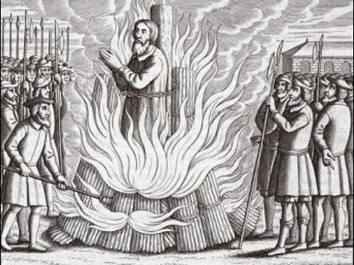
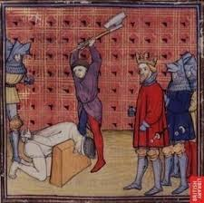

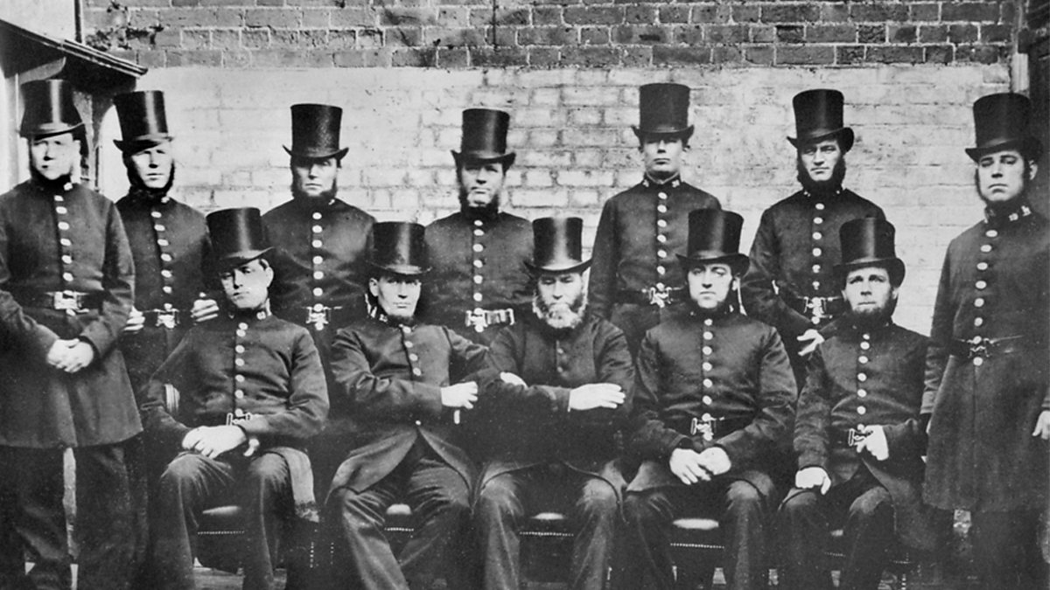
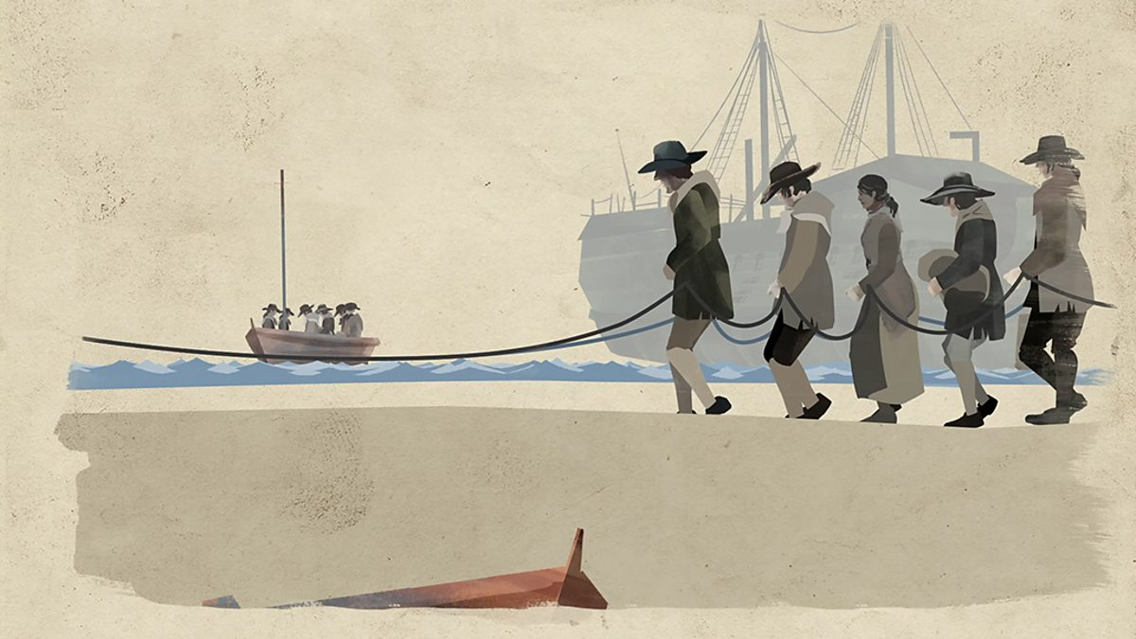
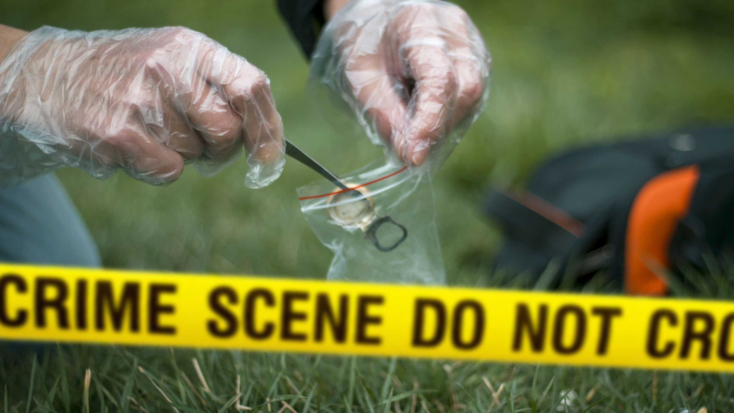
Crime and Punishment, c.1000 – Present.
Notes:
C&P studies the changes and continuities of Crime and Punishment since the year 1000 to the present. Content includes how ideas of punishment have change and stayed the same, the creation and developments of police forces and the use of technology in investigations. There is also a special emphasis on Whitechapel at the end of the 19th Century for inner city policing.

Slide 6
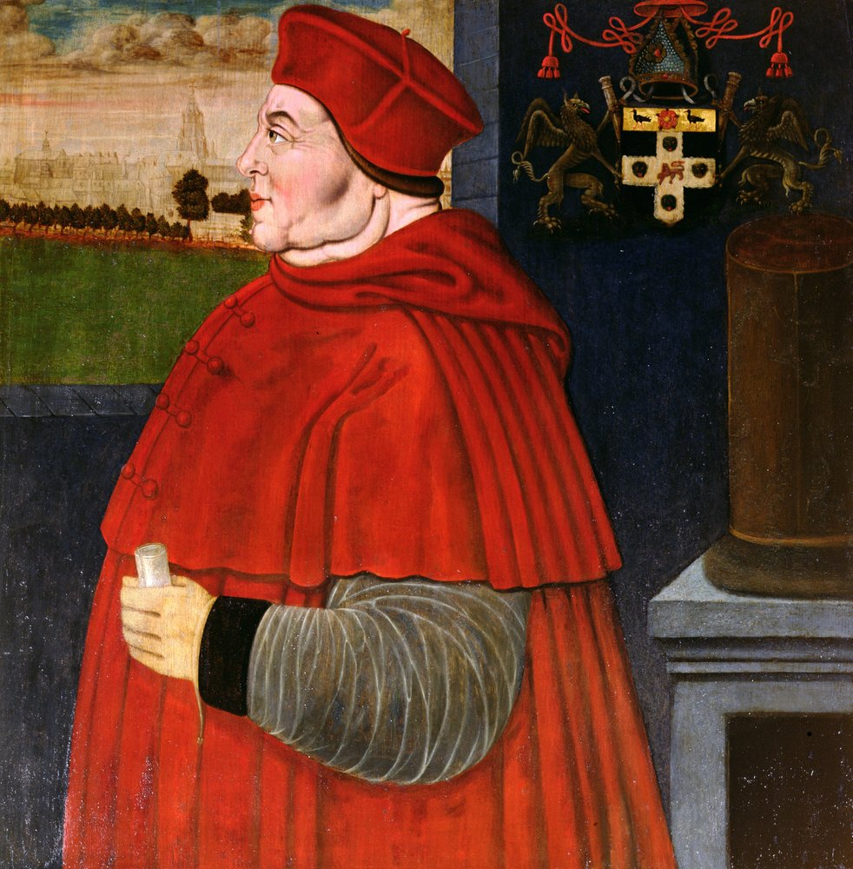
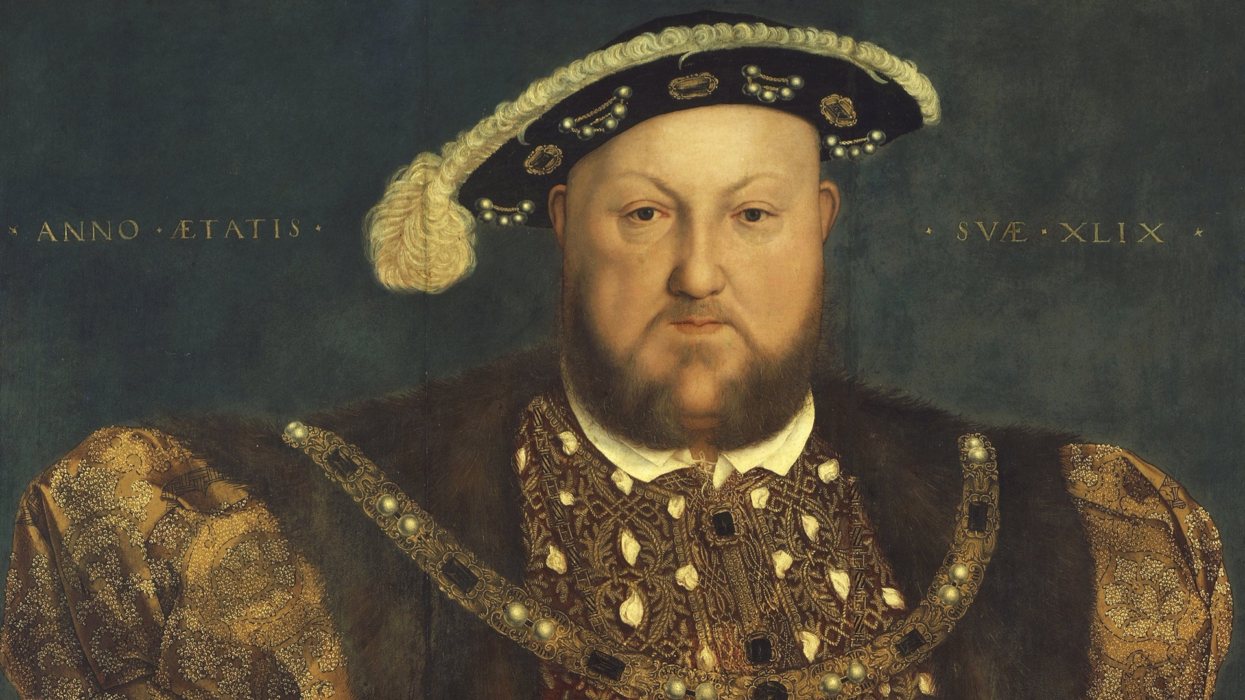
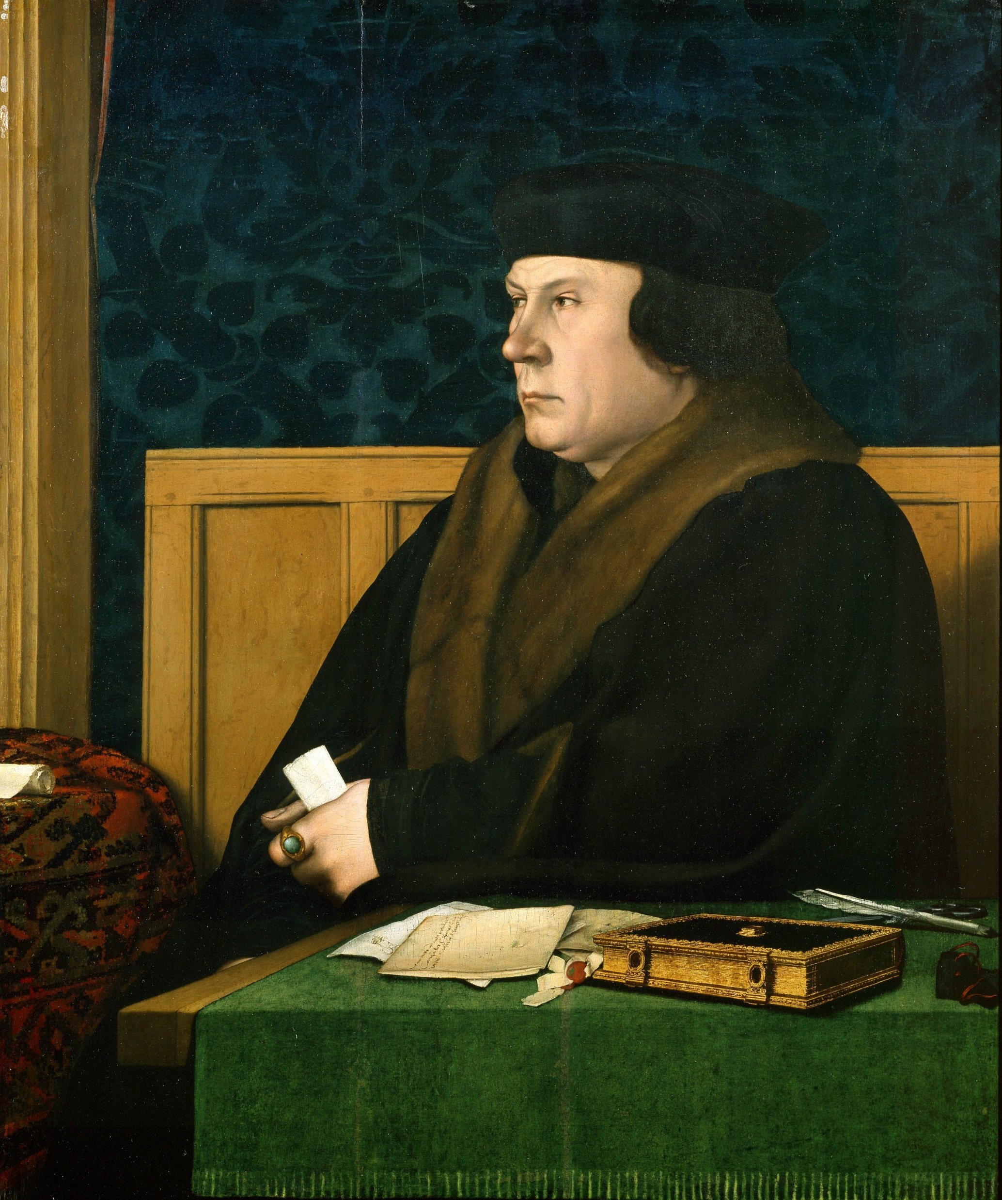
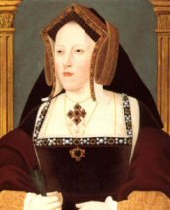
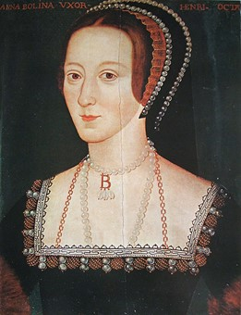
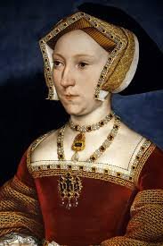
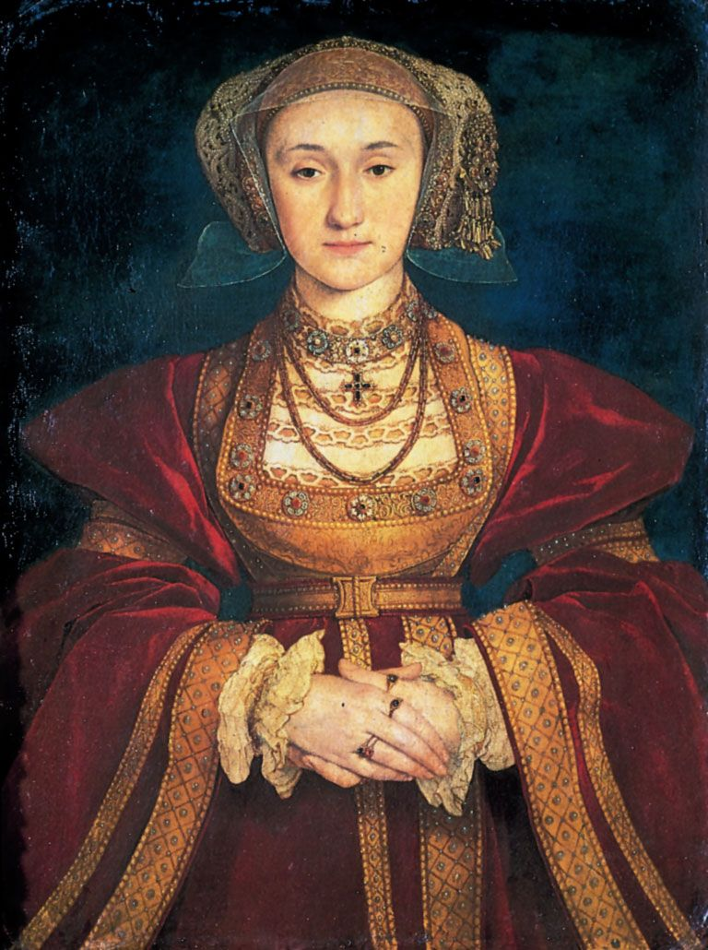
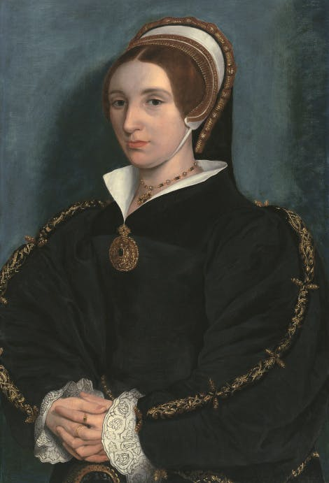
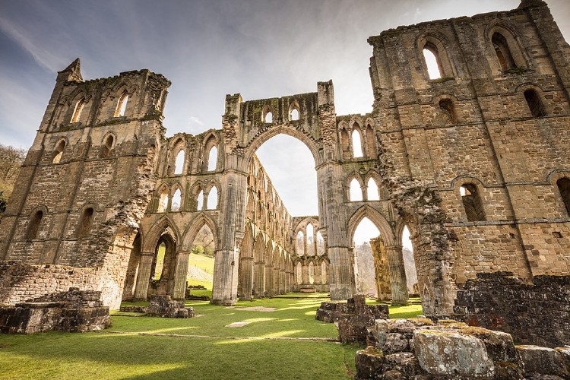
Henry VIII and his ministers, 1509-1540.
Notes:
Our British depth study is part one of Paper 2. It investigates the Tudor court of Henry VIII and the different power-plays going on around the king. The topic focus is on Henry and his kingship, his wives, chief ministers rise an downfalls and the English Reformation.

Slide 7
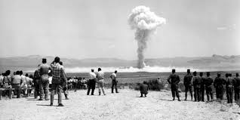

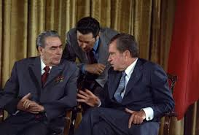
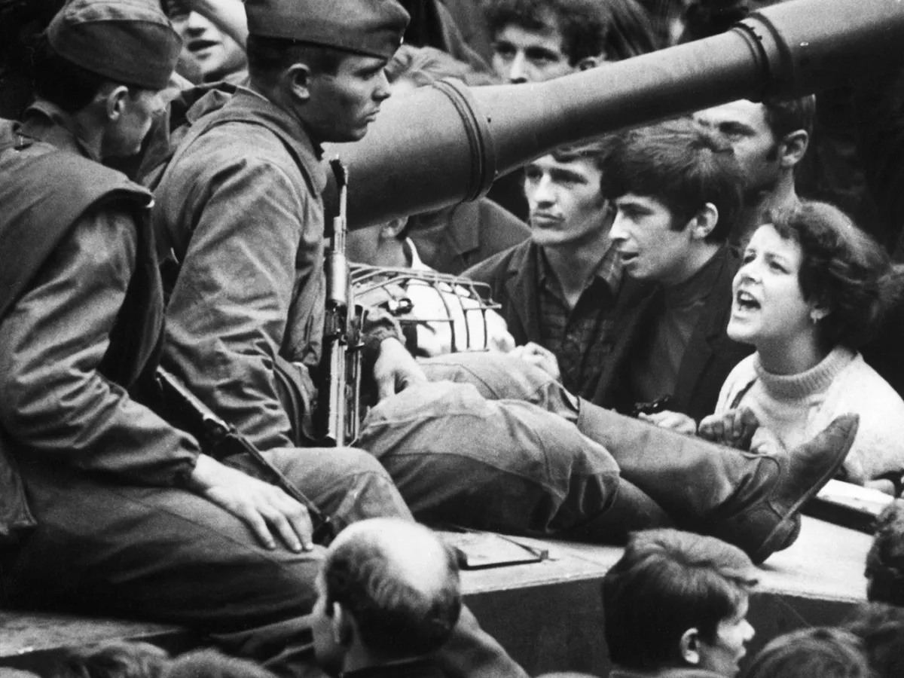
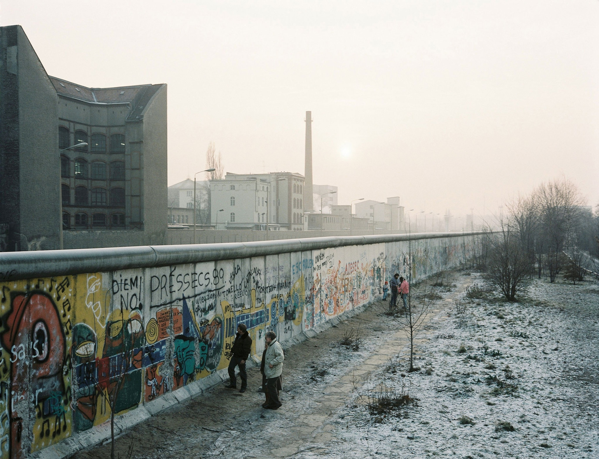
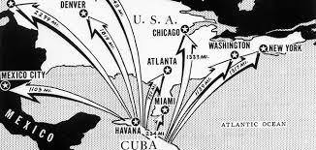
Superpower Relations and the Cold War 1941-1991.
Notes:
The second part of Paper 2 covers our period study which is the development of the Cold War and the different events of this period, that caused tensions to rise to a point where there was a very real threat of Nuclear war.

Slide 8
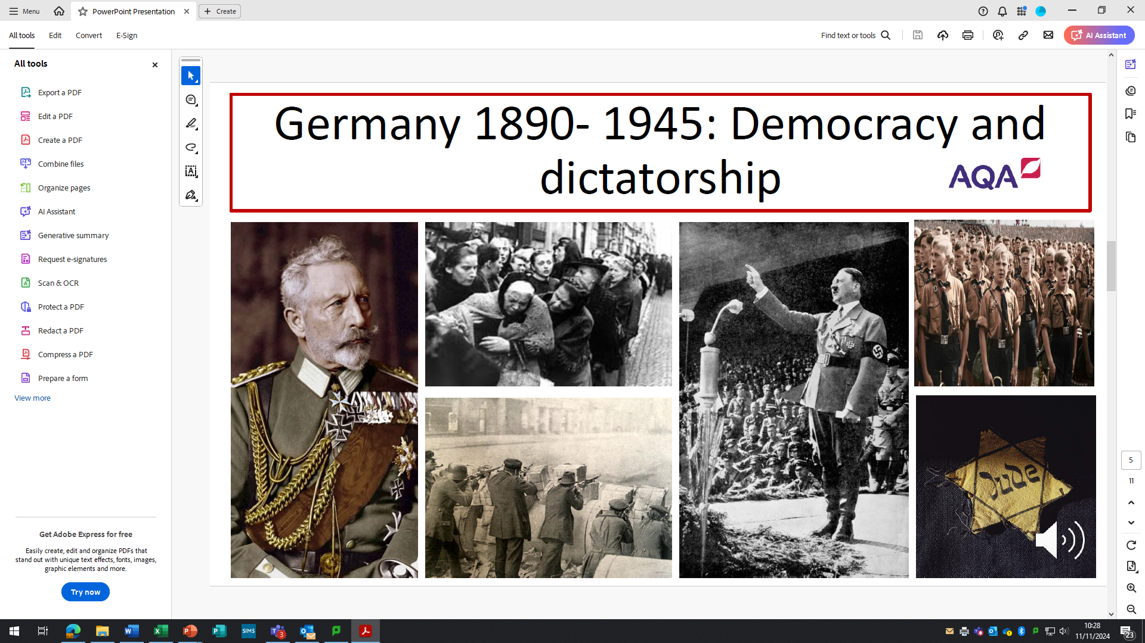

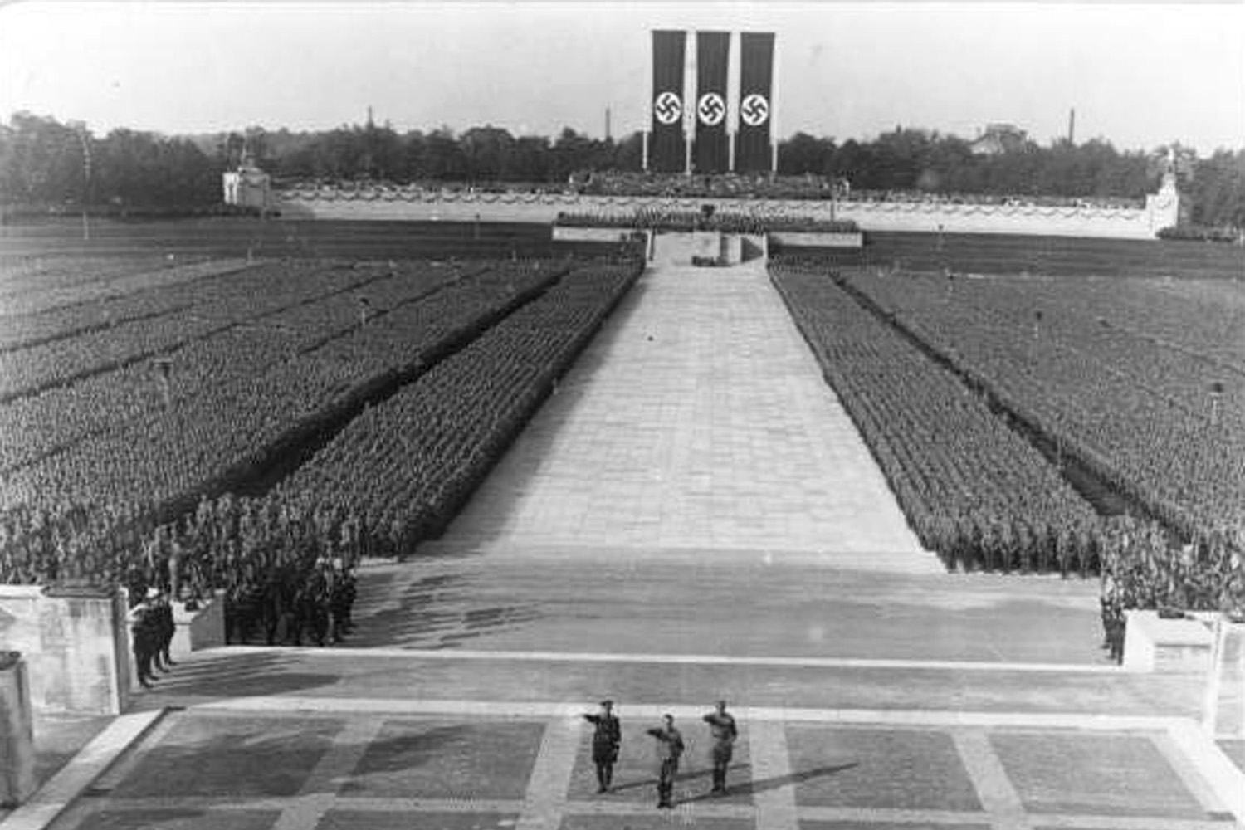
Weimar and Nazi Germany c.1918- c.1939
Notes:
Paper 3 develops the skills needed to handle sources and interpretations to the theme of Weimar and Nazi Germany. This paper not only covers the context of events happening in this turbulent period, but also uses source handling skills like analysis and evaluation to answer questions.

Slide 9
Why choose History?
Transferable skills
Communication, analysis, research, problem solving, extended writing, planning, arguing, using evidence, reaching judgments, etc.
Links with other subjects
Skills cross over well to other subjects like English, Religious Studies, Sociology, Geography and English Literature.
Reputation
A rigorous academic subject looked highly upon by colleges, sixth forms, universities, employers and apprenticeships.
Relevance
It’s not just the past! Helps students understand the present and learn from the past.
Notes:
There are several advantages to choosing History as a GCSE.

Slide 10
Careers with History.
Notes:
History is a pathway to many high paid, professional careers. Education, Law, Policing, Media, the Armed forces, Architecture and politics are but a few.

Slide 11
THANK YOU!
Notes:
Thank you for listening!

