Slide 1

AQA Science qualifications provide a variety of opportunities for progression.
Combined Science: Trilogy gives students the option to progress to A-levels in science or other subjects.
Separate Science : It provides an excellent choice if you are intending to study Science at Advance level, for example AS/A Level Biology, Chemistry, Physics and Applied Science. It will also provide the basis for future study of the Sciences at degree level and extensive employment opportunities.

Slide 2
AQA Combined science
There are six papers:2 biology, 2 chemistry and 2 physics. Each of the papers will assess knowledge and understanding from distinct topic areas.
How it's assessed
Written exam: 1 hour 15 minutes
Foundation and Higher Tier
70 marks
Each paper is 16.7% of GCSE
Questions:
Multiple choice, structured, closed short answer, and open response.

Slide 3
AQA Science Required Practical work
Practical work is at the heart of science!
There are three interconnected, but separate reasons for doing practical work in schools. They are:
To support and consolidate scientific concepts (knowledge and understanding).This is done by applying and developing what is known and understood of abstract ideas and models. Through practical work we can make sense of new information and observations and provide insights into the development of scientific thinking.
To develop investigative skills. These transferable skills include:
  Devising and investigating testable questions
  Identifying and controlling variables
  Analysing, interpreting and evaluating data.
To build and master practical skills such as:
  using specialist equipment to take measurements
  handling and manipulating equipment with confidence and fluency
  recognising hazards and planning how to minimise risk.

Slide 4
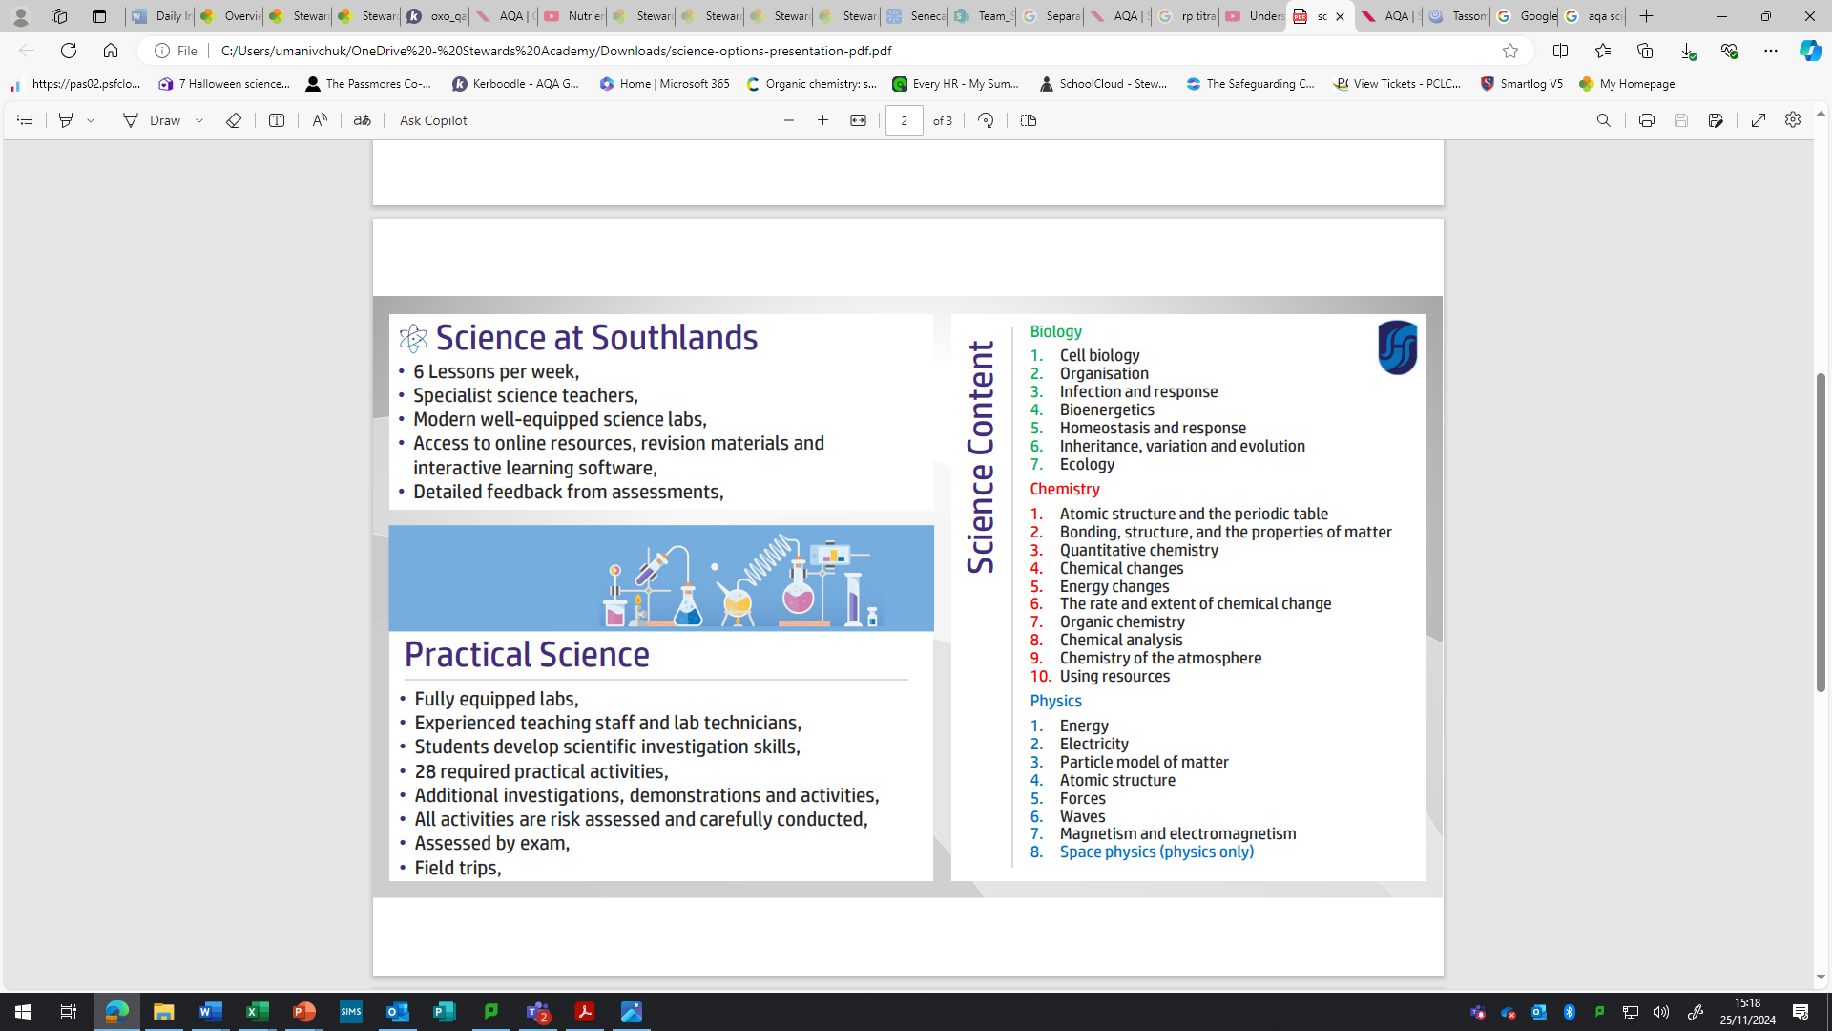
GCSE Science topics

Slide 5
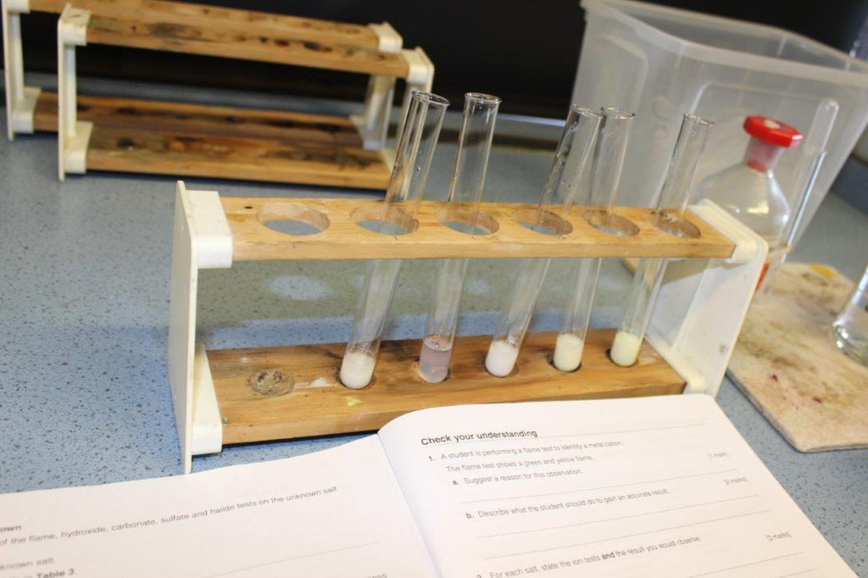
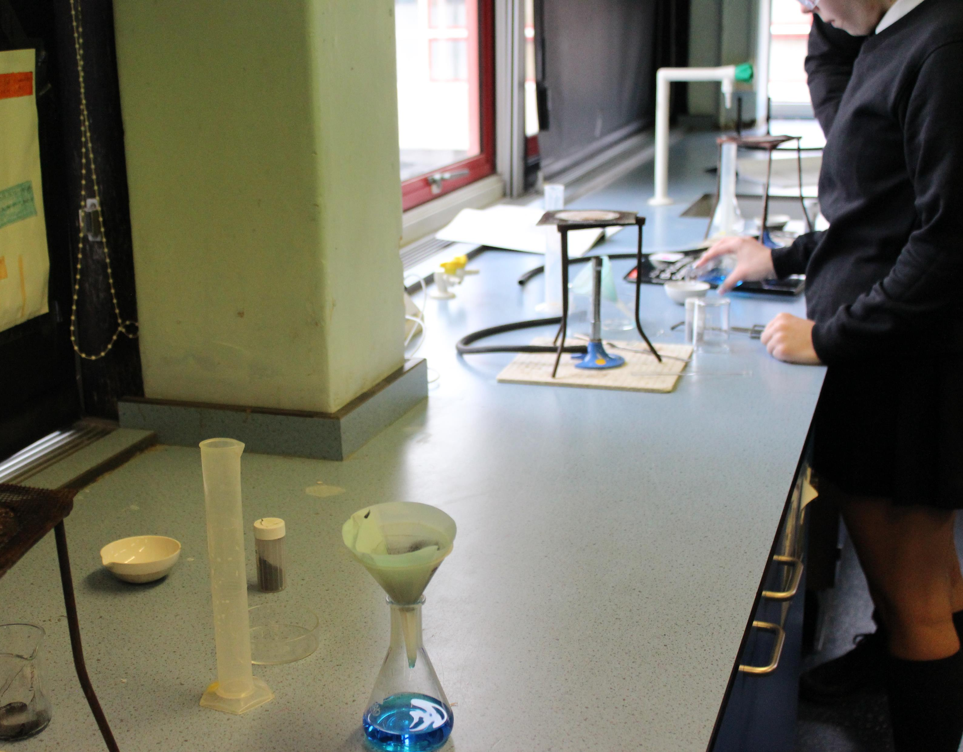
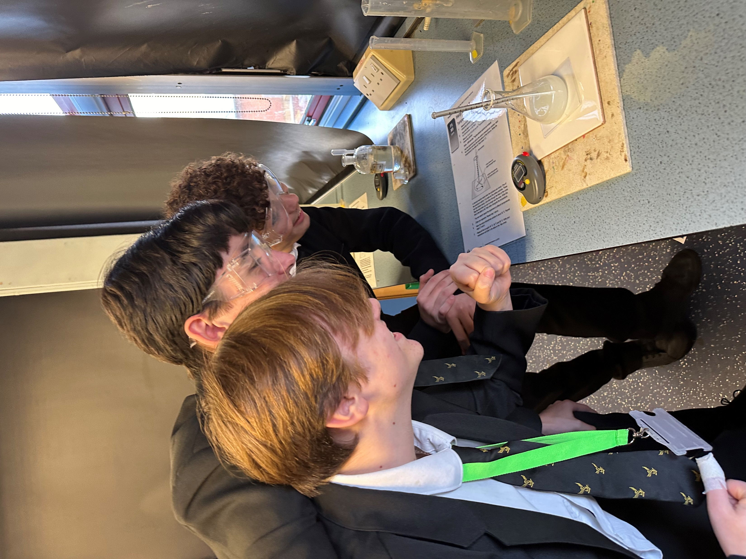
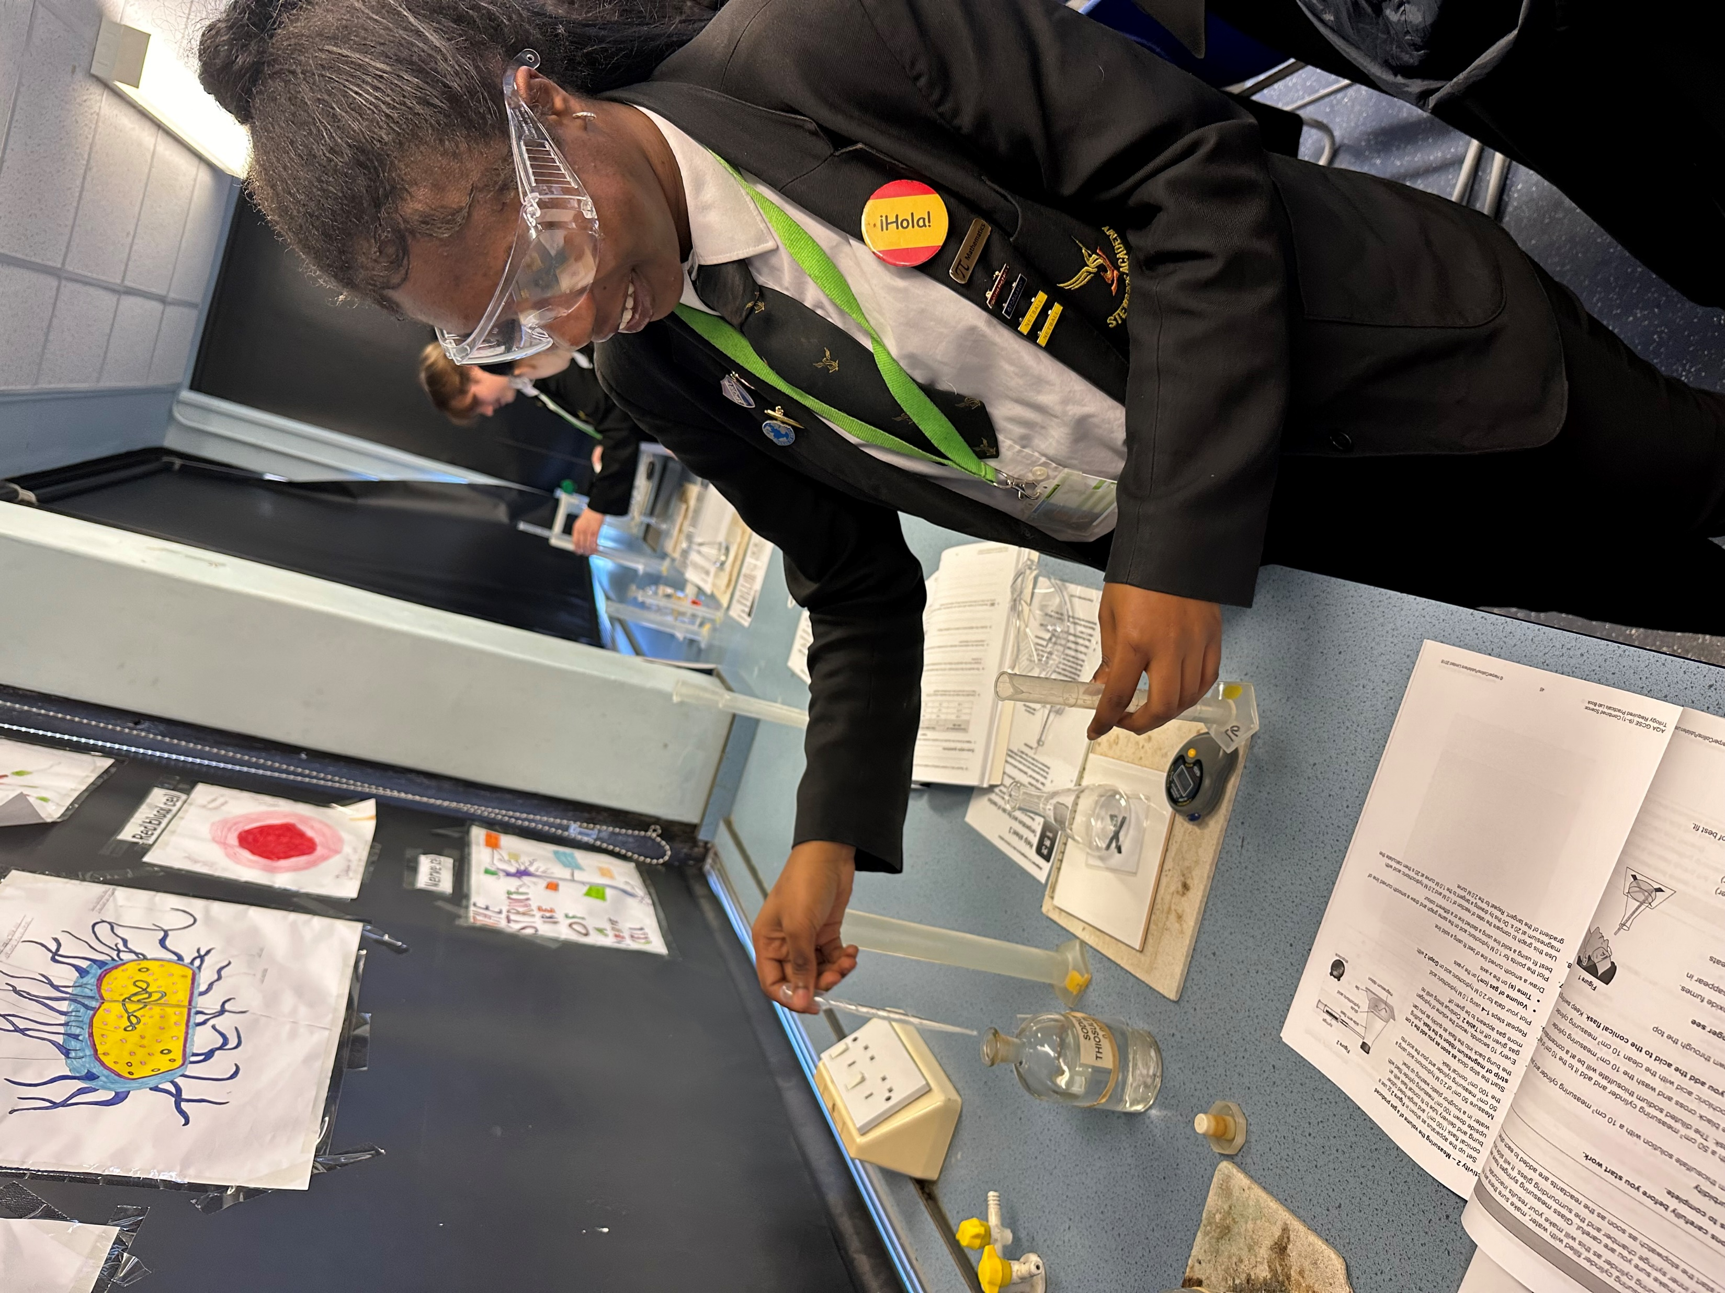
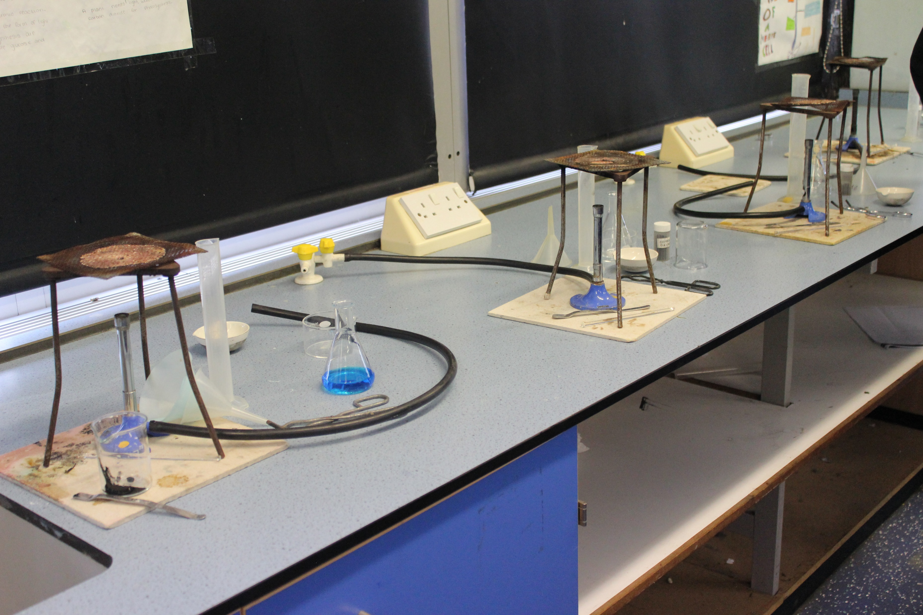
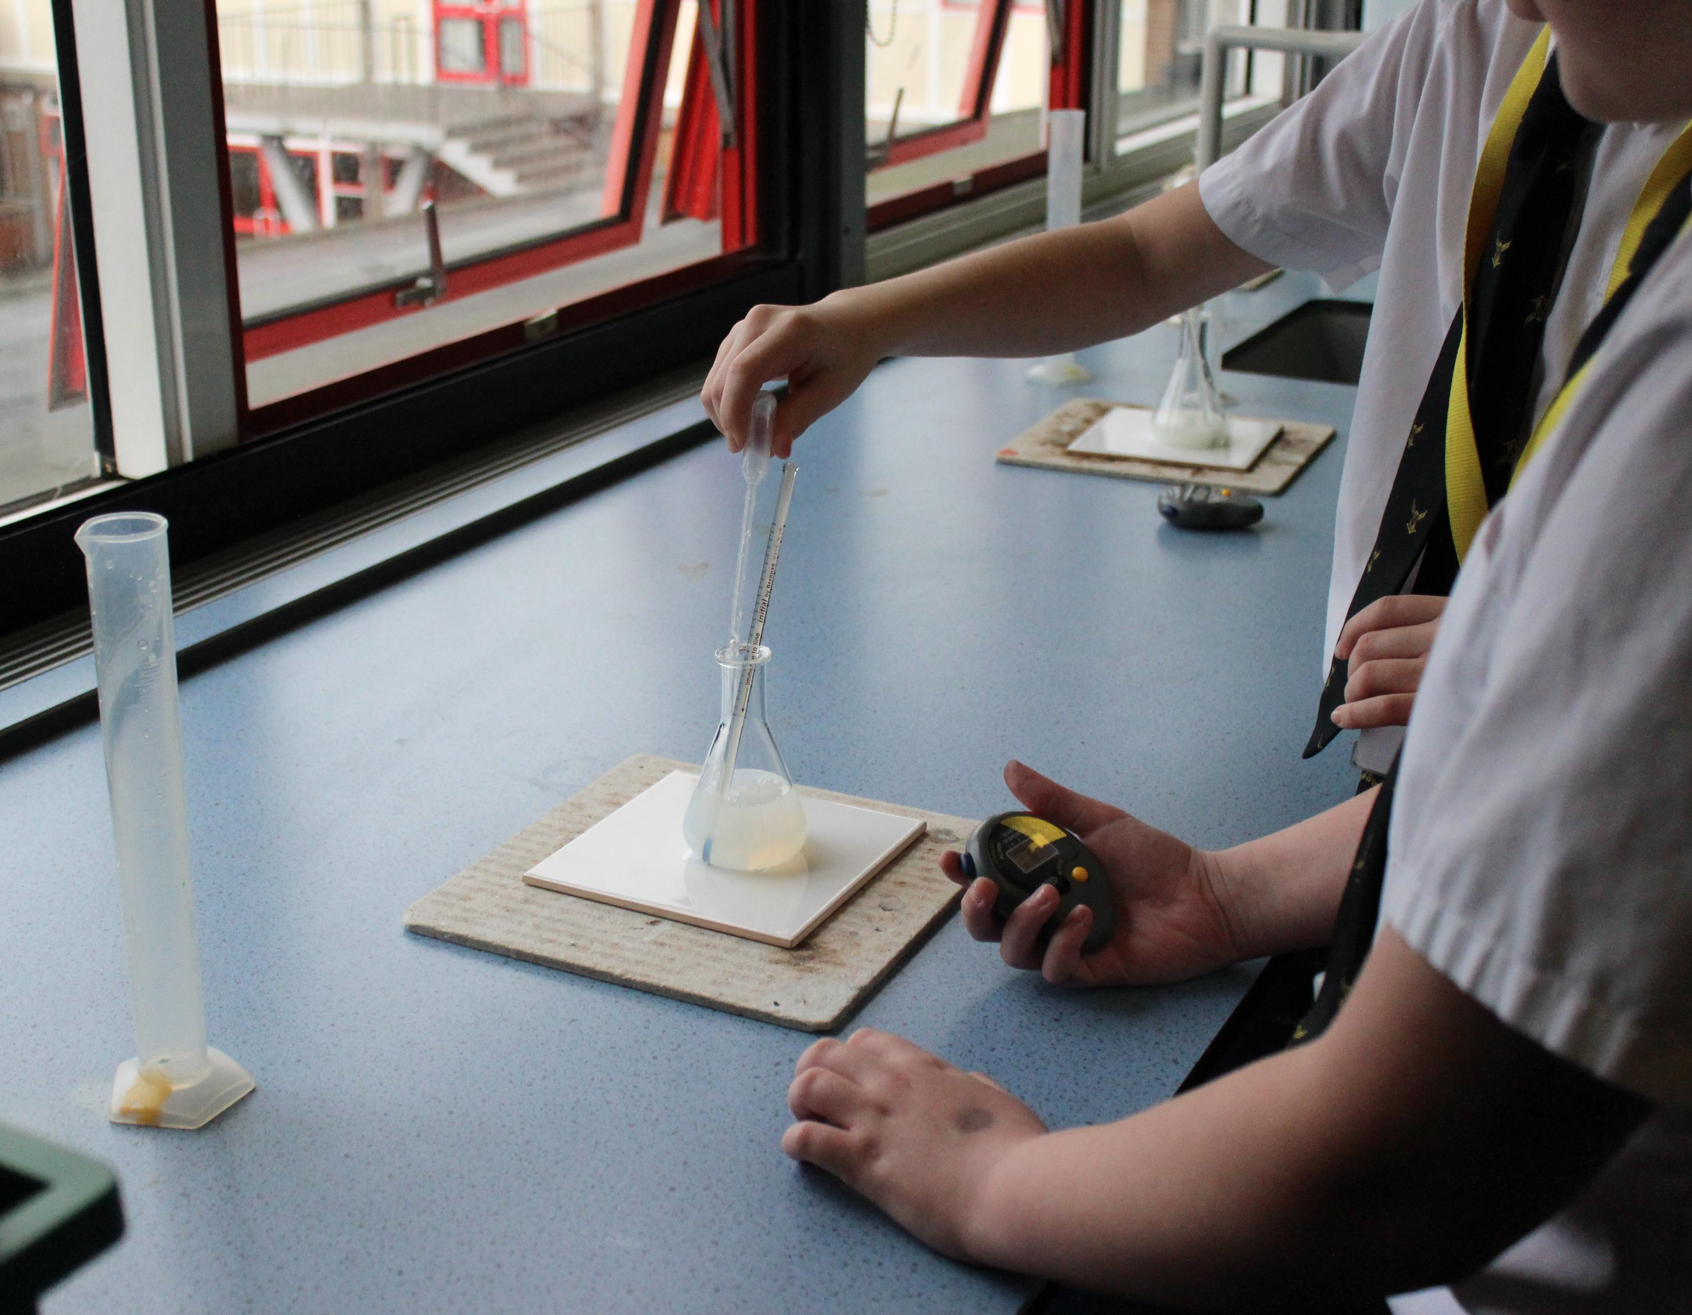
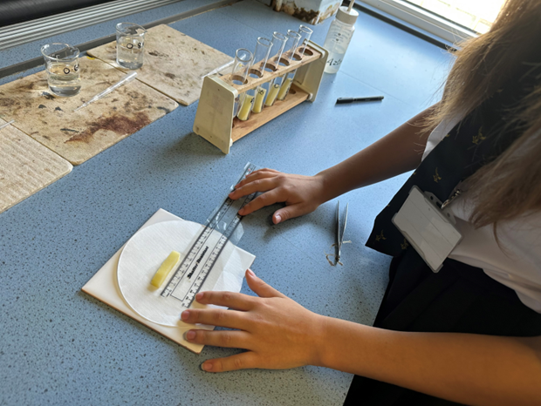
Our students completing Combined Science Required practical work

Slide 6
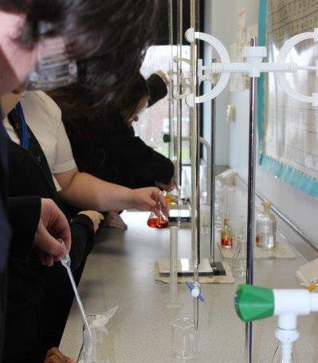
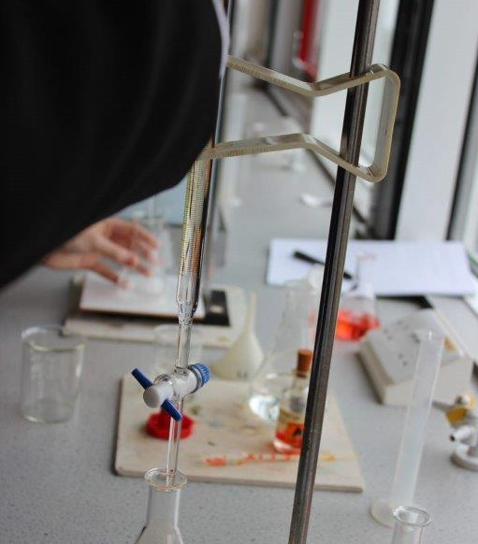
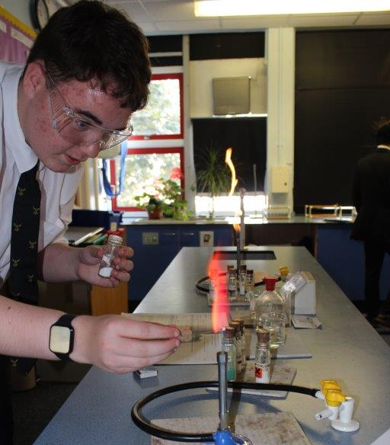
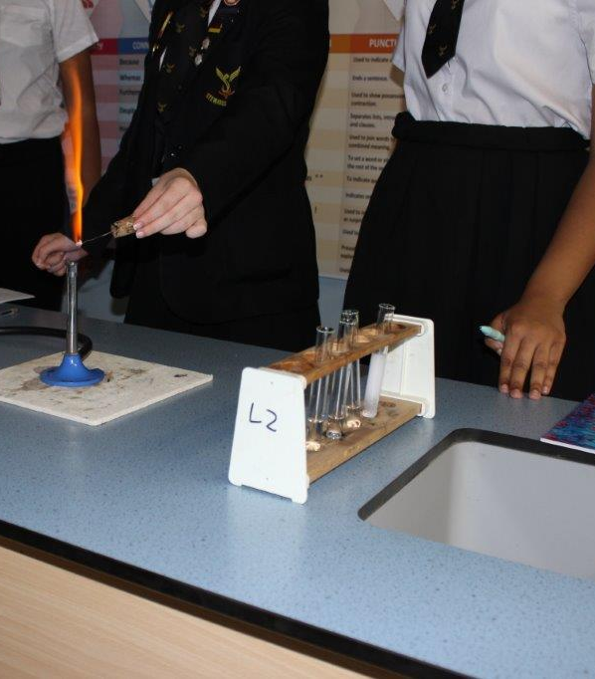
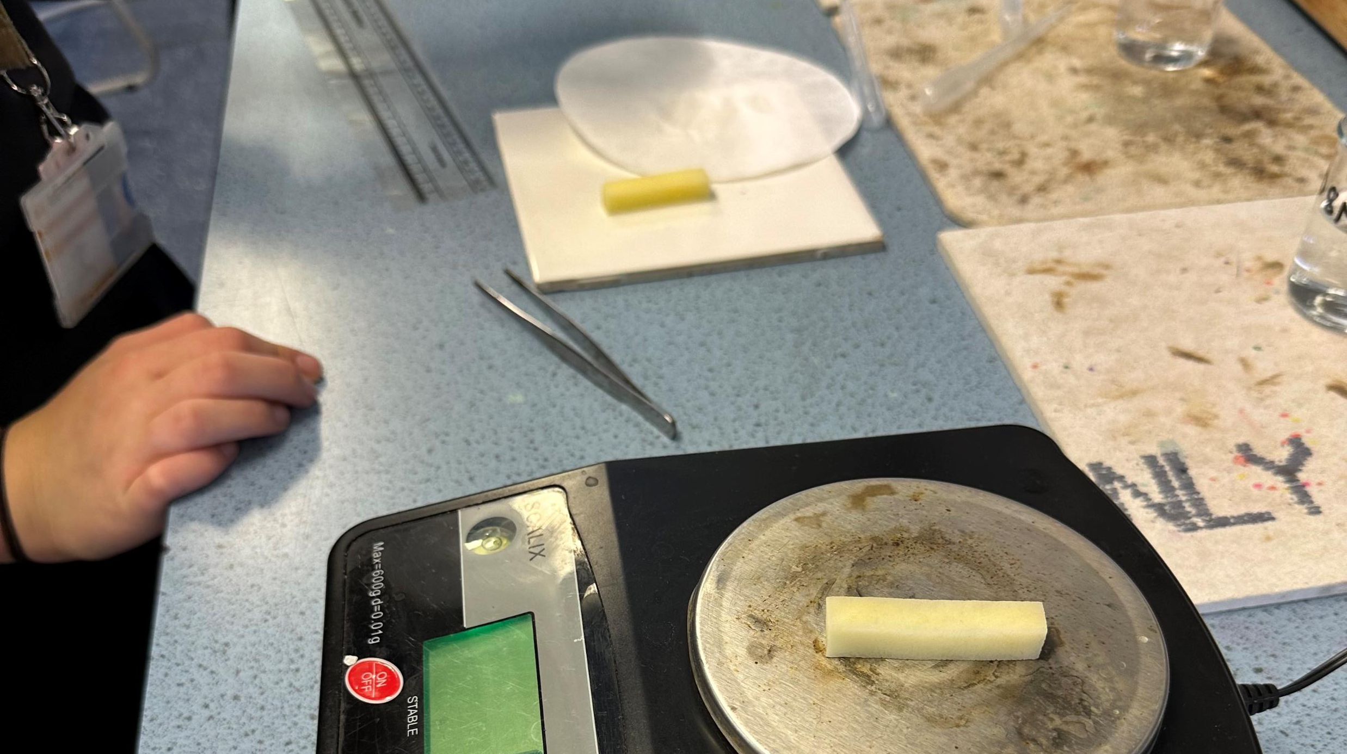
Triple Science students at work!

Slide 7
AQA Triple Science –Separate science
There are six papers: two biology, two chemistry and two physics. Each of the papers will assess knowledge and understanding from distinct topic areas.
How it's assessed
Written exam: 1 hour 45 minutes
We enter our students into Higher Tier however there is also Triple science foundation tier.
100 marks
Each paper is 50% of GCSE
Questions:
Demonstrating knowledge and understanding, interpreting and evaluating data, making judgements, drawing conclusions, developing and improving experimental procedures.

Slide 8
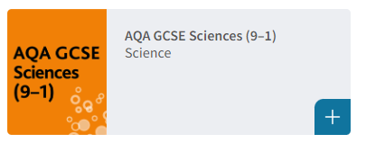
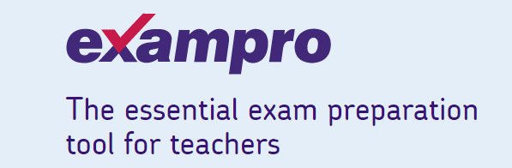
Revision tools
Kerboodle online book & targeted worksheets
Tassomai quiz
Past papers, mark schemes and examiners’ reports
Sample papers and mark schemes for new courses
Exampro: a searchable bank of past AQA exam questions
Example student answers with examiner commentaries
BBC Bitesize science resources

Slide 9
Thank you

