Slide 1

WJEC Level 1/2 Vocational Award in Construction And The Built Environment

Slide 2
What is a vocational subject and who is this for?
WJEC Level 1/ 2 Vocational Awards (Technical Awards) provide students with opportunities to study vocational subjects alongside GCSE's and other general and vocational qualifications as part of a broad programme of study.
They are primarily designed for learners aged 14-16 and offer an experience that focuses on applied learning i.e acquiring and applying knowledge, skills and understanding through purposeful tasks set in sector or subject contexts that have many of the characteristics of real work.

Slide 3
Qualification Objective
The Vocational Award in Construction and the Built Environment (Technical Award) has been designed to support students in schools who want to learn about this vocational sector and the potential it can offer them for their careers or further study.
It is most suitable as a foundation for further study.
This further study would provide students with the opportunity to develop a range of specialist and general skills that would support their progression to employment.

Slide 4
What will the students study?
This is a unitised qualification through which there are two routes. Learners must follow one route and study two units.
The two units which will be studied are;
Unit 1: Introduction to the Built Environment
Unit 3: Constructing the Built Environment

Slide 5
A glance at the subject content
Unit 1 introduces students to the built environment and provides them with the opportunity to develop skills, knowledge and understanding in identifying, explaining and evaluating different ideas and concepts of the built environment
Students will explore a range of profession and trade roles, and some of the different structures and buildings of the built environment.
Unit 3 offers students the opportunity to develop skills, knowledge and understanding of three construction trade areas of the built environment, including planning, undertaking and evaluating construction tasks.

Slide 6

Unit 1: Introduction to the built environment
Vocational context:
The construction industry is large and very diverse. This unit provides an appropriate foundation which reflects this size and diversity. Students are required to demonstrate their knowledge and understanding of eight specified areas of content, all of which are critical to the industry.
Overview of unit:
This unit introduces learners to the construction sector and the type of professional and trade roles and activity that is undertaken. Students will explore the different types of buildings and structures that the built environment forms. Sustainability and the impact of the built environment on the local community is explored along with reduction measures that can be employed.

Slide 7
Unit 3: Constructing the Built Environment
Vocational Context
The realisation of construction projects requires the services of many construction specialists. A significant number of these specialists will be engaged in what are often referred to as 'trades'.
This unit requires students to complete a construction project which focuses on the preparation and completion of three realistic trade-based tasks.
Overview of Unit
In this unit, students are required to develop knowledge, skills and understanding in three of four areas;
Plumbing, electrical, carpentry tiling
Students will need to make use of their knowledge and understanding gained from Unit 1 throughout this unit, including:
1.1.4 Professional and managerial roles & responsibilities associated with the built environment sector
1.2.3 Building life cycle: construction
1.2.6 Disposal, reuse or recycling
1.6.4 Waste disposal, re-use and recycling
1.7 Trades, employment and careers
1.8.1 Risks for employees, employers and the public during construction and the built environment projects
1.8.2 Following procedures and carrying out risk assessments
1.8.4 Using personal protective equipment (PPE)

Slide 8
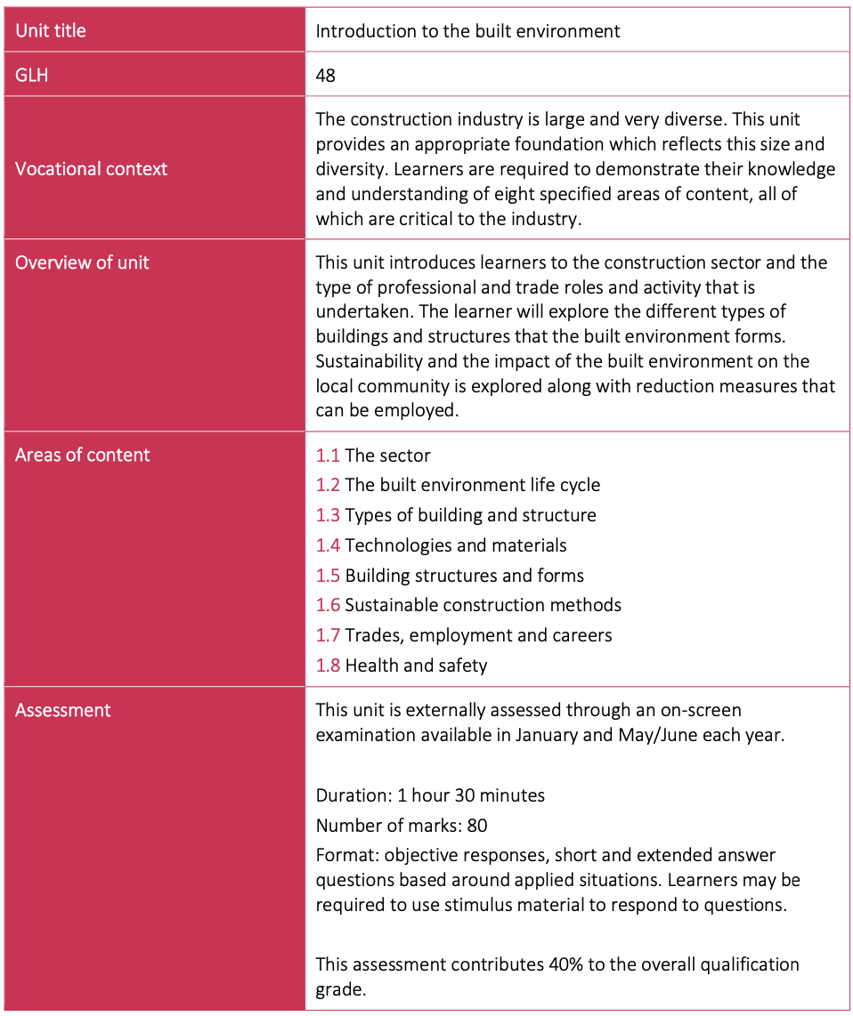
Unit 1: Introduction to the built environment
Areas of content:
1.1 The Sector
1.2 The built environment life cycle
1.3 Types of building and structure
1.4 Technologies and materials
1.5 Building structures and forms
1.6 Sustainable construction methods
1.7 Trades, employment and careers
1.8 Health and Safety

Slide 9
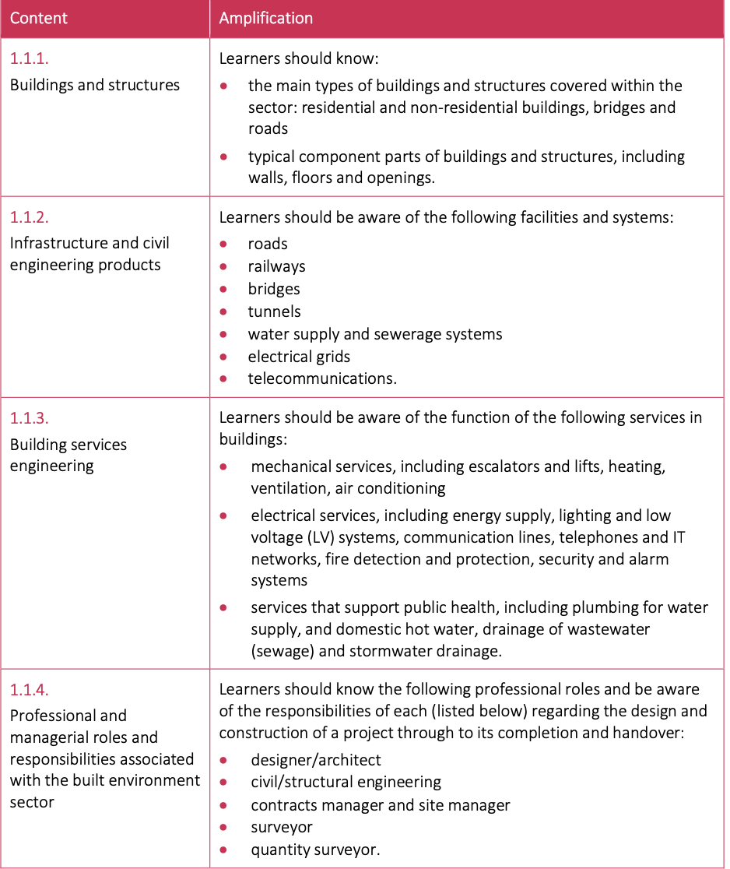
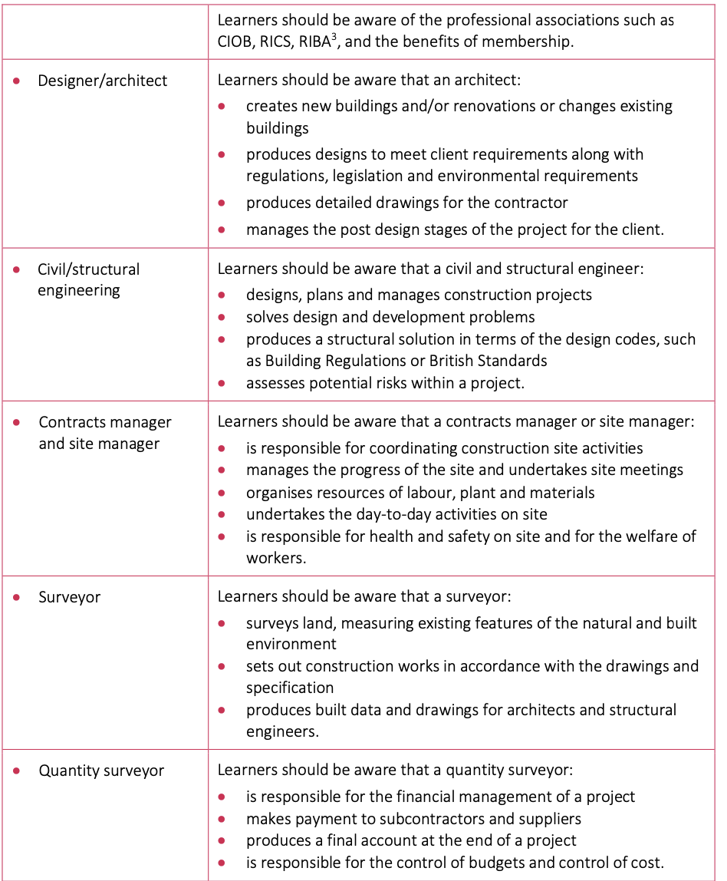
1.1 The Sector
In this topic, students will gain knowledge and understanding of the following areas in construction and the built environment sector:
Buildings and structures
Infrastructure and civil engineering products
Building services engineering
Professional and managerial roles and responsibilities associated with the built environment sector

Slide 10
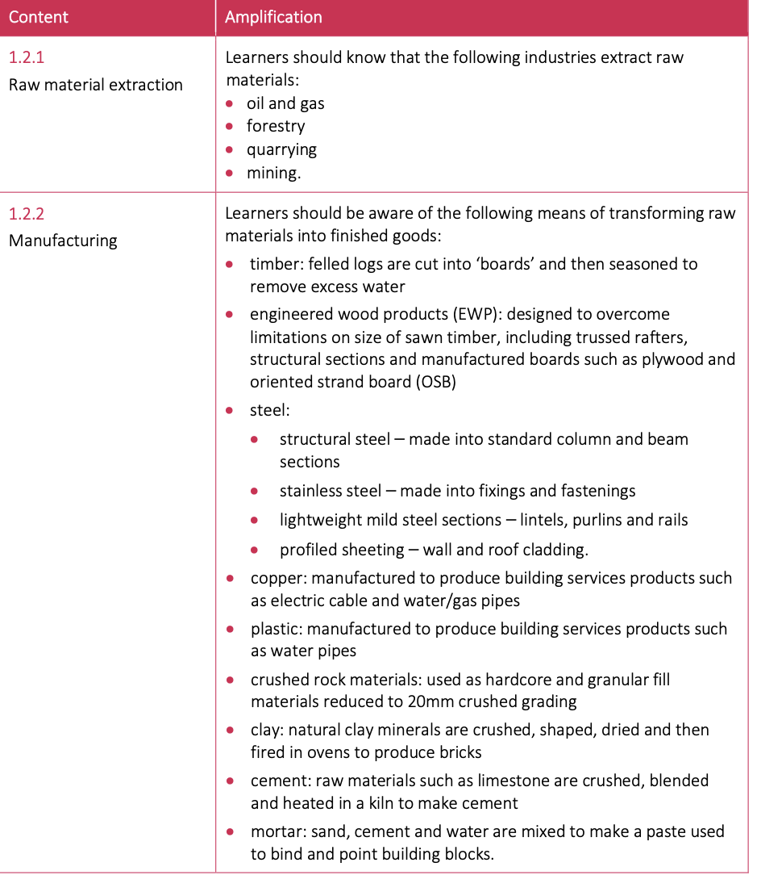
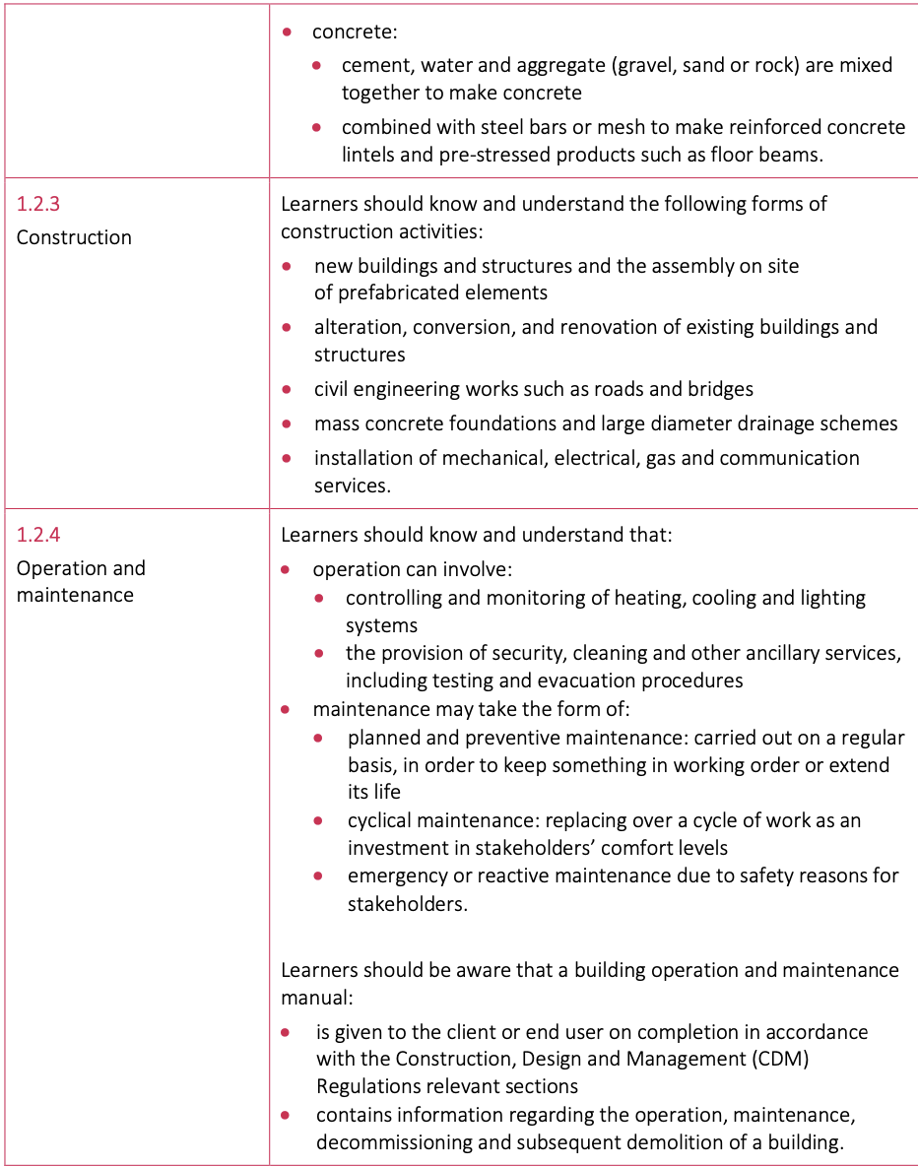
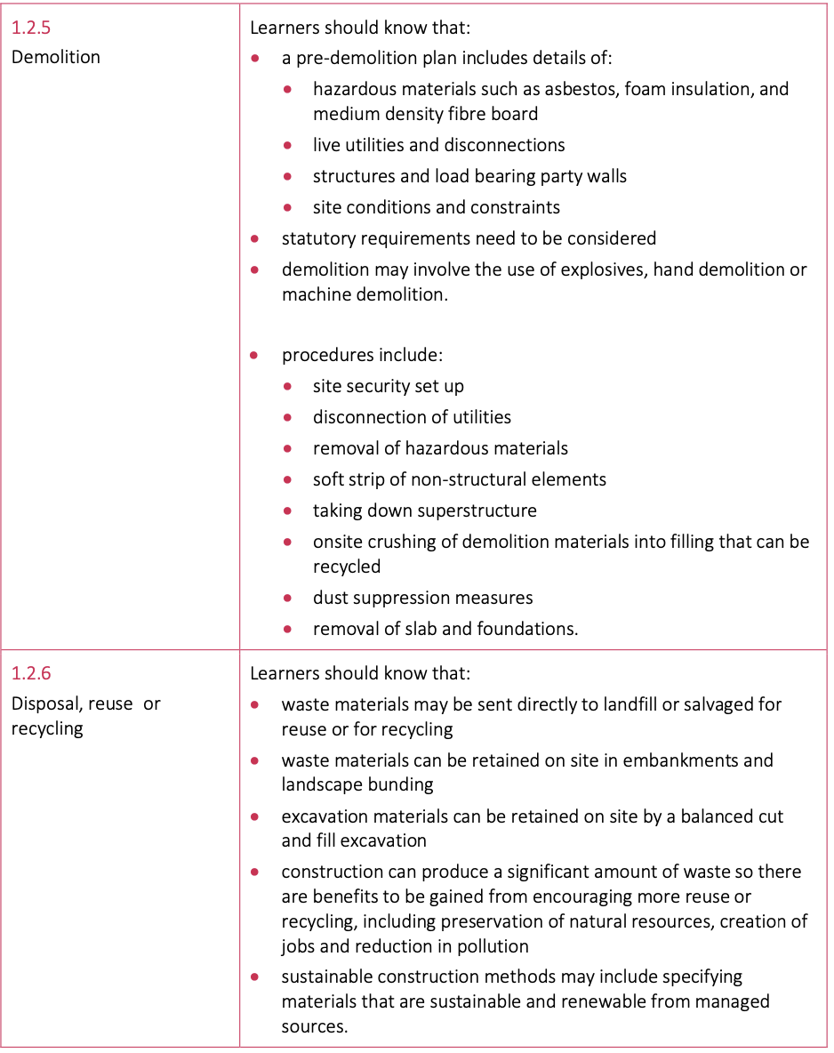
1.2 The Built Environment life cycle
In this section students will gain knowledge and understanding of the built environment life cycle, specifically:
raw material extraction
Manufacturing
Construction
Operation and maintainance
Demolition
Disposal, reuse or recycling

Slide 11
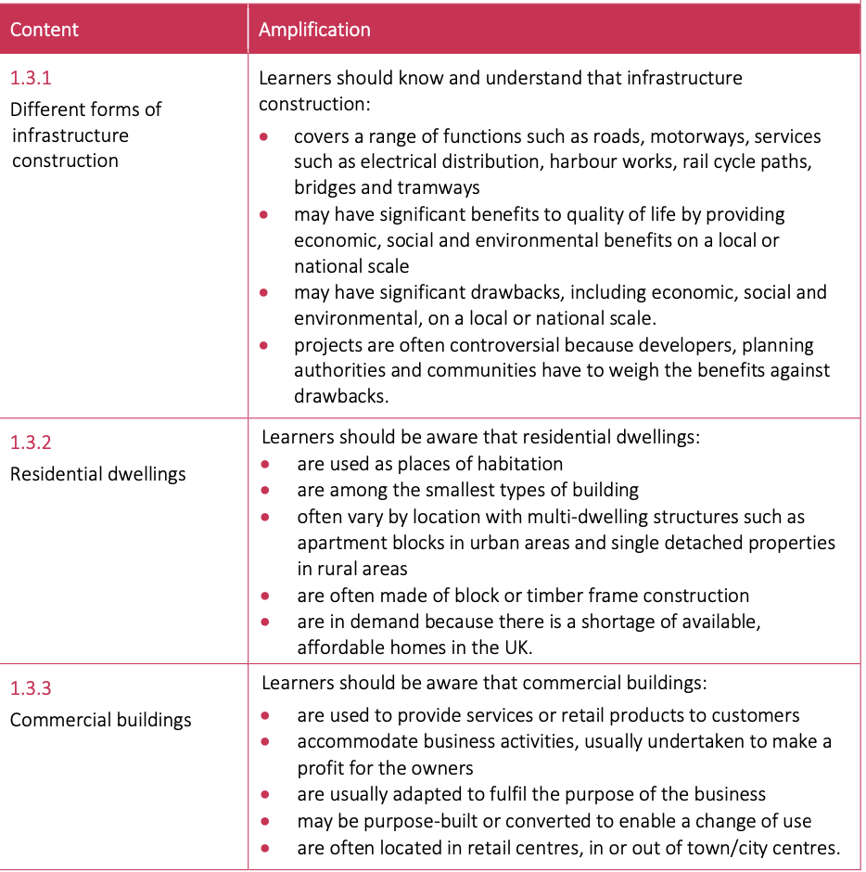
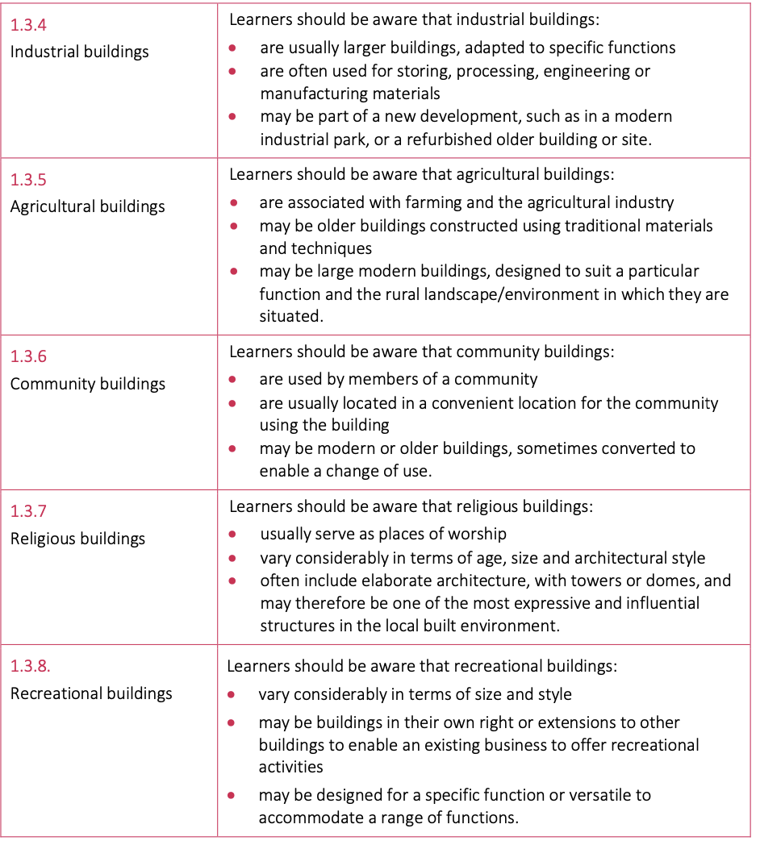
1.3 Types of building and structure
In this section students will gain knowledge and understanding of the features and characteristics of
Different forms of infrastructure construction
Low rise:
Residential dwellings
Commerical buildings
Industrial buildings
Agricultural buildings
Community buildings
Religious buildings
Receational buildings

Slide 12
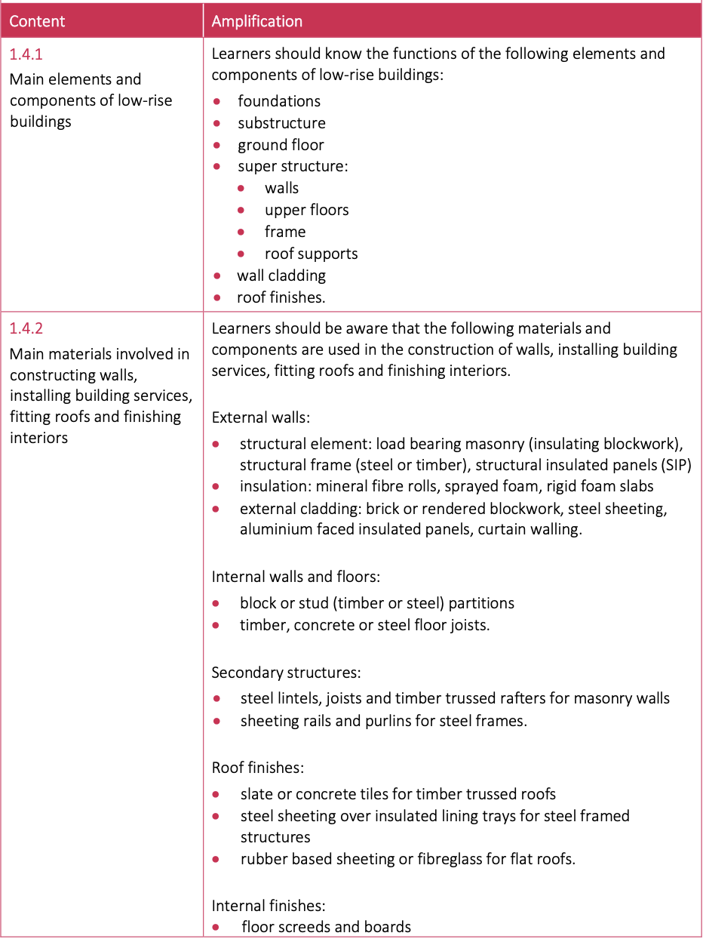
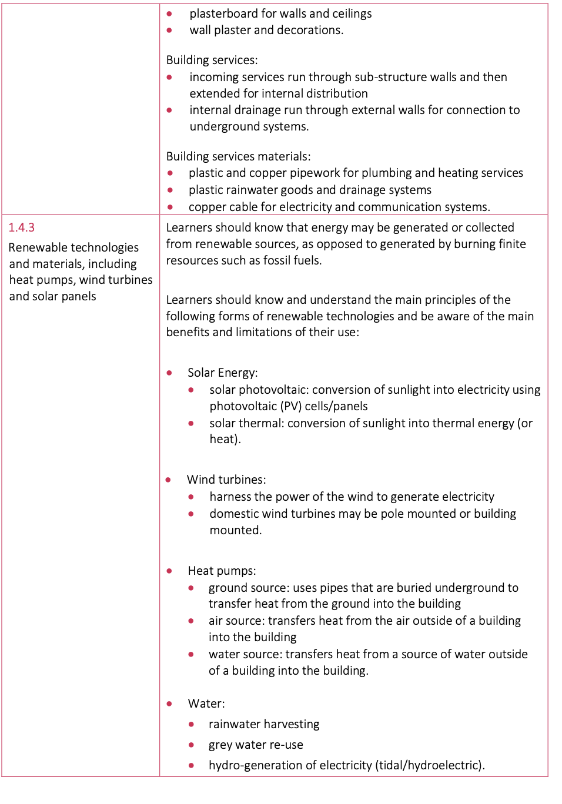
1.4 Technologies and materials
In this section students will gain knowledge and understanding of tools, technologies and materials used in the construction and built environment sector:
Main elements and components of low-rise buildings
Main materials involved in constructing walls, installing building services, fitting roofs and finishing interiors
Renewable technologies and materials, including heat pumps, wind turbines and solar panels

Slide 13
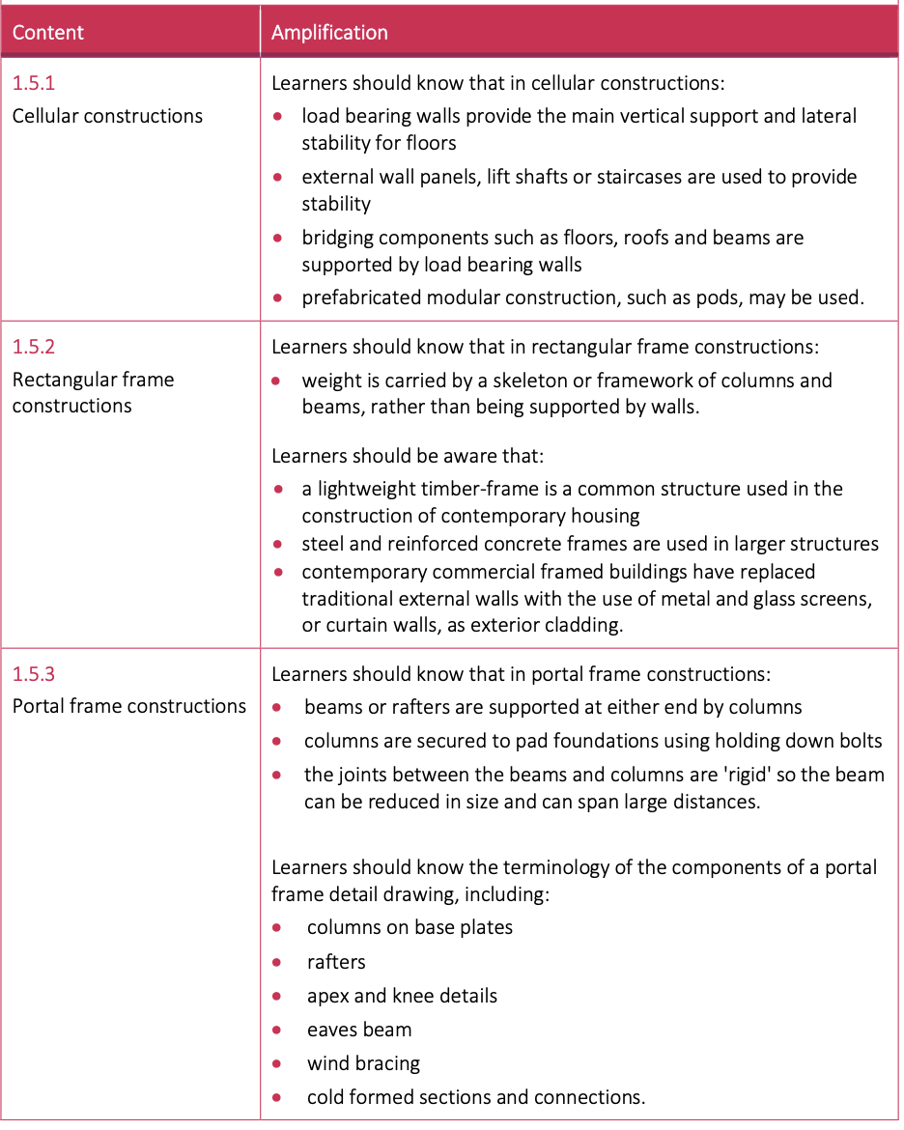
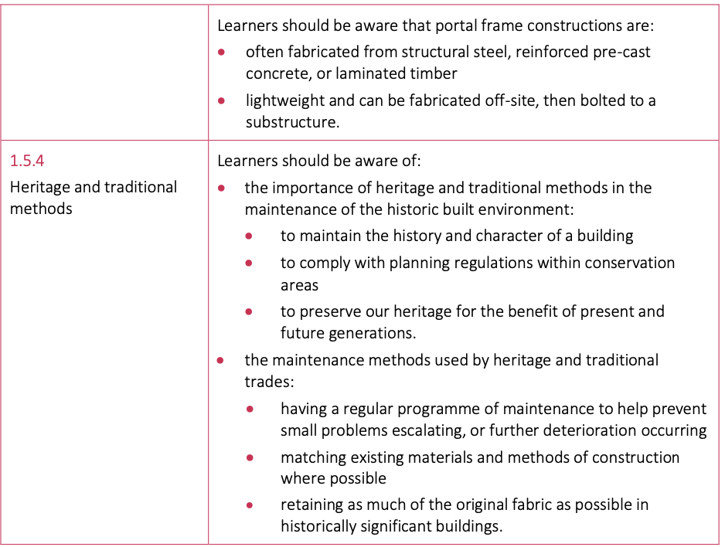
1.5 Building structures and forms
In this section students will gain knowledge and understanding of the following building structures and forms:
Cellular constructions
Rectangular frame constructions
Portal frame constructions
Heritage and traditional methods

Slide 14
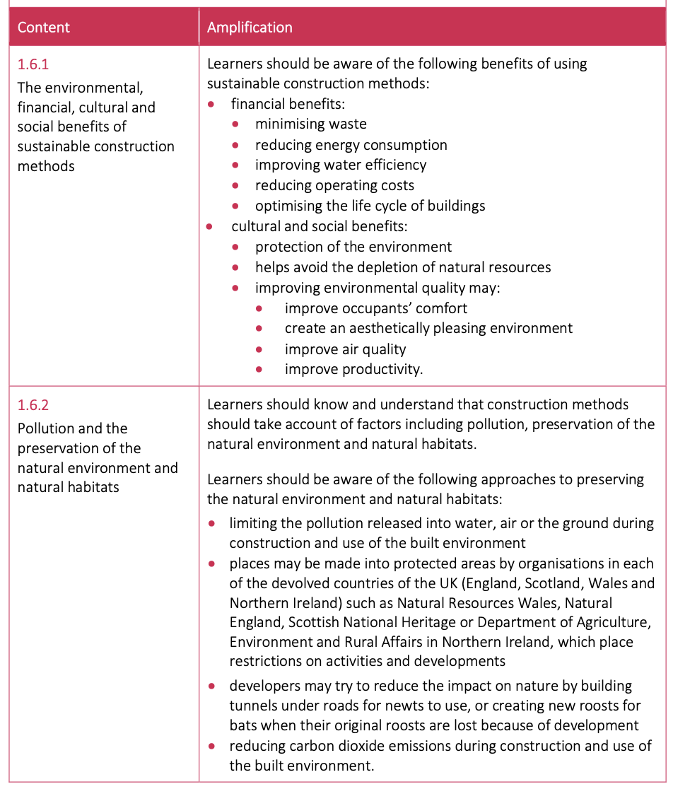
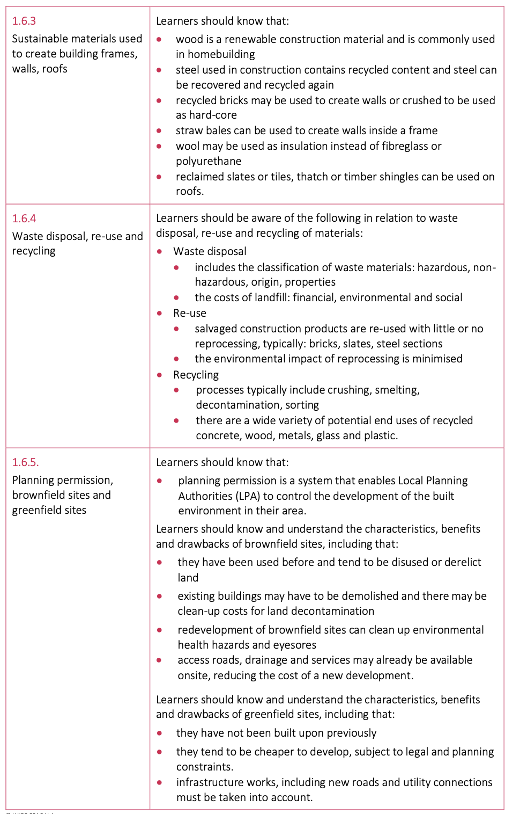
1.6 Sustainable construction methods
In this section learners will gain knowledge and understanding of issues related to sustainable construction methods:
The environmental, financial, cultural and social benefits of sustainable construction methods
Pollution and the preservation of the natural environment and natural habitats
Sustainable materials used to create building frames, walls, roofs
Waste disposal, re-use and recycling
Planning permission, brownfield sites and greenfield sites

Slide 15
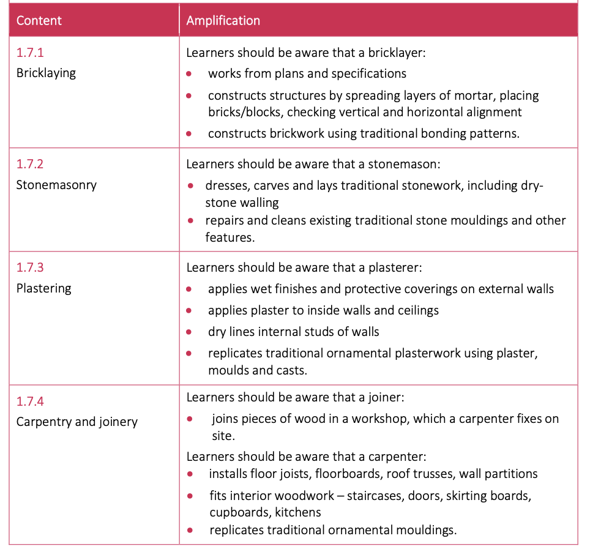
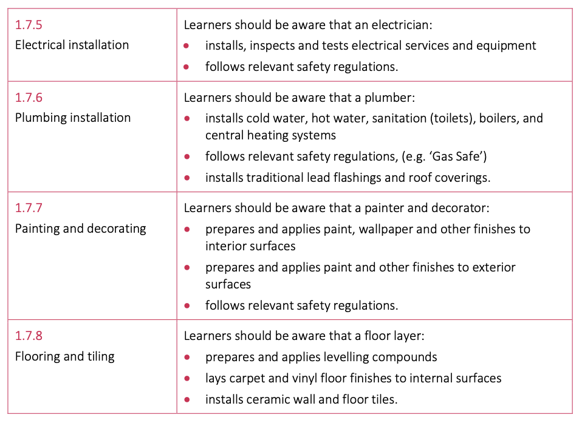
1.7 Trades, employment and careers
In this section, students will gain knowledge and understanding of the following
Bricklaying
Stonemasonry
Plastering
Carpentry and joinery
Electrical installation
Plumbing installation
Painting and decorating
Flooring and tiling

Slide 16
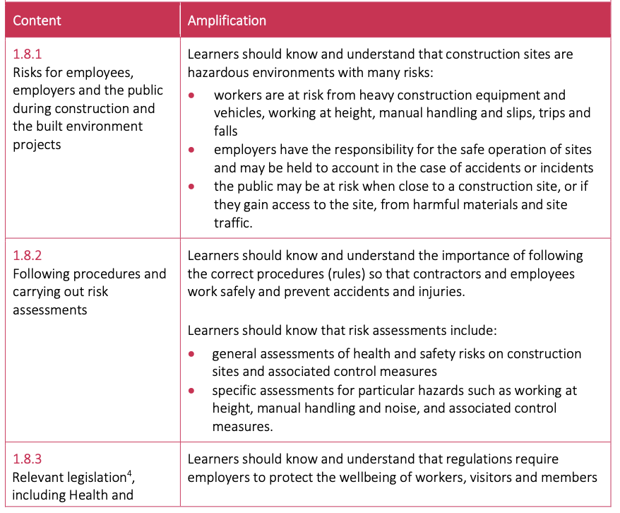
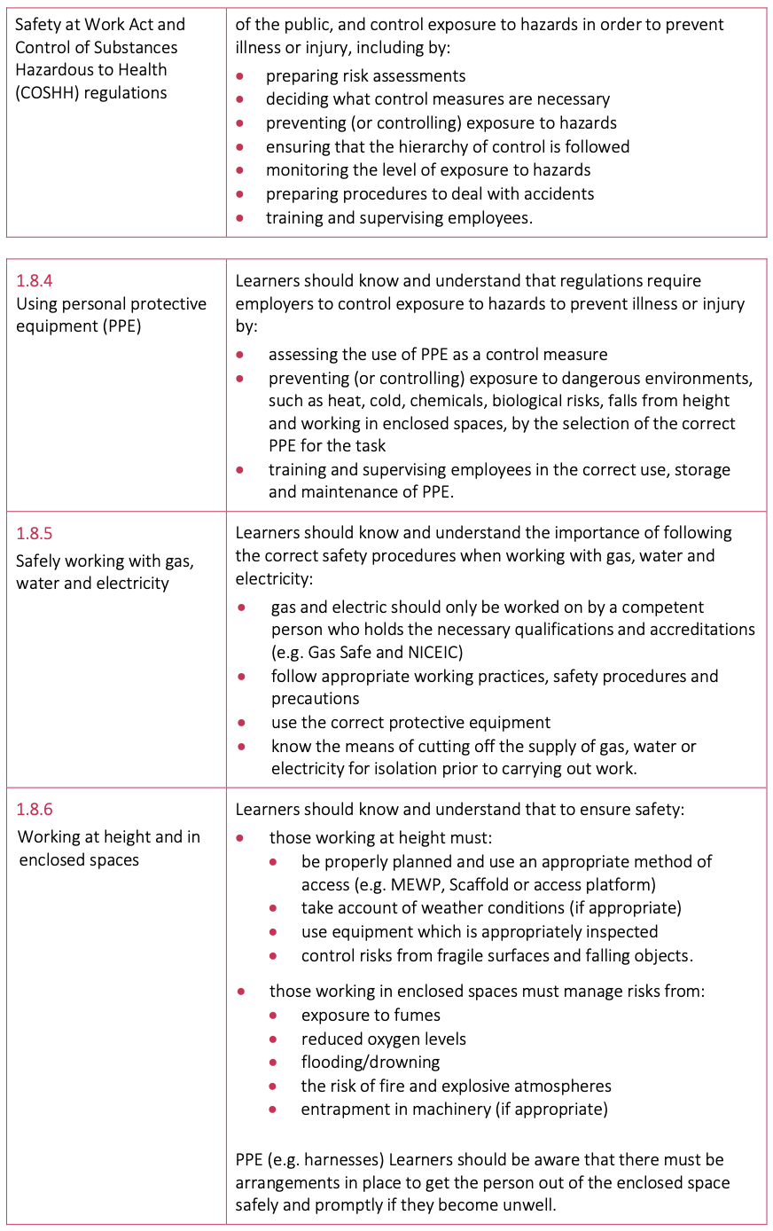
1.8 Health and Safety
In this section students will gain knowledge and understanding of health and safety in relation to:
Risks for employees, employers and the public during construction and the built environment projects
Following procedures and carrying out risk assessments
Relevant legislation, including Health and Safety at Work Act and Control of Substances Hazardous to Health (COSHH) regulations
Using personal protective equipment (PPE)
Safely working with gas, water and electricity
Working at height and enclosed spaces

Slide 17
Unit 1 (External Assessment)
Unit 1 is assessed through an external on-screen examination available in January and May/June each year.
Each external examination will:
Be set and marked by WJEC
Consist of a 1 hour, 30 minute on-screen examination
Assess content from each topic in the unit each series
Include 80 marks
Include a balance of short and extended answer questions, based on stimulus material and applied contexts
Only use the command verbs listed in the Assessment guide
Be graded Level 1 Pass, Level 1 Merit, Level 1 Distinction, Level 2 Pass, Level 2 Merit, Level 2 Distinction, Level 2 Distinction

Slide 18
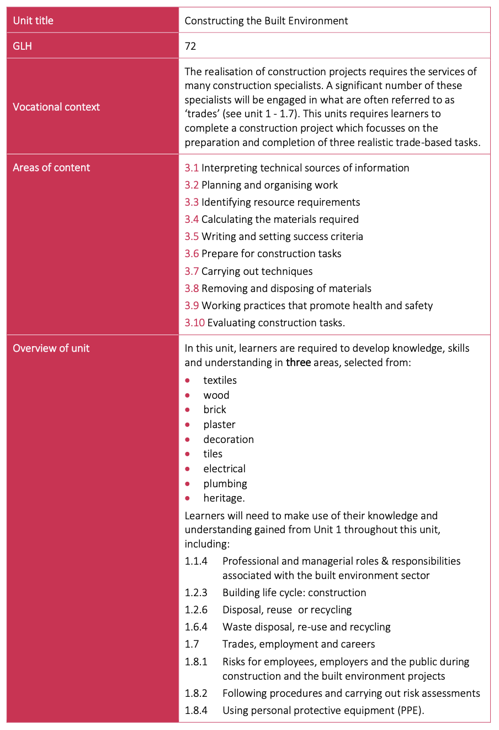
Unit 3: Constructing the Built Environment
Areas of Content:
3.1 Interpreting technical sources of information
3.2 Planning and organising work
3.3 Identifying resource requirements
3.4 Calculating the materials required
3.5 Writing and setting success criteria
3.6 Prepare for construction tasks
3.7 Carrying out techniques
3.8 Removing and disposing of materials
3.9 Working practices that promote health and safety
3.10 Evaluating construction tasks

Slide 19
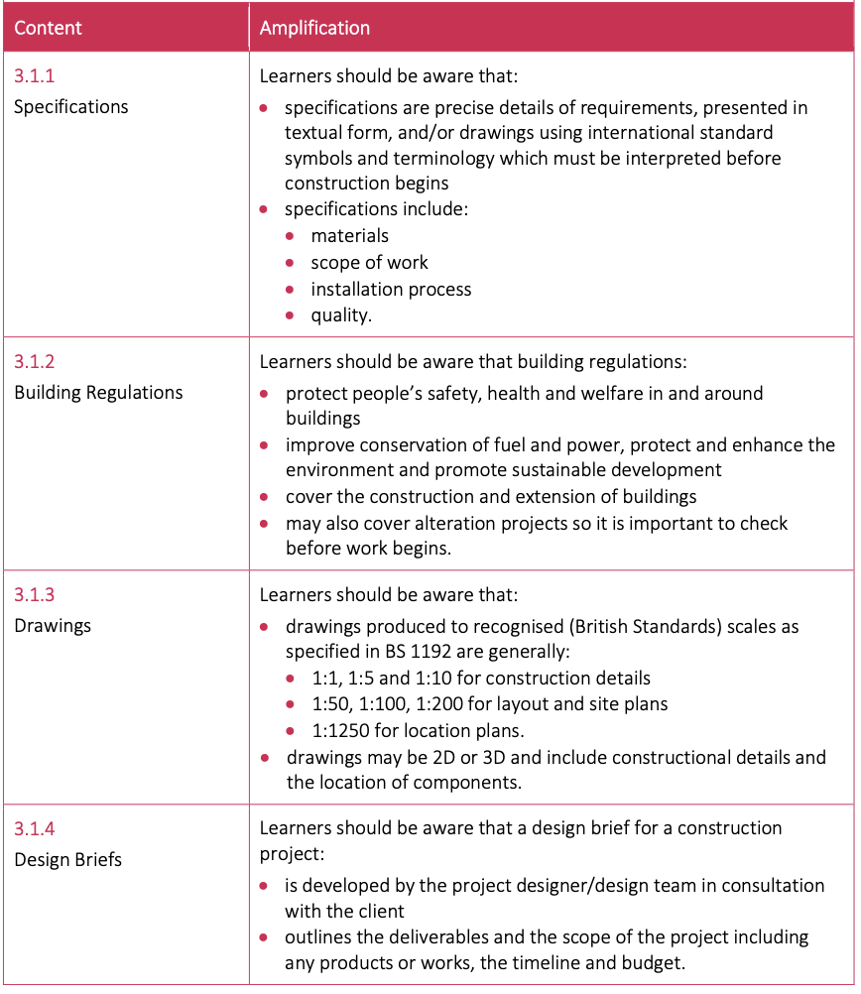
3.1 Interpreting technical sources of information
In this section students will gain knowledge, understanding and skills in interpreting a range of technical sources of information, using the symbols, conventions and terminology of:
Specifications
Building regulations
Drawings
Design beliefs

Slide 20
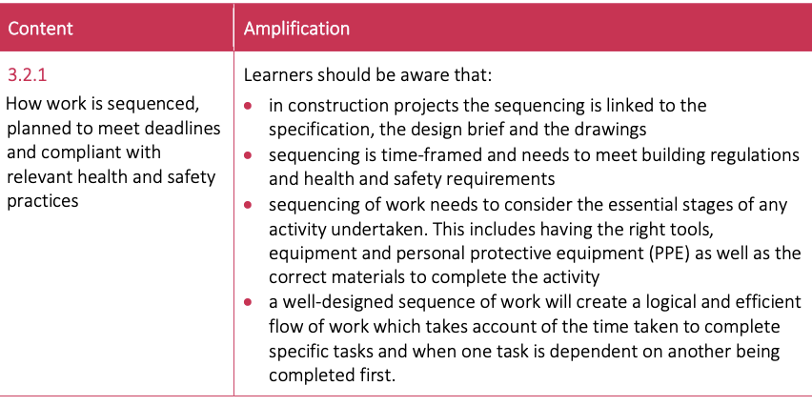
3.2 Planning and Organising Work
In this section students will gain knowledge, understanding and skills in planning and organising work that meets specific requirements, including how work is sequenced, planned to meet deadlines and compliant with relevant health and safety practices.

Slide 21
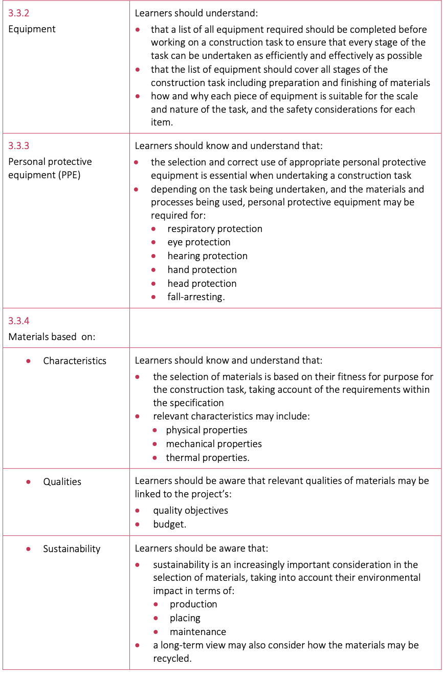
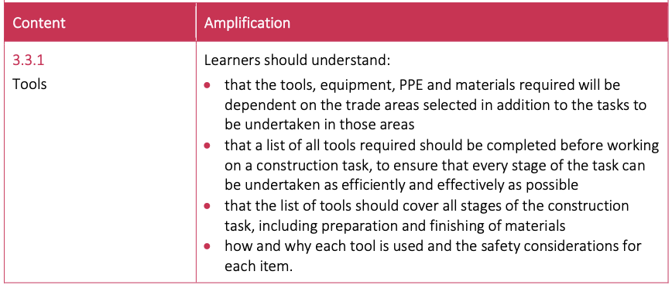
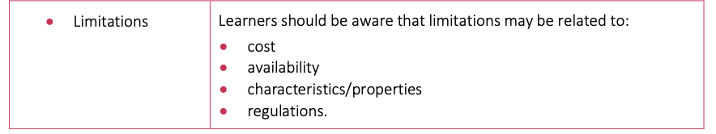
3.3 Identifying resource requirements
In this section students will gain knowledge, understanding and skills in identifying resource requirements, for the three selected trade areas, to meet design requirements:
3.3.1 Tools
3.3.2 Equipment
3.3.3 Personal Protective Equipment (PPE)
3.3.4 Materials based on characteristics, qualities, sustainability and limitations

Slide 22
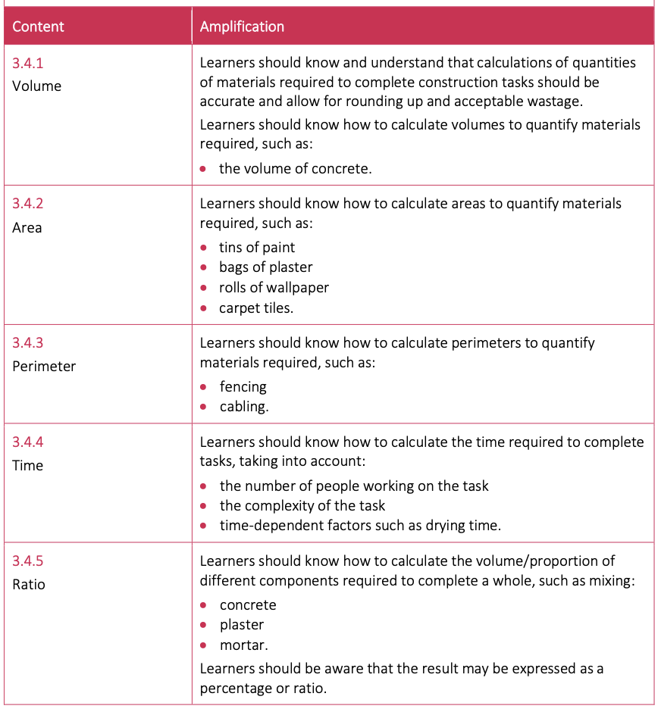
3.4 Calculating the materials required
In this section students will gain knowledge, understanding and skills in calculating the materials required to complete construction tasks that meet design requirements, in relation to:
Volume
Area
Perimeter
Time
Ratio

Slide 23
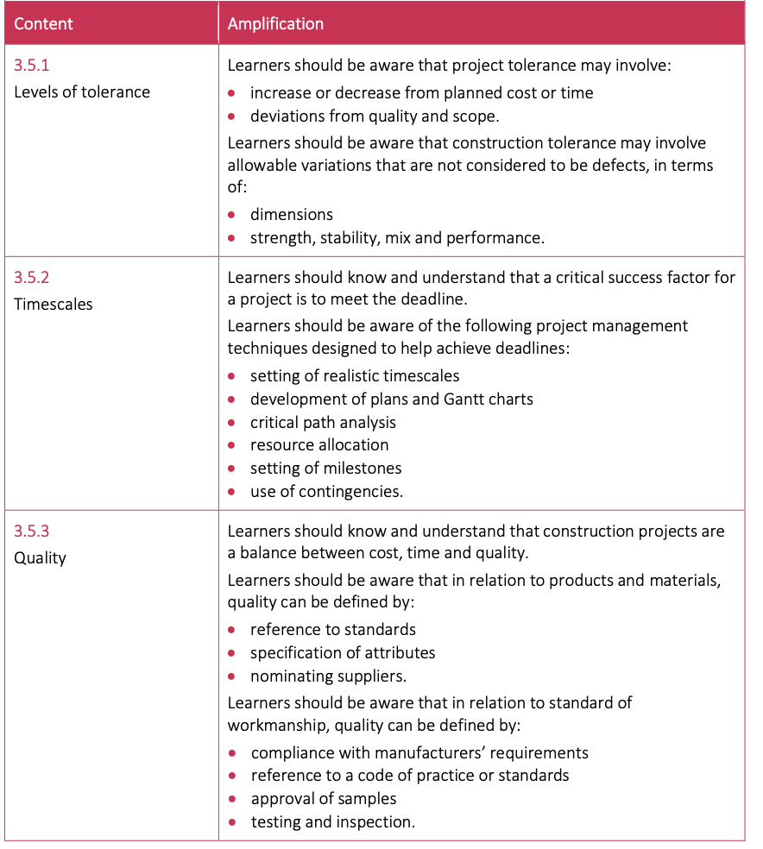
3.5 Writing and setting success criteria
In this section students will gain knowledge, understanding and skills in writing and setting appropriate project success criteria to meet the requirements of set briefs, with respect to:
Levels of tolerance
Timescales
Quality

Slide 24
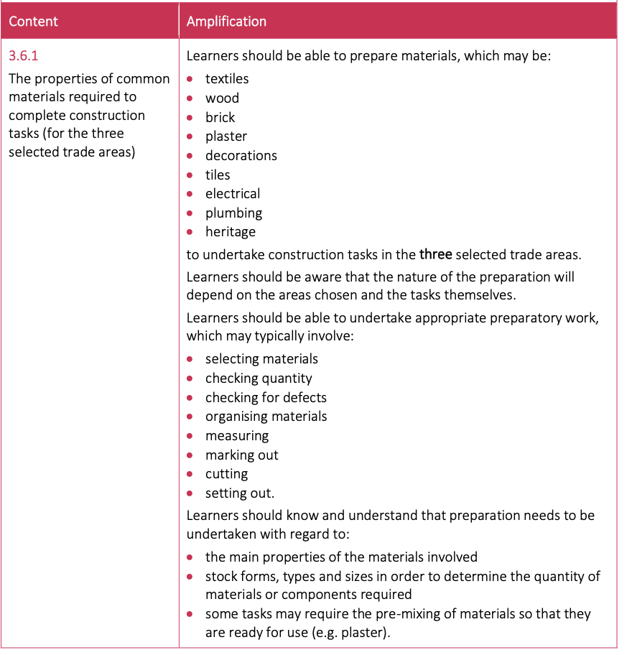
3.6 Prepare for construction tasks
In this section students will gain knowledge, understanding and skills in preparing materials and undertaking any other required preparations for each selected task, with regard to:
The properties of common materials required to complete construction tasks

Slide 25
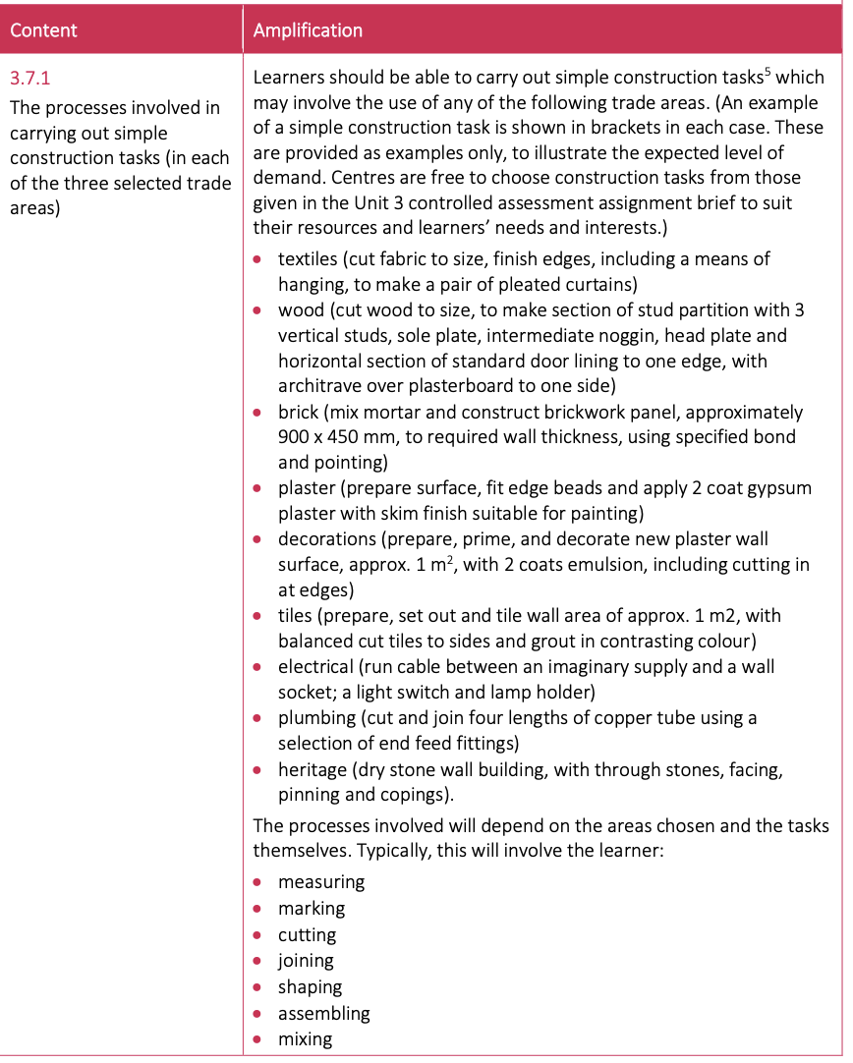
3.7 Carrying out techniques
In this section students will gain knowledge, understanding and skills in carrying out techniques focusing on:
The processes involved in carrying out simple construction tasks

Slide 26
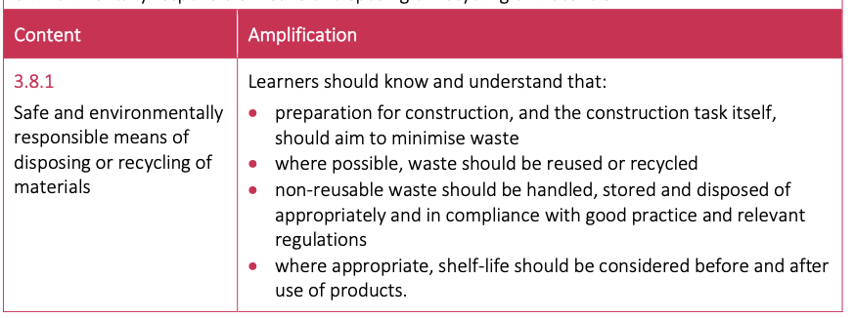
3.8 Removing and disposing of materials
In this section students will gain knowledge, understanding and skills in removing and safely disposing of materials used in carrying out three of the above techniques, focusing on safe and environmentally responsible means of disposing or recycling of materials

Slide 27
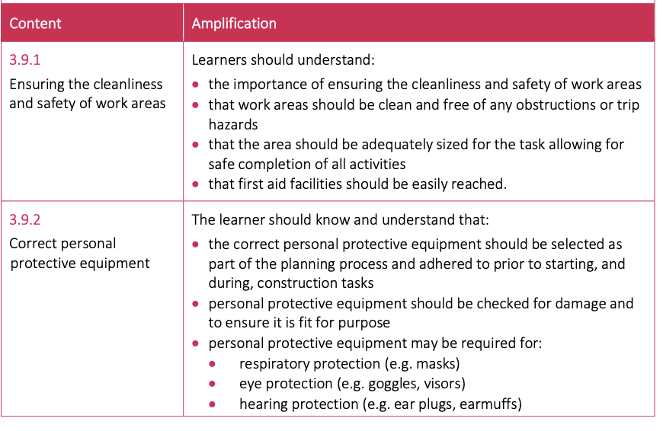

3.9 Working practices that promote health and safety
In this section students will gain knowledge, understanding and skills in working practices that promote their own health and safety and that of others, developing an awareness of health and safety practices related to each of the three selected trade areas, including:
Ensuring the cleanliness and safety of work areas
Correct personal protective equipment

Slide 28
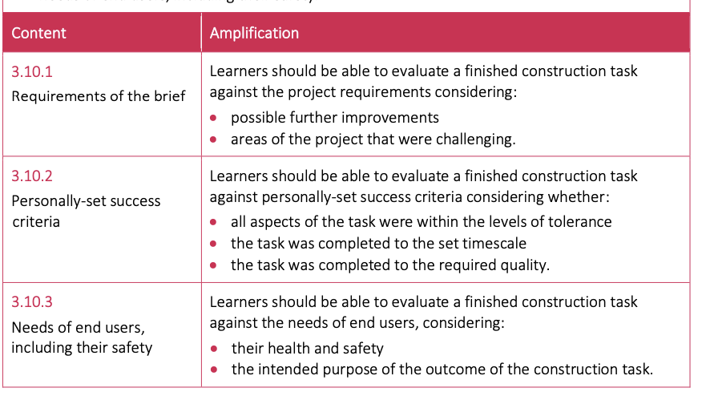
3.10 Evaluating construction tasks
In this section learners will gain knowledge, understanding and skills in evaluating the quality of completed construction tasks, including how outcomes can be evaluated
Requirements of the brief
Personally-set success criteria
Needs of end users, including their safety

Slide 29
Unit 3 (Internal Assessment)
Unit 3 is assessed through controlled assessment, released in May each year and submitted for external moderation in December and May each year.

Slide 30
Where can this course lead to in the future?
The successful completion of this qualification, together with other equivalent qualifications, such as in maths and the sciences, could provide the learner with opportunities to access a range of qualifications including the GCE, apprenticeships, vocationally related and occupational qualifications. These include:
Level 3 Extended Project
Level 3 qualifications in construction, such as Diplomas in Construction and the Built Environment;
Level 2 qualifications in construction, including specialist areas such as plumbing, bricklaying and carpentry
Apprenticeships in construction

Slide 31
F&Qs

Slide 32
List of Skills that they develop during the 2 years

