Slide 1


Year 11 Music Autumn B 2021-2022
GCSE Unit: Music and Me: Free Brief Composition
Song Writing with Gary Barlow BBC Maestro Series
Name:___________________________
Class:________

Slide 2
Specifics for 2022 (Reduced requirements):
Playing: 1.5 minutes
Learners may still perform multiple pieces to meet the performance minimum duration.
Composition: 2 minutes.
Integrated Portfolio – YES
The Solo playing and the Free Composition are known as the ‘Integrated Portfolio’ and they are requirements
The Practical Portfolio: NO
The group playing and the set brief composing are know as the Practical Portfolio and we are not required to produced these.

Slide 3
Overview:
Week 8:
1. Tuesday, Composing
Thursday, Composing
Week 9:
Tuesday, Playing prep for following week
Thursday, Playing prep for following week
Week 10:
Tuesday, Composing
WEDNESDAY, PLAYING MOCK All afternoon
Thursday, Composing
Week 11:
Tuesday, Composing
Thursday, Composing
Week 12:
Tuesday, Composing
Thursday, Composing
Week 13:
Tuesday, Start sending finished compositions to teachers on Classcharts
Thursday, Last compositions to be finished
Week 14:
Tuesday, Composition should be completely finished and all three items handed in
*Complete scores/lead sheets, *Composing journey and *iPad/Phone Recording. Must have a title.
Official intervention for GCSE Music:
Week 2s, Thursdays after school
We cannot ask you to come other days unless your teachers say they are free from your allocated subject.
SMR free Tuesdays and Thursdays after school – students can book for help.

Slide 4
COMPOSING SCORE:
Your composition score can be one of the following:
- a print out of the work you have done on Soundation/Garage band/other software
- a print out of the work you have done on Sibelius/Encore/Note Flight/Musescore
- a print out or hand written lead sheet with the melody notes or letters, the chords, bassline, guitar riffs, drum patterns written out in standard notation/letters etc.
- a typed description of what happens and when, in your composition.
This must be as detailed as possible, in order for the reader to be able to imagine your piece
Use the structure of the piece to show what
Do not forget to put your:
Full name, OCR ID number, school, school ID number and the title of your composition at the top of the paper.
When you hand it in, do so by e-mail to sreeves@stewardsacademy.org

Slide 5
KO: GCSE Composing
Mood/Atmosphere/a Feeling: Imagine the kind of scene you would like to create. Perhaps it’s for a scene in a film
Genre/Style/Period: Is your piece modern or old? Does it sound as though it comes from a certain period of time? How will you recreate this?
Time signature, tempo: Where are the strong beats? How many beats in a bar? Is your piece fast/slow or medium speed?
Key and Tonality: Which note is the Home Note, the tonic, note 1 in your composition? Is it in a major or minor key? (Happy/sad?)
Melody/Riff/ (1st subject) Theme 1: Create a tune which often goes up then down and is 4 or 8 bars long. Starts and ends on home/tonic note and is often fairly symmetrical. If you are writing a song it could be the Chorus which is very catchy and repetitive.
Harmony: We usually use chords I and V, with a few others along the way, such as IV and VI. They accompany the melody, This can be written 1st if you like - Chords 1 4 5 6 is a good way to start your chord progression but don’t forget to think outside your comfort zone.
Perhaps lyrics: Lyrics if you are writing a song. They are usually closely tied with the melody.
Instrumentation: Which instruments do you want to use? Don’t use too many, two can be ideal
Italian Terms/Dynamic markings/Articulation: Use Italian musical terms and dynamics to tell the players how to achieve the style (E.g. Pizzicato, Staccato, quietly, loudly, slowly etc)
Structure: What will be played first? What will come next? Will you follow a set formula, such as Sonata Form?

Slide 6
KO: GCSE Composing Continued
A second melody/Riff (2nd subject) Theme 2: This will be a contrasting melody to the first one, but it must match and not be too wildly different. It will usually have 4 or 8 bars and is also fairly symmetrical and well balanced. It may begin and end on the tonic or home note, too, or may be more complicated than melody or theme 1. If you are writing a song, it could be the verse that would tell a bit more of the story.
Development of Melodies/ Bridge: Take one melody and change it so that it is longer, shorter, higher, lower, surprising, in a different tonality, different time signature, different key etc. Don’t get too radical as it must still match the piece.
Recapitulation: Repeat the melodies. This could mean repeating the verse and chorus for a song. In classical form it means repeating Themes 1 and 2
Introduction maybe: If you wish, you can put a short amount of music at the start which suggests how the rest of the piece will go. In Sonato Form, this could be very slow. In a song, it could be a riff, such as Eric Clapton’s Layla
Coda maybe: This is a short piece of music at the end, to finish it off, such as the La la’s at the end of ‘Hey Jude'
You must create a recording of your composition and send it to Ms Reeves as an MP3 or MP4. Deadline is: 21st May, 2021
You must create a Composing Score to accompany your recording so a listener can follow what is happening. Deadline: 21st May, 2021

Slide 7
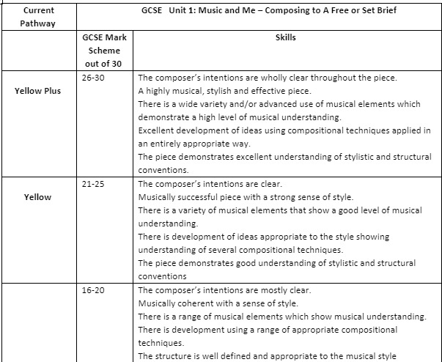

Slide 8
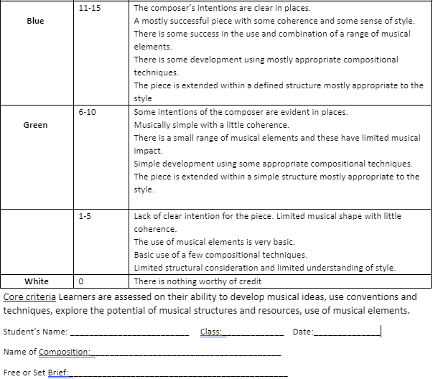

Slide 9
Title: Getting Started
LI: to learn how to begin song writing:
Listen to Gary Barlow singing Patience with Take That
https://www.youtube.com/watch?v=273eSvOwpKk
ACTIVATE:
DART: Read synopsis of Gary Barlow's Wikipedia (see next page)
Watch Lessons 3, 4, 5 from Gary Barlow's BBC Maestro's Song Writing Series
DEMONSTRATE:
(See 'demonstrate' slide)
CONSOLIDATE:
Teacher assesses continuously
H/W:

Slide 10
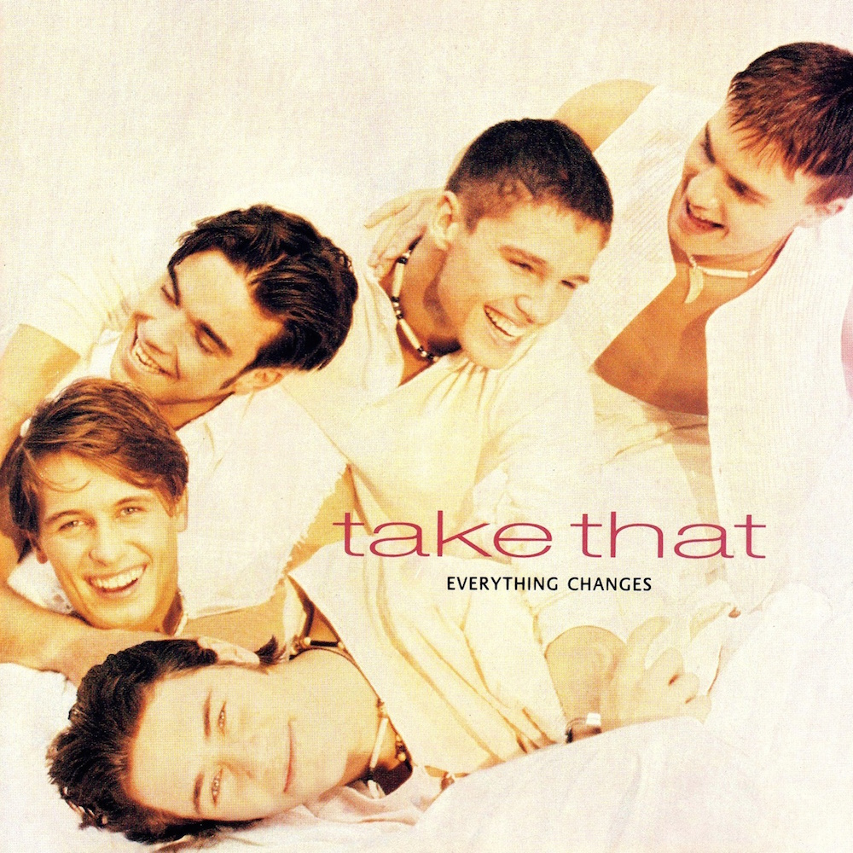
.
DART: Wikipedia: ACTIVATE
Gary Barlow OBE (b.1971) is an English singer, songwriter, record producer, actor, and television personality. He is the lead singer of the British pop group Take That Gary Barlow is one of Britain's most successful songwriters, having written fourteen number-one singles (10 with Take That, 3 solo, 1 with Robbie Williams "Candy") and twenty-four top-ten hits.As a solo artist, he has had three number-one singles, six top-ten singles and three number-one albums,^{[5][6]} and has additionally had seventeen top-five hits, twelve number-one singles and eight number-one albums with Take That. Barlow has also established himself as a talent show judge and television personality. He has judged on The X Factor UK (2011–2013) and Let It Shine (2017).
Barlow has received six Ivor Novello Awards from the British Academy of Songwriters, Composers and Authors, including the award for Outstanding Services to British Music. He has sold over 50 million records worldwide.[He was appointed an Officer of the Order of the British Empire (OBE) at the 2012 Queen's Birthday Honours for his services to the entertainment industry and charity.

Slide 11
Gary Barlow 'Song Writing' BBC Maestro Series (ACTIVATE)Lesson 3: The Process: 1' 40'' to 3': How hard it is to be in the business
3': Work Ethic: Hard work and putting in the hours, Ed Sheeran, Elton John,
Lesson 4: Listening: (Inspiration and recommending to get involved.)
Gary's childhood listening, creating your own taste, what you appreciate, listen for inspiration, training your ears, ear training:
5' 30'' to 9'28'' Different ways that songs are born, wrong chords etc, get on with composing, challenge your ears, Beethoven, how does it fit together? Get involved and participate
Lesson 5: Early Days: Watch whole thing: Nitty gritty of actually writing. He wrote the music first and then lyrics. He found lyrics hard. Always had musical idea first. Need another hook after initial musical idea. Started in C Major.

Slide 12
DEMONSTRATE:Use Gary Barlow's experience to start to think about your own composing.
Will you begin with lyrics or music?
Will your lyrics rhyme?
How will you use your voice?
What will the song be about?
Draw up a rough but neat plan for your song
Check that your Soundation account is working
This is either: on your instrument or using software such as Soundation or Garage Band.
You can use Soundation at school and at home.
You can only use Garage Band if you have it yourself

Slide 13
Plan for Free Composition: Can be completed/modified as you go along
Title/theme
Lyrics
Melodies/riffs
Chord progressions
Instrumentation/ sonorities
Tempo: fast/slow/moderate
Vocals: M/F/ high/low etc
Structure etc

Slide 14
CONSOLIDATE:
Teacher checks progress of students
Homework: continue with playing at home/in the music dept
You need another hook after your initial musical idea
Write about a life changing experience
Deadline for composing is last week of this term

Slide 15
Notes:

Slide 16
Title: Parts of the Song
LI: to understand how major and minor chords create tonality CONNECT:
You need another hook after your initial musical idea
Write about a life changing experience
Think about the chords you will use – will they be major (1, 4, 5) or minor (2, 3, 6)
What is your note 1? If you write it in C, you don’t need sharps or flats, until you modulate to a different key (I hope you will)
ACTIVATE:
Gary Barlow: Lesson 9: Major to minor: (tonality) Gary pulls apart the song, Pray, and shows us its component part. Show the whole thing. Actually about composing. Maj to min creates tension. Sometimes comes together during production. Think bigger than the song – think about an overall style.
DEMONSTRATE:
Continue to work on your Free Composition
Playing lessons next week so bring instruments
CONSOLIDATE:
Teacher supports/checks progress
Show us your main melody

Slide 17
Notes:

Slide 18
Week 9: Playing
Both lessons are put aside this week for you to prepare for your playing mock next Wednesday afternoon, 17th November, 2021, Periods 3 & 4
You must play your solo for 1 and ½ minutes.
You will be recorded and graded according to the GCSE mark scheme
(See p. 14)
Write your allocated mock time here:_______________

Slide 19
Title of Piece being played for Mock:
__________________________________
Composer:__________________________
Instrument:______________________
I found the piece on Youtube or in a book or from my teacher or:
____________________________
The piece lasts: _____________________

Slide 20
Notes:

Slide 21
Title: Emotion in Music
LI: to learn to use your emotions in your composing CONNECT:
Remind yourself of you new melody
ACTIVATE:
DART: Read synopsis of Lessons 9 & 10 from Gary Barlow's BBC Maestro series (see next slide)
Watch Gary Barlow's BBC Maestro series, Lessons 9 & 10
DEMONSTRATE:
On going work on composing using instrument or software
CONSOLIDATE:
Write when you are feeling emotion
No idea is ever wasted

Slide 22
ACTIVATE: Lesson 10: Find Your Voice: THIS IS GOOD STUFF:
Gary Barlow says: There are no shortcuts to finding your own voice. Gary shows you the ways in which you can get started. Worth listening to. Gary shows you the ways in which you can get started. Don't go in and start with same chord every day, use something new, new key, write about something that changed your life, extreme amount of soul searching. Documenting something that is important to you. And live! You need experience and connection. Write when you're feeling extreme emotion. Writer's block. Read a newspaper, listen to music. Doesn't have to be at the piano. Look around, songs are everywhere. Log your ideas. (George Michael) Use phone to record an idea. Stop watch. Don't be distracted. Last section of song – different. Come up with 3 different versions and use the best one.

Slide 23
Title: No Idea is Ever Wasted
LI: to learn how chords can dictate emotions CONNECT:
No idea is ever wasted
Write when you are feeling extreme emotion
ACTIVATE:
DART: Lessons 11, 12, 13 of Gary Barlow's Song Writing Series
DEMONSTRATE:
On going work on composing using instrument or software
If finished: Use your BLB Conventions of Pop to read about 'Pop Ballads of the 1970's, '80's and '90's. Answer the questions about this up to and including p.17 in the Questions section
CONSOLIDATE:
Remember that chords can dictate the emotions in a song
Get your chorus going fast if you want a dramatic effect

Slide 24
Notes:

Slide 25
ACTIVATE: Gary Barlow BBC Maestro Series 11: No Idea is Ever Wasted:
'It’s critical that you keep all your ideas safe so that you can come back to them. Gary illustrates this with the story of a song that stuck with him until he was ready to complete it.' (All worth watching)
Came back to a song eight years later and found the inspiration.
Lesson 12: The Chorus: Find out why Gary likes to get a song started with the chorus.
Fit it all together like a jigsaw.
Lesson 13: Chords: 'Chords are great building blocks for songwriters. They have dictated the emotions and sentiments of many of Gary’s most famous songs'. (All worth watching)
Ideas to get started and inspired, or just play some chords. Something that makes you emotional. What can I add to this? Chords are a great way to get started.

Slide 26
ACTIVATE:
Lesson 14: Experiment with Chords: 'Gary shows us how he brought two ideas to the studio and fused them together to create a song big enough to open a sell out show at Wembley Stadium'. (Worth watching) Idea: RH does same thing repeating, LH changes
Chorus is where you connect. How to get there quickly. Get to the chorus soon, within 40 seconds.
Was writing for huge stadiums, therefore simple songs so all can sing it together. So need 'big' words like 'universe', 'magnificent' etc. So you are considering your audience.
Lesson 15: Collaboration: 'Arguably the greatest comeback in pop history was launched off the back of a collaboration. Gary explains how a partnership with producer John Shanks, helped create the song, Patience'. 8' 38''
It's all about collaboration. So many jobs around music. All needed. Have fun. Most of his songs are from the piano. Worked with a guitarist who did it differently to piano. Title in chorus or not? Get uncomfortable. Used falsetto. Melisma/hook. Simplicity. Friday night in the pub. Can folks in the pub sing that song?

Slide 27
Title: Experiment With Chords
LI: to learn how to experiment with chords CONNECT:
Remember that chords can dictate the emotions in a song
Get your chorus going fast if you want a dramatic effect
ACTIVATE:
DART: Read synopsis of Gary Barlow's Lessons 14 & 15 (See next slide)
Watch Gary Barlow's lessons 14 & 15
DEMONSTRATE:
On going work on composing using instruments or software
CONSOLIDATE:
Continue to experiment with chords for your chord progressions
Get uncomfortable
PLAYING RECORDING DEADLINE/SCORE OR YOUTUBE URL IS FRIDAY

Slide 28
Notes:

Slide 29
Title: Constructing a Song
LI: to learn how to use structure in song writing CONNECT:
Experiment with chords for your chord progressions
Get uncomfortable with the music – step out of your comfort zone
ACTIVATE:
DART: Lesson 17 & 18 Gary Barlow's BBC Maestro Song Writing Series
DEMONSTRATE:
On going work on composing using instrument or software
CONSOLIDATE:
Check your laundry list and use a thesaurus if you can’t find the words
Is it a soft song or a strong song?
PLAYING RECORDING DEADLINE/SCORE IS TOMORROW

Slide 30
Notes:

Slide 31
ACTIVATE
Lesson 17 & 18 Gary Barlow's BBC Maestro Song Writing Series Lesson 17: Constructing a Song: Part 1: 7 minutes. Watch all of this
'Starting with a clean slate, Gary shows you how to construct a brand new song and explains many of the decisions you need to make right from the start'.
Don't do demos – do good sound quality straight away. Using Thesaurus.
Laundry list. Just putting ideas down. No music as yet. Finds a last line and saves it.
Style – acoustic or electronic?
Lesson 18: Constructing a song: Part 2: 13 minutes. Watch all of this
'Tempo, sentiment and choice of key come into focus as a new song takes shape'. Is it a soft song or a strong song? Starts on a new key to refresh. Ballad, or something faster? Uses Logic Pro. Keep exploring, don't settle for the first thing. Less is more? Plays the voice part an octave above on keyboards. Add drums for attitude. What would the drummer do? How would he play it? Choruses are big and verses go inwards more. Words don't have to make sense straight away or ever. What happens at your junctions? Do we go back there? Have we got more to say

Slide 32
Title: Choruses
LI: to learn how to not be annoying when writing choruses CONNECT:
Think about the structure of your song, from the last lesson
Is it binary, ternary, rondo (ABACADA) or typical song structure of:
Intro-verse-chorus-verse-chorus-bridge-chorus-outro??
ACTIVATE:
DART: Read synopsis of Gary Barlow's Song Writing Series, Lessons 19 & 20 (next slide)
Watch Gary Barlow's Song Writing Series, Lessons 19 & 20 (see next slide)
DEMONSTRATE:
On going work on composing using instrument or software
CONSOLIDATE:
Check that your structure is strong – it will frame your piece

Slide 33

ACTIVATE: Gary Barlow: Song Writing, ContinuedLesson 19: Constructing a Song: Part 3 12 mins: Very good lesson Do this one if nothing else
'Gary points out the pitfalls one encounters when writing choruses'
3rd time, slightly change it. Got to have a hook, but don't push it too much.
Choruses should feel like everyone's joining in. Must be memorable. Add strings. 'The Rub'. Using G, D, C (I V IV) Inverted the suspended chord, playing 3rd above it. D chord (D F# A and adding G to create a 'rub' or discord between the F# and G) Gives the music some personality. Try adding some extra notes. Inciting emotion.
Lesson 20: Constructing a Song: Part 4 10 mins: Watch this
'Gary talks about the importance of staying in the moment to maintain the flow and puts the melody of our new song under the spotlight'.
Not too much melody on chorus, please. Don't be too annoying.
In the flow: About an hour to work before you lose the flow. Stay in the moment.
The computer can help the process. If you don't have the lyrics immediately, scat until they come.
Expand the Song: Consider the listener.

Slide 34
Notes:

Slide 35
Title: The Magic
LI: How to use the drop to push the hook home CONNECT:
Check the structure of your song -Is is binary, ternary, rondo (ABACADA) or typical song structure of:
Intro-verse-chorus-verse-chorus-bridge-chorus-outro??
ACTIVATE:
DART: Lessons 21 & 22 Gary Barlow Series
DEMONSTRATE:
On going work on composing using instruments or software
CONSOLIDATE:
Throw in some ‘magic’ to your composition – this could be a modulation (change of key) or some melisma (several notes for one word)

Slide 36
Notes:

Slide 37
ACTIVATE:
Gary Barlow BBC Maestro Series Lesson 21: Constructing a song Part 5 10 mins
Gary drives the hook home and fine-tunes the lyrics.Gary playing around with melody, lyrics, rhyming etc. A lot.
Add instruments. Get 16 bars
The Drop, to push the hook home. See it at 9 minutes.
Lesson 22: Constructing a Song: Part 6:
'Gary believes the song now has that one piece of magic in the melody of the chorus'.
How to find that unique moment. One bit of magic- the intro/hook. Get to the magic soon. Verses might change as chorus firms up.
Strip It Back: Want it to be easily singable, and doable on the guitar or keyboard.
7 mins: shows simple but effect hook.
Great moment, when your song asks for more. Another line comes.
9' 40'' Everyone can do this....

Slide 38
Title: Confidence is King:
LI: to learn to be resilient in song writing
CONNECT:
Your composition must be in by Thursday next week
ACTIVATE:
DART: Read synopsis of Gary Barlow's Song Writing Series, Lessons 23 & 24 (next slide)
Or: Watch Gary Barlow's Song Writing Series, Lessons 23 & 24(see next slide)
DEMONSTRATE:
On going work on composing using instrument or software
CONSOLIDATE:
Check you have a firm structure with sections, in your piece.
Be sure to compose with confidence; no ‘U-turns’. Keep going with your original plan

Slide 39
Notes:

Slide 40
ACTIVATE:Confidence 6 mins.
Only first 4 minutes is worth watching.
In the creative world, confidence is king. Without it everything falls apart. Gary speaks from the heart about how he once lost his confidence and what he did to build it back up. Don't allow jealous people to bother you and take away your confidence.
Use criticism to help you improve and to prove others wrong
Be ready: (Keep trying even if think it won't work)
Lesson 24: See An Opportunity 7 mins Very Good
In songwriting, everything you do will prepare you for a moment that will take you by surprise. One chord per bar, then hots up and chords change more often (harmonic rhythmic is changing faster) Singing the 7th in the melody, part of the hook. The bridge and tonality. Don't be scared. Feel the thrill.

Slide 41
Title: When Is A Song Finished?
LI: to keep tweaking until it’s fantastic
CONNECT:
Remember that your composition must be finished and sent by Thursday next week
ACTIVATE:
DART: Read synopsis of Gary Barlow BBC Maestro Song Writer Series: Lesson 25: Creativity (next slide)
Or: Gary Barlow BBC Maestro Song Writer Series: Lesson 25: Creativity (Next slide)
If you are using Soundation, ensure you know how to download it and send it.
DEMONSTRATE:
On going work on composing using instrument or software
CONSOLIDATE:
Ask a member of your family, or a friend, to listen to it and critique your composition

Slide 42
ACTIVATE: Gary Barlow BBC Maestro Song Writer Series:
Lesson 25: Creativity 13 minsGary talks about the joys of living a creative life and reflects on how Back For Good came about through experimentation.
Natural born song writer – maybe doesn't exist. Some have a need and desire to do that. Anyone can do it. Push your creativity. THE SONG 'WHATEVER I DO' USE UNEXPECTED FALSETTO AND WORKS V. WELL.
It is more than melody and lyrics
Keep at it. Hooks are always good. Add earcandy. More flavour, more taste, more sugar, etc.
When Is a Song Finished? Keep going, keep tweaking until it's fantastic. You can do so much to it. Don't rush it.
(CAN SKIP THIS BIT) Practice: 9:50 mins Get going and get ideas down
The Moment: 12 mins

Slide 43
Notes:

Slide 44
Title: Composing Deadline Today LI: to ensure the Free Composition is complete and has reached the teacher
CONNECT:
Get your composition in today (deadline)
ACTIVATE:
Make sure you send your MP4 to classcharts
Check in with the teacher if you don't understand something.
DEMONSTRATE:
Check over your composition for any last minute tweaks
CONSOLIDATE:
Ask someone else to check it over
Ensure it has reached the teacher

Slide 45
Start thinking about the last tweaks to Composing before sending your composition to Classcharts
It must last 2 minutes

Slide 46
Title: Creating the Composing Score
LI: to create the score for the Free Composition
CONNECT:
The purpose of the score is to show us how it sounds
ACTIVATE:
Write out the structure of your piece
Check back to see the template of your composition.
DEMONSTRATE:
Show exactly what happens and when, in your Free Composition
Write in the Pitches, Sonority, (Structure), Tempo, Texture Tonality, Dynamics
Indicate any loops you made/didn't make your self (This can be checked)
No marks given for loops you didn't make yourself
Put as much detail in as possible to show how it should sound
Write out pitch in letters or show the notation
Write out rhythm in notation (Ms Reeves will support)
Print out your score from Soundation, following the instructions on the site (or Garage Band)
CONSOLIDATE:
Check that if someone looks at the score, they know how it sounds
Send to Ms Reeves on Classcharts

Slide 47
Title: Writing up the Composing Journey
LI: to write a side of A4 about how my composing process CONNECT:
Think about how you went about composing your piece
ACTIVATE:
Check in with the teacher if you don't understand anything.
Explain how you composed your piece. Use the Composition Journey document to help you do this
DEMONSTRATE:
Write an A4 side of paper about how you composed your Free Composition, using the Composition Journey document
CONSOLIDATE:
Check your grammar and spelling before handing this in, to
sreeves@stewardsacademy.org

Slide 48
Notes:

Slide 49
Composition Journey:
Template:
Title of your piece and YOUR NAME
Genre: why and how (Is the genre pop, classical, rock, heavy metal, Baroque, samba..)
Pitch: Is it high/low/around the middle range? Is the range narrow or wide?
Chord progression: any you have used
Melody: how did you create it/where did you get the inspiration
Sonority: What is the sonority – which instruments and how does the performer play these instruments?
Structure: What are the different sections? – inro, Verses, choruses, bridge, chorus, outro etc
Or is it binary or ternary or even Rondo (ABACADA) Or is it in Sonata Form? :)
8. Tempo: Is it fast, slow or moderate?
9. Texture: (Is it thin, thick, homophonic (solo with chordal accompaniment) or polyphonic? (more than one tune at a time)
10. Tonality: Is your piece in a major or minor key? Which note provides the tonal centre of the piece?
10. Are there lyrics and what are they about? Or does an instrument play the melody?
11. Where did you get your inspiration from?

Slide 50
My Composition Journey

