Slide 1
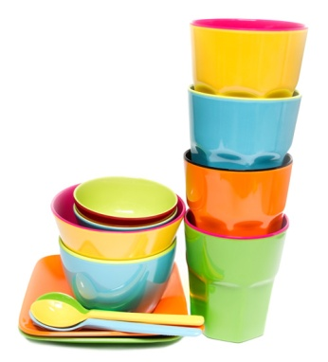
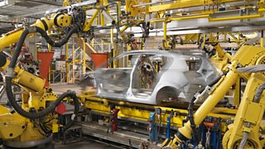

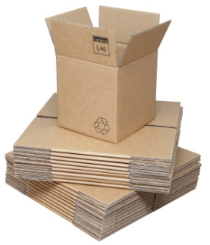
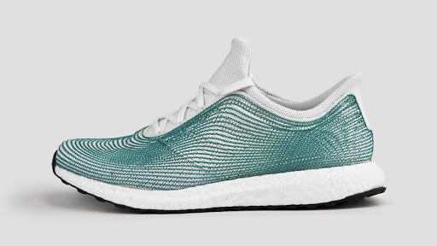
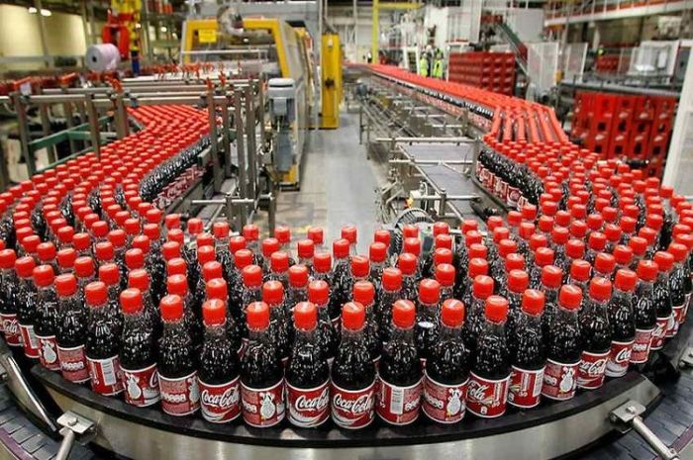
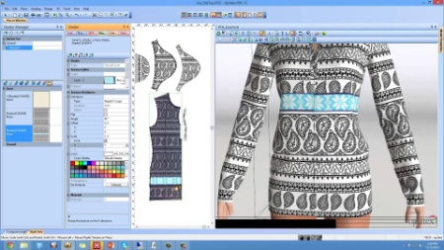
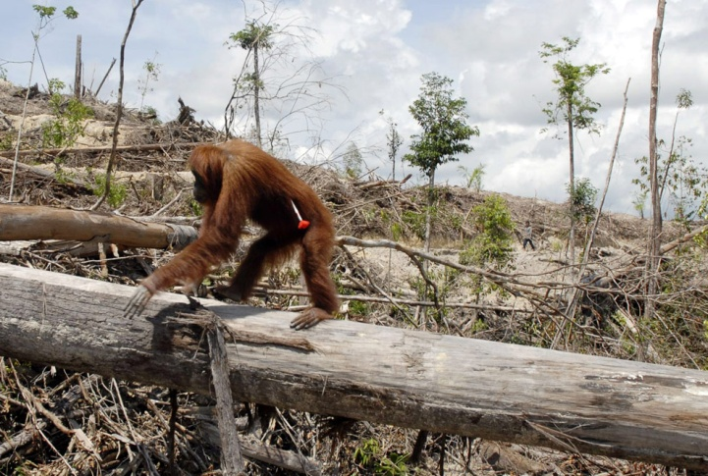
Stewards Academy
Design & Technology
KS4 Blended Learning Booklet

Slide 2
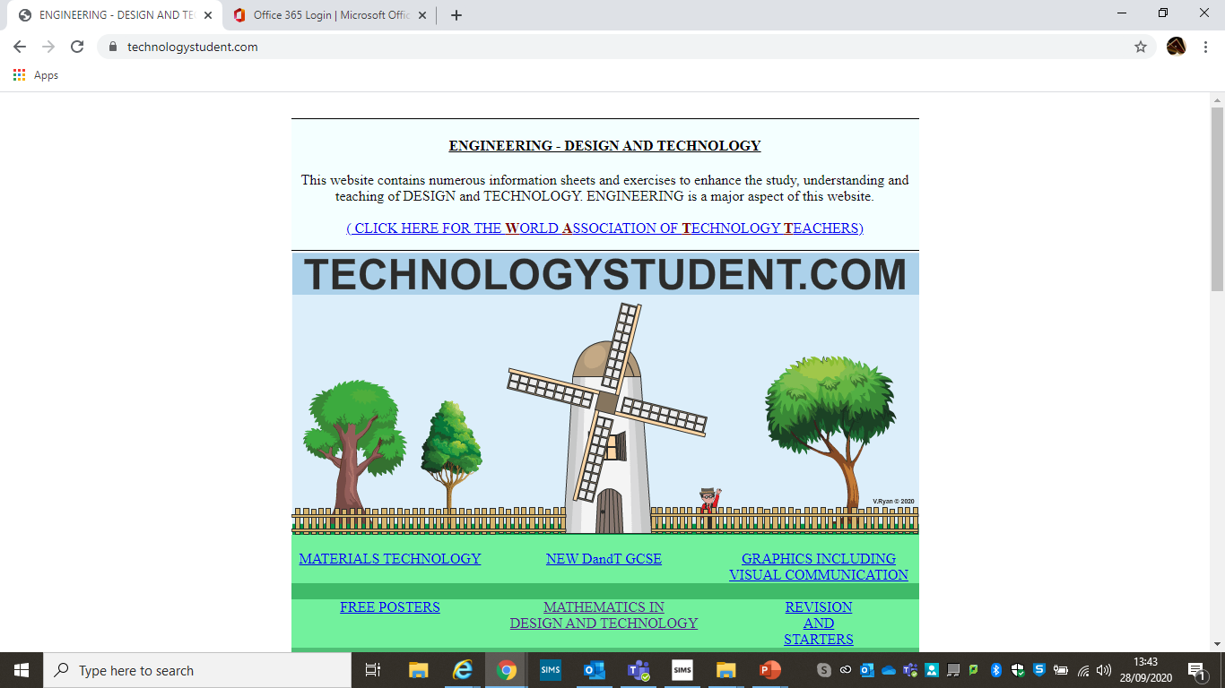
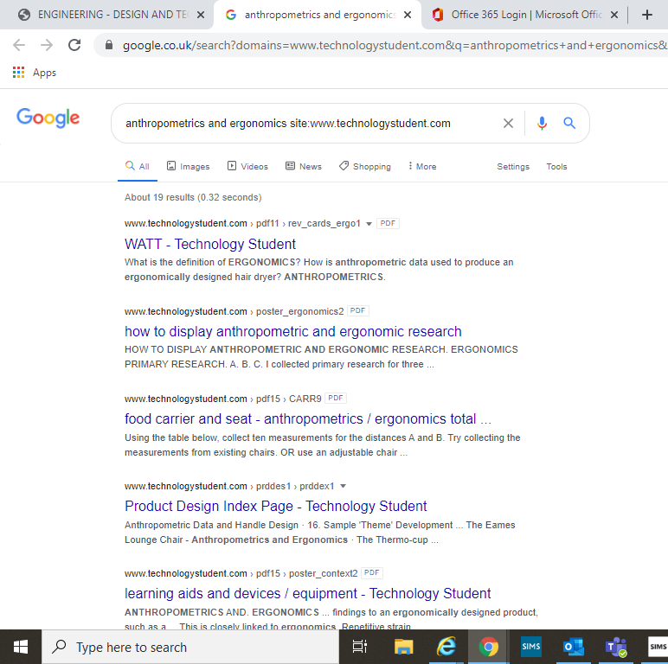
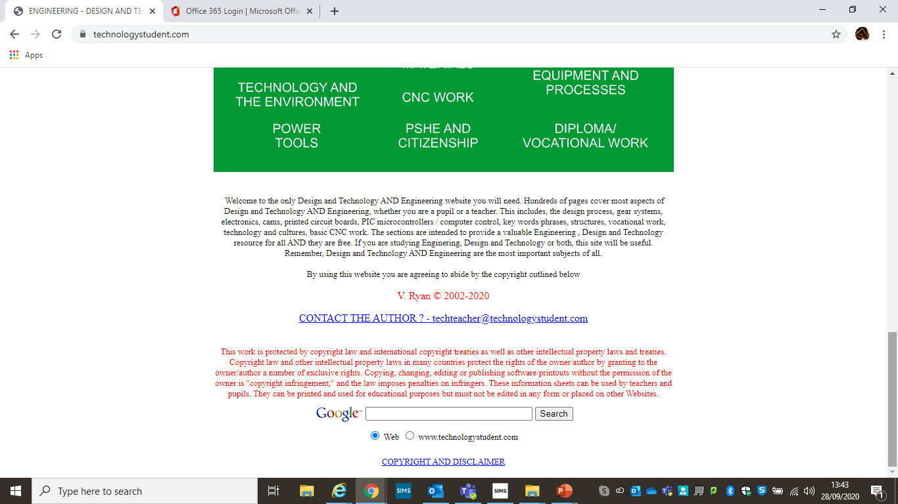
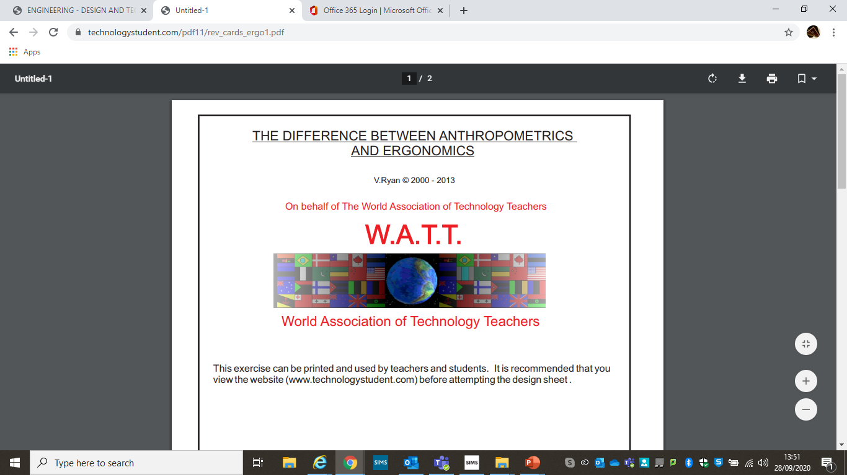
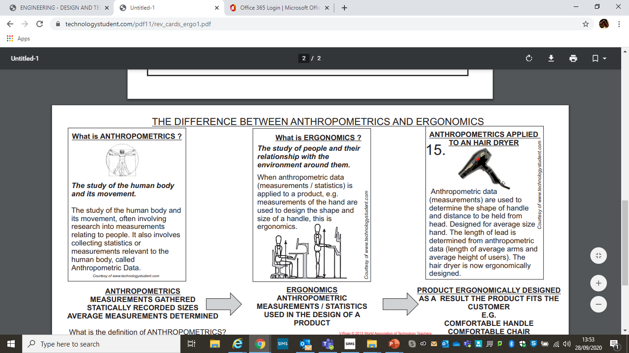

You can find all the answers you need by visiting www.technologystudent.com
A page will appear on google.
Choose the most relevant answer.
And click on it.
Scroll down to the foot of the page
A new page will appear in technologystudent.com.
Scroll down and read the information.
Enter the phrase or words you need to search which are in the first paragraph of the page you are reading.
Read through the information and fill in the powerpoint page.
Click on technologystudent.com

Slide 3
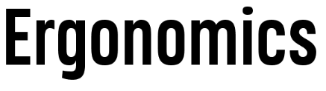
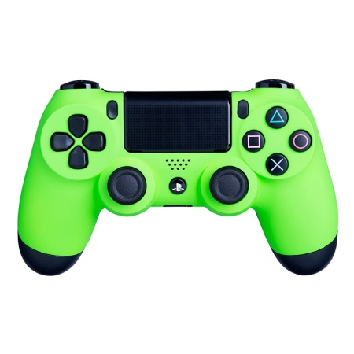

Can you answer these questions?
Explain what is meant by ‘ergonomics’.
………………………………………………………………………
………………………………………………………………………
………………………………………………………………………
In the box below write the definition of ergonomics and why it is important to consider ergonomics when designing new products.
Anthropometrics and Ergonomics page on www.technologystudent.com
2) Look at the image below of a Playstation controller.
Give two examples of how ergonomics has been considered in
the design of the controller. One has been completed for you.
1. There are no sharp edges so the controller is comfortable
to hold.
2. …………………………………………………………………
3. …………………………………………………………………..
………………………………………………………………………………………………………………………………………………………………………………………………………………………………………………………………………………………………………………………………………………..................................................
Challenge!
Have a look around
your home for any
products where
ergonomics has
been considered in
their design.
Example
The ergonomics in the design of this
computer mouse are the curved
shape to make it more comfortable to
hold and the rubber scroll wheel
allows the user to scroll with ease.

Slide 4
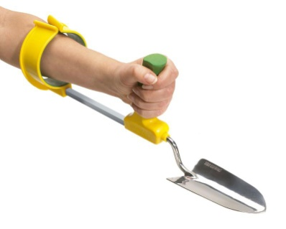
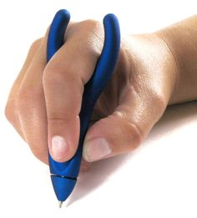
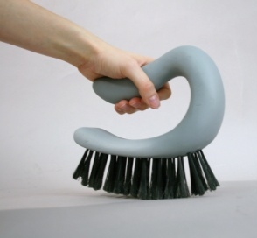
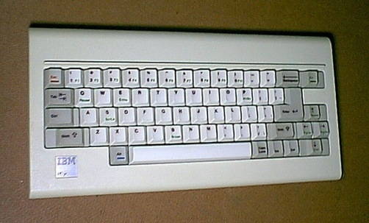
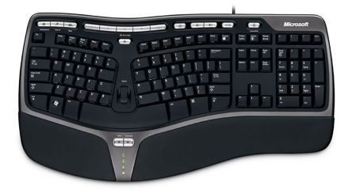
Challenge!
Design a new product to be used in the house or garden. This could be a new tool, chair,
remote control or something of your choice. You
must draw in pencil and you can use colour pencils
if you have them. Label your design to explain what
your new product is and how it will work.
Can you answer these questions?
3) Look at the two computer keyboards below.
Explain how the use of ergonomics has improved and
changed the design of keyboards and identify three key
features from the modern day keyboard where ergonomics
have been used.
……………………………………………………………………...
……………………………………………………………………...
……………………………………………………………………...
……………………………………………………………………...
……………………………………………………………………...
……………………………………………………………………...
……………………………………………………………………...
……………………………………………………………………...
1980’s keyboard
Modern day keyboard

Slide 5


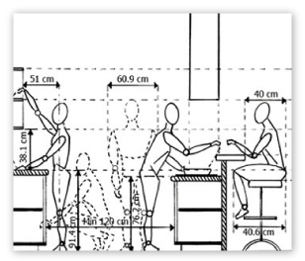
Can you answer these questions?
In the box below write the definition of anthropometrics. Give an example of a product where anthropometrics are used.
Anthropometrics and ergonomics page on www.technologystudent.com
Look at the image of the headset shown below.
Identify two key features where anthropometrics are used
in the design of the headset. One has been completed for
you.
1. The location of the microphone on the headset is in line
with the average adult’s mouth.
2. ………………………………………………………………..
3. ………………………………………………………………….
………………………………………………………………………
………………………………………………………………………
………………………………………………………………………
………………………………………………………………………………………………………………………………………………………………………………………………………………………………………………………………………….
Challenge!
Have a look at the layout of your kitchen at home. Look closely at
how anthropometric data is
used in the design of your
kitchen. How many examples
can you find?
Example
Look closely at the size
of handles, height of
work tops/hobs and oven.
-Are they in reach for
an adult?
-Do handles fit the size
of an average sized hand?

Slide 6
In the box below write the meaning of planned obsolescence is and give an example of a product where planned obsolescence may be used.
‘What is Planned Obsolescence’ page on www.technologystudent.com
Can you answer these questions?
Explain why some manufacturers use planned obsolescence
in the design of their products.
……………………………………………………………………………………………………………………………………………………………………………………………………………………………………………………………………………………………………………………………………………………………………………………………………………………………………………………………………………………………………………………………………………………………………………………………………………………………………………….
…………………………………………………………………………………………………………………………………………………………………………………………………………………………………………………………………………
………………………………………………………………………………………………………………………………………………………………
Challenge!
Explain why some people would argue that the use of
planned obsolescence in the design or products is not
considerate towards the environment.
Find some items around your
home that may slow down over
time due to planned obsolescence.
Have a look at any electrical
items and think about how long
they are likely to last for.
…………………………………………………………………………………………………………………………………………………………………………………………………………………………………………………………………………………………………………………………………………………………………………………………………………………………………………………………………………………………………………………………………………………………………………
Example
Mobile phones are deliberately built to
slow down after three or four years.
This makes the user buy a new mobile
phone and keeps mobile phone
manufacturers in business.

Slide 7

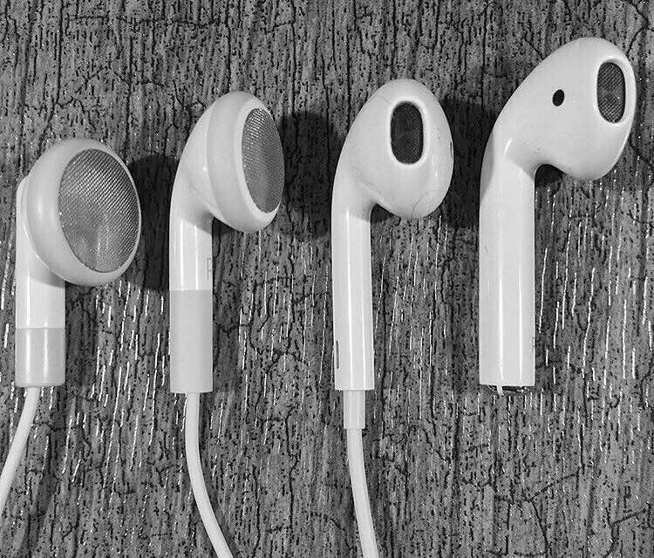
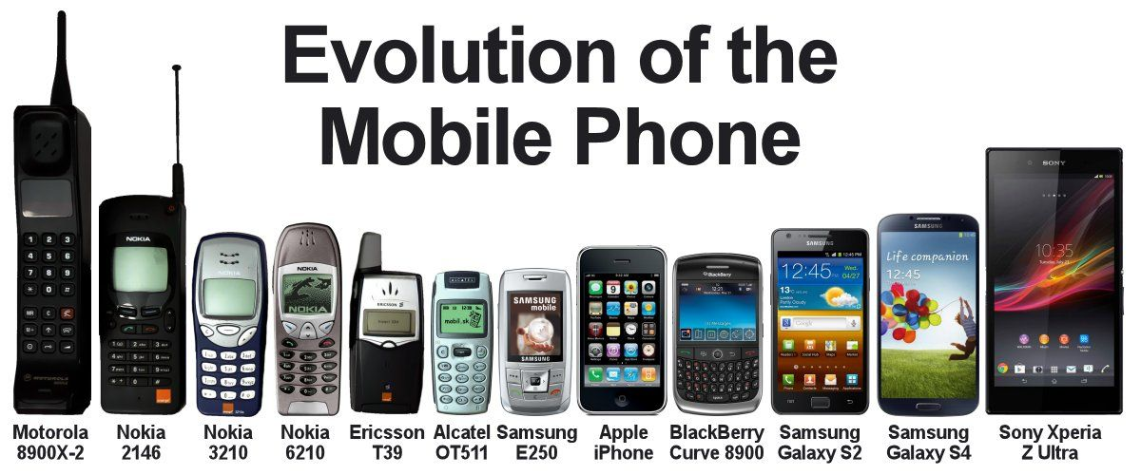
Can you answer these questions?
Look at the image below of Apple earphones.
Explain how technology push has changed the
design of Apple earphones. You must identify at
least two design features.
Identify one feature of the earphones that is
ergonomic.
In the box below write the meaning of technology push and give an example of a product that has developed over time due to changes in technology.
Find out on the ‘What is the Technology Push Model of Product Development’ page on www.technologystudent.com
…………………………………………………………………………………………………………………………………………………………………………………………………………………………………………………………………………
………………………………………………………………………………………………………………………………………………………………
………………………………………………………………………………………………………………………………………………………………………………………………………………………………
………………………………………………………

Slide 8

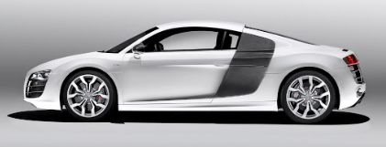
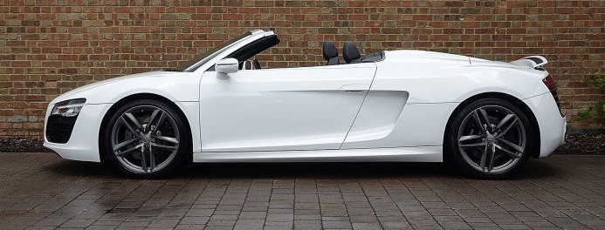
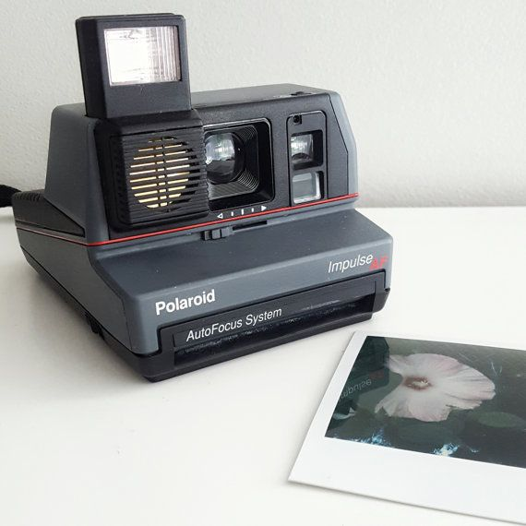
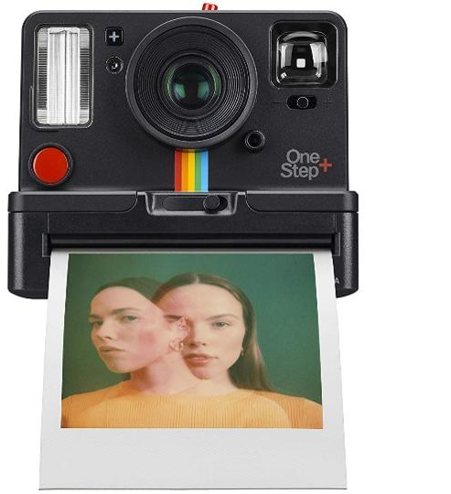
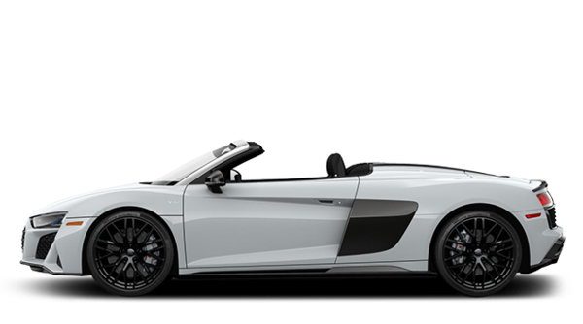
State two ways that manufacturers can collect feedback from
the public.
………………………………………………………………………………………………………………………………………………………………………………………………………………………………
In the box below write what ‘market pull’ means. Explain how market pull can change a design of a product.
Find out on the ‘What is Market Pull’ page on www.technologystudent.com
Design features come back when a large
amount of people request it!
………………………………………………………………………………………………………………………………………………………………………………………………………………………………………………………………………………………………………………………………………………………………………………………………………………………………………………………………………………………………………………
2010
2012
1980’s Polaroid camera
2020 Polaroid camera
2020

Slide 9

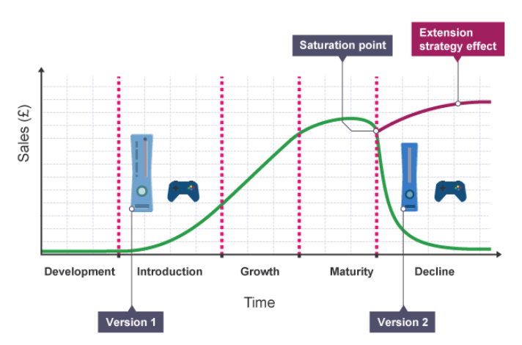
Can you answer these questions?
Use your theory booklets or use the internet to read about product life cycle.
Search "product life cycle" on
www.technologystudent.com
Look at the one relating to cars.
Look at the diagram on the left. It shows the amount
of sales and stages of the play station game life cycle.
a) Explain why more games are being sold in it’s
maturity stage.
b) Suggest one way how the sales can increase
during the introduction stage.
c) Suggest why sales of the game decline.
………………………………………………………………………………………………………………………………………………………………………………………………………………………………
………………………………………………………………………………………………………………………………………………………………………………………………………………………………
………………………………………………………………………………………………………………………………………………………………………………………………………………………………

Slide 10

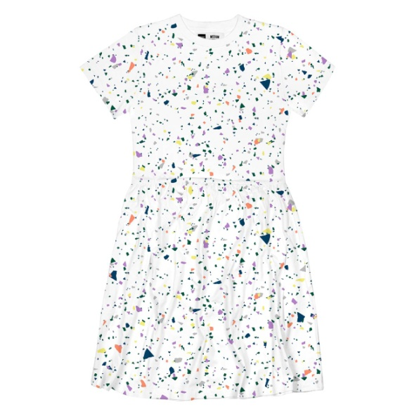
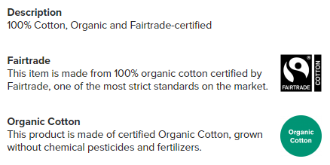

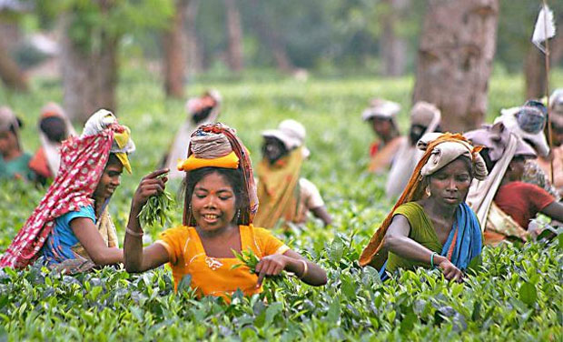
Can you answer these questions?
The image below shows a dress that is sold by a Fairtrade textile
company. Read the information that is provided on their website
about the dress.
Explain what information this gives to the customer about the
-Sourcing of raw materials
-Working conditions
-Consideration of wildlife
………………………………………………………………………
………………………………………………………………………
………………………………………………………………………
………………………………………………………………………
………………………………………………………………………
………………………………………………………………………
In the box below write the definition of Fairtrade and why Fairtrade is important.
Look up Fairtrade on the
‘Enterprise: Crowdfunding, Fairtrade and Co-operatives’ page on technologystudent.com
………………………………………………………………………………………………………………………………………………………………………………………………………………………………………………………………………….……………………………………………………………………………………………………………………………………………………………………………………………
…………….……………………………………………………………………………………………………………………………………………………………………………………………

Slide 11


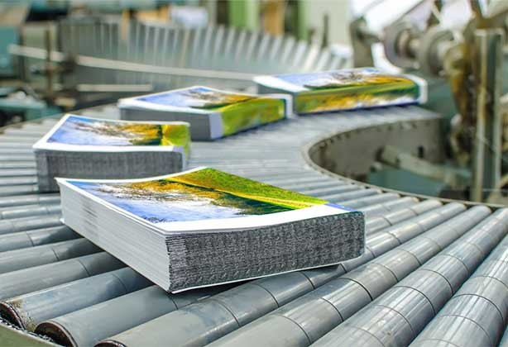


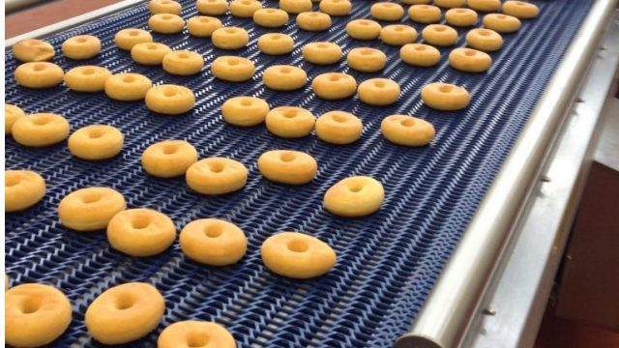

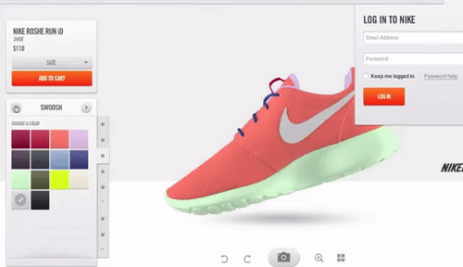
Use your theory booklets to read about different types of production methods. This includes, mass, batch, one off and continuous production. In each box write the definition of the production method.
Look on the ‘Scales of Production’ pages on technologystudent.com
……………………………………………………………………………………………………………………………………………………………………………………………………………………………………………………………………………………………………………………………………………..……………………………………………………………………………………………………………………………………………………………………………..
………………………………………………………………………………………………………………………………………………………………………………………………………………………………………………………………
………………………………………………………………………………………………………………………………………………………………………………………………

Slide 12


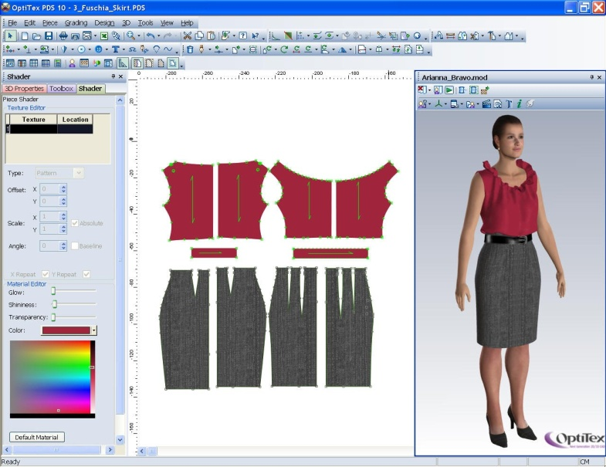
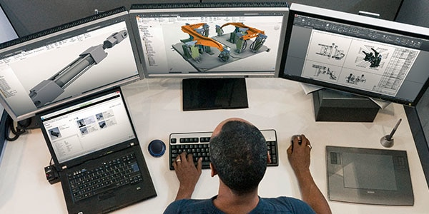
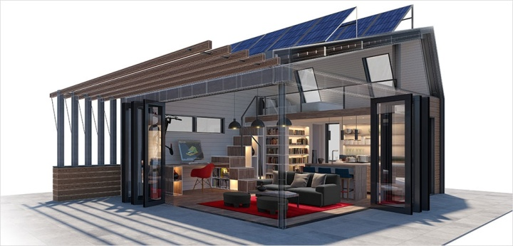
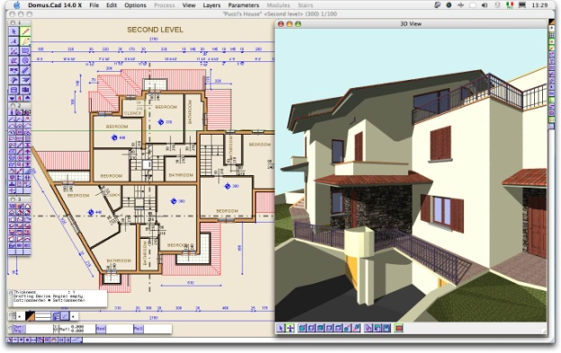
In the box below write the definition of computer aided design. Give an example of a product, industry or a game where computer aided design is used.
Look on the ‘Production Techniques and Systems’ and ‘CAD’ pages on technologystudent.com
………………………………………………………………………………………………………………………………………………………………………………………………………………………………………………………………………….
Give three advantages and three disadvantages of using
computer aided design,
…………………………………………………………………………………………………………………………………………………………………………………………………………………………………………………………………………………………………………………………………………………………………………………………………………………………………………………………………………………………………………………………………………………………………………………………………………………………………………………………………………………………………………………………………………………………………………………………

Slide 13


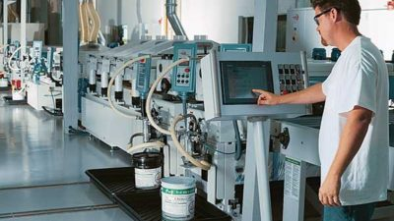
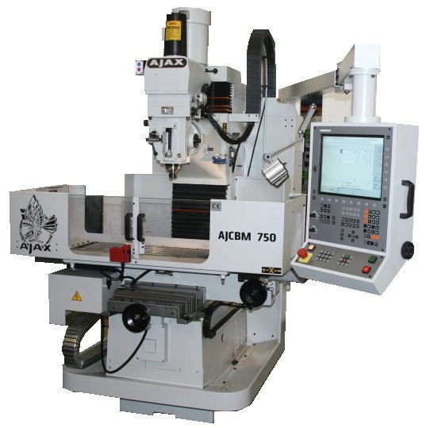
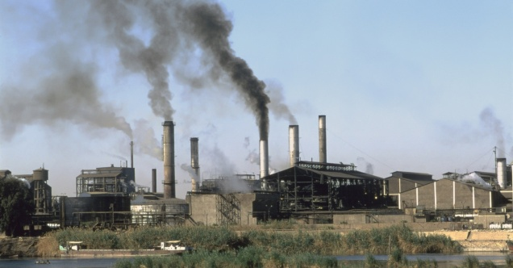
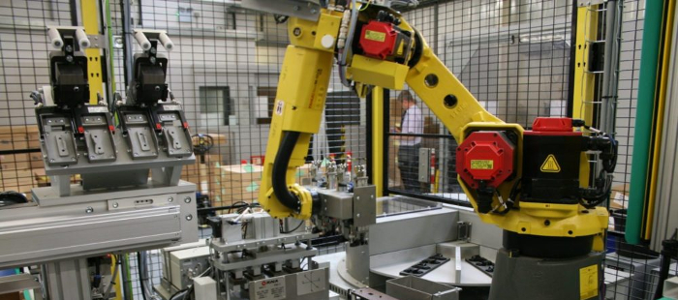
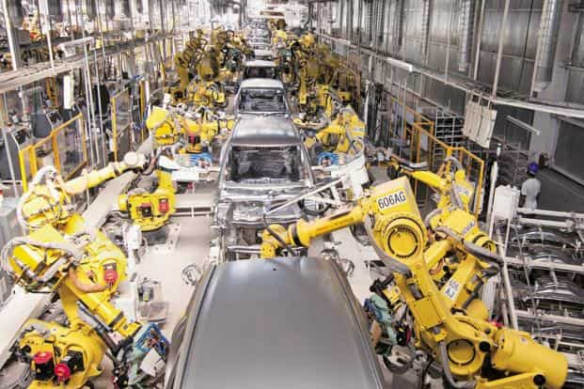
In the box below write the definition of computer aided manufacture. Explain how computer aided manufacture is different to computer aided design.
Look on the ‘Production Techniques and Systems’ and ‘CAM’ pages on technologystudent.com
………………………………………………………………………………………………………………………………………………………………………………………………………………………………………………………………………….
Give two advantages and two disadvantages of computer aided manufacture
Explain how computer aided design can cause
a negative impact on the environment.
……………………………………………………………………………………………………………………………………………………………………………………………………………………………………………………………………………………………………………………………………………………………………………………………………..
…………………………………………………………………………………………………………………………………………………………………………………………………………………………………………………………………………………………………………………………………………………………

Slide 14



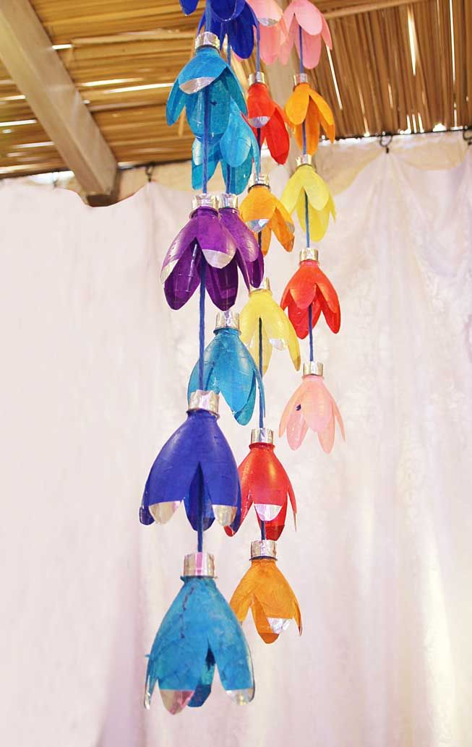
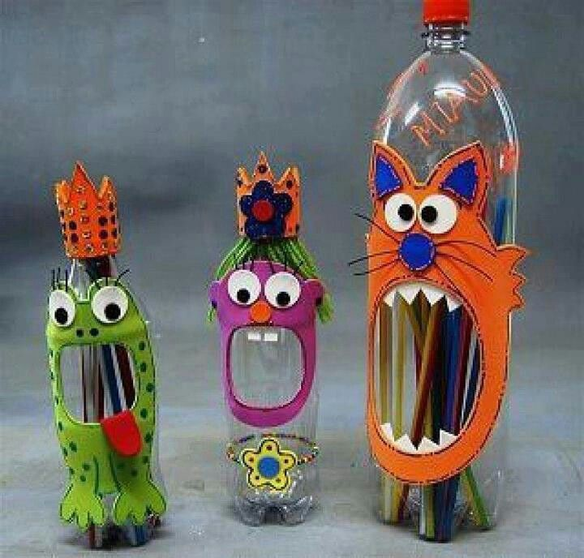
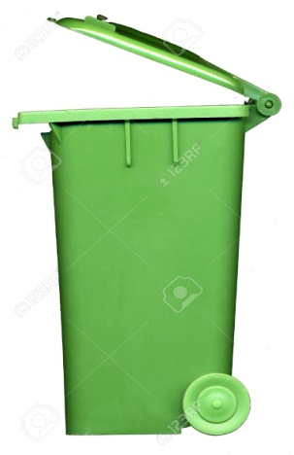


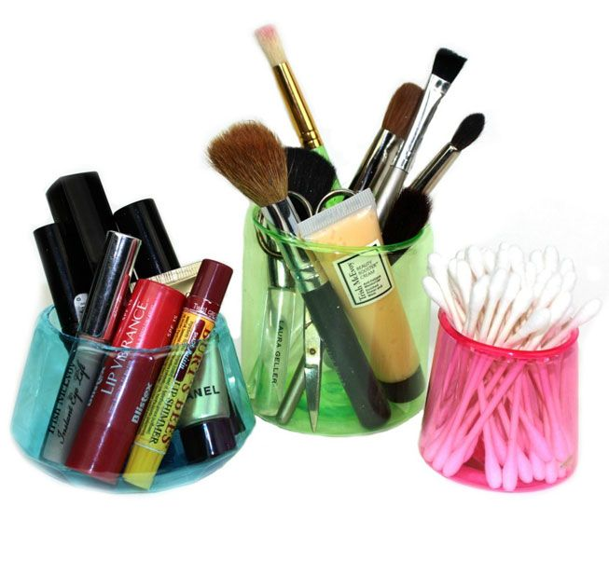
Challenge!
Product Sustainability
Manufacturers are rethinking about how they design products to make sure that they are more sustainable.
Adidas have manufactured a new range of ‘Parley’ trainers.
Use the internet and go onto the Adidas website to find what the Adidas Parley trainers are made from.
Challenge!
Use plastic bottles to create something new!
You could cut up bottles and create a hanging
display
Challenge!
Have a look at items you have in your house
That can be recycled. You may need to look
at packaging labels if you’re not sure.

Slide 15

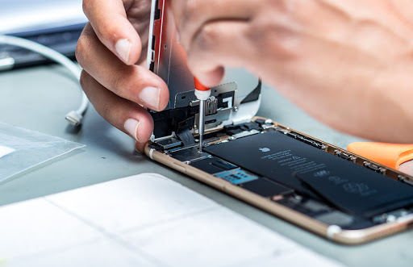

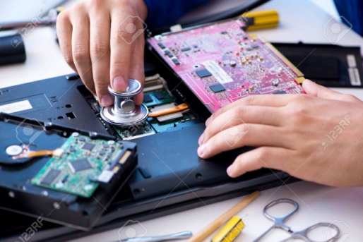
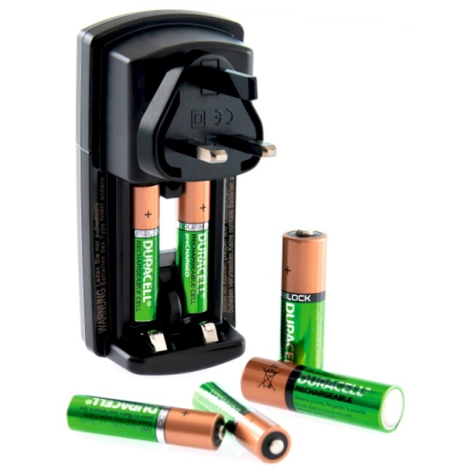







Product Sustainability
Challenge!
Challenge!
Manufacturers and designers are thinking of ways to make products more long –lasting and durable. One example of this is the use of bamboo eco coffee cups instead
of single-use polystyrene
cups. Another example
are rechargeable batteries so that people do not have to keey buying new batteries. Have a look at home and find any products that are designed to last a long time or can be used
many timesm
Look around your house and try and find as many products that could be repaired rather than buying brand new products. Many electrical product components can be repaired.
Challenge!
Manufacturers are
now refusing to
use certain
materials and
Instead using less packaging or more ecological materials.

Slide 16





Challenge!
Can you answer these questions?
Have a look around your home for
any scrap or old objects and
materials to make a robot
figure. Materials could include
wire, old coins, bottle tops.
old keys and cans. If you
need to use superglue ask someone
at home to show you how to use
it safely.
If you are stuck for an answer use the ‘Sustainability’ pages
on technologystudent.com to help you.
Many people use ‘bags for life’ for their shopping rather
than plastic carrier bags.
Explain why using bags for life are more sustainable than
plastic carrier bags.
…………………………………………………………………………………………………………………………………………………………………………………………………………………………………………………………………………………………………………………………………………………………
Some materials are biodegradable. Explain what
biodegradable means.
…………………………………………………………………………………………………………………………………………
……………………………………………………………………

Slide 17






Where does paper come from?
Look at the
‘How paper and card are manufactured’ page on technologystudent.com
Answer the questions on this page and use the images below to help you with your answers.
Look at the images to the left of how paper is
made in industry. Explain in detail how paper is made.
…………………………………………………………………………………………………………………………………………………………………………………………………………………………………………………………………………………………………………………………………………………………………………………………………………………………………………………………………………………………………………………………………………………………………………………………………………………………………………………………………………………………………
……………………………………………………………………………………………………………………………………………………………………………………………………………………………………………………………………………………………………………………………………………………………………………………………………………………………………………………………………………………………………………………………………………………………………………………………………………………………………

Slide 18





Challenge!
Use paper to create mini paper
animals, you can use scissors and
glue to do this. If you have coloured
paper or pencil crayons you can
make your animal look more
creative and interesting!
Can you answer these questions?
Look at the
‘How paper and card are manufactured’ page on technologystudent.com
State the name of the raw material that is used to make
paper from.
……………………………………………………………………
Explain how the manufacture of paper can contribute
to deforestation and biodiversity.
3) Look at the diagram below which shows the life cycle of paper. Label the diagram to explain the different stages indicated by the black arrows.
………………………………………………………………………………………………………………………………………………………………………………………………………………

Slide 19





Types of paper
Look at the
‘How paper and card are manufactured’ page on technologystudent.com
Match up the type of paper to it's correct use. One has been done for you.
Corrugated cardboard
Used for regular
printing
Transparent, used over the top of pictures to create a copy
Used for delivery
packaging
Copier paper
Tracing paper
Cartridge paper
Used for presenting and mounting photographs
Recycled paper
Mount board
Art sketchbook
Paper towels

Slide 20



Challenge!
Look around for any scrap pieces
of corrugated cardboard at home
and try building a small architectural
model. You can use other materials
that you might find lying around to add
more detail to your design, The more creative your model is, the better!
Look at the
‘How paper and card are manufactured’ page on technologystudent.com
Can you answer these questions?
The image below shows corrugated cardboard packaging for a take away pizza.
Give two reasons why corrugated cardboard is suitable material to use for pizza takeaway.
Give one disadvantage of corrugated cardboard.
……………………………………………………………………
…………………………………………………………………………………………………………………………………………
……………………………………………………………………

Slide 21




Paper and board finishes
Look at the
‘How paper and card are manufactured’ page on technologystudent.com
Embossing is a finishing technique
that is often used on business cards
or greetings cards which can
suggest quality.
Explain how embossing is carried out in industry on
paper or card.
……………………………………………………………………
……………………………………………………………………
……………………………………………………………………
……………………………………………………………………
UV glossing is a finishing technique that
is used on magazine covers.
Explain why UV glossing is used for
magazine covers.
………………………………………………………………………………………………………………………………………………
………………………………………………………………………………………………………………………………………………
2) Give two reasons why playing cards are varnished.
………………………………………………………………………………………………………………………………………………

Slide 22





Challenge!
Have a look at home for scrap pieces
of paper, card, magazines and create
a 3D greetings card. Layer up different
types of card and paper to create
an unusual and interesting design.
You could design a ‘Thank you’ card or
a ‘Celebrate’ card or for any other
occasion that you can think of.
Can you answer these questions?
Look at the image below of a greeting card with gold lettering.
State the finishing technique that has been used for the
gold lettering.
……………………………………………………………………
Give one advantage and one disadvantage for using this
finishing technique.
……………………………………………………………………
……………………………………………………………………
……………………………………………………………………

Slide 23



Challenge!
Work out:
1) How many A4 sheets of paper do
you need to make A3 size?
How many A3 sheets of paper do
you need for A2 size?
How many A5 sheets of paper
do you need to make A4 size?
Can you answer these questions?
Many work environments, schools and hospitals have posters displayed. Posters are often laminated, an example of a poster and a laminating machine is shown below.
Explain how laminating is carried out and give two advantages of laminating posters.
……………………………………………………………………
……………………………………………………………………
……………………………………………………………………
……………………………………………………………………

Slide 24



CAD and CAM in industry
Tessellation is used in mass or batch production. The
image below shows nets for packaging .
Give two reasons why tessellation is used in the production
process.
……………………………………………………………………
……………………………………………………………………
……………………………………………………………………
State the name of the computer aided manufacture machine shown below that can be used in industry to cut the packaging nets.
……………………………………………………………
3) Give two advantages of using an inkjet printer.
……………………………………………………………

Slide 25





Ergonomics and anthropometrics
Challenge!
Create a mask using anthropometric data.
You will need to measure the size of your
head so that your mask will fit and the size of your eyes and mouth depending on the
design of your mask. Design the mask how you wish and you could use coloured pens and card to decorate your mask.
The images below shows a prototype (mock up design)
for a new relaxation chair before it is manufactured.
Identify three features of
the prototype where
ergonomics has been
considered into the
design of the product.
………………………………………………………………………………………………………………………………………………………………………………………………………………………………………………………………………………………………………………………………………………………………………………………………

Slide 26


Look at the
‘How paper and card are manufactured’
page on technologystudent.com
Name the most suitable paper to use for
art sketchbooks
How many sheets of A4 paper do you need to make an A3 size?
Give two examples of products that can be
made from recycled paper.
Name the type of board which is mainly used for delivery packaging and explain why this board is suitable for delivery packaging.
Give one property of tracing paper.
Is paper renewable or non-renewable material?
Paper is measured in GSM, explain what GSM stands for.
Names and properties of different types of paper and
boards.
Paper and card finishing techniques
Use of microns to measure thickness of card &
standard paper sizes

Slide 27
Textiles

Slide 28








Where do fibres come from?
Natural fibres are made from a plant source or an animal source. Match up the correct pictures to the fibre. Look at the ‘Textiles’ chapter’ on technologystudent.com. One has been done for you.
Synthetic/man-made fibres are made from crude oil.
Explain why crude oil for fibres is not sustainable.
Silk
Jute
………………………………………………………………………………………………………………………………………………………………
…………………………………………………….
Wool
2) Synthetic fibres do not biodegrade easily. Explain
what this means..
Cotton
………………………………………………………………………………………………………………………………………………………………
…………………………………………………….
………………………………………………………………………………………………………………………………………………………………
Linen

Slide 29

Challenge!
Look in your wardrobe and see what c items of clothing you have that
are made from natural fibres. You
will find a label inside the clothing to tell you which materials have been used. Feel the material to understand it’s texture and elasticity.
Look at the names of each of the natural fibres, use the theory booklet and write the properties for each type of fibre, the source it is made from (plant or animal), in the pink box draw a picture of a product that the fibre is usually used for.
Look at the ‘Textiles’ chapter’ on technologystudent.com.
Example
JUTE
LINEN
COTTON
WOOL
SILK
Jute is very strong but feels very coarse. It is used for sustainable shopping bags or rope. It is made from a plant.
..............................................................................................................................................................................
..............................................................................................................................................................................
..............................................................................................................................................................................
..............................................................................................................................................................................

Slide 30




Challenge!
At home ask your family if anyone knows how
to knit, if someone does and you have some
wool and knitting needles ask them to show you
how to do it! There are lots of Youtube videos
That can help you too!
Can you answer these questions?
Look at the ‘Textiles’ chapter’ on technologystudent.com.
Explain why wool is a suitable fabric to use for winter
jumpers.
……………………………………………………………………
……………………………………………………………………
……………………………………………………………………
Challenge!
If you have wool at home try making a decorative
letter which could go on a wall in your bedroom
or on a bookshelf. Cut your letter out of cardboard
and start to wrap wool around it. If you have
different coloured wool you can mix and change colours.
Give one disadvantage of wool.
……………………………………………………………………
3) State the natural source that is used to make wool from.
……………………………………………………………………

Slide 31

Challenge!
Look in your wardrobe, and garage and see what items of clothing items you have tha are made from synthetic fibres. You will find a label inside the clothing to tell you which materials have been used. Feel the material to understand it’s texture and elasticity.
Look at the names of each of the synthetic fibres, Look at the ‘Textiles’ chapter’ on technologystudent.com. and write the properties for each type of fibre, the source it is made from (plant or animal), in the pink box draw a picture of a product that the fibre is usually used for.
ELASTANE
POLYPROPLYENE
ACRYLIC
POLYESTER
NYLON
Elastane has high elasticity and is always mixed with other fibres. It is used to produce fabrics for sportswear.
..............................................................................................................................................................................
..............................................................................................................................................................................
..............................................................................................................................................................................
..............................................................................................................................................................................

Slide 32

6) Plant fibres are often treated with chemical fertilisers. Explain the impact on the environment of using chemical fertilisers.
7) Explain why synthetic fibres or fabrics are non-renewable.
………………………………………………………………………………………………………………………………………………………………
…………………………………………………….
Can you answer these questions?
Look at the ‘Textiles’ chapter’ on technologystudent.com
Give one advantage of polyester.
Give one example of a product that is mainly made from
nylon.
Name the most suitable fabric for sports clothes.
Explain the difference between a natural and a synthetic fibre.
Natural fibres are biodegradable. Explain what biodegradable means.
……………………………………………………………………
………………………………………………………………………………………………………………………………………………………………
…………………………………………………….
……………………………………………………………………
8) Look at the symbol below which can be found on many types of products or packaging. State what the symbol means and it’s
importance.
……………………………………………………………………
……………………………………………………………………
……………………………………………………………………
………………………………………………………………………………………………………………………………………………………………
…………………………………………………….
……………………………………………………………………
……………………………………………………………………

Slide 33





Challenge!
Look at the ‘Textiles’ chapter’ on technologystudent.com
At home see if anyone in your family has embroidery thread or cotton. You will need an embroidery needle and some fabric to sew onto. Experiment with different types of stitches. You can use YouTube to find videos to help you.
Challenge!
At home ask someone
if there is a sewing
machine, ask a parent
guardian to show you
How to use a a sewing
machine safely.
Experiment and see
What patterns you can
do!
Challenge!
Have a look if you have any spare buttons lying around and have a go at sewing a button onto a piece of fabric. Ask someone at home to help show you how to do this.

Slide 34



Chemical finishes
The chart below shows different types of chemical finishes that can be applied to fabrics. Complete
the missing areas of the chart. Look at the ‘Textiles’ chapter’ on technologystudent.com to help you.
A shirt is an example of a
product that may have a
crease resistant finish
Name of chemical finish | Definition
 | a silicone-based spray can be used to prevent grease and dirt clinging to the fibres and is usually sprayed on after a product has been manufactured
flame resistance
water repellency | silicones (a tough synthetic material) are applied to a fabric’s surface to temporarily prevent water being absorbed by the fabric; PVC can coat the fabric to make it permanently water proof but doesn’t allow the skin to breathe
 | synthetic fibres can be treated with chemicals to help decrease their water absorption, making them waterproof and prevent the build-up of static that makes fabric cling to itself
shrink resistance
crease resistance
mercerising
Table cloths or rucksacks
are examples of products
that have a water resistant
finish
Some types of uniform or protective clothing are given a flame resistance finish

Slide 35





Mixed fibres and microfibres
Look at the ‘Textiles’ chapter’ on technologystudent.com to help you.
Fibres are sometimes mixed together in some items of
clothing.
Explain why fibres are mixed together on some textile
products.
Microfibers are used in cleaning cloths. The below images show what the fibres look like under a microscope.
Explain what microfibers are and why they are used in
cleaning cloths.
………………………………………………………………………………………………………………………………………………………………………………………………………………………………………………………………………………………………………………....
…………………………………………………………….
………………………………………………………………………………………………………………………………………………………………………………………………………………………………………………………………………………………………………………....
…………………………………………………………….

Slide 36





CAD and CAM in industry
Look at the ‘Textiles’ chapter’ on technologystudent.com to help you.
Explain how CAD is used in the textile industry. Give
two advantages and two disadvantages of using
CAD in the design and production of textile products.
Give two advantages of using a sewing machine to sew rather than sewing by hand.
………………………………………………………………………………………………………………………………………………………………
…………………………………………………….
…………………………………………….…………………………………………………………………………………………………………………………………………………………………………………………………………………
Give one advantage and one disadvantage of
using digital printing onto fabric/textile products.
Explain how a CNC embroidery machine is different to a standard sewing machine.
………………………………………………………………………………………………………………………………………………………………………………………………………………………………………………………………
………………………………………………………………………………………………………………………………………………………………
…………………………………………………….

Slide 37



Production methods
2) In the textile industry cell and line production is used.
Look at the ‘Scales of Production’ chapter’
on technologystudent.com to help you.
The diagram below indicates line production.
The diagram below indicates cell production.
Some textile products are made specifically
for the user. State the type of production method
that is used for customised products.
Explain the difference between line production and
cell production.
………………………………………………………………………………………………………………………………………………………………………………………………………………………………………………………………………………………………………………....
…………………………………………………………….
……………………………………………………
Give an example of a textile product that is
mass produced.
……………………………………………………

Slide 38



Ergonomics and Anthropometrics
Look at the ‘Ergonomics and Anthropometrics’ page on technologystudent.com to help you.
Challenge!
In the box below draw a design of a new textile product that can be used inside or outside of the home that is comfortable to use and designed with human measurements in mind (adult or children). This could be an item of clothing , a new home furnishing, for example cushions or a child’s toy. Examples are shown below of textile products where ergonomics and anthropometrics have been used in their design.
1) The image below shows a travel pillow that is used for long distance travelling on aeroplanes. Explain how ergonomics and anthropometrics have been used in the design of the travel pillow.
…………………………………………….…………………………………………………………………………………………………………………………………………………………………………………………………………………
…………………………………………….…………………………………………………………………………………………………………………………………………………………………………………………………………………

Slide 39
Use the technologystudent.com to read the following information
Name the most suitable fabric for sports clothes.
Give two properties of cotton.
Give one disadvantage of linen.
Explain why crude oil is a finite resource.
Are natural fibres renewable or non-renewable?
Give an example of a textile product that is manufactured through one-off production
State one use of nylon.
Types of synthetic and natural fibres including
their properties.
Chemical finishes that are applied to fabrics
Production methods

Slide 40
Plastics

Slide 41





Where do plastics come from?
Look at the ‘Polymers’ chapter’ on technologystudent.com to help you.
4) Scientists and manufactures are starting to manufacture bioplastics. Explain what bioplastics are and name a bioplastic that is used in 3d printers.
Most plastics are made from crude oil. State how
crude oil is extracted from the Earth’s crust.
………………………………………………………………………………………………………………………………………………………………………………………………………………………………
4) Plastics take many years to decompose and are not
biodegradable. Explain the impact of plastic waste on
biodiversity.
…………………………………………………….…
2) Crude oil is a finite resource. Explain what finite
means.
………………………………………………………………………………………………………………………………………………………………………………………
………………………………………………………………………………………………………………………………………………………………………………………………………………………………………………………………………………………………………………....
…………………………………………………………….
3) Explain what is meant by ‘single use plastic’.
………………………………………………………………………………………………………………………………………………………………………………………

Slide 42






Types of plastics
There are two main categories of plastics. Thermoplastics and Thermosetting plastics. Use technologystudent.com to match up a type of plastic and what it is used for. One has been done for you. In the box below write the definition s of thermosetting plastics and thermoplastics.
Acrylic (thermoplastic)
………………………………………………………………………………………………………………………………………………………………………………………………………………………………………………………………………………………………………………....
…………………………………………………………….
Epoxy Resin
(Thermosetting)
High density polythene
(thermoplastic)
Melamine formaldehyde
(Thermosetting)
Polyvinyl Chloride
(thermoplastic)
Urea formaldehyde
(Thermosetting)
Low density polythene
(thermoplastic)

Slide 43






CAD and CAM in industry
3) CNC machines are used to cut plastic. Give one advantage of using a CNC machine.
Look at the ‘CAM’ PAGES on technologystudent.com to help you.
Give one advantage and one disadvantage
of using a 3D printer to manufacture products.
…………………………………………………………………………………………………………………………………………………………………………………………………………………………………………………….
…………………………………………………………………………………………………………………………………………………………………………………………………………………………………………………….
The image below shows a laser cutter. Explain how a
laser cutter works.
2) The image below shows a vinyl cutter. Explain how
a vinyl cutter works and what it is used for.
……………………………………………………………………………………………………………………………………………………………………………………………………………………………………………………
………………………………………………………………………………………………………………………………………………………………………………

Slide 44


Production methods
Look at the ‘Scales of Production’ chapter’ on technologystudent.com and read about production methods. Complete the missing areas of the chart of advantages and disadvantages for each production method.
Scale of production | Advantages | Disadvantages
One-off
Batch |  | Downtime between batches
Mass | High volumes can be produced, materials can be bulk purchased at cheaper rates, low-skilled workforce required
Continuous |  | Expensive to set up due to specialised equipment, expensive machinery repairs
3d printers use additive manufacture. Laser cutters use subtractive manufacture. Explain the difference between additive and subtractive manufacture.
……………………………………………………………………………………………………………………………………………………………………………………………………………………………………………………………………………………………………………………………………………………………………………………………………………………

Slide 45


Ergonomics and Anthropometrics
Challenge!
Look at the ‘Ergonomics and Anthropometrics’ page
on technologystudent.com to help you.
In the box below redesign the comb to make it more ergonomic. For example, you could add a handle with a rubber grip to make it more comfortable or change the shape of it to make it more comfortable and easy to use.
The image below shows a bucket that has been designed with ergonomics and anthropometrics in mind. Explain how ergonomics and anthropometrics have been used in the design of the bucket.
……………………………………………………………………………………………………………………………………………………………………………………………………………………………………………………………………………………………………………………………………………………………………………………………………………………

Slide 46





Can you answer these questions?
Challenge!
Take some plastic bottles, carefully cut them with
scissors to shape them into an unusual design to
create planters for garden plants. You can
decorate your planters by painting them or gluing
buttons on to them. Be creative and have fun!
Look at the ‘Polymers’ and ‘Fairtrade’ pages
on technologystudent.com to help you.
1) Plastic identification codes are used on plastic products. Explain why plastic identification codes are used.
…………………………………………………………
………………………………………………………….
2) The symbol shown below is often found on plastic packaging. Explain what information this gives to the customer about the sourcing of produce.
………………………………………………………………………………………………………………………………………………………………………………………

Slide 47
Use technologystudent.com to read the following information
Explain the difference between a thermoplastic and a thermosetting plastic.
Give one use of low density polythene.
Explain what ‘single use’ plastic means.
Name the finite resource that is used to make most plastics.
Give one advantage and one disadvantage of using a 3d printer.
7) What are plastic identification codes?
Thermoplastic and thermosetting plastics
Use of CAD and CAM in the production of
plastic products
How plastics are made

Slide 48
Timber

Slide 49



Where does wood come from?
There are lots of different types of trees and woods but similar to plastics they are usually put into two categories. Hardwoods and softwoods. Look at the ‘Natural and Manufactured Timbers’ chapter on technologystudent.com to help you find out about what hardwoods and softwoods are and make notes in the boxes.
Hardwoods
What type of tree do hardwoods come from? Do these trees lose their leaves?
Do hardwoods grow in cool or warm climates?
Are hardwoods cheap or expensive to buy?
How long does it take for hardwood trees to grow
Softwoods
What type of tree do softwoods come from? Do these trees lose their leaves?
Do softwoods grow in cool or warm climates?
Are softwoods cheap or expensive to buy?
How long does it take for softwood trees to grow
……………………………………………………………………………………………………………………………………………………………………………………………………………………………………………………………………………………………………………………………………………………………………………………………………………………………………………………………………………………………………………………………………………………………………………………………………………………………………………...
……………………………………………………………………………………………………………………………………………………………………………………………………………………………………………………………………………………………………………………………………………………………………………………………………………………………………………………………………………………………………………………………………………………………………………………………………………………………………………...

Slide 50



Can you answer these questions?
2) Explain how deforestation can affect biodiversity.
Answer the following questions about sourcing wood. Look at the ‘Natural and Manufactured Timbers’ chapter on technologystudent.com to help you to help you or use the internet for research.
To make wooden products trees need to be cut down, this is called logging. If new trees are not planted this is called deforestation.
Explain what deforestation means.
……………………………………………………………………………………………………………………………………………………………………………………………………………………………………………………
Some wooden products will have the FSC symbol
(Forest Stewardship Council). Explain how the
Forest Stewardship Council helps forest
management.
……………………………………………………………………………………………………………………………………………………………………………………………………………………………………………………………………………………………………………………………………………………………………………………………………………………………………………………………………………………………………
……………………………………………………………………………………………………………………………………………………………………………………………………………………………………………………

Slide 51





Types of woods
Read about the different types of hardwoods and softwoods in your theory booklet or use technologystudent.com to help you, match up the name of the wood to the correct picture.
Green = hardwoods Blue = softwoods
Oak
Pine
Cedar
Mahogany
Beech

Slide 52



Manufactured boards
Cross section stability is used in plywood.
Explain what cross section stability is and why it is used in plywood.
Boards are separate to softwoods and hardwoods. They are used for many different things. Look at the ‘Natural and Manufactured Timbers’ chapter on technologystudent.com to help you and read how boards are made and what they can be used for.
Challenge!
At home try and find a piece of furniture
that is made from a type of board. You
may need to ask someone at home to
help you.
………………………………………………………………………………………………………………………………………………………………………………………………………………………………………………………………………………………………
3) The image below shows M.D.F board.
State what M.D.F stands for and give an
example of one use for this board.
………………………………………………………………………………………………………………………………………………
State the name of the board shown below and state what
the board is made from.
………………………………………………………………………………………………………………………………………………………………………………………………………………………………………………………………………………………………

Slide 53




Flat pack furniture
Chipboard and M.D.F board are usually used for flat pack furniture.
Explain what flat pack furniture is and give one advantage
and one disadvantage of flat pack furniture.
Look at the ‘Natural and Manufactured Timbers’ chapter on technologystudent.com to help you
Challenge!
At home try and find a piece of
assembled flat pack furniture.
This could be a bed, wardrobe,
Drawers. Ask someone at home to
help you if you’re not sure.
Veneers thin strips of wood that are glued onto board (usually chipboard).
Explain why veneers are used.
……………………………………………………………………………………………………………………………………………………………………………………………………………………
…………………………………………………………………………………………………………………………………………………………………………………………………………………………………………………………………………………………………………………………………………………………………………………………………
……………………………………………………………………………
……………………………………………………………………………
……………………………………………………………………………
……………………………………………………………………………

Slide 54


Wood finishes
Challenge!
Use technologystudent.com or the internet to read about different types of wood finishes. Answer all questions on this page.
Ask someone at home if there is any wood stains/varnishes/primer in the garden shed or garage and a scrap piece of wood that you could test the varnish or wood stains out on to make a sample..
Explain why varnish is a suitable finishing technique to use on outdoor wooden products.
3) A garden bench needs to be primed before painting.
State two ways in which a primer helps to prepare the
wood for painting.
………………………………………………………………………………………………………………………………………………………………………………………………………………………………………………………………
Give one advantage and one disadvantage of using
wood stains.
………………………………………………………………………………………………………………………………………………………………………………………………………………………………………………………………
………………………………………………………………………………………………………………………………………………………………………………………………………………………………………………………………

Slide 55



CAD and CAM in industry
Look at the ‘CAD’ and ‘CAM’ pages on
technologystudent.com to help you
Give two advantages of using a CNC machine rather than
a laser cutter in mass production of wooden products.
1) Give two advantages and two disadvantages
computer aided manufacture.
………………………………………………………………………………………………………………………………………………………………………………………………………………………………………………………………………………………………………………………………
……………………………………………………………………………………………………………………………………………………………………………………………………………………
State the name of the machinery shown
in the image below.
Give two advantages of using computer aided design
to design furniture.
……………………………………………………………………………………………………………………………………………………………………………………………………………………
…………………………………………………………………………………………………………

Slide 56


Production methods
1) Look at the two wooden products shown on the left
and the information that is provided for each product.
Answer the following:
Which production methods have been used for each
product (mass/batch/one-off)
Which product is cheaper to buy and why
Comment on the sourcing of timber used for the products
Use the ‘Scales of Production’ page on technologystudent.com to read about different types of production methods to help you answer the question on this page.
…………………………………………………………………………………………………………………………………………………………………………………………………………………………………………………………………………………………………………………………………………………………………………………………………………………………………………………………………………………………………………………………………………………………………………………………………………………………………………………………………………………………………………………………………………………………………………………………………………………………………………………………………………………………………………………………………………………………………………………………………………………………………………………………………………………………………………………………………………………………………………………………………………………………
Hardwood stool
Plywood flat pack chair
Hardwood
Hand crafted
Fair trade
FSC symbol displayed
Plywood with a veneer finish
Flat pack furniture
FSC symbol displayed

Slide 57


Ergonomics and Anthropometrics
Answer the questions below about how ergonomics and anthropometrics are considered in the design of the wooden products shown. Use the relevant pages on technologystudent.com
The image below shows a wooden kitchen toy set for
children to use. Identify three features of the kitchen set
where anthropometric data has been used.
1) The image below shows a foldable walking cane that
can be used by elderly people or people with disabilities.
Write about how ergonomics have been used in the
design of the walking cane. You must identify two
features.
………………………………………………………………………………………………………………………………………………………………………………………………………………………………………………………………………………………………………………………………………………………………………………………………………………
………………………………………………………………………………………………………………………………………………………………………………………………………………………………………………………………………………………………………………………………………………………………………………………………………………………………………………………………………………………………………………………………………………………………………………………………………………………………………………………………

Slide 58






Challenge!
If you have a garden have a look for
any sticks or twigs, collect them and
put together a mini sculpture made
from twigs and sticks. You can use
tape or string to attach twigs
together.

Slide 59
Use technologystudent.com to read the following information
State which board uses cross section stability.
Explain what flat pack furniture is.
Explain how the Forest Stewardship Council helps manage forests.
What does biodiversity mean?
Explain the difference between hardwoods
and softwoods.
Name two hardwoods and two softwoods.
10) What are veneers and why are they used?
Softwoods, hardwoods and boards
Deforestation and biodiversity
Wood finishes

Slide 60
Metals

Slide 61



Where do metals come from?
The image below shows miners/workers for a company called ‘Fairtrade Gold’. The company has strict requirements on
working conditions. The Fairtrade symbol is shown on their products and website. Use this information to write what this suggests about the following listed below…
-Sourcing of materials
-Working conditions for miners
-
Use your theory booklet or the internet to read about where metal comes from to help you answer the questions on this page.
Look at the ‘Metals’ chapter on technologystudent.com to help you
1) The image below shows an ore. Explain what an ore is.
………………………………………………………………………………………………………………………………………………………………………………………………
…………………………………………………………………………………………………………………………………………………………………………………………………………………………………………………………………………
2) Explain why iron ore is a finite resource.
………………………………………………………………………………………………………………………………………………………………………………………………
…………………………………………………………………………………………………………………………………………………………………………………………………………………………………………………………………………

Slide 62







Types of metals
Metals are usually put into one of two categories, ferrous and non-ferrous metals. Look at the ‘Metals’ chapter on technologystudent.com to help you research the properties of ferrous and non-ferrous metals.
………………………………………………………………………………
………………………………………………………………………………
Non- Ferrous metals
Aluminium is used for….
Silver is used for….
..............................................................................................................................................................................................................................................................................................................................................................................
Non-Ferrous metals
are NOT magnetic
because they do not contain iron.
………………………………………………………………………………
Copper is used for….
………………………………………………………………………………
Zinc is used for….
………………………………………………………………………………
………………………………………………………………………………
Tin foil is used for….

Slide 63






Types of metals
Metals are usually put into one of two categories, ferrous and non-ferrous metals. Look at the ‘metals’ chapter on technologystudent.com to help you or use the internet to research the properties of ferrous and non-ferrous metals.
Ferrous metals
………………………………………………………………………………
Cast iron is used
for….
………………………………………………………………………………
Stainless steel is used
for….
..............................................................................................................................................................................................................................................................................................................................................................................
………………………………………………………………………………
High speed steel is used
for….
Ferrous metals
are magnetic
because they
contain iron.
………………………………………………………………………………
Mild steel is used for….
………………………………………………………………………………
High carbon steel is used
for….

Slide 64


Alloys
An alloy is a mixture of more than one metal. Look at the ‘Metals’ chapter on technologystudent.com to help you to read what alloys are used for and use the internet to answer the following questions.
1) Explain why metals are sometimes mixed together to
make alloys.
………………………………………………………………………………………………………………………………………………………………………………………………………………………………………………………………………………………………………………………………
………………………………………………………………………………
….................................
…………………………
………………………………………………………………………………
….................................
…………………………
Brass is used for….
Bronze is used for….
2) Steel is an alloy. Complete the boxes below of the
elements that create steel.
Brass is a mixture of
Bronze is a mixture of
I…………….
C…………….
C…………….
C…………….
Z…………….
T…………….
Steel

Slide 65



Can you answer these questions?
4) Explain why stainless steel is used for cutlery.
Look at the ‘Metals’ chapter on technologystudent.com to help you
Explain why copper is used in electrical wires.
……………………………………………………………………………………………………………………………………………………………………………………………………………………
……………………………………………………………………………………………………………………………………………………………………………………………………………………
5) Explain why metals are used for radiators.
……………………………………………………………………………………………………………………………………………………………………………………………………………………
2) Explain what is a non-ferrous metal is.
3) List three magnetic metals.
……………………………………………………………………………………………………………………………………………………………………………………………………………………
………………………………………………………………………………………………………………………………………………………………

Slide 66





Metal finishes
Powder coating
Use technologystudent.com the chapter on ‘Finishes to Metals’ to read about metal finishes and why they are used.
Then answer these questions.
Dip coating
2) Explain what powder coating is and why it is used.
………………………………………………………………………………………………………………………………………………………………
Galvanising
3) Explain why zinc is used for galvanising.
…………………………………………………………………………………………………………………………………………………………………………
1) Explain what dip coating is and why it is used.
………………………………………………………………………………………………………………………………………………………………………………………………………………………………………………………………………………………………………………………………

Slide 67


CAD and CAM in industry
Use technologystudent.com to read about ‘CAD’ and ‘CAM’ production methods to help you answer these questions.
It is now possible to 3D print metal.
Give one advantage of using a 3d printer.
Give three advantages of using automation in continuous production.
…………………………………………………………………………………………………………
………………………………………………………………………………………………………………………………………………………………………………………………………………………………………………………………………………………………………………………………
. State the name of the machine that is shown
in the image below that is used to cut and
etch into metal.
……………………………………………………………………………………………………………………………………………………
Give two disadvantages of relying on the use of computer aided
design in industry.
……………………………………………………………………………………………………………………………………………………………………………………………………………………

Slide 68


Production methods
2) Look at the diagram below. Explain the differences between additive and subtractive manufacture.
Use your theory booklet or the internet to read about different types of production methods to help you answer the question on this page.
1) Hundreds of thousands of metal fixtures and
fittings are being manufactured globally.
State which production method is being used
for this.
……………………………………………………………………………………………………………………………………………………………………………………………………………………
Explain why additive manufacture is less wasteful than subtractive manufacture.
………………………………………………
……………………………………………………………………………………………………………………………………………………………………………………………………………………

Slide 69

Ergonomics and Anthropometrics
Look at the ‘Ergonomics and Anthropometrics’ pages on technologystudent.com to help you
The image below shows a foldable metal zimmer frame which can be used be elderly people or people with disabilities to support them to walk. Label key features where ergonomics and anthropometric data has been used in the design of the zimmer frame. One example has been done for you.
Ergonomics
Foldable and adjustable
settings so the zimmer
frame can be stored away
easily and can fit inside
vehicles.

Slide 70





Challenge!
At home have a look for any tin cans that you can use to make tea light holders or pencil pots. Please make sure if you are cutting into the tin can that someone at home helps you with this as it can be dangerous and you can cut yourself. Paint your can to decorate it or wrap string around it to make it look creative.

Slide 71
Use technologystudent.com to read the following information
Explain the difference between a ferrous
metals and non-ferrous metals.
Are ferrous metals magnetic?
What is an ore?
What is an alloy?
What alloy does copper and tin make?
Explain why zinc is used for galvanising.
What does a CNC machine do?
Ferrous and non-ferrous metals
Alloys
Metal finishes

