Slide 1
Music
BLB
Solo Playing
OCR GCSE
Name:_________________
Class:___________

Slide 2
KO
Music and Me – GCSE Playing (SOLO) 02 Non-exam Assessment
The performance should normally be a commercially available piece and a copy of the score or lead sheet should be supplied.
Where a written score or lead sheet is unavailable (because it doesn’t exit) other means of referencing the performance intentions can be permitted. However, where a written score or lead sheet is available, it should still be used.
Alternative material will only be accepted where a written score or lead sheet is unavailable because it does not exist and the only other types of evidence permissible are:
The chord pattern used
The note pattern/raga used
A recording of the piece by the original commercial performer
A recording by a commercial artist in the style of the learner’s performance.
It must last more than two minutes
Practice: Practice makes progress. Practice almost every day and in small chunks, then big chunks and finally, all the way through. Use a metronome at times and practice wise.

Slide 3
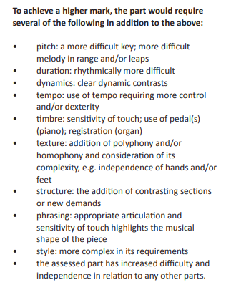
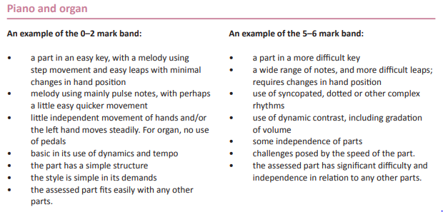
KO (cont’d)

Slide 4
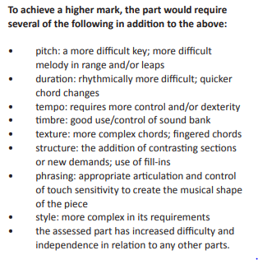
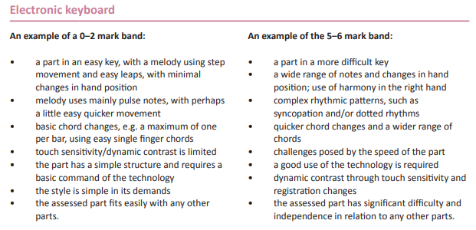
KO (cont’d)

Slide 5
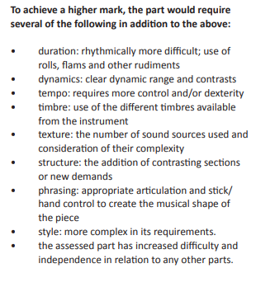
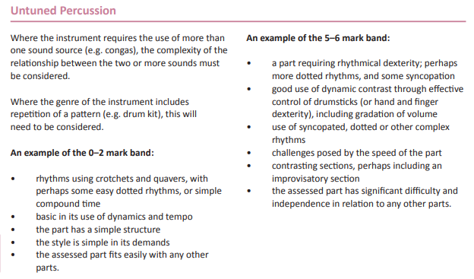
KO (cont’d)

Slide 6
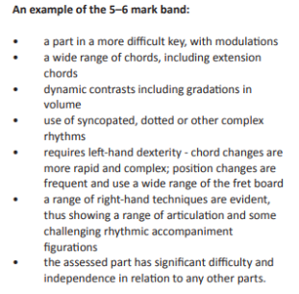
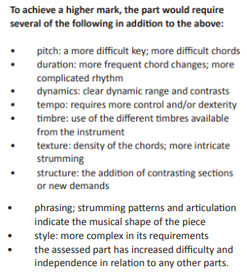
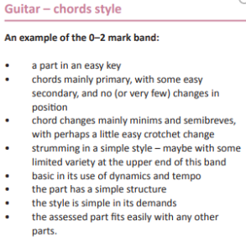
KO (cont’d)

Slide 7
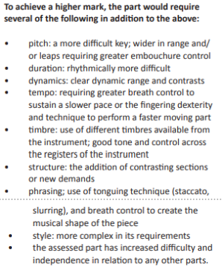
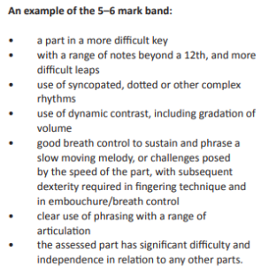
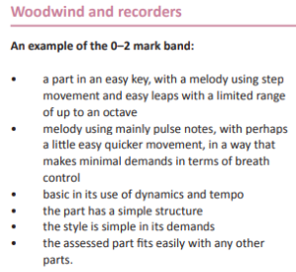
KO (cont’d)

Slide 8
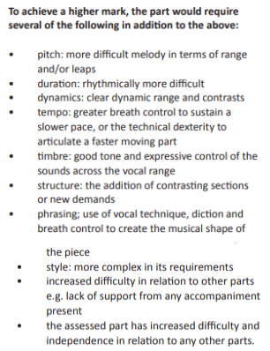
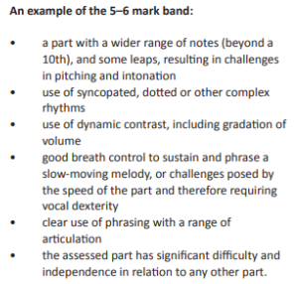
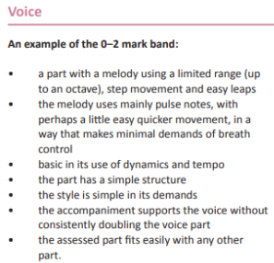
KO (cont’d)

Slide 9
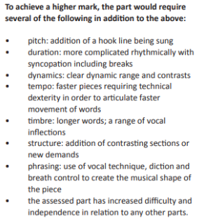
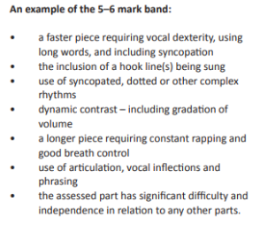
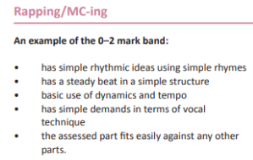
KO (cont’d)

Slide 10
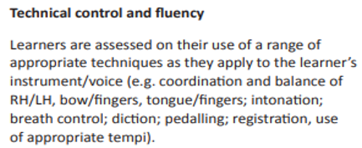
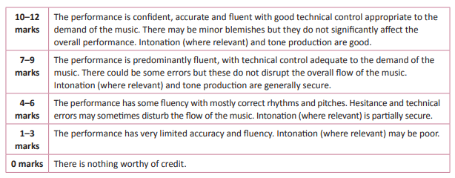
SAL: Playing
Technical Control and Fluency Mark: Solo: out of 12

Slide 11
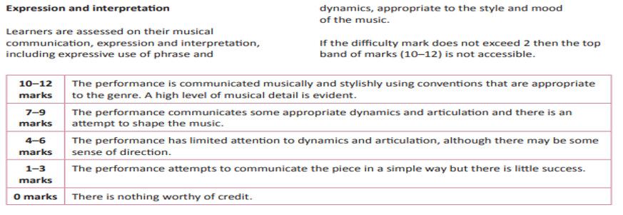
SAL: Playing (cont’d)
Expression and Interpretation Mark: Solo: out of 12

Slide 12
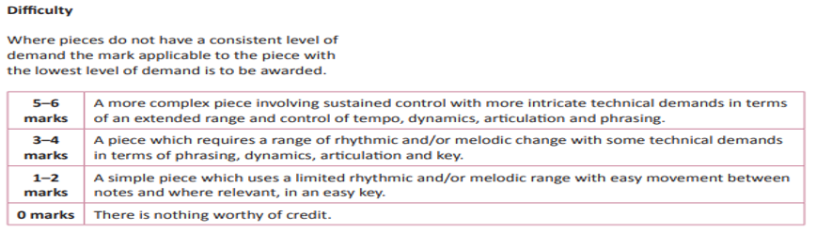
SAL: Playing (cont’d)
Difficulty Mark: Solo: Out of 6

Slide 13

SAL: Playing (cont’d)
TOTAL SOLO: /30 Double this to obtain a GRAND TOTAL: /30 = Grade: _______
Duration of Solo: Total duration: (Must be > 1’ 30’’)
Name: ___________________________________ Instrument:_________________________
Solo Piece Played:___________________________________ by Composer:_______________________
Accompanied by (None/ other learner / member of staff / other person / backing track/Self)
Comment:_________________________________________________________________________
Solo playing is out of 30 which makes up 30% of the overall mark.
If you double your playing grade, you will see what grade you are on, approximately.

Slide 14
Suggestions for Pieces to Play
Student | Solo Piece
Beginner Piano | The Beatles – Hey Jude Radiohead – Karma Police
Beginner Piano | The Beatles Lady Madonna The Kinks Waterloo Sunset
Beginner Piano | Mancini, arr. Ward Pink Panther Take That Rule the World
Intermediate Piano | Beethoven- Bagatelle in C Benda -Sonatina in A minor
Advanced Piano | ABBA Super Trouper Mancini, arr. Ward Pink Panther
Advanced Piano | W. F. Bach - Allegro in A J.S Bach -. Aria: 4th movt, Partita No. 4 in D
Intermediate Voice/Piano | Adele Set fire to the rain B.o.B. Airplanes
Beginner Guitar | Radiohead – Creep Razorlight – Golden Touch
Intermediate Guitar | Paolo Nutini – Jenny Don’t Foo Fighters – The Pretender
Advanced Guitar | Stevie Ray Vaughn – Scuttle Buttin’ Steve Vai – For the Love Of God
Beginner Bass | The Wombats -Moving To New York Muse – Time is Running Out
Intermediate Bass | Troup, Simon- Alka Seltzer Muse Time is running out
Advanced Bass | The Wombats -Moving To New York Troup, Simon- Alka Seltzer
Intermediate Native American Flute | Yuma Lullaby Kayowajineh
Beginner Drums | Kings Of Leon – Sex On Fire R.E.M – Man On The Moon
Beginner Drums | Green Day Minority Kings of Leon Sex on fire
Advanced Drums | Elbow The Bones of You Ellis, arr. Tween The Chicken
Intermediate Saxophone | Harvey, Paul Caprice Anglaise Harvey, Paul Christopher's Calypso

Slide 15
Week 1 Title: Choosing your piece Date:________
Li: to find a piece that is a appropriate for your level of playing
CONNECT:
Decide on the piece you would like to play by listening to some examples and trying out some of the suggestions. Discuss with your teachers to see what they think, too.
ACTIVATE:
Listen to a few versions of the piece you are considering
Find the piece on line in notation form, or perhaps as a Youtube tutorial
Watch the whole piece to gain an overall impression and check the difficultly level. Ensure it is not going to be too hard or too easy.
DEMONSTRATE:
Practice your piece as well as a couple of others. Play for at least 10 minutes every day.
CONSOLIDATE:
Play the examples for someone in your family to see what they think

Slide 16
The Piece I have Chosen is: ______________
The artist or composer is__________________________
It is longer than 1 and 1/2 minutes Yes or No
I found this piece (where?)________________________
The url is___________________________________

Slide 17
Week One: Practice Journal
Day | Minutes practiced | What was practiced
Monday
Tuesday
Wednesday
Thursday
Friday
Saturday
Sunday

Slide 18
Week 2 Title: Pitch Date:________
LI: to improved pitch in the piece practiced
CONNECT:
Listen to the piece, considering the notes and the pitches used, if relevant
ACTIVATE:
Decide which notes are most difficult to achieve and why
DEMONSTRATE:
Play the hotspots where the notes are hard and repeat those areas eight times, slowly
CONSOLIDATE:
Play the whole hotspot faster and decide if you have improved

Slide 19
Hotspot practice:
Hotspot bar numbers | Times practiced | Did it improve? Yes or No?

Slide 20
Week 3 Title: Sonority
LI: What instrument are you playing and how are you playing it?
CONNECT:
Look through the piece you are playing
ACTIVATE:
Which instrument are you playing?
What special effects or special ways are you playing it?
(could be with a pedal, pizzicato, strumming, staccato, (spikey) legato (smooth, whispered etc)
DEMONSTRATE:
Play or sing your piece through, paying special attention to the above sonorities.
Practice these particular parts and write down the vocabulary pertaining to them:
________________________________
CONSOLIDATE:
Write down 6 words describing the effects/sounds you are using.
_______________________________________________________________________________

Slide 21
Week 4 Title: Structure Date:___________
LI: to understand the structure of the piece played
CONNECT:
Consider the following vocabulary:
Binary, Ternary, Sonata Form, Rondo, Verse-chorus, Verse repeating (strophic)
ACTIVATE:
Play through your piece (or listen to it if you can’t yet)
Decide what the structure is
DEMONSTRATE:
Write the structure of your piece here:
CONSOLIDATE:
Play your piece or listen to it from start to finish, labelling each part as you go

Slide 22
The Structure of the Piece Played:
Suggestions:
Introduction
Verse (or theme 1)
Chorus (Or theme 2)
Verse
Chorus
Instrumental
Chorus
Chorus
Outro
Other?

Slide 23
Week 5 Title: Tempo Date:______
LI: to establish the tempo of the piece played
CONNECT: Tempo is how fast or slow a piece is played
ACTIVATE: Look at the marking at the start of the piece to see what the tempo should be. Or: use an online metronome to measure how many beats per minute in your piece.
Also, look at how many beats there are in a bar. Pop music usually has four beats in a bar
DEMONSTRATE:
Play your piece with the online metronome. Work out if you are up to speed yet. If not, keep practicing every day until you are.
CONSOLIDATE:
Play your piece for a family member or a friend, to see if you can keep a steady beat. If it is too fast, slow down the tempo and try the whole piece at that speed.

Slide 24
Tempo (speed) and time signature
Day this week | Tempo (beats per minute) of my playing
Monday
Tuesday
Wednesday
Thursday
Friday
Saturday
Sunday
 | There are: four or three or two beats in every bar in my piece

Slide 25
Week 6 Title: Recording and Expression Date_____
LI: to record your playing and play expressively
CONNECT: Listen to a recording or other version of your piece
ACTIVATE: Think about how you want to play your piece differently or in a similar fashion. Consider how you will phrase/shape your piece and what message you want to get across to the listener.
DEMONSTRATE:
Use a smart phone to record yourself. Listen back to decide what you like and what needs more work. Decide whether you are playing expressively enough and whether you are getting your message across to the listener.
CONSOLIDATE:
Decide whether you want to keep the recording or re-record.
Write here what needs more work before you will be satisfied with your playing. Remember, you get points for accuracy and points for expression.
_________________________________________________________

Slide 26
Week 7 Title: Final Recording Date:_____
LI: to make a recording of the piece chosen that is as good as possible and is over 1 and ½ minutes long
CONNECT: Think about how you will play the piece
ACTIVATE: Set up the phone to record yourself
DEMONSTRATE:
Announce your name, the date, your piece, the composer/artist and your instrument
Play the piece for more than 1 and 1/2 minutes.
It is best if you can video your hands playing so that the teacher can see what you are doing as well as hear
CONSOLIDATE:
Listen back to the recording and decide if you think it is as good as possible.
Once you are satisfied, send it to the teacher as they have requested.
Complete the next page.

Slide 27
My Solo Piece:
Name:____________________________
Date:___________
Piece:_____________________________
Composer/Artist:____________________________
Instrument played:__________________________

