Slide 1
Ethics and Values
Year 10 Blended Booklet – Autumn 2

Slide 2
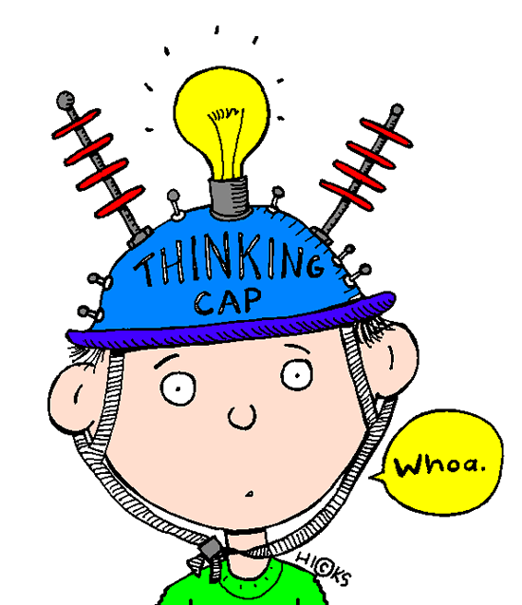

Ethics and Values – Year 10
Lesson 4: Eating Disorders
Learning intent: To be able to describe what eating disorders are and the different types and explain how eating disorders damage the body
Connection phase Lets recall the self-esteem lesson 1. How does having positive self esteem benefit your life? 2. What causes/contributes to low self esteem? 3. How can we help to raise a person’s self esteem? 4. Can having very positive self esteem ever be a bad thing? | Activation phase I can describe what eating disorders are and the different types I can explain how eating disorders damage the body I can evaluate whether placing tighter controls on the fashion industry would reduce the number of people suffering from eating disorders in the UK What would you do?
https://www.youtube.com/watch?v=WGvDoFrfMeQ

Slide 3
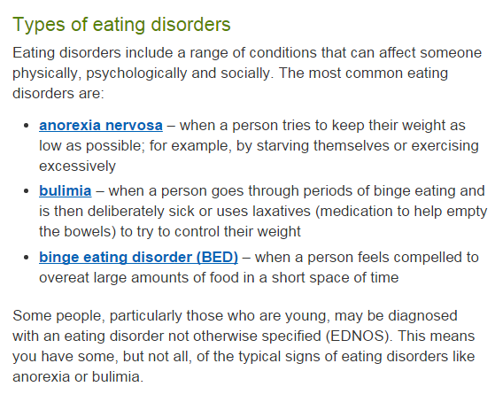
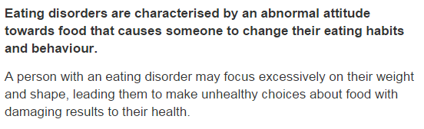
New Information
https://www.youtube.com/watch?v=dXBFwKQJJb8

Slide 4
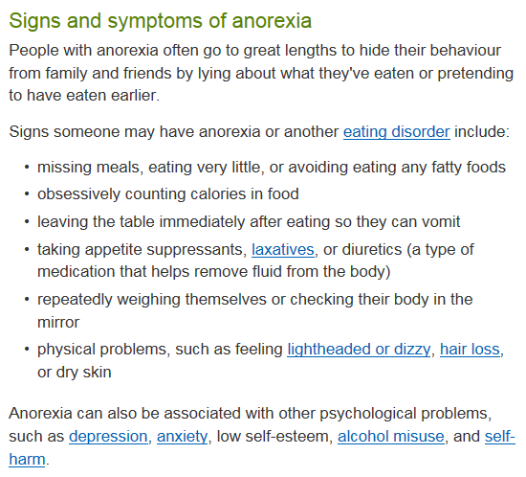
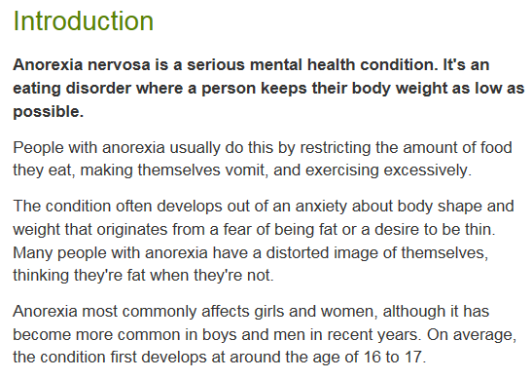
New Information

Slide 5
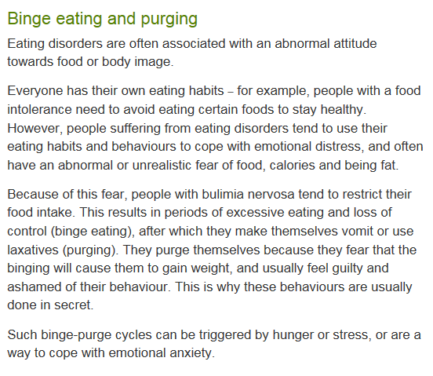
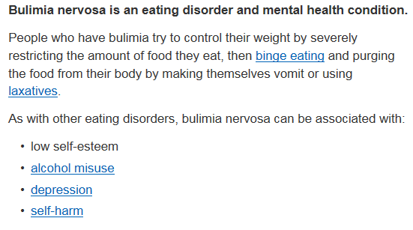
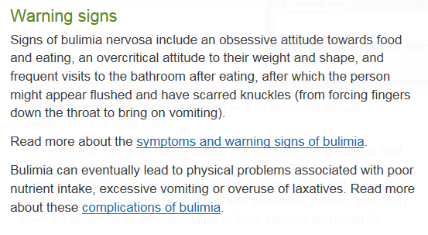
New Information

Slide 6
Demonstration Phase Do you think banning super thin models and airbrushed images (like France has) would reduce the number of people suffering from eating disorders in the UK? Answer this question showing your excellent understanding of eating disorders. You could include your knowledge on: The different types of eating disorders (not all people suffering from them are super skinny) Who they affect The very serious health problems caused by eating disorders The cause of eating disorders Use sophisticated sentence starters (e.g. Furthermore,… Moreover,… In addition,… However,…) | Consolidation phase You have 2 minutes to write as many keywords and pointers that have been covered in this lesson Design three questions, these can be true or false, or multiple choice questions to cover facts in todays lesson
Watch the video and decide if this is a good idea
https://www.youtube.com/watch?v=qO0t5lqJRSQ

Slide 7
Ethics and Values – Year 10
Lesson 5: Stigma
Learning intent: To learn how to challenge mental health stigma
Connection phase What would you do? https://www.youtube.com/watch?v=BB_LqWFTq9Q | Activation phase L/O I can describe what is meant by mental health and can give examples of mental health conditions I can describe what is meant by stigma and understand how this affects people suffering from mental health conditions I can explain how I can help people close to me who have mental health problems
https://www.youtube.com/watch?v=VQoiz4wfV_c

Slide 8
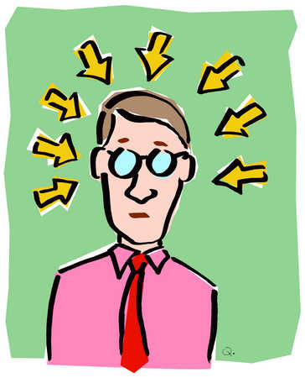
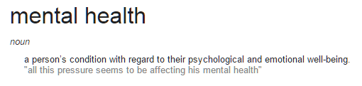

New Information
We all have times when we feel down or stressed or frightened. Most of the time those feelings pass. But sometimes they develop into a more serious problem and that could happen to any one of us.
Everyone is different. You may bounce back from a setback while someone else may feel weighed down by it for a long time.
Your mental health doesn’t always stay the same. It can change as circumstances change and as you move through different stages of your life.
Being mentally healthy doesn’t just mean that you don’t have a mental health problem.
If you’re in good mental health, you can:
make the most of your potential
cope with life
play a full part in your family, school, community and among friends.
Some people call mental health ‘emotional health’ or ‘well-being’ and it’s just as important as good physical health.
What is meant by mental health?

Slide 9
New Information
We all have times when we feel down or stressed or frightened. Most of the time those feelings pass. But sometimes they develop into a more serious problem and that could happen to any one of us.
Everyone is different. You may bounce back from a setback while someone else may feel weighed down by it for a long time.
Your mental health doesn’t always stay the same. It can change as circumstances change and as you move through different stages of your life.
How do mental Heath problems affect young people?
850,000 children aged 5-16 have mental health problems
Three children in every classroom have a diagnosable mental health disorder.
Nearly 80,000 children and young people suffer from severe depression.
Half of all lifetime cases of mental illness begin by age 14.
45% of children in care have a mental health disorder - these are some of the most vulnerable people in our society.
Nearly 300,000 young people in Britain have an anxiety disorder.
95% of imprisoned young offenders have a mental health disorder. Many of them are struggling with more than one disorder.

Slide 10
New Information
The top tips for helping friends or family cope with their mental problems are:
Encourage them to seek help from their doctor
Encourage them to talk about their feelings rather than bottling them up
Be sympathetic and affectionate, spend time with them
If they live alone send them messages to let them know you are thinking about them
Be patient with them; they might be irritable or behave in a way that may upset you.

Slide 11
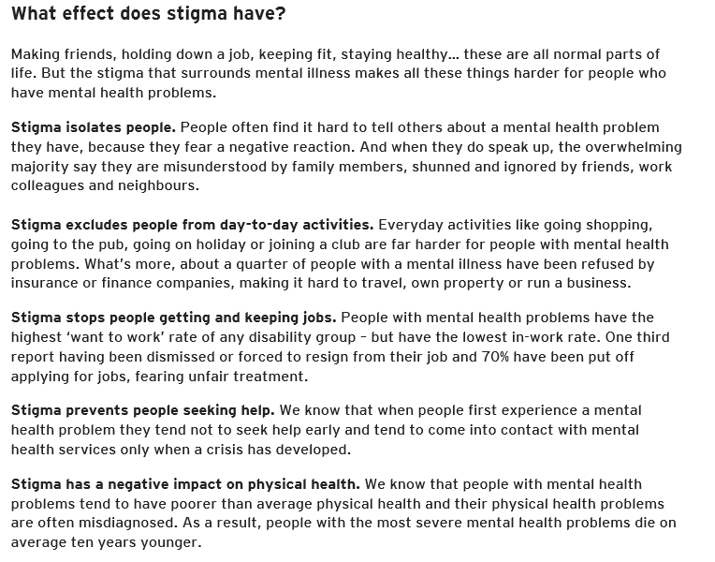

Slide 12
Demonstration Phase
A Time to Change survey found that nine out of ten people with mental health problems (87%) reported the negative impact of stigma and discrimination on their lives.
Stigma - a mark of disgrace associated with a particular circumstance, quality, or person
Main Activity
Task 1: How you can help people close to you who have mental health problems.
Choose three of these tips and explain why each of them is important. Why will it help your friend or family member?
The top tips for helping friends or family cope with their mental problems are:
Encourage them to seek help from their doctor
Encourage them to talk about their feelings rather than bottling them up
Be sympathetic and affectionate, spend time with them
If they live alone send them messages to let them know you are thinking about them
Be patient with them; they might be irritable or behave in a way that may upset you.
Task 2: Discuss how stigma of mental health affects people suffering from mental health problems:
It isolates people
It stops people getting and keeping jobs
It stops people seeking help
It has a negative impact on physical health
Design a poster to help give advice to people.
we know that people with mental health problems tend to have poorer than average physical health and their physical health problems are often misdiagnosed. As a result, people with the most severe mental health problems die on average ten years younger.
https://www.youtube.com/watch?v=hdPZ7rw0wMc

Slide 13

Demonstration phase ____ children aged 5-16 have mental health problems ____ children in every classroom have a diagnosable mental health disorder. Nearly ____ children and young people suffer from severe depression. Half of all lifetime cases of mental illness begin by age ___ ___ of children in care have a mental health disorder - these are some of the most vulnerable people in our society. Nearly ______ young people in Britain have an anxiety disorder. ___ of imprisoned young offenders have a mental health disorder. Many of them are struggling with more than one disorder | Mind.org.uk have compiled some excellent resources on how you can look after your own mental health and how to help people you know who may be struggling at the moment. These can be found on the Citizenship Frog pages. Their top tips for helping friends or family cope with their mental problems are: Encourage them to seek help from their doctor Encourage them to talk about their feelings rather than bottling them up Be sympathetic and affectionate, spend time with them If they live alone send them messages to let them know you are thinking about them Be patient with them; they might be irritable or behave in a way that may upset you
https://www.youtube.com/watch?v=hdPZ7rw0wMc
Explain how you can help people close to you who have mental health problems. Choose three of these tips and explain why each of them is important. Why will it help your friend or family member?

Slide 14

Consolidation phase Check your answers 850,000 children aged 5-16 have mental health problems Three children in every classroom have a diagnosable mental health disorder. Nearly 80,000 children and young people suffer from severe depression. Half of all lifetime cases of mental illness begin by age 14 45% of children in care have a mental health disorder - these are some of the most vulnerable people in our society. Nearly 300,000 young people in Britain have an anxiety disorder. 95% of imprisoned young offenders have a mental health disorder. Many of them are struggling with more than one disorder
Can I describe what is meant by mental health and can give examples of mental health conditions?
Can I describe what is meant by stigma and do I understand how this affects people suffering from mental health conditions?
Can I explain how I can help people close to me who have mental health problems?
Check it

