Slide 1
Ethics and Values
Year 9 Blended Booklet – Autumn 1 and 2

Slide 2
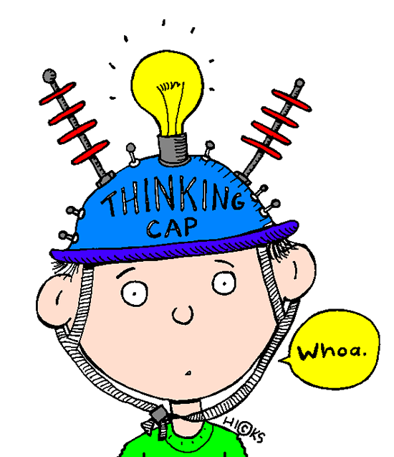

Ethics and Values – Year 9
Lesson 2: Taking Risks
Learning intent: To be able to describe the nature of positive and negative risk and identify physical and emotional risks
Connection phase Peer Pressure is when you make decisions without worrying what people think. TRUE/FALSE Peer Pressure can be positive or negative. TRUE/FALSE It is impossible to deal with peer pressure. TRUE/FALSE You have the power to deal with peer pressure. TRUE/FALSE Circle the correct answers and we will check them later | Activation phase I can identify situations where the potential gain is worth the risk and situations where it is not, and explain how to make this judgement; I can describe the nature of positive and negative risk and identify physical and emotional risks; I can explain the difference between the terms risky, dangerous and challenging; What do you think about this statement? “Taking stupid risks is part of growing up. It’s the only way that young people can really learn to be mature”
https://www.youtube.com/watch?v=BUIRWbBdfMY

Slide 3
Risk Scenario 1
I don’ know what’s up with my brother at the moment, he’s just turned 14 and he will do anything his friends dare him to do. It’s like his brain is broken. I’m worried he’ll do something stupid. What’s up with him?
Demonstration Phase
Main Activity
Risk Scenario 2
My sister drives me to school everyday and she drives so fast. I feel like I’m risking my life just getting in the car with her. She sometimes goes on her phone as well while driving. I don’t want to offend her by refusing a lift though – what should I do?
“Taking stupid risks is part of growing up. It’s the only way that young people can really learn to be mature”
Answer the question above using the sentence starters below:
I think that taking stupid risks is/isn’t part of growing up
I think this because…
Another example is…
In conclusion, young people do/do not need to take stupid risks because…
Now use a counter argument, when you address the opposite point of view and say why it is wrong.
Someone who disagrees with me would say…
They might believe this because…
Now choose a scenario from the list and discuss with your table how you would deal with the situation and reduce the risk to themselves and others. Be ready to share your ideas.
Risk Scenario 3
My friends have arranged a competition to see who can down a bottle of vodka in one go at my party. I’m not going to do this – I know it’s a stupid game but how do I convince them of that?
Risk Scenario 4
My older brother and his shady friend seem to have a lot of money at the moment. What might they be doing, what risks might they be taking and what are the consequences?

Slide 4
New Information
Demonstration Phase
Some risks can be good – Can you think of any?
Trying new things can be daunting.
The unfamiliar makes us nervous in a way that’s hard to describe. The act of leaving our comfort zone puts us in a vulnerable position and leaves us with an onslaught of questions running through our heads.
We ask ourselves: “Should I be doing this? Can I do this? Will I look stupid? What am I doing!?” While it may not feel like it, this is normal—and it’s good.
Trying new things not only helps us to vanquish those fears, but it also allows us to expand our minds and learn—both about said new thing, and about ourselves.
Think about the different experiences below and how you could reduce the risks:
Going on holiday
Going to a festival or concert
Getting home
Write a list of ways you could reduce the risk in one of the above scenarios
Now check the advice given for your chosen scenario and add
anything extra, in blue pen, using the next section

Slide 5
Going on Holiday
Research the destination and hotel you are travelling to before you book
Inform family and friends of where you are travelling to and your itinerary
Do not openly display your cash or carry all your cards with you at once
Contact the local police station and obtain a statement if your passport or valuables are stolen
Contact your bank and tell them you are going away before you travel
Pack any daily medication you may need to take and other medical supplies
Make sure you have travel insurance
Going to a festival or concert
Research and pick the festival wisely
Go with at least one other person and stick together
Plan what equipment and money you think you will need
Be prepared for sun AND rain
When at the festival locate the medical assistance area
Stay hydrated
Stick to well-lit, busy areas, especially at night
Never leave your drink unattended
Try and keep your cash and cards on you, even at night
If you are a victim of crime, contact on site police or festival security immediately
Consider carrying a personal safety alarm
Leave your valuables at home if possible
If you see an individual or group becoming ‘over-boisterous’ or aggressive, move away
Agree where your group will meet at certain times of the day
Getting home
Make sure someone always knows where you are going and when you will be back
Go out in a group or at least with one other person
Don’t travel with people that you don’t know well or trust
Avoid isolated areas at night
If you are walking at night, stay alert to your surroundings
Take your phone so you can make a call home if needed
Carry extra money for a taxi in case you get stuck for a ride
If you are taking the bus, sitting near the driver
Never get into a car where the driver has been drinking or doing drugs

Slide 6
Consolidation Phase
Assessment for Learning
Plenary
Write down the key things that you will take away with you from this lesson.

Slide 7
Ethics and Values – Year 9
Lesson 4: Gangs
Learning intent: To learn about the identification of gangs and the risks in belonging to a gang; and the legal and physical risks of carrying a knife.
Connection phase Have you taken any risks since last lesson? Good or bad What was the outcome of these risks? | Activation phase I can identify what makes a group of friends different from a gang; I can explain the manipulation techniques used by gangs to gain new members and why some young people may want to join a gang; I can describe the risks involved in joining a gang and explain the social, legal and physical consequences of being a member of a gang; Jay, 15 feels pretty grown up to be working for Terry who is part of the K10 Krew. He’s pretty quick on his bike and doesn’t mind making deliveries. The money’s good at the end of a job – not to mention the respect he gets for doing it. Jay is worried now though, as he’s been mugged on his delivery – and they’ve taken everything What is Jay doing? Who are the K10 Krew? What is likely to happen to Jay 1) In the short term from being mugged on delivery 2) in the long term joining the gang? Explain who might have mugged Jay and why.
https://www.youtube.com/watch?v=zaR_gwUo5qc

Slide 8
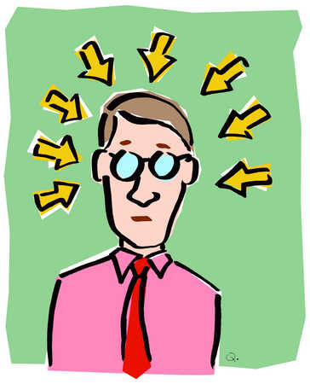
New Information
The K10 Krew themselves arranged for Cameron to be mugged. Why?
Well, then they could say he was in debt to them, to the value of the drugs he was carrying. This debt happens to be £9,500.
From now on, Cameron won’t be paid, he will be working off a debt. This will make it even more difficult to escape the gang, so therefore the K10 Krew have trapped Cameron, who is now their lackey and will have to take on yet more risky and dangerous tasks.
The next plan is to send Cameron into the country, where he will stay to establish the gangs drugs network, away from this family and on call 24/7.
It may seem like Cameron is a bit daft. When we are sitting here objectively, looking at the facts, it seems like it is obvious Cameron is being exploited. However, a person doesn’t just go from never speaking to gang members to being a drugs runner for them. There are subtle steps taken in-between to prepare a person to accept the role the gang wants them to take. This is called grooming.
Discuss how the gang could have won Cameron’s trust The gang would have flattered Cameron by telling him he had a lot of potential and a life of wealth, cars and respect ahead of him in the K10 Krew.
County Lines is a term used by law enforcement agencies for urban gangs supplying drugs to suburban areas and market and coastal towns using dedicated mobile phones or 'deal lines'. Urban gangs exploit children, youths and vulnerable adults to transport drugs and money, and to deal drugs on their behalf. Gangs often establish a base in the market location, typically by taking over the homes of local vulnerable adults by force or coercion in a practise known as "cuckooing".
County Lines crosses various crime types, including drugs, violence, gangs, criminal and sexual exploitation, modern slavery and missing people.

Slide 9
New Information
Who is vulnerable to county lines exploitation?
- Children as young as 12 being exploited by gangs to courier drugs out of their local area (15 - 16 years is the most common age)
- Both boys and girls can be exploited
- Often gangs use social media to target children and young people
- Class A drug dealers are often targeted so that gangs can take of their homes (cuckooing)
How to spot possible victims
- Changes in behaviour
- Appears to have a number of mobile phones
- Unexplained bus or train tickets
- Truancy from school or going missing from home
- Unexplained gifts such as clothes, trainers and cash
- Signs of assault and malnutrition

Slide 10
New Information
Gangs can be identified by: -
Their Name, Tag or tattoo
Clothes
Badge
Initiation ceremony to gang
Beliefs
Race
Gender
Religion
Interests
Music
Age Group
Walk
Hat
Judgemental ideals
Stereotypes
Prejudices
Gangs offer people: -
A sense of belonging
Adrenaline to break the law
Own Politics/Rules
Sense of ownership
An Identity
Social deviation from society/school/home
Affirmation that to break rules/Law is ok
Safety in numbers
Somewhere to hang out
Ownership of an area
Friends
Similarities

Slide 11
New Information
The downsides to being in a gang are: -
Drug Taking
Enemies
Other gang rivalry
Bullying
Peer Pressure to conform or not
Initiation ceremonies
Politics
Leaving the gang is disloyal/not accepted
Having money for clothes of certain brands etc
Crime expectations
Change own identity to fit in and be accepted
Be labelled & judged by others
I would choose not to be in a gang because: -
Fights with other gangs
Initiation Ceremonies
Proving loyalty to gang could hurt me and or others
Bully others
Drug Taking
Law breaking activities
Lose own sense of identity
Confidence in my own abilities, my qualities & myself as an individual person
Vandalism
Turf Wars

Slide 12
Demonstration Phase How is a gang identified? What do gangs offer people? What are the downsides of being in a gang? Why would you choose not to be in a gang? You are a Youth Crime Advice Counsellor. You run a support page for teenagers who live in areas dominated by gangs. You have a lot of messages to get through today from people who want help. Choose a message to respond to with advice: | Consolidation phase “We should legalise drugs like heroin and cocaine. That way, we wouldn’t have problems like County Lines and all the other issues caused by the illegal drugs trade” Sentence starters that you may use: I mostly/completely agree/ disagree with the statement One reason why I do/don’t agree is… Therefore, I believe that…
Debate it
Message 1: My little bro can suddenly afford the new iPhone – on a paperboy wage. Does he think we’re stupid? Who do I contact about this?
Message 2: My friend Ky keeps two mobile phones on him and whenever one rings he dashes out the door, like, he won’t speak on it in front of us. Then a lot of the time he’s gone up the road on his bike without a word… what’s going on?
Message 3: My sister has been missing for a week. I know she’s in a gang. We’re out of our minds with worry. The police have tracked the GPS on her phone to some rural village – they found her but she say’s she doesn’t want to come home. What is going on?

Slide 13
Ethics and Values – Year 9
Lesson 5: Self-esteem
Learning intent: To recognise the link between healthy self-esteem and healthy body image
Connection phase What are the definitions for both keywords? | Activation phase L/O I can understand how mental health can affect someone I can suggest tips for helping someone cope with mental health problems I can explain self-esteem, and someone can build their self-esteem
Adolescence
Puberty
https://www.youtube.com/watch?v=DxIDKZHW3-E
Don’t be afraid to talk about Mental Health

Slide 14
New Information
We all have times when we feel down or stressed or frightened. Most of the time those feelings pass. But sometimes they develop into a more serious problem and that could happen to any one of us.
Everyone is different. You may bounce back from a setback while someone else may feel weighed down by it for a long time.
Your mental health doesn’t always stay the same. It can change as circumstances change and as you move through different stages of your life.
How do mental Heath problems affect young people?
850,000 children aged 5-16 have mental health problems
Three children in every classroom have a diagnosable mental health disorder.
Nearly 80,000 children and young people suffer from severe depression.
Half of all lifetime cases of mental illness begin by age 14.
45% of children in care have a mental health disorder - these are some of the most vulnerable people in our society.
Nearly 300,000 young people in Britain have an anxiety disorder.
95% of imprisoned young offenders have a mental health disorder. Many of them are struggling with more than one disorder.

Slide 15
New Information
The top tips for helping friends or family cope with their mental problems are:
Encourage them to seek help from their doctor
Encourage them to talk about their feelings rather than bottling them up
Be sympathetic and affectionate, spend time with them
If they live alone send them messages to let them know you are thinking about them
Be patient with them; they might be irritable or behave in a way that may upset you.

Slide 16
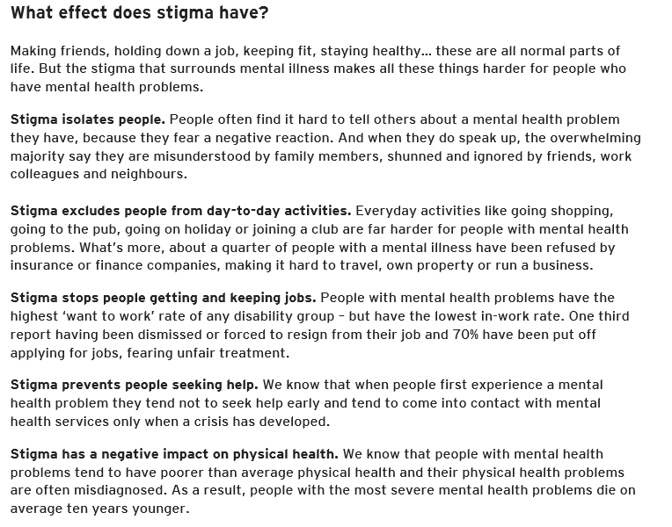

Slide 17
Demonstration Phase
A Time to Change survey found that nine out of ten people with mental health problems (87%) reported the negative impact of stigma and discrimination on their lives.
Stigma - a mark of disgrace associated with a particular circumstance, quality, or person
Main Activity
Task 1: How you can help people close to you who have mental health problems.
Choose three of these tips and explain why each of them is important. Why will it help your friend or family member?
The top tips for helping friends or family cope with their mental problems are:
Encourage them to seek help from their doctor
Encourage them to talk about their feelings rather than bottling them up
Be sympathetic and affectionate, spend time with them
If they live alone send them messages to let them know you are thinking about them
Be patient with them; they might be irritable or behave in a way that may upset you.
Task 2: Discuss how stigma of mental health affects people suffering from mental health problems:
It isolates people
It stops people getting and keeping jobs
It stops people seeking help
It has a negative impact on physical health
We know that people with mental health problems tend to have poorer than average physical health and their physical health problems are often misdiagnosed. As a result, people with the most severe mental health problems die on average ten years younger.
https://www.youtube.com/watch?v=hdPZ7rw0wMc

Slide 18

Demonstration phase Think about these questions – how relatable are they to you? I don’t answer questions in class even when I have the right answer When others praise me, it’s hard for me to believe what they say When I’m honest about what I really think, I’m embarrassed later I worry about how I look I don’t think I’m as good as other people I know I’d rather not do something than risk doing it wrong Consider the following questions: What affects our self-esteem? How can it be raised? How can it be lowered? | Consolidation phase Take risks. Push yourself, it’s not the end of the world if you fail Stand up for yourself. People may target you as they recognise you have low self esteem Be able to cope with criticism. View it as constructive rather than an attack on you Be realistic with your aims. You won’t ever be perfect and trying to be will make you miss all the things you did well at along the way Think positively. Focus on what you are good at and what you enjoy
Prepare a 30 second news report on the topic today. You can create this either to be presented on TV or on the radio. Remember – feel free to make it dramatic
Report it

