Slide 1

Make your own ideas come to life!
z
Stewards Academy
DESIGN & TECHNOLOGY
YEAR 9 CURRICULUM BOOKLET
z
“Imagine it, Design it, Make it”
Name: Technology Group: Tutor Group:

Slide 2
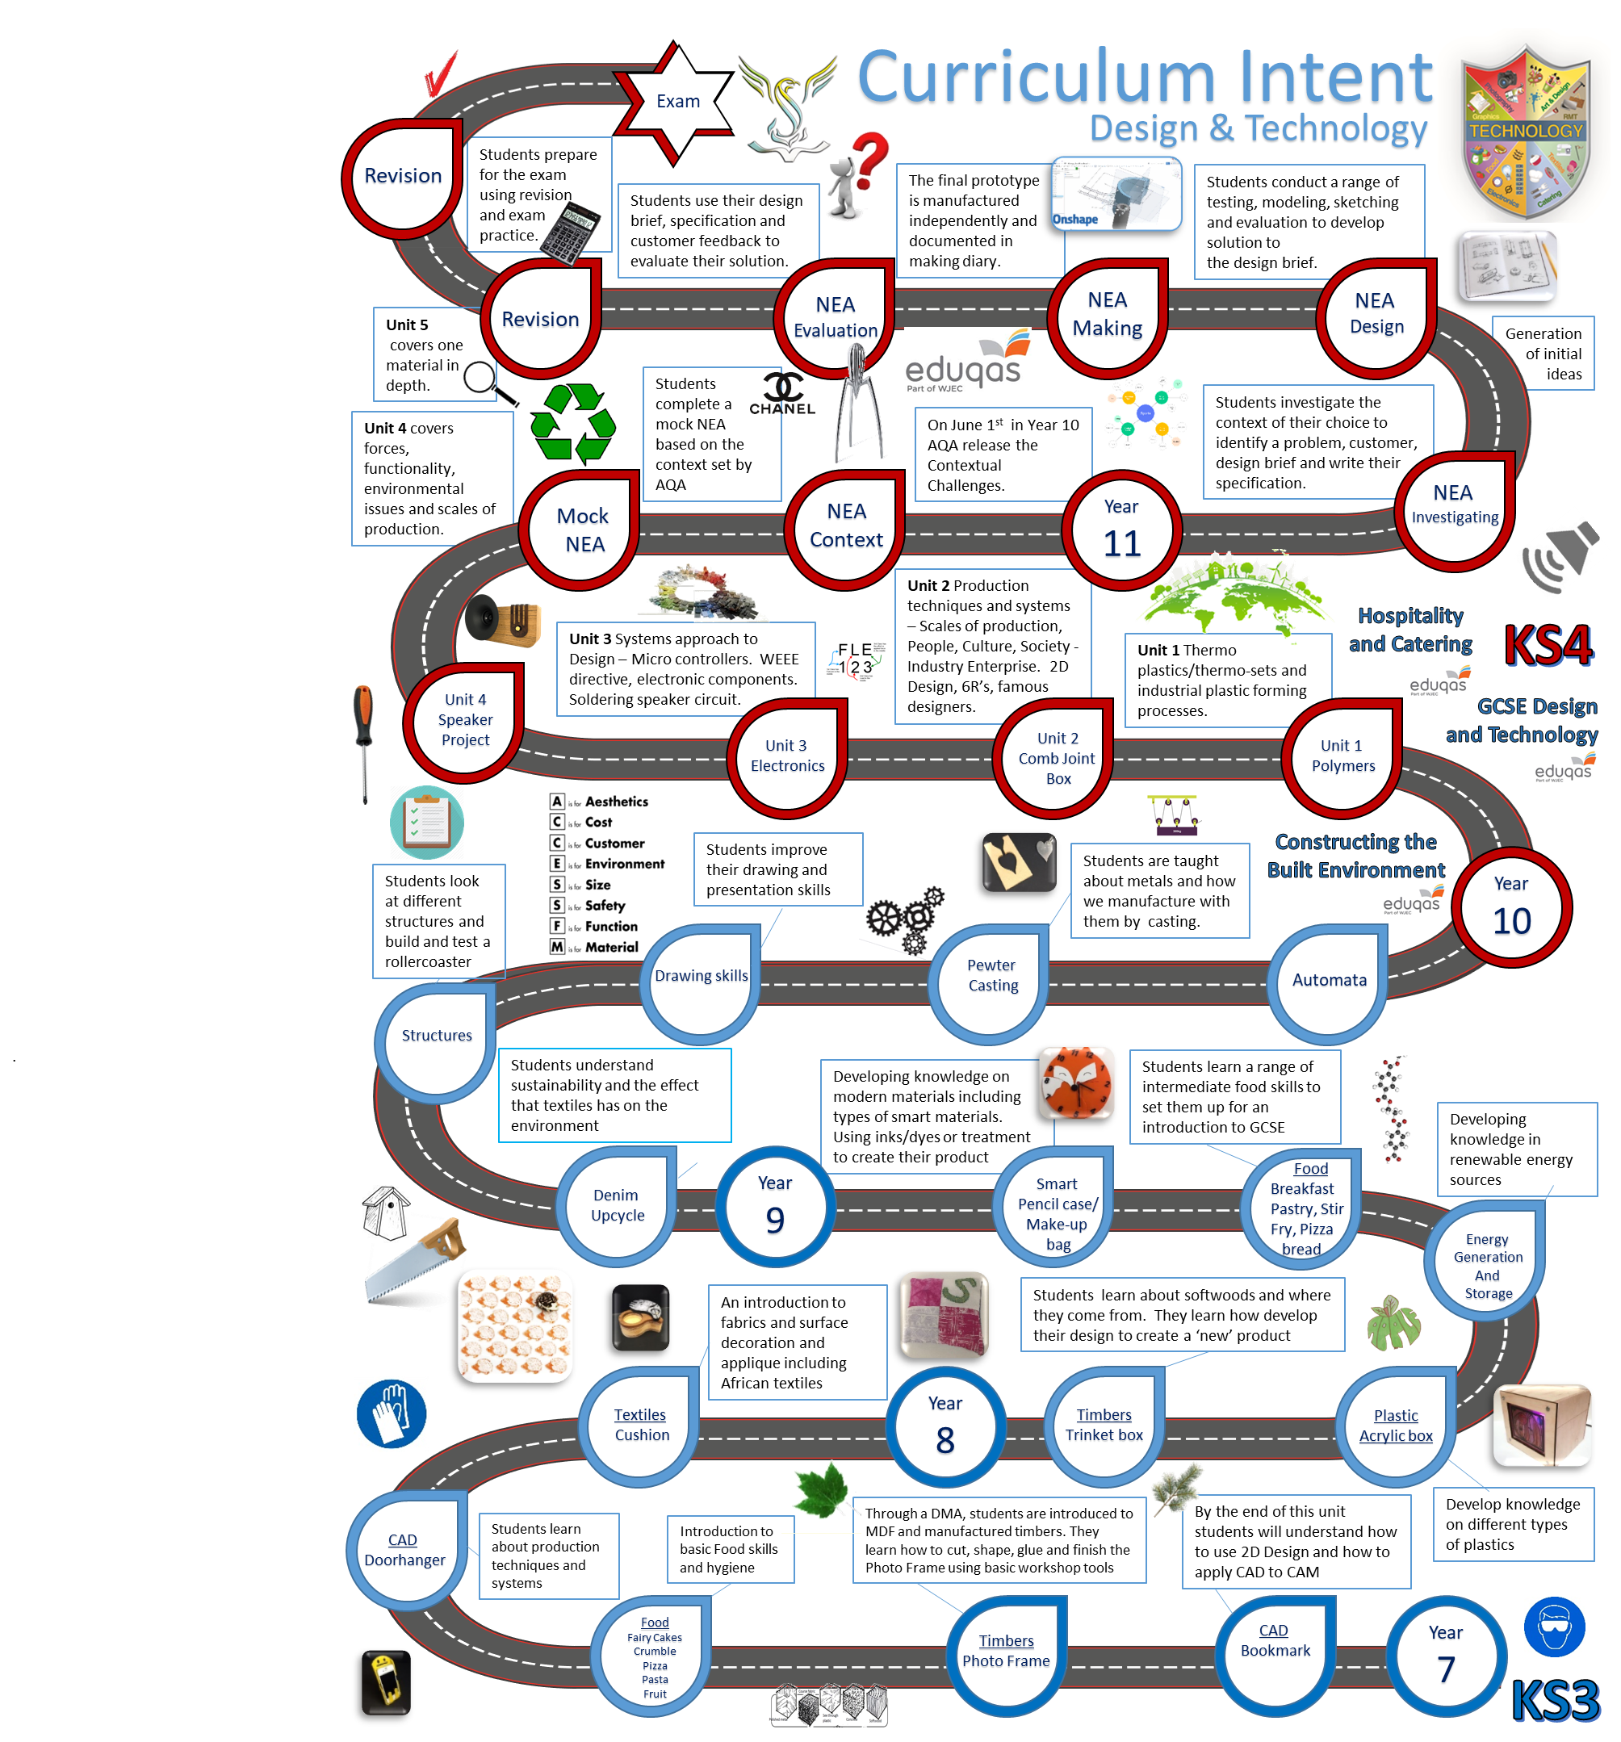

Slide 3
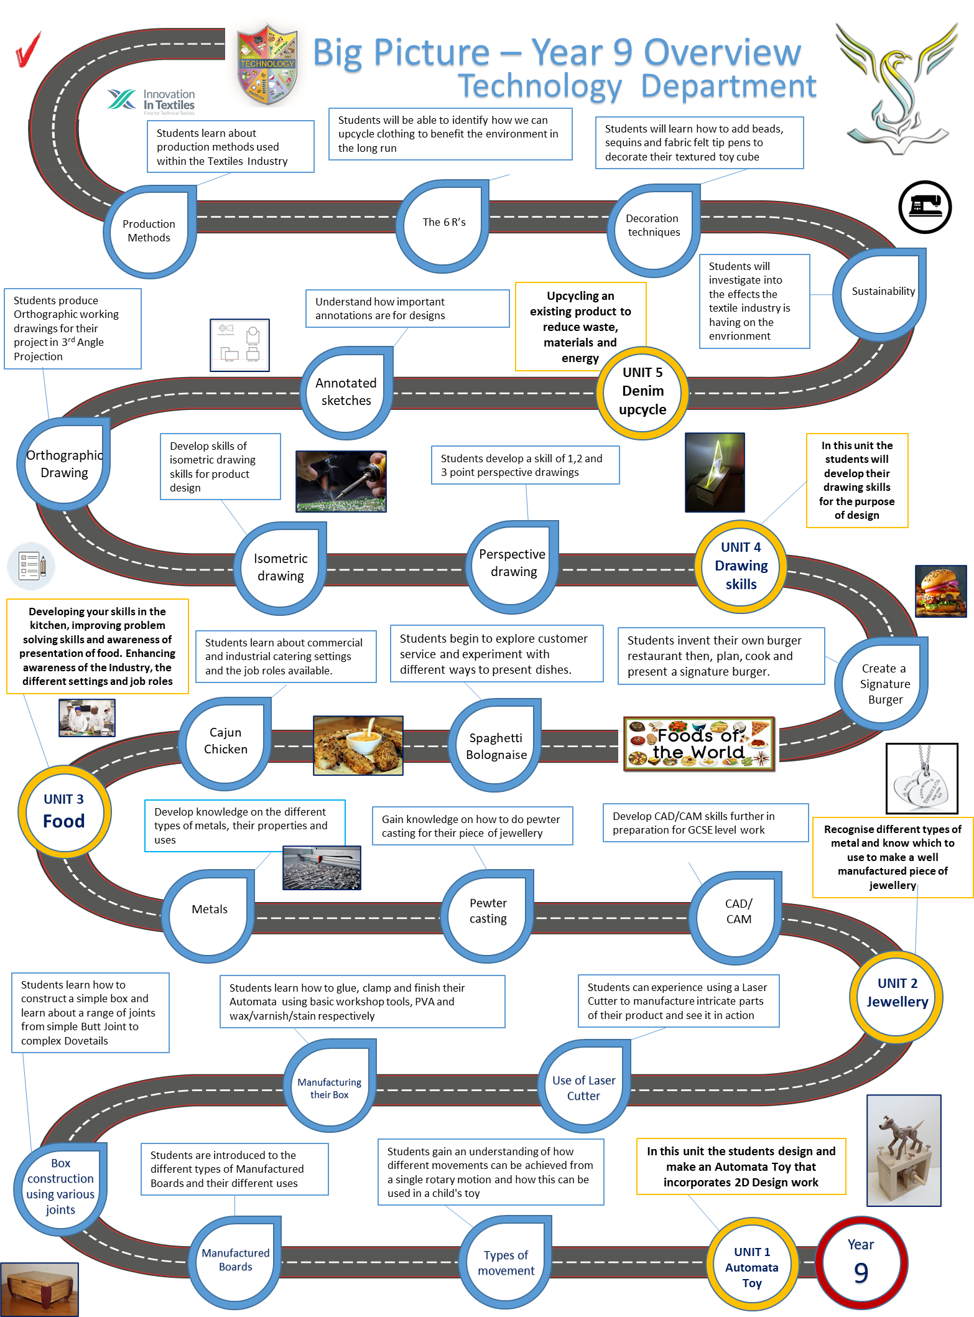

Slide 4

Rules for
Design & Technology workshops
DART
Year assessment of
Design & Technology
The biggest danger in a DT workshop is you.
You are at risk if you do not understand the hazards and consequences of accidents in the classroom.
Remember to always report any accidents, spillages or breakages to your teacher or technician.
Only enter a workshop when told to do so by a teacher or with teacher supervision
Keep your work area, and floor area tidy at all times
You must not run in a workshop at any time especially when machines are running
Follow instructions precisely and only use a machine or tool when instructed to do so.
Never remove anything from a DT workshop unless asked to move it to a different location
When using naked flames, ensure all loose/untucked items are secure.
Wear eye protection when specified
Stand up when doing most practical work so you are able to move quickly in-case of an emergency
Wash your hands thoroughly when entering a food technology room
If you are scalded, burnt or are aware that any chemicals have come into contact with your skin, immediately wash your hands with water until it has eased.
Assessment journey in Design and Technology. Fill in teacher initials and project
Yellow Plus
Yellow
Blue
Green
White
Average attainment:
Why is health and safety important?

Slide 5

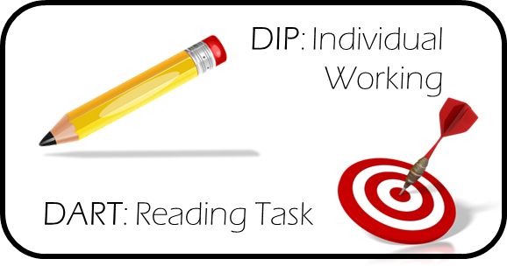
Year 9 Vocabulary (Key Words)
LI: To continuously reference key words when completing work
DART
Design brief
Something used to help us understand the problem that needs to be solved.
Design Specification
A list of conditions that a product should meet.
Analyse
Study something to discover and evaluate its features.
Ergonomic
Easy and comfortable for people to use.
Annotation
Detailed labelling of a design for others to understand how to make.
Evaluate
Critically reviewing work to improve
Prototype
A practice version of a product that you make during the development stage. It’s probably made from easy-to-work materials and might be scaled down to size.
Sustainability
The ability to be maintained at a certain level
CAD/CAM
Designing and manufacturing using a computer.
Surface treatment/finish
A substance, technique or tool you use to apply to a product to prepare or finish it perfectly
Investigate
To research into something in detail
Synthetic
Man-made, un-natural
Components
The different parts that are assembled to make a product.
Anthropometric
Measuring the human body

Slide 6
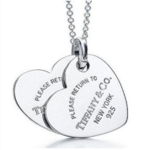
Make your own ideas come to life!
z
Stewards Academy
DESIGN & TECHNOLOGY
Jewellery Project
z
“Imagine it, Design it, Make it”
My target level................................

Slide 7

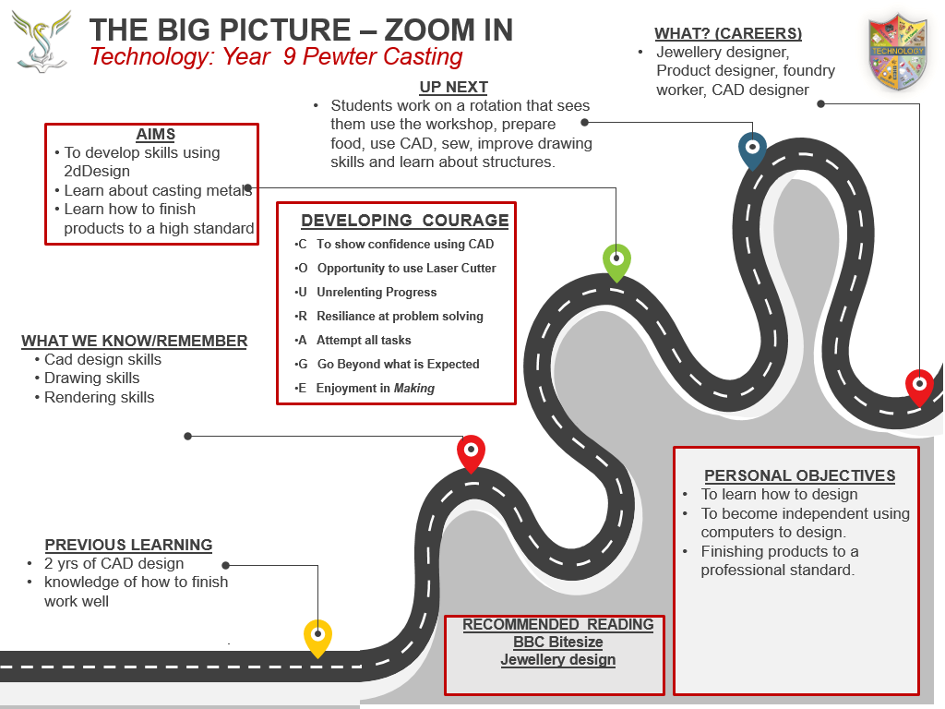

THE BIG PICTURE – ZOOM IN
Technology: Year 9 Jewellery
WHAT? (CAREERS)
Graphic designer
Engineer (F1)
CNC Machine operator
AIMS
To introduce students to the concept of designing and manufacturing using CAD CAM
To introduce students to 2D Design and then become confident in its basic features
For students to manufacture a product using the Laser Cutter
UP NEXT
Advanced 2D Design
Independent use of the 3D printer or Roland CAMM1
Technology Club to develop STEM students
DEVELOPING COURAGE
C To show confidence using CAD
O Opportunity to use Laser Cutter
U ............................................
R Resiliance at problem solving
A ...........................................
G ...........................................
E Enjoyment in Making
WHAT WE KNOW/REMEMBER
Personalisation of products
Quality of manufactured goods
Outsourcing of manufacturing to other countries and the economic benefits
What the term STEM means and the importance of the STEM subjects in a multitude of different job roles
PERSONAL OBJECTIVES
To develop skills using CAD and CAM
To become independent using a range of industry standard programmes such asFusion 360 (AutoDesk), Photoshop as well as educational programmes such as 2D Design and Tinker CAD
Students to become confident setting up and using the CAM machines
PREVIOUS LEARNING
Possible learning in Primary School
Outrach with Feeder Secondaries?
Simple control – Lego Dacta/Edison Robot
.
RECOMMENDED READING
2D design ‘Tasty Tips’ booklet
Eduqas GCSE Technology

Slide 8
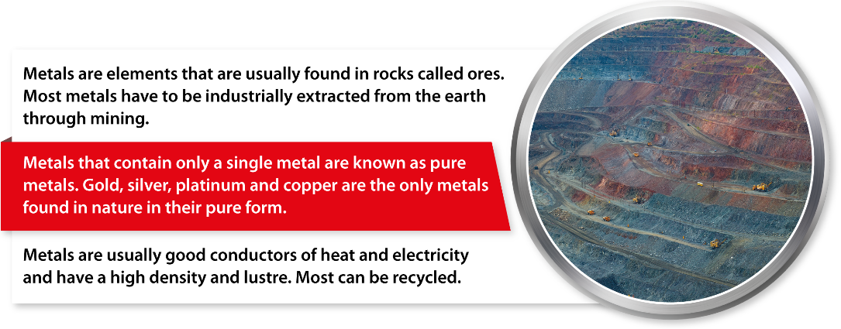
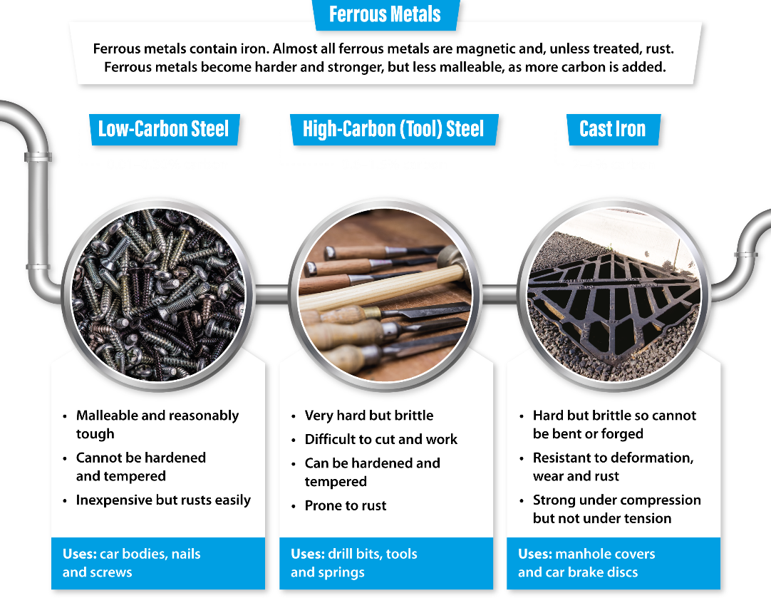
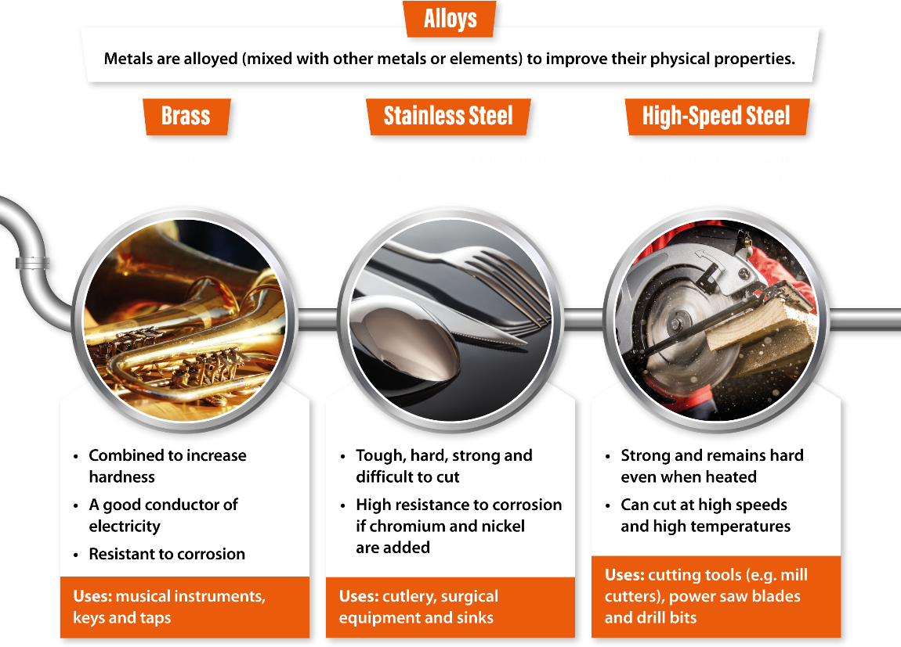
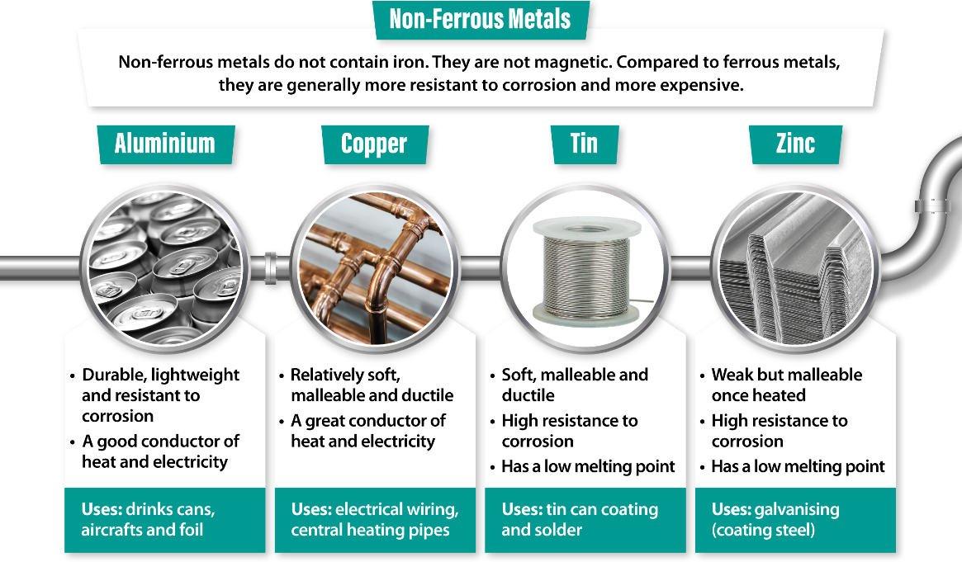
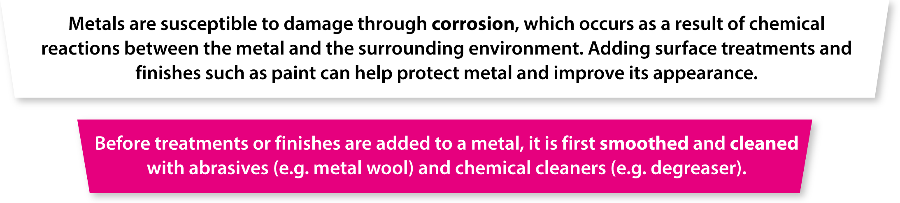
Knowledge Organiser

Slide 9



Design Brief
DIP
LI: Create a purposeful design brief
Lots of people give jewellery at many different occasions in their lives.
You have been asked by ‘GEMS Ltd’ A Jewellery company, to research, design and prototype a new range of jewellery.
The finished product could be either a keyring or necklace but you will need to design with both in mind.
Your Jewellery should be unique, made to a high standard and be attractive to the customer.
Numeracy Challenge
If each letter of the alphabet has a value according to its position (i.e.. A=1 B=2 C=3 and Z=26).
What is the Total of
JEWELLERY = ……………….
Key Words from the TASK
Deeper thoughts?
Design Brief - Success Criteria
Demonstrate that you can write a clear design brief and plan all your relevant research.
Demonstrate that you can write a design brief and how to plan research.
Demonstrate that you can write a basic design brief.
Who? What? Where? When? Why How?? Why?
Next Steps…
Add more detail to your Design Brief regarding Customer, Material and the Shape of your product. Use ACCESS FM to help you. What else could you add?
I am going to research, design and manufacture a…..
Write your Brief here…
Literacy Target Area: | Action(s)
Spelling: | Make use of a dictionary
 | List and learn corrections
Punctuation: | Use the punctuation pyramid
 | Write in FULL sentences
Vocabulary: | Use Key Words for this subject
Grammar: | Correct Non-Standard English

Slide 10


Mind Map
Investigation – Success Criteria
You have analysed past and present professionals in depth and drawn relevant conclusions of key points.
You have analysed past and present professionals and identified some key points.
You have analysed past and present professionals in a basic fashion with little relevance to your project.
LI: Generate ideas to produce your product
DIP
Next Steps…
Ensure that the products you have found inform your next steps and that you use some of the designs in your own work. Use parts of other designs to come up with something new
Mind mapping increases your creativity and productivity because it's an excellent tool to let you generate more ideas, identify relationships among the different data and information, and effectively improve your memory and retention. Making a mind map is an excellent way for you to be able to sort through your thoughts and ideas. This activity allows you to quickly generate creative and even unique ideas in less time. It gives you the freedom you need when brainstorming so that the flow of ideas is not blocked or hampered like linear thinking does.
Jewellery
What is the definition of linear?
DART

Slide 11
Specification
Specification – Success Criteria
You can write a fully justified specification which helps design innovative, functional and appealing products.
You can write a specification, which is justified in parts, and helps design appealing products.
You can write a specification
DIP
Specifications are detailed statements prescribing materials, dimensions, and quality of work for something to be designed or built.
LI: Understand how a specification can be used to refer to when designing
Next
Steps…
*Ensure that the points you mention are measurable and you can easily see whether your design work meets these points. *Remember you will evaluate your final product around the Specification at the end.
Aesthetics
Consumer
Cost
Environmental
Sizing
Safety
Function
Material

Slide 12


Existing Products
Initial product research will help you evaluate your idea for a new product and service and see if there is a need for it and what it is that your potential customers are looking for. If your product already exists, product research will tell you whether the available options on the market are meeting the needs and expectations of existing customers. This way you can learn what you can do differently, to meet the needs and expectations but also to exceed the competition.
Investigation – Success Criteria
You have analysed past and present professionals in depth and drawn relevant conclusions of key points.
You have analysed past and present professionals and identified some key points.
You have analysed past and present professionals in a basic fashion with little relevance to your project.
Use the space below to help you generate ideas for your cushion. You can use any form of investigation e.g. Internet, magazines, newspapers or books.
Look for key aspects that you could use in your designs.
DART
Next Steps…
Ensure that the products you have found inform your next steps and that you use some of the designs in your own work. Use parts of other designs to come up with something new
What are consumers?
Your Image Here
Your Image Here
Your Image Here
Your Image Here
DIP
l like this because:
.................................................................................................................................................................................................................This can be improved by:
...............................................................................................................................................................................................................
l like this because:
.................................................................................................................................................................................................................This can be improved by:
...............................................................................................................................................................................................................
l like this because:
.................................................................................................................................................................................................................This can be improved by:
...............................................................................................................................................................................................................
l like this because:
.................................................................................................................................................................................................................This can be improved by:
...............................................................................................................................................................................................................

Slide 13

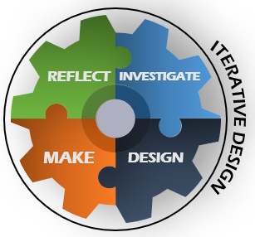
Initial Ideas
DART
LI: Evaluate during the design process to improve
Design and technology is a practical and valuable subject. It enables children and young people to actively contribute to the creativity, culture, wealth and well-being of themselves, their community and their nation. It teaches how to take risks and so become more resourceful, innovative, enterprising and capable. Students develop a critical understanding of the impact of design and technology on daily life and the wider world. Additionally, it provides excellent opportunities for students to develop and apply value judgements of an aesthetic, economic, moral, social, and technical nature both in their own designing and when evaluating the work of others.
Idea 1
Idea 2
Idea 3
Idea 1
Idea 2
Idea 3
DIP
Peer evaluation
…………………………………………………………………………………………………………………………………………………………………………………………………………………....................................................................................................................................................
Teacher evaluation
…………………………………………………………………………………………………………………………………………………………………………………………………………………....................................................................................................................................................
Self Evaluation
…………………………………………………………………………………………………………………………………………………………………………………………………………………....................................................................................................................................................
Start creating your initial ideas. Reflect on them after the evaluations and improve the next one.

Slide 14
CAD Ideas
LI: Evaluate during the design process to improve
Stick in your 2design print outs on this page.
DIP

Slide 15


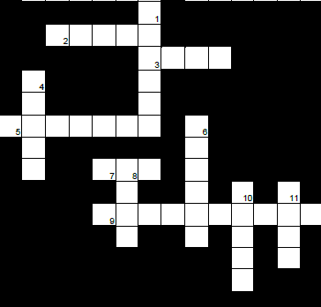
Pewter
Metal
Metals are usually produced by mining ore from the Earth, then extracting the metal out of the rocks in a large scale industrial process. There are three main categories of metal although some will fit into more than one type:
• Ferrous Metals
• Non-ferrous Metals
• Alloys
LI: Recognise all metals and their properties
DART
Ferrous Metals
Ferrous metals consist mostly of iron and
small quantities of other elements and metals.
Ferrous metals are prone to rusting if exposed
to moisture and can be picked up by a magnet.
Examples: Mild Steel, Cast Iron, and Stainless Steel.
Non-ferrous Metals
Non-ferrous metals do not contain any iron at all. These metals therefore do not rust when exposed to moisture and are not attracted to a magnet. Examples: Copper, Aluminium, Tin, Lead and Zinc.
Alloys
These are substances that contain two or more metals, and sometimes other elements, to improve their properties. The metals are carefully chosen and mixed to achieve specific properties which may include reducing the melting point.
Examples: Brass, Pewter, Casting Alloy and Duralumin.
Using the information above, complete the crossword on metals.
1. These substances contain two or more metals.
2. What this crossword is all about!
3. This metal was once used in pencils.
4. This metal can be stainless or mild.
5. The type of metal that is attracted to a magnet.
6. Plumbers use this metal.
7. Your baked beans may come in a can made of this metal.
8. A ferrous metal
9. The type of metal that is not attracted to a magnet.
10. An alloy of copper and zinc.
11. This is what happens to ferrous metals when exposed to moisture.

Slide 16
Laser ready cutline
LI: Design for your project to a high standard
Stick in your printed out cutline on this page.
Make sure you have separated each layer of pewter that you want cut out.
Make sure you have shared the file with me from onedrive. Send the file to jbutler@stewardsacademy.org

Slide 17
Manufacture
Draw a Flow Chart, using a series of the shapes to describe how you have manufactured your Jewellery.
LI: Organise a manufacture chart
Start
No
Yes
Stages of Manufacture – Success Criteria
You have precise and detailed planning for how you will manufacture your idea with exact details.
You have some clear planning for how you will manufacture your idea with some details.
You have some basic planning for how you will manufacture your idea.
Next
Steps…
*Add more technical details including the names of the tools/equipment, break down each stage into subsections
*Use a black fine liner, ruler and coloured pencils to enhance your work
DIP

Slide 18
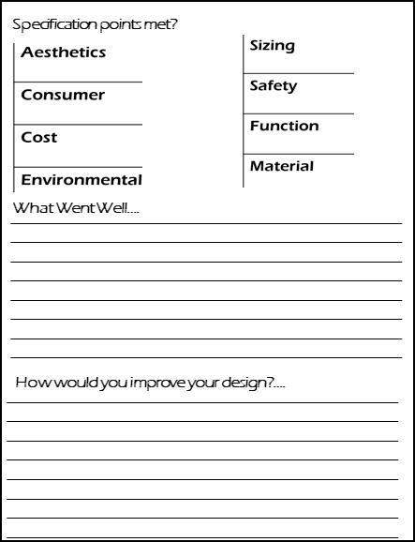
Evaluation
Print an image of your finished product and glue it in the space provided. Then review your product against your specification points, say what went well and, most importantly, how you would improve it.
WRITE IN FULL SENTENCES.
DIP
Your Image Here
Literacy Target Area: | Action(s)
Spelling: | Make use of a dictionary
 | List and learn corrections
Punctuation: | Use the punctuation pyramid
 | Write in FULL sentences
Vocabulary: | Use Key Words for this subject
Grammar: | Correct Non-Standard English

Slide 19
Make your own ideas come to life!
z
Stewards Academy
DESIGN & TECHNOLOGY
Denim Upcycle Project
z
“Imagine it, Design it, Make it”
My target level................................

Slide 20
THE BIG PICTURE – ZOOM IN
Technology: Year 9 Denim Upcycle
WHAT? (CAREERS)
Fashion designer/stylist
Denim textile designer
Denim buyer
AIMS
To introduce students to sustainability and the effects design and technology can have on the environment
For students to manufacture a product using recycled denim
To use different distressing and decorative techniques on denim
UP NEXT
Understanding the 6 R's
Independent use of tools to distress denim
Technology Club to develop STEM students
DEVELOPING COURAGE
C Confidence in sewing machine use
O Opportunity to disrtess denim
U Using decorative techniques
R Resiliance at problem solving
A Annotating designs to a high standard
G Gain knowledge on the history of denim
E Evaluating through entire process
WHAT WE KNOW/REMEMBER
Personalisation of products
Quality of manufactured goods
Properties of fabrics
Different decorative techniques and how they may be achieved
The use of CAM in textiles
What recycling is.
PERSONAL OBJECTIVES
To develop skills using CAD and CAM
Understand the importance of sustainability and recycling in fashion
Students to become confident setting up and using the CAM machines
Obtain knowledge on the properties of denim and the techniques used to distress.
PREVIOUS LEARNING
Smart materials in relation to textiles and decorative techniques
Cultural inspiration in designs
How to design, annotate and evaluate for improvement
.
RECOMMENDED READING
History of denim
Eduqas GCSE Technology

Slide 21

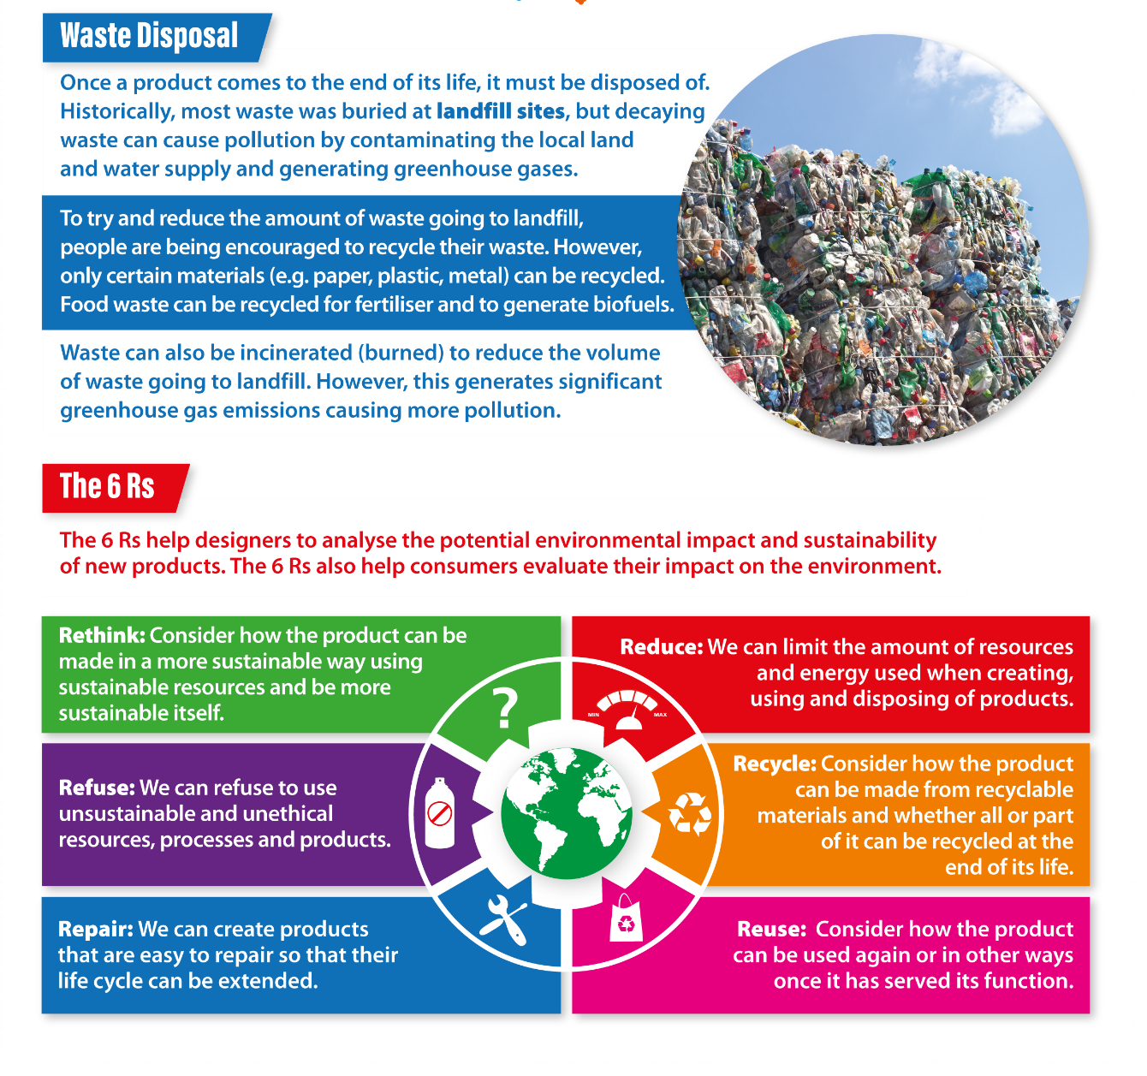
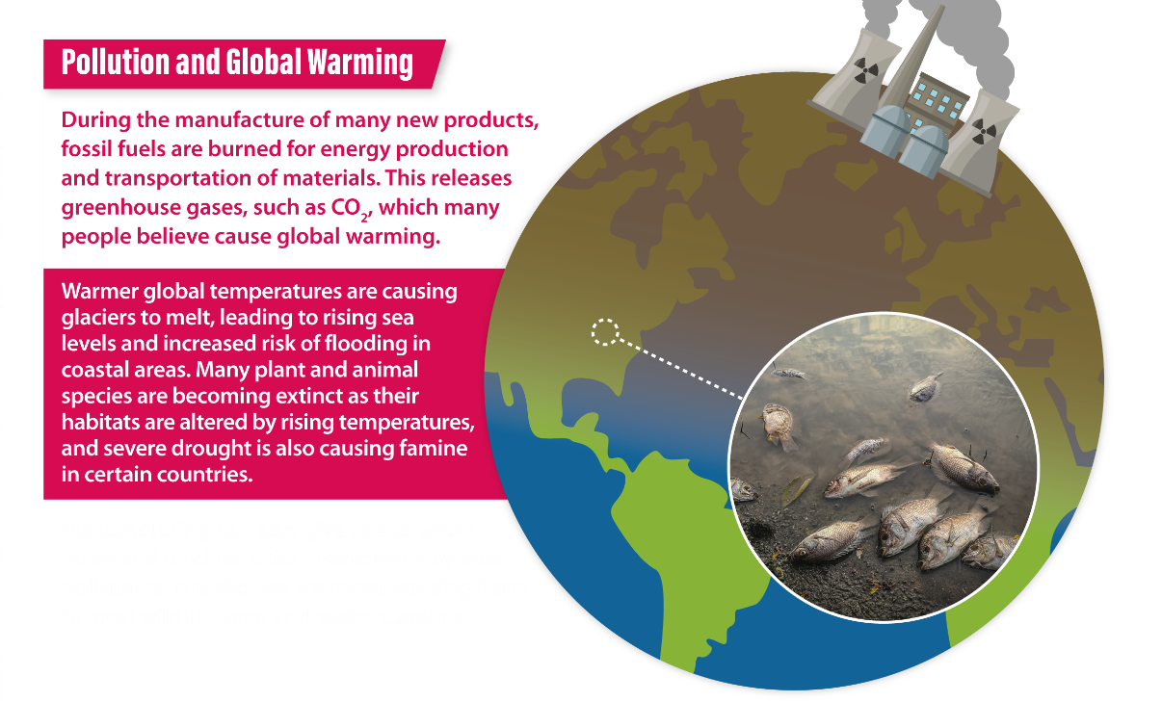
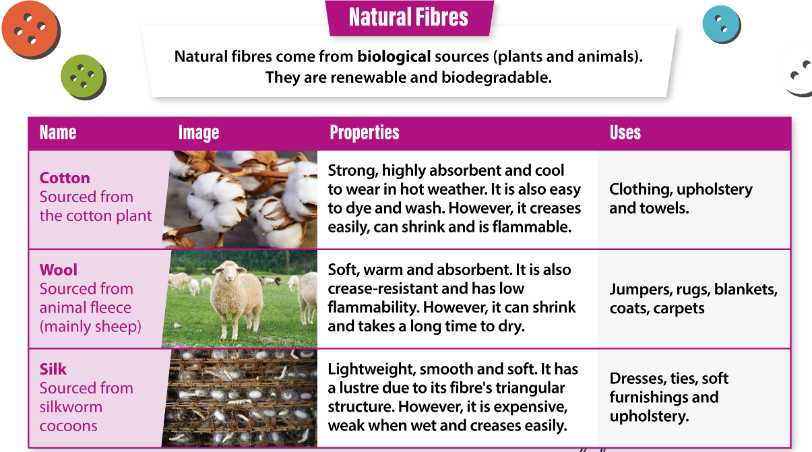
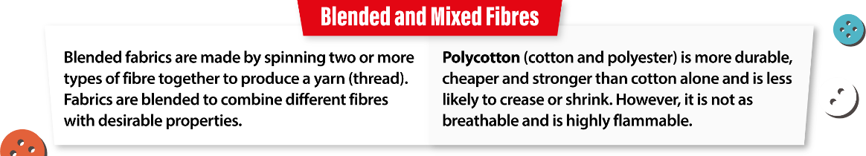
Knowledge Organiser

Slide 22
Assessment Ladder
 | Knowledge and Understanding | Skills
Yellow Plus | Produces independent projects to a high standard. Understands how to design and draw to a professional standard in colour and to annotate designs to a high standard. Knowledge of tools, materials, and processes is used to predict the time needed to complete the project. Use the iterative design process to constantly evaluate and improve Confidence in the 6 R’s, global warming effects and can explain what impact design and technology has on the environment including a carbon footprint | Can analyse and evaluate research Uses research to help design work. Produces 4 good quality designs, annotated and can develop designs and produce a final design. Able to create a making plan Selects and uses a range of tools and equipment with accuracy to produce high quality products. Can evaluate research, designs and making.
Yellow | Good knowledge of how to find quality research Annotation shows understanding of how products are made Knowledge of tools, materials and processes help to make good quality products. Evaluation shows understanding of how to improve work. Understands the 6 R's and the effect design and technology has on the environment | Finds a variety of unusual research images, analyses them and evaluates research. Produce 4 good designs from the research and 1 final design in colour and annotated. Able to work out the sequence of a making plan Chooses the correct tools, uses them accurately and creates quality products Can evaluate work
Blue | Has sound knowledge of tools and workshop safety Understands how designs come from research and investigation Understands how to do a simple evaluation. Knows the 6 R's in sustainability | Can find useful research images and evaluate research Can make 3 design ideas, annotated and in colour, 1 final design Can follow a simple plan Selects and uses a range of tools and equipment safely, 3 www and 3 EBI’s. Can create sophisticated designs using 2ddesign
Green | Understands the information and explains ideas and concepts with limited support. Explains ideas and suggest ways to make them better. Can design to an average standard | Can research independently and print out images to help designs Can create 2 design ideas and improve one final design Selects and uses tools, machines and processes safely, taking into consideration the health and safety aspects with little supervision. Can use decorative techniques to complete product
White | Remembers information with help. Identifies likes and dislikes of products. | Research information with help. Draws or demonstrates a simple idea with help. Can be helped to use simple tools and equipment safely. Can use basic tools to complete part of product

Slide 23
Design Brief
DART
Key words: Sustainability, distress, denim, recycle, reuse, rethink, upcycle, wastage, design, iterative, evaluate, durability, manufacturing, designing, annotation, reflection
LI: Recognise the importance of a design brief
The farms that grow raw materials used to make fabrics, including crops like cotton, flax, and hemp, require a lot of water. In fact, cotton is an especially thirsty plant. In addition, to protect these valuable crops, some farmers use lots of pesticides and herbicides that end up in the environment. Again, cotton is a big culprit, being one of the most pesticide-intensive crops in the world. Other types of textiles also use up a lot of natural resources. Manufacturing rayon, an artificial fabric made from wood pulp, has resulted in the loss of many old-growth forests. During the process that transforms it into fabric, the pulp is treated with dangerous chemicals that eventually find their way into the environment. Now consider synthetic fabrics, or man-made fabrics like nylon and polyester. These textiles are made from petrochemicals and fossil fuels and manufacturing them requires lots of water and energy. Nylon manufacturing also creates greenhouse gasses that harm the air we breathe. Additionally, synthetic fabrics are not biodegradable, which means that something made of nylon can take decades to decompose.We can do our part by using scraps of denim, upcycling them and creating a functioning product, which means we can decrease the negative effect that textile manufacturers have on the environment. The final product should appeal to everyone​, show a range of techniques used to enhance denim, cost virtually nothing to resource, raise ethical issues related to the textiles industry and make a positive impact on the environment. What type of fabric is denim? …………………………………………………………………………….
I am going to investigate, analyse and design…. _______________________________________________________________________________________________________________________________________________________________________________________________________________________________________________________________________________________________________________________________________________________________________________________________________________________________________________________________________
Cross-curricular links:
Extended vocabulary opportunity - English
Measurements - Maths
Computer use - IT
Carbon footprint - Geography
Design Brief - Success Criteria
Demonstrate that you can write a clear design brief and plan all your relevant research.
Demonstrate that you can write a design brief and how to plan research.
Demonstrate that you can write a basic design brief.
Next Steps…
Add more detail to your Design Brief regarding Customer, Material and the Shape of your product. Use ACCESS FM to help you. What else could you add?

Slide 24

Denim Fact Sheet – Read through, fill in the blanks and highlight key words
Denim is a cheap widely available fabric which appeals to people worldwide. It started out as work wear fabric but has since become a timeless fashion fabric.
Properties & Qualities – denim is a tough, hardwearing fabric. It is useful for work wear because of its strength. It is a thick fabric although there are lighter weight versions. Cotton is absorbent so denim soaks up water, it can get very heavy when wet and as it is thick as well as absorbent it may take a long time to dry.
Fibre - Denim should be made from cotton, although denim type fabrics may be made using a combination of cotton & polyester. The advantages of having some polyester would be that it would dry quicker, need less ironing and may be have more stretch
Care & Maintenance - It can withstand high washing temperatures, e.g. 60ºC and a vigorous washing cycle. It should not be washed with pale-coloured fabrics as the colour is likely to run, especially when it is new. Denim can be tumble dried, although it should not be bleached as the colour will be affected. This is what happens when you tie-dye denim with bleach.
Variations - Stonewash denim used to be made by washing the denim with pumice stones to batter it about, these days enzymes, sand or ceramic balls may be used.
Stretch denim is achieved by using a small amount of elastane (like elastic) fibre to the threads. Usually up to 5% of the fibre content is elastane, the rest is cotton. If the stretch is added to the weft it helps jeans to have a snug fit (round your hips), if the stretch is added to the warp it helps the jeans stretch when bending & sitting down.
Bleaching lightens denim but it also makes it weaker.
Ripped denim is achieved by sanding the area down to look worn away. In factories, there are sanding machines which do this for you, but to achieve your own, you can use sandpaper.
Social & Environmental issues - Cotton is a natural fibre so its production does not use the oils and chemicals that synthetic fibres would. However, pesticides are used on large cotton plantations and these are bad for the environment. The dyes used are also harmful to the environment.
LI: Obtain knowledge on the history and properties of denim
DART

Slide 25
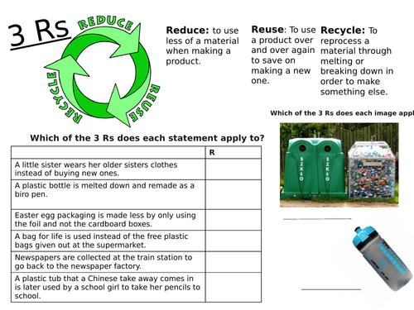
Investigation: The 6 R's and the environment
Write in bullet point form, the effect that textiles has on the environment.
...................................................
...................................................
...................................................
...................................................
...................................................
...................................................
...................................................
...................................................
...................................................
..................................................
Name the 6 R's:
DIP
Investigation – Success Criteria
You have analysed past and present professionals in depth and drawn relevant conclusions of key points.
You have analysed past and present professionals and identified some key points.
You have analysed past and present professionals in a basic fashion with little relevance to your project.
Next Steps…
Ensure that the products you have found inform your next steps and that you use some of the designs in your own work. Use parts of other designs to come up with something new
LI: Analyse and understand the importance of the 6 R's in sustainability

Slide 26
Stick Fairtrade HW here

Slide 27
Specification
Specification – Success Criteria
You can write a fully justified specification which helps design innovative, functional and appealing products.
You can write a specification, which is justified in parts, and helps design appealing products.
You can write a specification
Specifications are detailed statements prescribing materials, dimensions, and quality of work for something to be designed or built.
DIP
LI: Understand how a specification can be used to refer to when designing
Next
Steps…
*Ensure that the points you mention are measurable and you can easily see whether your design work meets these points. *Remember you will evaluate your final product around the Specification at the end.
Aesthetics
Consumer
Cost
Environmental
Sizing
Safety
Function
Material

Slide 28
Investigate, research, discuss and plan
Designer write-up
……………………………………………………………………………………………………………………………………………………………………………………………………………………………………………………………………………………………………………………………………………………………………………………………………………………………………………….
Find images of denim upcycle examples including designer’s work
Develop your own ideas from them in the mind map below
Write up about the designer
Include images on this page
DIP
Denim
upcycle
Investigation – Success Criteria
You have analysed past and present professionals in depth and drawn relevant conclusions of key points.
You have analysed past and present professionals and identified some key points.
You have analysed past and present professionals in a basic fashion with little relevance to your project.
Next Steps…
Ensure that the products you have found inform your next steps and that you use some of the designs in your own work. Use parts of other designs to come up with something new
LI: Develop ideas from investigation and research

Slide 29

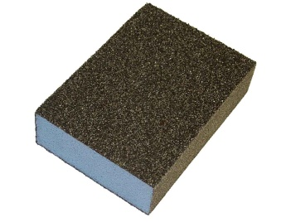
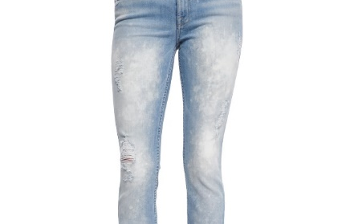
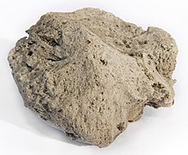
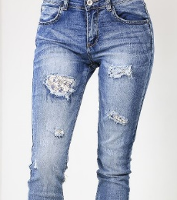
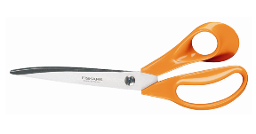
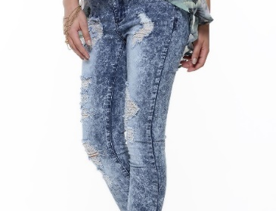
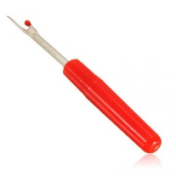
Read the descriptions, match the definition to the picture, label the process and then identify the equipment on the right.
DART
Achieved by sanding the area down to look worn away. In factories, there are sanding machines which do this for you, but to achieve your own, you can use sandpaper.
Denim used to be made by washing the denim with pumice stones to batter it about, these days enzymes, sand or ceramic balls may be used.
Lightens denim but it also makes it weaker. This is used in tie-dye also.
Stages of Manufacture – Success Criteria
You have precise and detailed planning for how you will manufacture your idea with exact details.
You have some clear planning for how you will manufacture your idea with some details.
You have some basic planning for how you will manufacture your idea.
LI: Gain knowledge on denim manufacturing techniques
At what stage of your project would you use these techniques and why then?
…………………………………………………………………………………………………………………………………………………………………………………………………………
*Add more technical details including the names of the tools/equipment, break down each stage into subsections
*Use a black fine liner, ruler and coloured pencils to enhance your work

Slide 30
Initial Ideas
Initial Ideas – Success Criteria
LI: Evaluate during the design process to improve
You have communicated, and developed, design ideas using annotated sketches with line quality and colour.
You have clearly communicated your design ideas using annotated sketches and line quality.
You have communicated design ideas using annotated sketches.
DART
Annotations are brief, written explanations provided with design deliverables in order to define & describe aspects of the design. They’re paired with numbered labels on the design itself to visually map each description to the relevant part of the design.
The primary purpose of annotations are to explain aspects of the design that the recipient may not otherwise perceive, understand, or account for during implementation. They may be used differently from project to project, but they should always be serving this goal.
Next
Steps…
* Ensure that you finish all your drawings to the same quality—remember it is not a race to finish first. Do not forget to annotate your drawings!
* Make sure you include WWW and EBI—Showing your thinking = MARKS!
Idea 1
Idea 2
Idea 3
Idea 1
Idea 2
Idea 3
People commonly mistake annotation for what?
Peer evaluation
…………………………………………………………………………………………………………………………………………………………………………………………………………………....................................................................................................................................................
Self Evaluation
…………………………………………………………………………………………………………………………………………………………………………………………………………………....................................................................................................................................................
Teacher evaluation
…………………………………………………………………………………………………………………………………………………………………………………………………………………....................................................................................................................................................
DIP

Slide 31
Developed Ideas
Note: This could be your final design
LI: Obtain confidence in entire design process
DIP
Developed Ideas – Success Criteria
You have developed ideas which are fully annotated and clearly show improvements from your initial ideas.
You have developed design ideas using annotated sketches and computer-based tools (CAD).
You have design ideas using annotated sketches and computer (CAD) -based tools.
Evaluation of your Designs
………………………………………………………………………………………………………………………………………………………………………………………………………………….............................................................................................................................................................................................................................................................................................................................................................................................................................................................................................................................
Next
Steps…
*Add more specific detail to your ideas regarding production methods - if you were making it commercially *Add more details on sizes, materials, production methods and relate to existing products and research *Use ACCESS FM

Slide 32
Stick environment HW here

Slide 33
Evaluation
LI: Test, Analyse and Evaluate entire project
Your Image Here
DIP
What plan did you have in place?
What Went Well?….
Evaluation – Success Criteria
Checklist:
Professional Designing
Detailed Annotation
Consistent Evaluation
Use D & T vocabulary
High-quality manufacture
Use of varied techniques
You have tested, evaluated and refined or developed your ideas against your specification.
You have evaluated and refined your ideas against your specification.
You have evaluated your ideas against your specification.
How would you improve your design?….
Next
Steps…
*Use more technical detail in identifying what you have learnt (WWW/EBI) e.g. tools, processes and equipment
*Take a photograph of your work to show what you have made

Slide 34
Make your own ideas come to life!
z
Stewards Academy
DESIGN & TECHNOLOGY
Drawing Skills Project
z
“Imagine it, Design it, Make it”
My target level................................

Slide 35
THE BIG PICTURE – ZOOM IN
Technology: Year 9 Drawing skills
WHAT? (CAREERS)
Graphic designer
Engineer (F1)
CNC Machine operator
AIMS
To introduce students to the concept of designing and manufacturing using CAD CAM
To introduce students to 2D Design and then become confident in its basic features
For students to manufacture a product using the Laser Cutter
UP NEXT
Advanced 2D Design
Independent use of the 3D printer or Roland CAMM1
Technology Club to develop STEM students
DEVELOPING COURAGE
C To show confidence using CAD
O Opportunity to use Laser Cutter
U ............................................
R Resiliance at problem solving
A ...........................................
G ...........................................
E Enjoyment in Making
WHAT WE KNOW/REMEMBER
Personalisation of products
Quality of manufactured goods
Outsourcing of manufacturing to other countries and the economic benefits
What the term STEM means and the importance of the STEM subjects in a multitude of different job roles
PERSONAL OBJECTIVES
To develop skills using CAD and CAM
To become independent using a range of industry standard programmes such asFusion 360 (AutoDesk), Photoshop as well as educational programmes such as 2D Design and Tinker CAD
Students to become confident setting up and using the CAM machines
PREVIOUS LEARNING
Possible learning in Primary School
Outrach with Feeder Secondaries?
Simple control – Lego Dacta/Edison Robot
.
RECOMMENDED READING
2D design ‘Tasty Tips’ booklet
Eduqas GCSE Technology

Slide 36
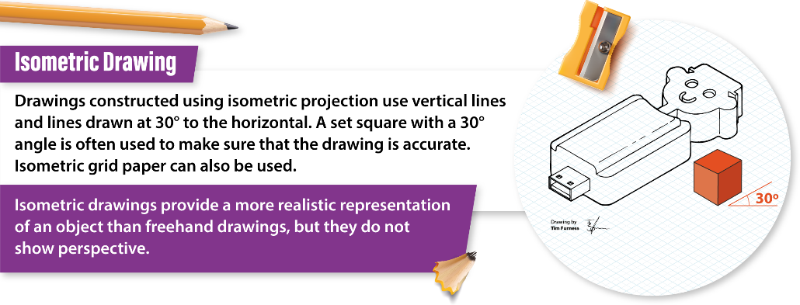
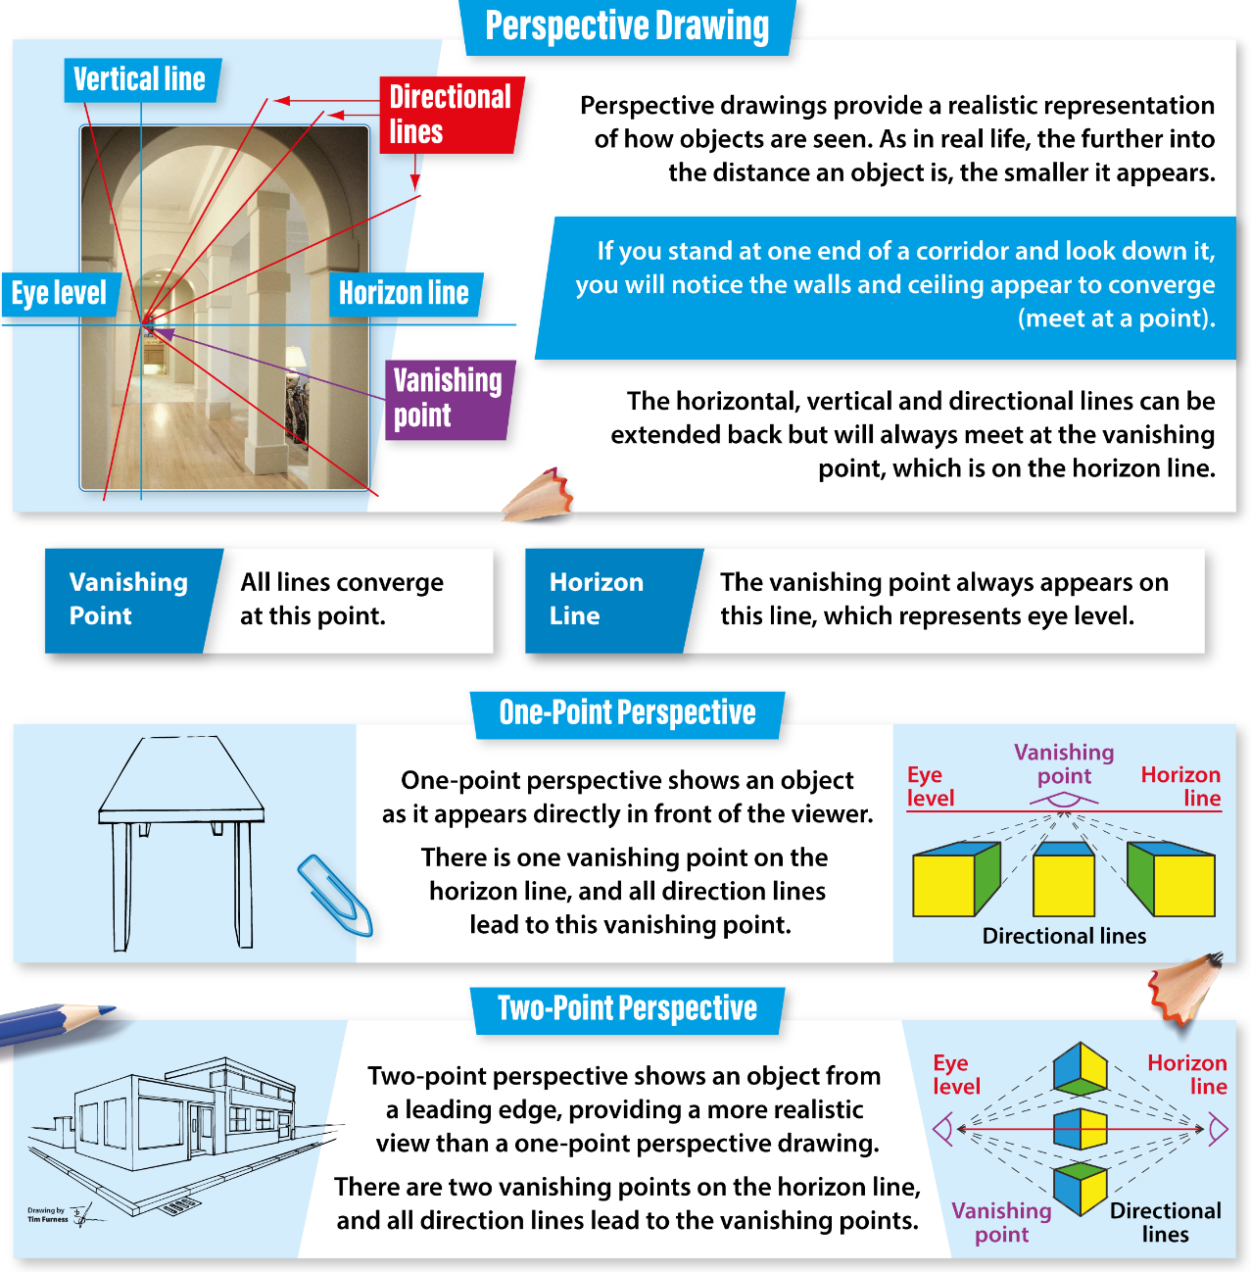
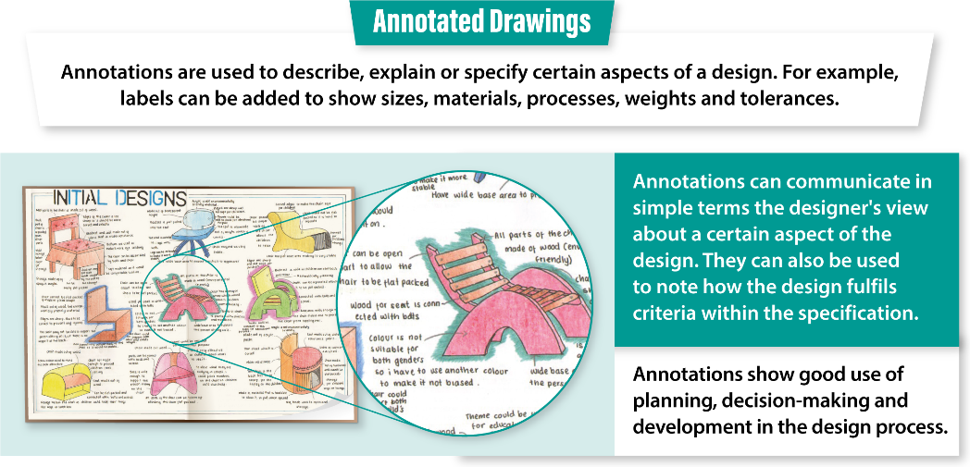
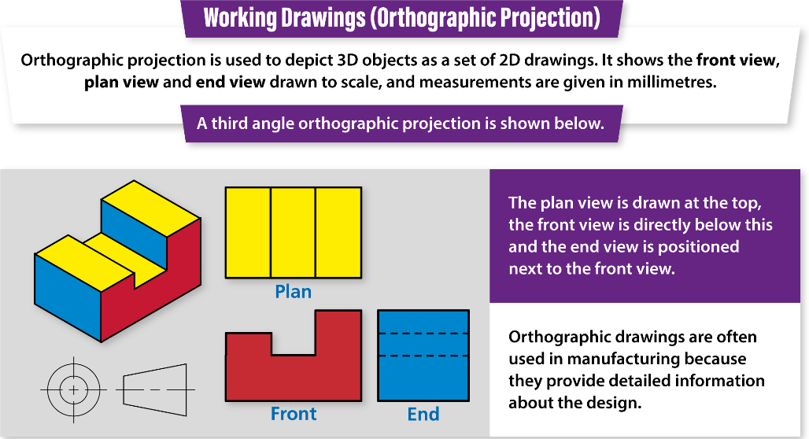
Knowledge Organiser

Slide 37

Drawing types
LI: Understand different types of 2D and 3D drawings
Highlight keywords that you will use throughout the project
2D shapes are flat, plane shapes. 3D shapes have 3 dimensions - length, width and depth. Architects draw 2D drawings of 3D shapes, called plans and elevations, to see how a building will look.
Designers use many techniques to create products and solve problems. Design and development involve creating working drawings and parts lists to enable a third party to manufacture the design.
Perspective
Perspective drawings show an object in 3D getting smaller in the distance.
Single-point perspective - This shows an object from the front in a realistic way as it gets smaller going into the distance. The front view goes back towards a vanishing point, which is a point on the horizon line that all lines meet at.
Two-point perspective - This shows an object from the side with two vanishing points. It gives the most realistic view of a product as it shows the item edge on, as we would see it. It is often used to produce realistic drawings of an object.
Single-point perspective is often used by interior designers to show a view into a room, whereas two-point perspective is often used by architects to show realistic building ideas.
Isometric
Isometric drawings, sometimes called isometric projections, are a good way of showing measurements and how components fit together. Unlike perspective drawings, they don’t get smaller as the lines go into the distance.
There are three main rules to isometric drawing:
horizontal edges are drawn at 30 degrees
vertical edges are drawn as vertical lines
parallel edges appear as parallel lines
Isometric drawings are used to show a graphical representation of a 3D object. They are used by architects and engineers to communicate their ideas to the client and manufacturer, showing the product or design to scale.
Orthographic projections are working drawings in either a first or third angle projection and show each side of a design without perspective, ie a 2D drawing of a 3D object. They are used to show an object from every angle to help manufacturers plan production. Starting with a front view of a product, construction lines show where areas join and are used to draw a side and plan (top) view, ensuring that the drawing is accurate from all angles. These drawings are to scale and must show dimensions.
DART

Slide 38
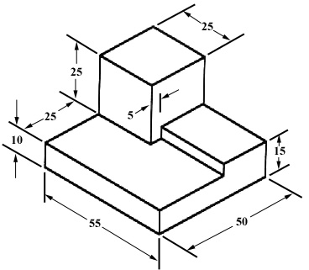
Orthographic Drawing
LI: Learn how to do an orthographic drawing
Plan View
Plan View
Front View
Side View
Front View
Side View
DIP

Slide 39
Orthographic Drawing
LI: Gain confidence in orthographic
drawing
Plan View
Plan View
Front View
Side View
Front View
Side View
DIP

Slide 40
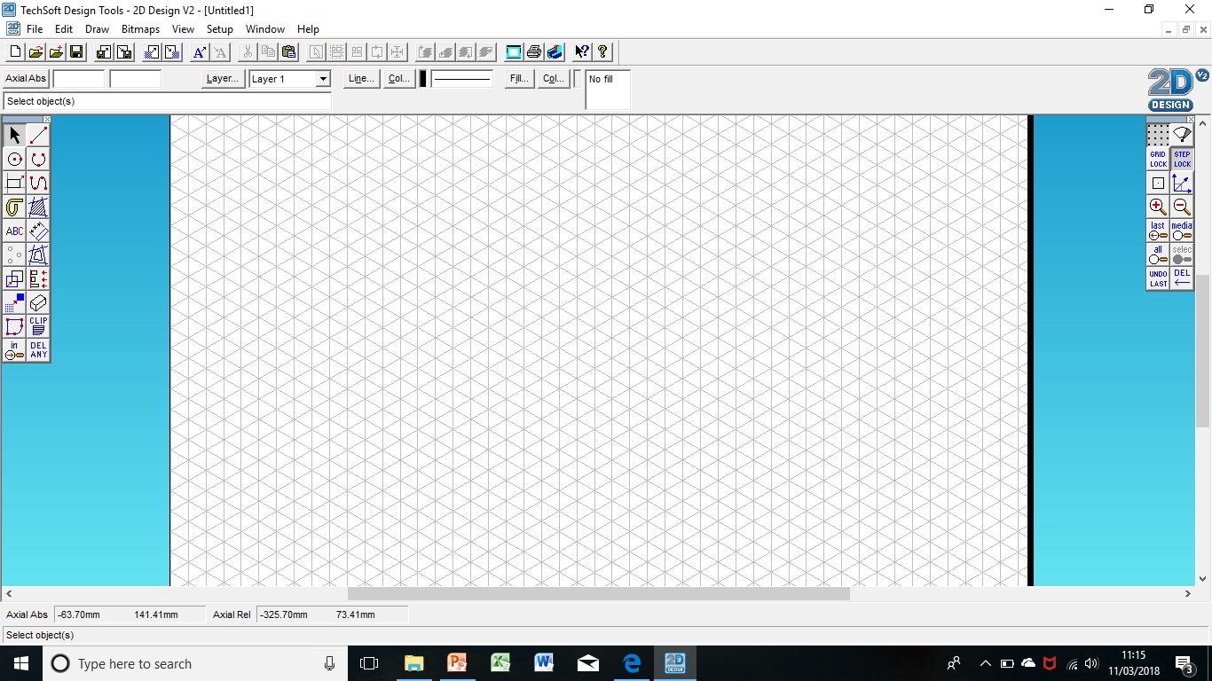
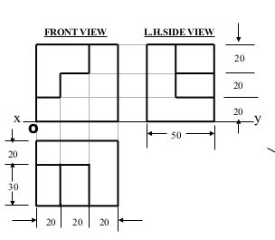
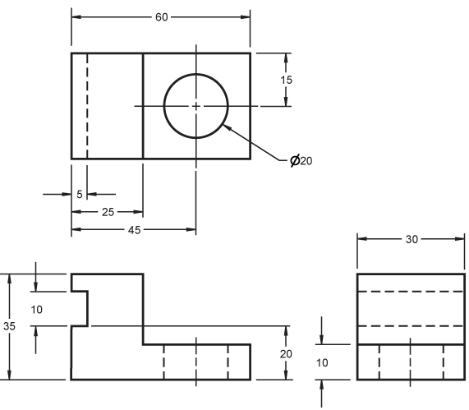
Isometric Drawing
LI: Gain knowledge on isometric drawing
Task 1
Task 2
DIP

Slide 41
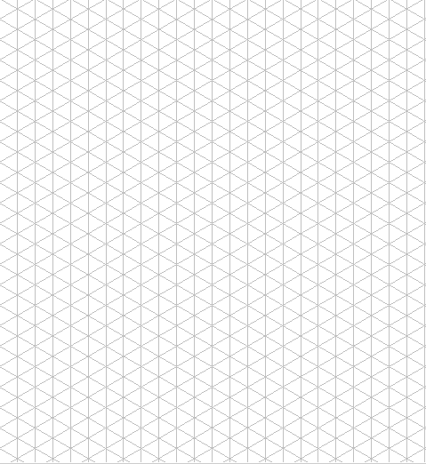
Isometric drawing
LI: Learn how to complete isometric drawings and evaluate them
DIP
Idea 1
Isometric
Idea 2
Isometric
Evaluation...............................................................................................................................................................................................................................................................................................................................................
Evaluation..............................................................................................................................................................................................................................................................................................................................................

Slide 42

Isometric drawing
Initial Ideas – Success Criteria
You have communicated, and developed, design ideas using annotated sketches with line quality and colour.
You have clearly communicated your design ideas using annotated sketches and line quality.
You have communicated design ideas using annotated sketches.
LI: Refine your isometric drawing skills
Idea 3
Isometric
Idea 4
Isometric
Next
Steps…
* Ensure that you finish all your drawings to the same quality—remember it is not a race to finish first. Do not forget to annotate your drawings!
* Make sure you include WWW and EBI—Showing your thinking = MARKS!
Evaluation.................................................................................................................................................................................................................................................................................................................................
Evaluation.................................................................................................................................................................................................................................................................................................................................
DIP

Slide 43
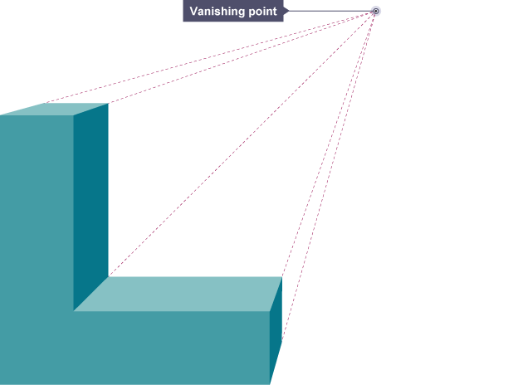
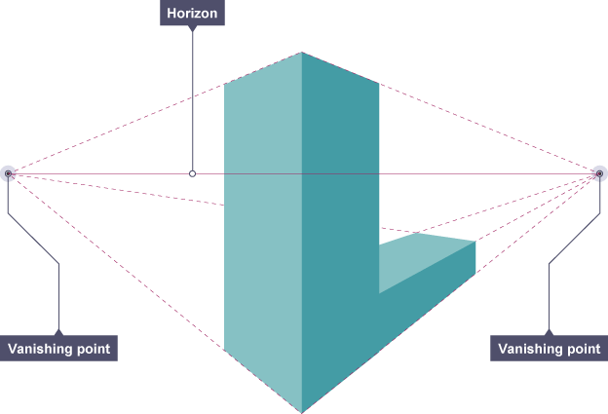

Perspective drawing
There are many different types of perspective drawing including 1-point, 2-point and 3-point perspectives. Generate 1-point and 2-point drawings below
LI: Obtain knowledge on how to do perspective drawings
DIP

Slide 44
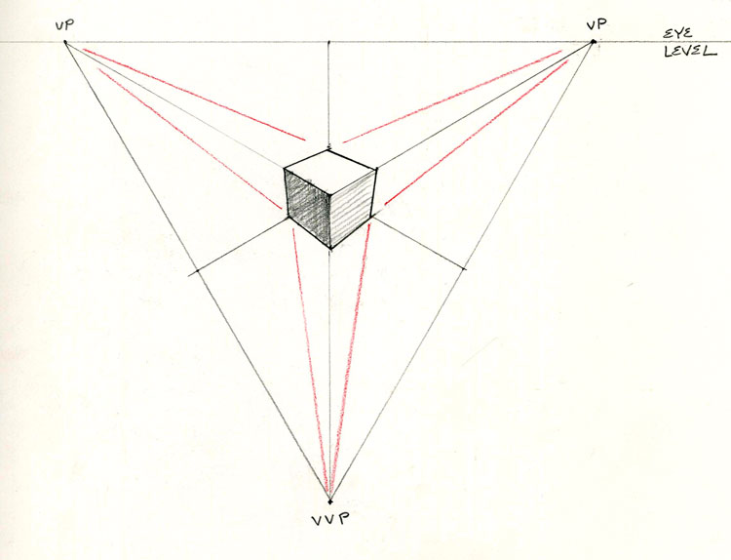

Perspective drawing
There are many different types of perspective drawing including 1-point, 2-point and 3-point perspectives.
Draw 2 3-point perspective drawings below and evaluate them
LI: Gain confidence in perspective drawing skills
Evaluation.................................................................................................................................................................................................................................................................................................................................
Evaluation.................................................................................................................................................................................................................................................................................................................................
DIP

Slide 45
Evaluation
LI: Test, Analyse and Evaluate entire project
Which drawings did you find most difficult and why?
How would you improve your skills?….
What drawings went well?….
What strategies and equipment did you use to help you draw?….
Evaluation – Success Criteria
What drawing technique would you use if you were an architect?
What technique would you use to draw a product for manufacturing?
What technique would you use when planning a product?
Checklist:
Professional Designing
Detailed Annotation
Consistent Evaluation
Use D & T vocabulary
Use of varied techniques
You have tested, evaluated and refined or developed your ideas against your specification.
You have evaluated and refined your ideas against your specification.
You have evaluated your ideas against your specification.
Next
Steps…
*Use more technical detail in identifying what you have learnt (WWW/EBI) e.g. tools, processes and equipment
*Take a photograph of your work to show what you have made
DIP

