Slide 1
Ethics and Values
Year 8 Blended Booklet – Autumn 2

Slide 2

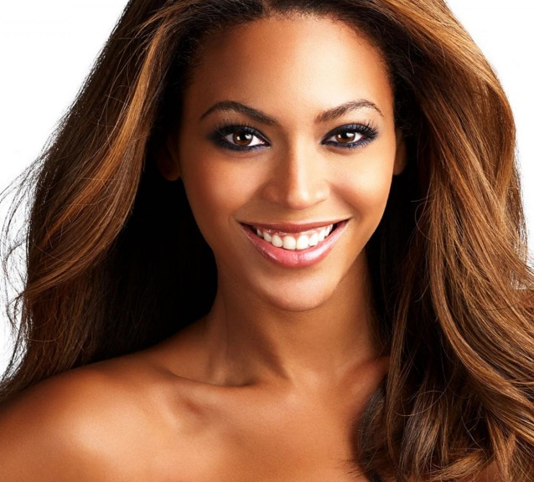

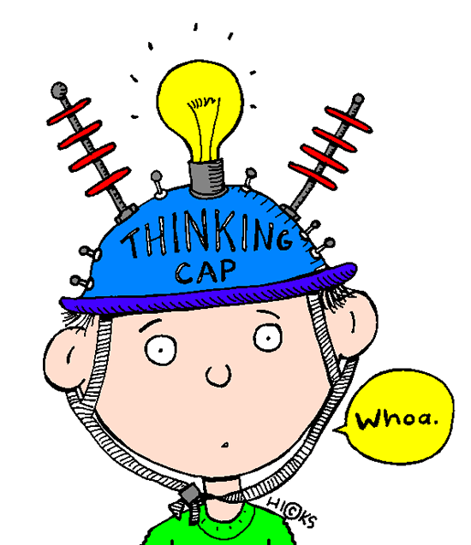
Ethics and Values – Year 8
Lesson 4: Adolescence
Learning intent: To understand the difference between puberty and adolescence and describe changes during puberty and adolescence
Connection phase What are the different changes that happen during puberty | Activation phase I can understand the difference between puberty and adolescence I can describe changes during puberty and adolescence I can suggest alternative strategies to support mental and emotional health and wellbeing Who is this? What’s changed?
https://www.youtube.com/watch?v=rFanNkAT1_Q

Slide 3
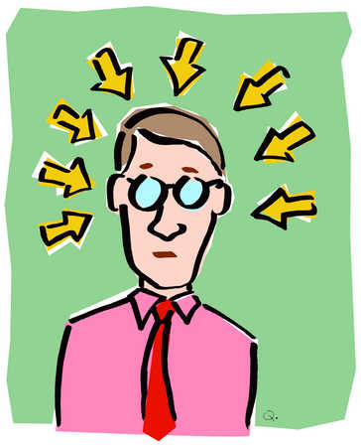
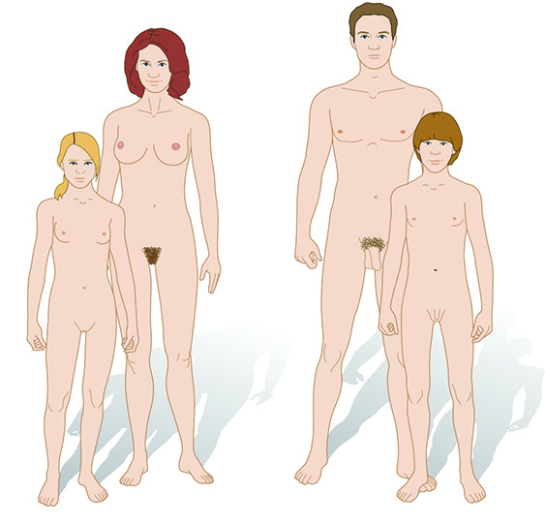
New Information
Adolescence is the time where you change from a child to an adult
Puberty is the physical changes that occur during adolescence
Sex Hormones that are made in the Ovaries in girls and the testes in boys. They are chemical messengers that travel round in your blood

Slide 4
New Information
What Changes happen to girls
Get taller and heavier
Bones grow bigger and heavier
Hips get wider and more curvy
Face changes shape
Voice gets a little deeper
Hair grows under the armpits, around the genitals (pubic hair)
Hair on arms and legs grows darker
Breasts and nipples get larger
Body sweats more
Internal and external sex organs grow
May have mood swings, sexual thoughts and feelings
What Changes happen to boys
Grow taller and heavier
Bones grow bigger and heavier
Nose and jaw get bigger and face gets longer
Get more muscles
Hair and skin can become oily and you may get spots
Body sweats more
Hair grows on the face, under the armpits, around the genitals (pubic hair).
May get more hair on arms, legs and chest.
Voice gets deeper
Penis and testicles grow bigger and longer
May have mood swings, sexual thoughts and feelings

Slide 5

Demonstration Phase
Write the changes that you think happen in
girls, boys and both in your Venn diagram –
we will add to this later
Changes in girls
Changes in boys
Changes in both

Slide 6
Demonstration Phase
Think about these questions and maybe discuss them with your partner.
Why do we need to grow up?
What is a typical concern a teenager might have about the changes they experience during adolescence?
Agony Aunt: You are an agony aunt for a teen magazine. Write back to the person with help and advice for their problems- use the key words below if you can
Main Activity
Green: Dear Agony Aunt Me and my brother are 12 and are twins. We have been learning about sex education in science, but we are unsure about how each of our bodies is going to change. Are we going to have the same changes or are they going to be different? Lisa
Blue: Dear Agony Aunt I’m sixteen years old and I’m starting to get very worried. My friends have started to become much taller than me and have started to grow facial hair. Some of them also have much deeper voices than me and my voice has started to become very squeaky and scratchy. Is this normal? Why isn’t it deeper than everyone else’s and why am I not having these changes like my friends? Bart
Yellow: Dear Agony Aunt I’m thirteen years old and I feel so much different since primary school. The boys in my class seem silly and immature and I’ve started to get new interests. My friends are into dolls and horses, but I’ve started reading magazines about boys and make-up. On some occasions I have fallen out with them a lot more. I’ve even started to wear some make-up and get a crush on a boy in the year above. Is this weird that I have new interests? Why are my friends different to me? What’s causing all this to happen? Marge
Keywords:
Adolescence:
The time period when physical and emotional changes occur in teenagers
Puberty:
The time when big physical changes happen in the body of a teenager
Hormones:
Chemicals in the body that cause puberty

Slide 8

Demonstration Phase
Can you add to your Venn Diagram?
Remember to use a blue pen!
Self/Peer Assessment
What Changes happen to girls
Get taller and heavier
Bones grow bigger and heavier
Hips get wider and more curvy
Face changes shape
Voice gets a little deeper
Hair grows under the armpits, around the genitals (pubic hair)
Hair on arms and legs grows darker
Breasts and nipples get larger
Body sweats more
Internal and external sex organs grow
May have mood swings, sexual thoughts and feelings
What Changes happen to boys
Grow taller and heavier
Bones grow bigger and heavier
Nose and jaw get bigger and face gets longer
Get more muscles
Hair and skin can become oily and you may get spots
Body sweats more
Hair grows on the face, under the armpits, around the genitals (pubic hair).
May get more hair on arms, legs and chest.
Voice gets deeper
Penis and testicles grow bigger and longer
May have mood swings, sexual thoughts and feelings

Slide 9

Consolidation phase
Write a short tweet about what you have learned at this stage in the lesson. Remember you can only use 140 characters...
Tweet it

Slide 10
Ethics and Values – Year 8
Lesson 5: Body Image
Learning intent: To learn about the nature of and influences on healthy and less healthy body image
Connection phase https://www.youtube.com/watch?v=nxpYuVr53zQ | Activation phase L/O I can understand what is meant by body image I can describe a positive and negative body image I can explain what factors affect a negative body image Watch the video and think about what ‘Body Image’ actually is Now think does body image only affect young girls? Who else can it affect?
https://www.youtube.com/watch?v=5mP5RveA_tk
https://www.youtube.com/watch?v=KF7OtqvIsV8

Slide 11
New Information
What is ‘Body Image’?
‘Your body image is how and what you think and feel about your body.’
It also includes the picture of your body that you have in your own mind, which might or might not match your body’s actual shape and size.
A positive body image
‘A positive or healthy body image is feeling happy and satisfied about your body, as well as being comfortable with and accepting the way you look.’
A negative body image
‘A negative or unhealthy body image is being unhappy with the way you look. It’s often associated with wanting to change your body size or shape.’
https://www.youtube.com/watch?v=IgqMqtnTJeE

Slide 12
https://www.youtube.com/watch?v=IgqMqtnTJeE
New Information
Stop avoiding your body
We know that one way to maintain negative body image is to avoid your body. So, in order to break this cycle, stop the avoidance! Face up to your body and get to know it, lumps, bumps and all. Get used to being with your body. If you usually avoid mirrors, start approaching them. Look at yourself as a whole person - don't just focus on the bits you don't like.
Stop checking
Some people check rather than avoid, which also perpetuates negative body image. Checking is when people repeatedly check their bodies for evidence of continuing "disgustingness". A person might study their body in the mirror for hours at a time, or pinch their sides to check on the "fat". Write a list of your "checking" behaviours. Once you have recognised what you are doing, make a point of refusing to check, or try to cut down.
Stop comparing
One form of "checking" behaviour is comparison. This is when you constantly compare your physical attributes to those of other people. It can be challenging to stop negatively comparing yourself to others: for many people, it's such a habit it is automatic and happens hundreds of times a day. Try to notice when you compare yourself to others and make a note of when you compare, who you compare yourself to, and what you say to yourself when it happens. Is it fair? Is it realistic? What effect does it have on how you feel about yourself? What can you say that may be more helpful?

Slide 13
New Information
Check out your assumptions
People sometimes interpret normal, everyday things as evidence of their "fatness". For example, a lot of women think that if their thighs or stomachs wobble, this means they are "fat". In actual fact, wobbliness is a normal female characteristic. We're made to wobble! Try to notice what you are assuming to be evidence of "fat", and look for the facts. This may mean doing a Google search, discussing your assumptions with friends and family, or even asking your GP.
Separate feeling bad from feeling fat
When you have weight or body-image issues, it can be hard to separate feelings from how you feel about your body. For example, if you have a stressful day at school, a fight with your parents and get an afternoon prep, you start to feel bad. You may then start to also feel "fat" and unattractive. If you start to feel this way, ask yourself what has triggered this feeling. Try to identify the real issue, and separate it from your body-image issues.
Practise self acceptance
Having a negative body image is like having a critic in your head. The critic is a harsh, derogatory narrative that makes nasty comments about you. For example, "I look disgusting in this outfit" or "I can't believe how fat I am". The critic makes you feel awful, because you believe it. Because you feel terrible about yourself, you look for ways to feel better. You may eat something, which gives momentary pleasure, but minutes later the critic is back to comment on how much of a pig you are for eating. The big key to changing negative body image is to kill the critic, and learn self-acceptance. This means accepting yourself as you are. Cognitive techniques are very effective in helping identify and change critical thinking. It can take time, but it's worth it

Slide 14
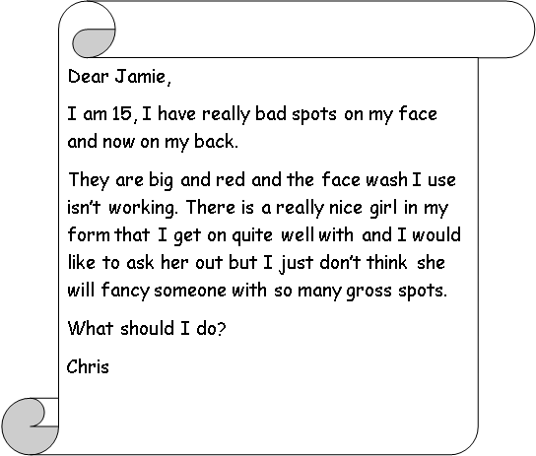
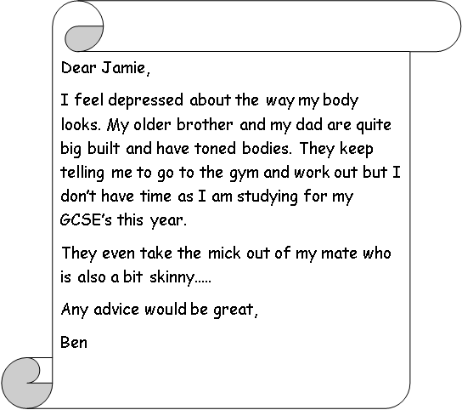
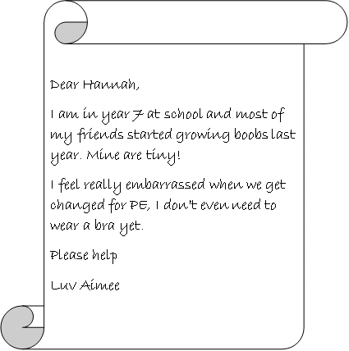
Demonstration phase Think of as many things that could affect a persons’ body image. Choose an agony aunt or understanding uncle and answer it in your books
https://www.youtube.com/watch?v=mRtjyAi5C3w

Slide 15

Consolidation phase
What question(s) do you still have?
Why do you think it was important to learn about this topic?
What has really stuck with you today?
Answer it

Slide 16
Ethics and Values – Year 8
Lesson 6: Self-esteem
Learning intent: To recognise the link between healthy self-esteem and healthy body image
Connection phase What are the definitions for both keywords? | Activation phase L/O I can understand how mental health can affect someone I can suggest tips for helping someone cope with mental health problems I can explain self-esteem, and someone can build their self-esteem
Adolescence
Puberty
https://www.youtube.com/watch?v=DxIDKZHW3-E
Don’t be afraid to talk about Mental Health

Slide 17
New Information
We all have times when we feel down or stressed or frightened. Most of the time those feelings pass. But sometimes they develop into a more serious problem and that could happen to any one of us.
Everyone is different. You may bounce back from a setback while someone else may feel weighed down by it for a long time.
Your mental health doesn’t always stay the same. It can change as circumstances change and as you move through different stages of your life.
How do mental Heath problems affect young people?
850,000 children aged 5-16 have mental health problems
Three children in every classroom have a diagnosable mental health disorder.
Nearly 80,000 children and young people suffer from severe depression.
Half of all lifetime cases of mental illness begin by age 14.
45% of children in care have a mental health disorder - these are some of the most vulnerable people in our society.
Nearly 300,000 young people in Britain have an anxiety disorder.
95% of imprisoned young offenders have a mental health disorder. Many of them are struggling with more than one disorder.

Slide 18
New Information
The top tips for helping friends or family cope with their mental problems are:
Encourage them to seek help from their doctor
Encourage them to talk about their feelings rather than bottling them up
Be sympathetic and affectionate, spend time with them
If they live alone send them messages to let them know you are thinking about them
Be patient with them; they might be irritable or behave in a way that may upset you.

Slide 19
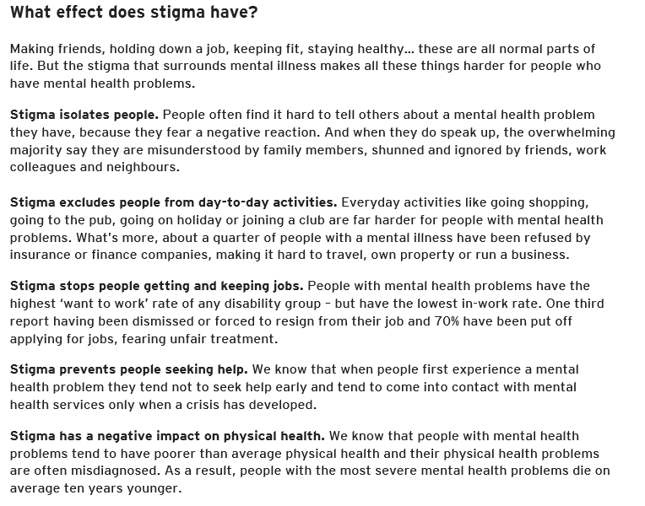

Slide 20
Demonstration Phase
A Time to Change survey found that nine out of ten people with mental health problems (87%) reported the negative impact of stigma and discrimination on their lives.
Stigma - a mark of disgrace associated with a particular circumstance, quality, or person
Main Activity
Task 1: How you can help people close to you who have mental health problems.
Choose three of these tips and explain why each of them is important. Why will it help your friend or family member?
The top tips for helping friends or family cope with their mental problems are:
Encourage them to seek help from their doctor
Encourage them to talk about their feelings rather than bottling them up
Be sympathetic and affectionate, spend time with them
If they live alone send them messages to let them know you are thinking about them
Be patient with them; they might be irritable or behave in a way that may upset you.
Task 2: Discuss how stigma of mental health affects people suffering from mental health problems:
It isolates people
It stops people getting and keeping jobs
It stops people seeking help
It has a negative impact on physical health
We know that people with mental health problems tend to have poorer than average physical health and their physical health problems are often misdiagnosed. As a result, people with the most severe mental health problems die on average ten years younger.
https://www.youtube.com/watch?v=hdPZ7rw0wMc

Slide 21

Demonstration phase Think about these questions – how relatable are they to you? I don’t answer questions in class even when I have the right answer When others praise me, it’s hard for me to believe what they say When I’m honest about what I really think, I’m embarrassed later I worry about how I look I don’t think I’m as good as other people I know I’d rather not do something than risk doing it wrong Consider the following questions: What affects our self-esteem? How can it be raised? How can it be lowered? | Consolidation phase Take risks. Push yourself, it’s not the end of the world if you fail Stand up for yourself. People may target you as they recognise you have low self esteem Be able to cope with criticism. View it as constructive rather than an attack on you Be realistic with your aims. You won’t ever be perfect and trying to be will make you miss all the things you did well at along the way Think positively. Focus on what you are good at and what you enjoy
Prepare a 30 second news report on the topic today. You can create this either to be presented on TV or on the radio. Remember – feel free to make it dramatic
Report it

