Slide 1

Make your own ideas come to life!
z
Stewards Academy
DESIGN & TECHNOLOGY
YEAR 8 CURRICULUM BOOKLET
z
“Imagine it, Design it, Make it”
Name: Technology Group: Tutor Group:

Slide 2
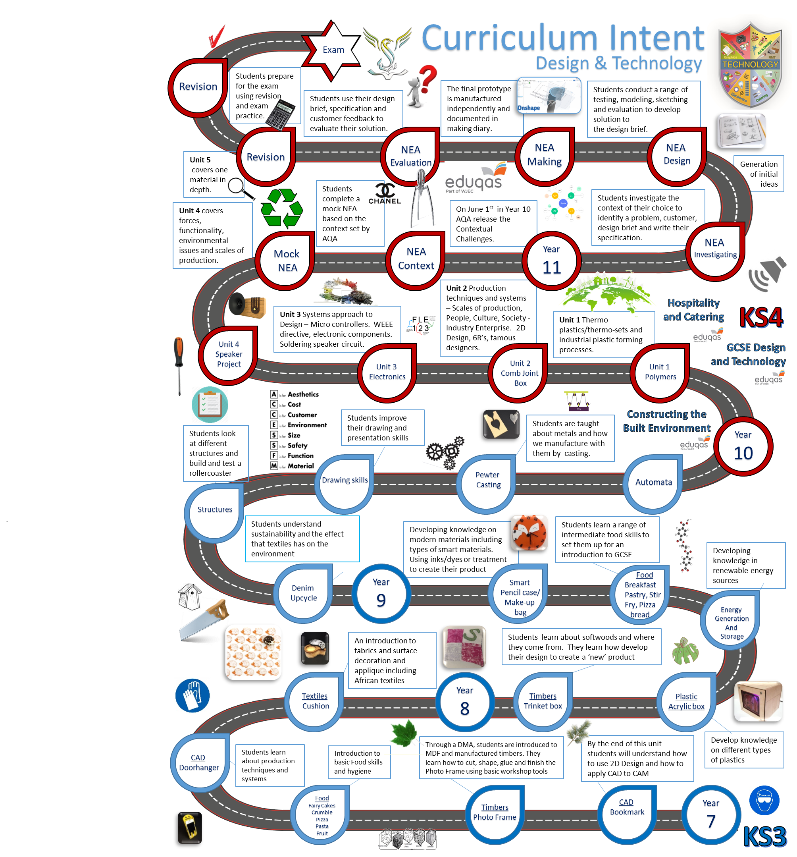

Slide 3
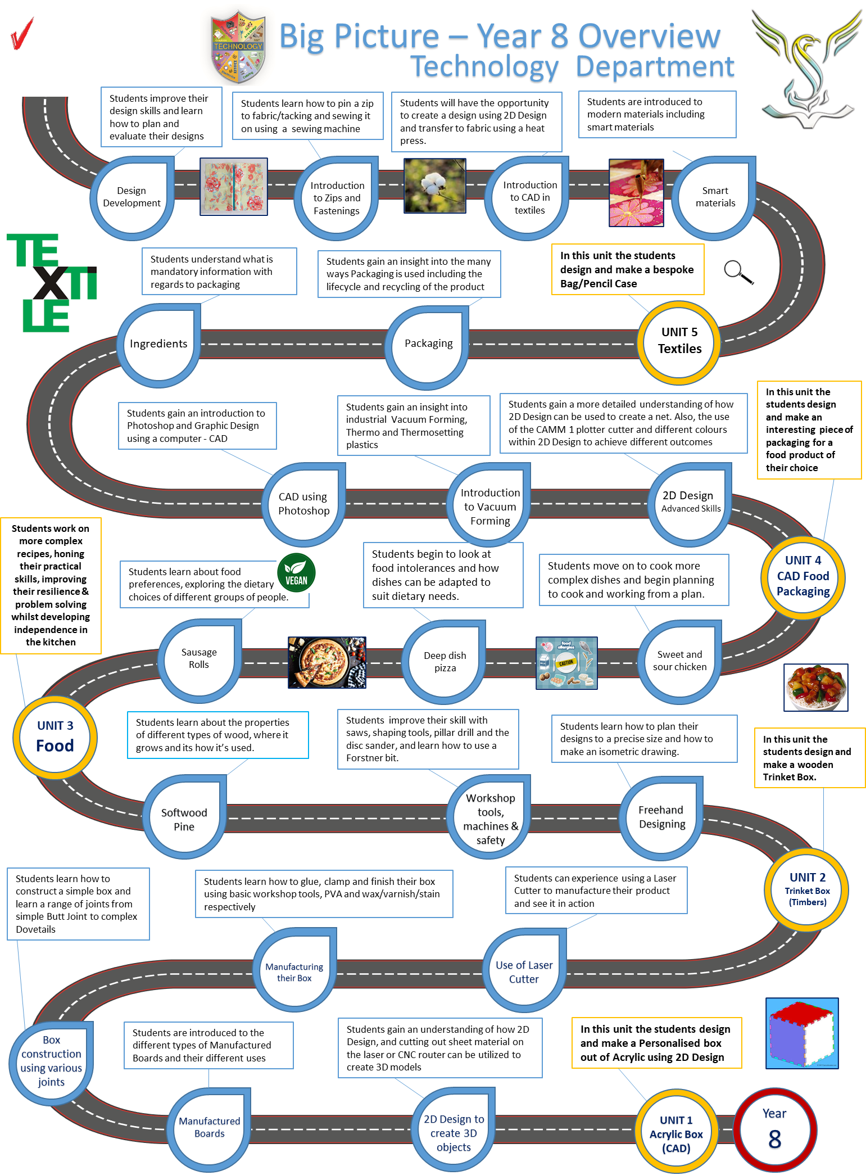

Slide 4

Rules for
Design & Technology workshops
DART
Year assessment of
Design & Technology
The biggest danger in a DT workshop is you.
You are at risk if you do not understand the hazards and consequences of accidents in the classroom.
Remember to always report any accidents, spillages or breakages to your teacher or technician.
Only enter a workshop when told to do so by a teacher or with teacher supervision
Keep your work area, and floor area tidy at all times
You must not run in a workshop at any time especially when machines are running
Follow instructions precisely and only use a machine or tool when instructed to do so.
Never remove anything from a DT workshop unless asked to move it to a different location
When using naked flames, ensure all loose/untucked items are secure.
Wear eye protection when specified
Stand up when doing most practical work so you are able to move quickly in-case of an emergency
Wash your hands thoroughly when entering a food technology room
If you are scalded, burnt or are aware that any chemicals have come into contact with your skin, immediately wash your hands with water until it has eased.
Assessment journey in Design and Technology. Fill in teacher initials and project
Yellow Plus
Yellow
Blue
Green
White
Average attainment:
Why is health and safety important?

Slide 5

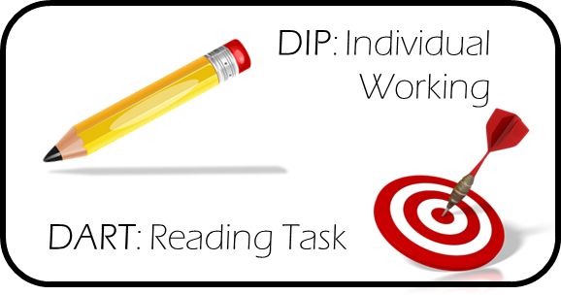
Year 8 Vocabulary (Key Words)
LI: To continuously reference key words when completing work
DART
Design brief
Something used to help us understand the problem that needs to be solved.
Design Specification
A list of conditions that a product should meet.
Analyse
Study something to discover and evaluate its features.
Ergonomic
Easy and comfortable for people to use.
Evaluate
Critically reviewing work to improve
Hazard
A potential danger to humans or the environment.
Model/Prototype
A practice version of a product that you make during the development stage. It’s probably made from easy-to-work materials and might be scaled down to size.
Thermochromic
A smart material that reacts and changes when in contact with heat.
CAD/CAM
Designing and manufacturing using a computer.
Renewable
A renewable resource is one that is replaced by natural processes as fast as it is consumed by humans, e.g. softwood trees in a plantation.
Conductor
An electrical conductor is a material that allows electricity to flow through it easily, e.g. copper. A thermal conductor is a material that lets heat flow easily.
Materials
Different types of fabrics, woods or metals used in manufacturing
Components
The different parts that are assembled to make a product.
Manufacture
To make

Slide 6
Make your own ideas come to life!
z
Stewards Academy
DESIGN & TECHNOLOGY
Smart Textiles Project
z
“Imagine it, Design it, Make it”
My target level................................

Slide 7
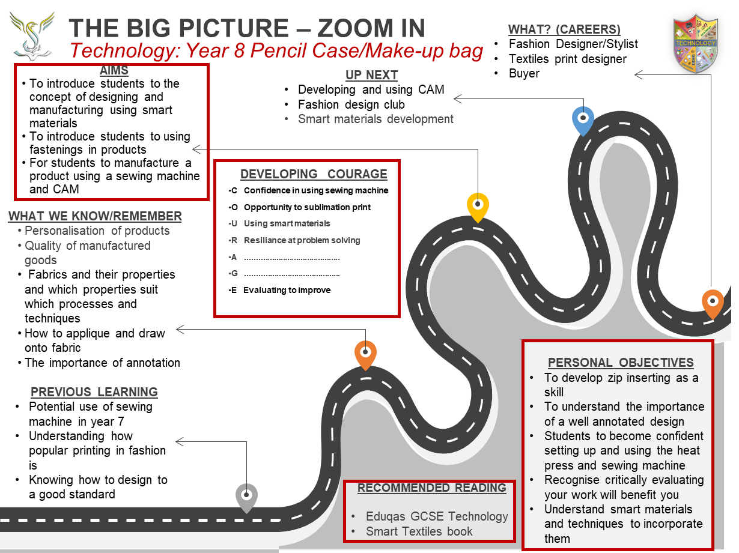
Notes:
7

Slide 8
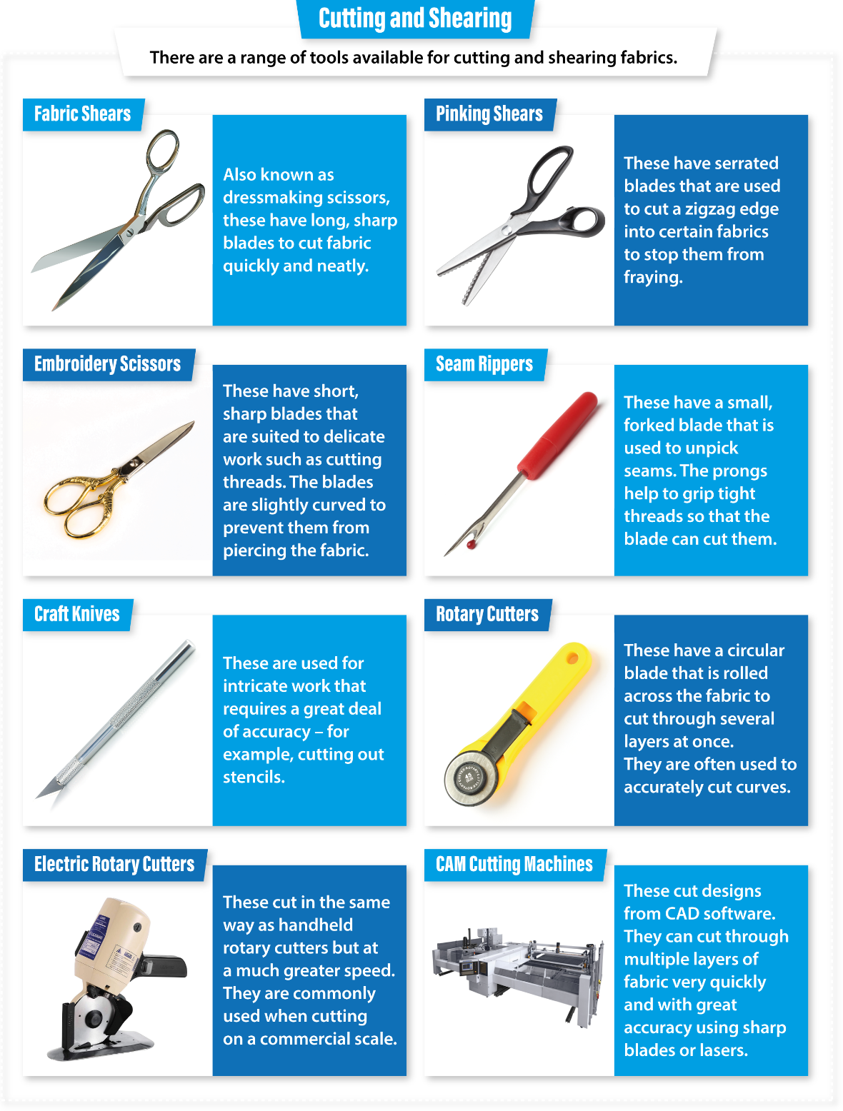
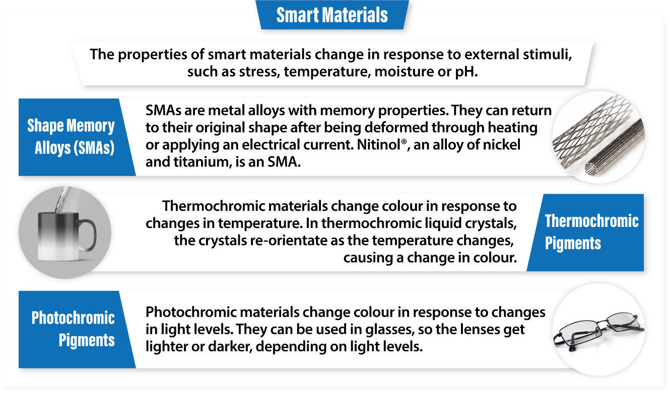
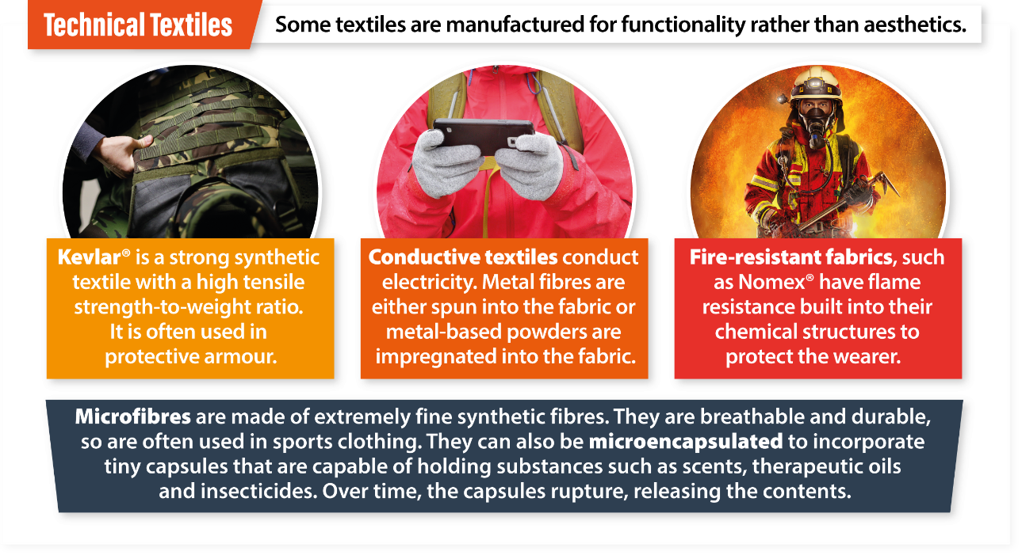
Knowledge Organiser

Slide 9
Assessment Ladder | PENCIL CASE/MAKEUP BAG PROJECT
 | Knowledge and Understanding | Skills
Yellow Plus | Understands safety in the workshop and can write 6+ rules. Knowledge of textiles materials, where they come from and their properties and be able to choose the appropriate one. Knows the names of all equipment, tools and decorative techniques and how to use/achieve them to a high standard. Evaluating critically of peers and shows ability for self-criticism and therefore improving. Insert a zip to a high standard. Recognises all types of smart materials and can define them. | Can produce 3 well drawn and coloured in designs that are annotated to a high standard Selects and uses a range of tools and equipment with accuracy to produce high quality products. Can use the sewing machine confidently, know how to thread it and produce a well sewn pencil case/makeup bag with a zip fastening
Yellow | Understands safety in the workshop and can write 5 rules Knowledge of textiles materials, where they come from and their properties Knows the names of all equipment, tools and decorative techniques and how to use/achieve them. Evaluating critically of peers and shows ability for self-criticism and therefore improving. Can insert a zip to a good standard Recognises all smart materials and can identify them | Can finish 3 designs that are well drawn and presented and annotated Chooses the correct tools, uses them accurately and creates quality products Know how to thread the sewing machine and produce a well sewn pencil case/makeup bag with a zip
Blue | Understands safety in the workshop and can write some rules. Knowledge of fabrics and where they come from Knows the names of some equipment, tools and decorative techniques Understand how to evaluate designs and a project Knows how to insert a zip Knows the name of smart materials | Can finish 3 designs to a reasonable standard. Selects and uses a range of tools and equipment safely and finishes their pencil case/makeup bag Sews the zip to a good standard
Green | Understands safety in the workshop and can copy out rules. Some knowledge of fabrics and where they come from Explains ideas and suggest ways to make them better. Knows the names of some equipment, decorative techniques and tools Needs some help in writing an evaluation. Understands how a zip works | Can create 2 or more design ideas Selects and uses tools, machines, and processes safely, May not finish manufacturing but understands how to insert a zip
White | Can be supported to be safe in the workshop. Can identify fabrics Knows the names of one or two tools and machines Can write an evaluation with help | Draws or demonstrates a simple idea with help. Can be helped to use simple tools and equipment safely. Tries to sew the pencil case to a good standard

Slide 10


Smart Textiles Pencil Case/Makeup bag
Design Brief
Key words: modern technologies, smart materials, thermochromic, photochromic, design, iterative, evaluate, manufacturing, designing, annotation
LI: Recognise the importance of a design brief
Developments in science and engineering lead to changes in materials technology. There are a range of modern materials with impressive properties, as well as traditional ones such as wood or metal. While smart materials are modern materials, modern materials are not necessarily smart. To be classed as a ‘smart material’ they need to exhibit a physical change in response to some external stimuli. In other words, they change when you do something to them, and when you remove what is causing that change, they return to their original form.
Tesco are looking for an innovative, new product that includes creative new technologies that will become the future of their gift set department. They need a variety of industry standard smart products using different smart techniques. The final product must be manufactured to a high quality, show good standards of inserting a zip and a well-practiced decorative technique.
DART
Design Brief - Success Criteria
Demonstrate that you can write a clear design brief and plan all your relevant research.
Demonstrate that you can write a design brief and how to plan research.
Demonstrate that you can write a basic design brief.
I am going to investigate, analyse and design…. _________________________________________________________________________________________________________________________________________________________________________________________________________________________________________________________________________________________________________________________________________________________________________________________________________________________________________________________________________________________________________________________________________________________________________________________________________________________________________________________________________
Next Steps…
Add more detail to your Design Brief regarding Customer, Material and the Shape of your product. Use ACCESS FM to help you. What else could you add?
Use red, yellow or green stickers to let me know how you’re getting on with each worksheet.
Extend yourself and reflect in the boxes throughout the booklet and then improve your work in blue pen

Slide 11
Health and Safety
LI: Recall hazards in a textiles workshop
DIP
Fabric Scissors
Sewing Machine
Pins
Needles
Bags/Coats/Chairs
ITEM/EQUIPMENT
SAFETY RULE
REASON
I declare that I know how to work safely in a textiles workshop
Print name: ……………………............................ Sign: …………………………………..

Slide 12
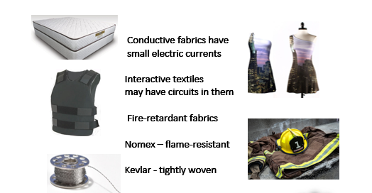
Smart materials
LI: Obtain knowledge about smart materials and their uses
What is a smart material?
Choose 3 of these and write down a definition for them and where you would find them used. (Extend yourself by defining all 5). Thermochromic, photochromic, hydrochromic, shape memory polymer, electrochromic
DIP

Slide 13
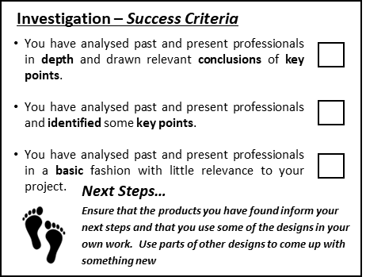
Stick inspiration Moodboard HW here

Slide 14
Specification
Specification – Success Criteria
DIP
You can write a fully justified specification which helps design innovative, functional and appealing products.
You can write a specification, which is justified in parts, and helps design appealing products.
You can write a specification
Specifications are detailed statements prescribing materials, dimensions, and quality of work for something to be designed or built.
LI: Understand how a specification can be used to refer to when designing
Next
Steps…
Aesthetics
Consumer
Cost
Environmental
Sizing
Safety
Function
Material
*Ensure that the points you mention are measurable and you can easily see whether your design work meets these points. *Remember you will evaluate your final product around the Specification at the end.

Slide 15


Existing Products
Initial product research will help you evaluate your idea for a new product and service and see if there is a need for it and what it is that your potential customers are looking for. If your product already exists, product research will tell you whether the available options on the market are meeting the needs and expectations of existing customers. This way you can learn what you can do differently, to meet the needs and expectations but also to exceed the competition.
Investigation – Success Criteria
You have analysed past and present professionals in depth and drawn relevant conclusions of key points.
You have analysed past and present professionals and identified some key points.
You have analysed past and present professionals in a basic fashion with little relevance to your project.
Use the space below to help you generate ideas for your cushion. You can use any form of investigation e.g. Internet, magazines, newspapers or books.
Look for key aspects that you could use in your designs.
DART
What words will you use to research?
Next Steps…
Ensure that the products you have found inform your next steps and that you use some of the designs in your own work. Use parts of other designs to come up with something new
Your Image Here
DIP
Your Image Here
Your Image Here
Your Image Here
l like this because:
.................................................................................................................................................................................................................This can be improved by:
...............................................................................................................................................................................................................
l like this because:
.................................................................................................................................................................................................................This can be improved by:
...............................................................................................................................................................................................................
l like this because:
.................................................................................................................................................................................................................This can be improved by:
...............................................................................................................................................................................................................
l like this because:
.................................................................................................................................................................................................................This can be improved by:
...............................................................................................................................................................................................................

Slide 16


Mind Map
DIP
Investigation – Success Criteria
LI: Generate ideas to produce your product
You have analysed past and present professionals in depth and drawn relevant conclusions of key points.
You have analysed past and present professionals and identified some key points.
You have analysed past and present professionals in a basic fashion with little relevance to your project.
What is another word for mind-mapping?
Next Steps…
Ensure that the products you have found inform your next steps and that you use some of the designs in your own work. Use parts of other designs to come up with something new
Mind mapping increases your creativity and productivity because it's an excellent tool to let you generate more ideas, identify relationships among the different data and information, and effectively improve your memory and retention. Making a mind map is an excellent way for you to be able to sort through your thoughts and ideas. This activity allows you to quickly generate creative and even unique ideas in less time. It gives you the freedom you need when brainstorming so that the flow of ideas is not blocked or hampered like linear thinking does.
Pencil Case/
Make-up bag
DART

Slide 17
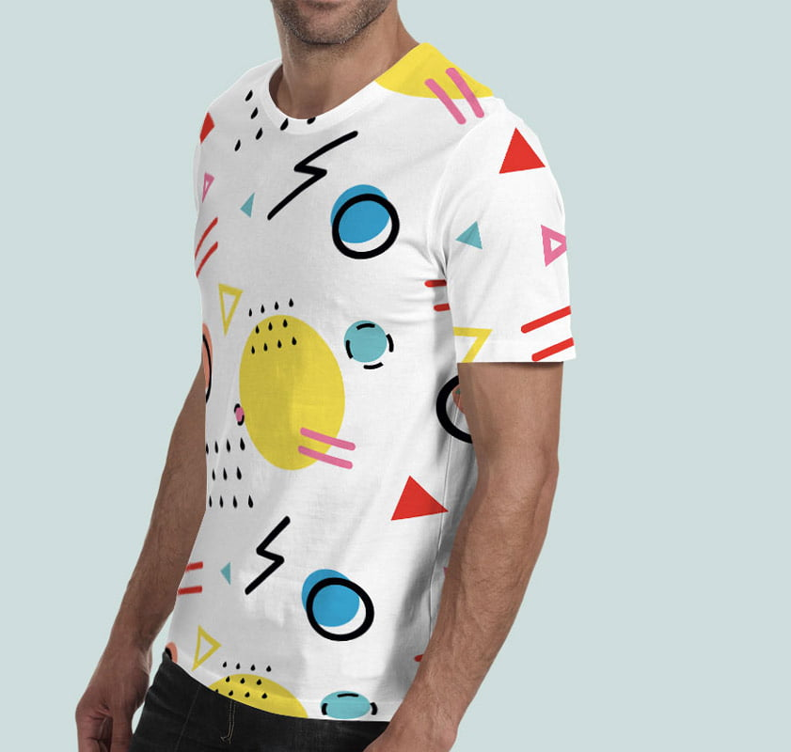
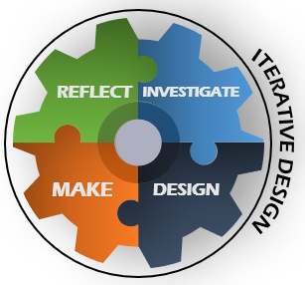

SUBLIMATION PRINTING HOMEWORK
LI: Analyse a recognised technique in the textiles industry and understand how we will use this for our project.
DIP
Sublimation printing definition:
Fabrics best for sublimation printing and why?
Pros of sublimation printing include......
However, the cons are.......
Extend: Think about what we are trying to achieve for this project. Why would sublimation printing be a good alternative for smart inks and expensive resources?

Slide 18

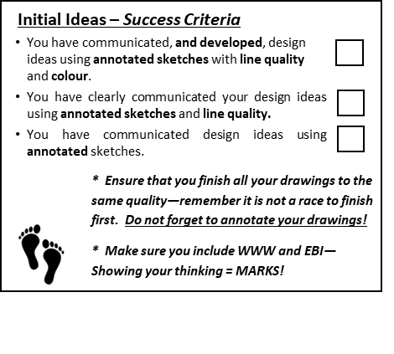

Initial Ideas
DART
LI: Evaluate during the design process to improve
Design and technology is a practical and valuable subject. It enables children and young people to actively contribute to the creativity, culture, wealth and well-being of themselves, their community and their nation. It teaches how to take risks and so become more resourceful, innovative, enterprising and capable. Students develop a critical understanding of the impact of design and technology on daily life and the wider world. Additionally, it provides excellent opportunities for students to develop and apply value judgements of an aesthetic, economic, moral, social, and technical nature both in their own designing and when evaluating the work of others.
Idea 1
Idea 2
Idea 3
Idea 1
Idea 2
Idea 3
DIP
Peer evaluation
…………………………………………………………………………………………………………………………………………………………………………………………………………………....................................................................................................................................................
Teacher evaluation
…………………………………………………………………………………………………………………………………………………………………………………………………………………....................................................................................................................................................
Self Evaluation
…………………………………………………………………………………………………………………………………………………………………………………………………………………....................................................................................................................................................
Start creating your initial ideas. Reflect on them after the evaluations and improve the next one.

Slide 19
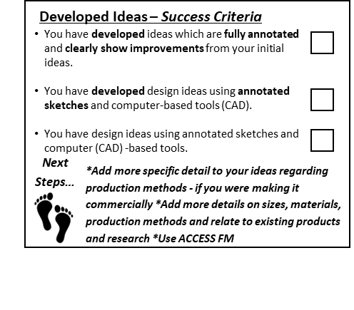
Final Idea Homework
Numeracy Challenge
What is the size of a standard zip?
What will the measurements of my product be?
Draw your final design front and back. Remember to annotate with the fabrics and techniques you will use
LI: Reflect during the design process to improve
DIP

Slide 20
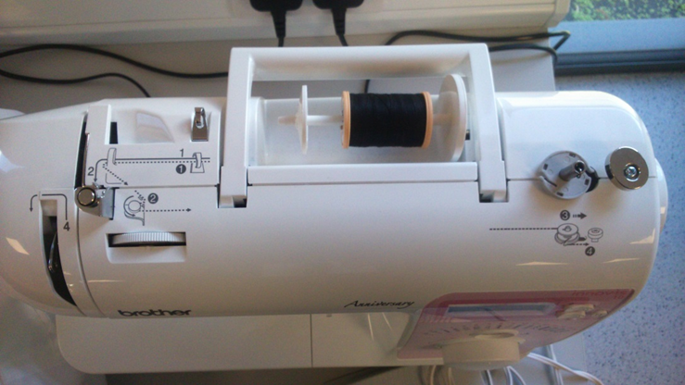
Equipment Set-up
DIP
Use a pencil to draw how you would wind a bobbin on.
Write yourself a tip for winding the bobbin on.
….........................................................................................................................................................................................................
Write down 3 steps to follow that you will understand when threading a machine
............................................................................................................................................................................................................
LI: Recall sewing machine knowledge
After the demonstration, think about how to thread a machine and bobbin.
Winding on a bobbin;
Label up in a way you will remember (eg, around the duck pond)
Extension: Write down a health and safety rule to remember when threading a sewing machine.

Slide 21
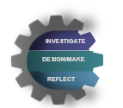
Stages of Manufacture
Step by step, it is necessary to have every detail of your process verified as much as possible to eliminate potential mistakes that could take a lot of time and money to recover from at a later stage. It is important to understand that any adjustments that need to be made during the design for manufacturing process will take time and affect the overall timeline. However, the payoff will be greater in the long run.
DART
LI: Recall prior manufacturing knowledge
In Design and Technology, a step-by-step plan will help you remember how to manufacture your product with fewer problems. Number these stages so they’re in the correct order in black pen. Highlight the equipment needed.
As a class we will go through the answers. Please mark yourself in blue pen.
Stages of Manufacture – Success Criteria
You have precise and detailed planning for how you will manufacture your idea with exact details.
You have some clear planning for how you will manufacture your idea with some details.
You have some basic planning for how you will manufacture your idea.
There is less chance of ………………......................................... If you plan beforehand.
SEW AROUND YOUR TWO PIECES (SEWING MACHINE)
CUT OUT FABRIC (FABRIC SCISSORS)
*Add more technical details including the names of the tools/equipment, break down each stage into subsections
*Use a black fine liner, ruler and coloured pencils to enhance your work
PIN PATTERN TO FABRIC (PINS)
LEAVE ZIP OPEN WHEN SEWING SO WE CAN TURN INSIDE OUT
Why is it important for you to know the stages of manufacture?
DRAW AND CUT YOUR PATTERN (SCISSORS AND PENCIL)
PIN PIECES TOGETHER (PINS)
TURN INSIDE OUT AND PUT YOUR CONTENTS IN
INSERT YOUR ZIP (SEWING MACHINE)
DECORATE YOUR PIECES OF FABRIC WITH YOUR CHOSEN TECHNIQUE
Mark out of 9:
DIP

Slide 22
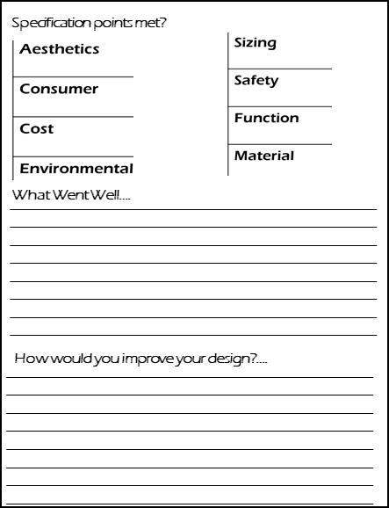
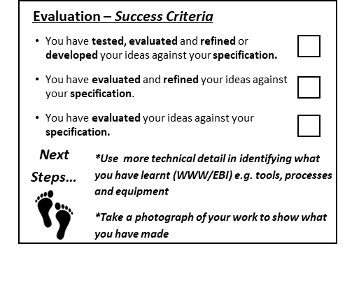
Evaluation
It is important for a designer to test and evaluate their prototype and finished product against the design specification by conducting a variety of tests under realistic conditions. This ensures that the product is fit for purpose and responds to wants and needs of the user. Feedback may be asked from the client, target market and other experts in the market. Allowing these groups of people to physically test the product, by handling and using it, will help in gathering useful feedback for improvements to be made. You must critically analyse your product and think of it as if you did not make it
DIP
LI: Analyse and evaluate entire project.
Who can you ask to test your product?
DART
Your Image Here
Well done for completing your project!

Slide 23
Make your own ideas come to life!
z
Stewards Academy
DESIGN & TECHNOLOGY
Trinket Box Project
z
“Imagine it, Design it, Make it”
My target level................................

Slide 24
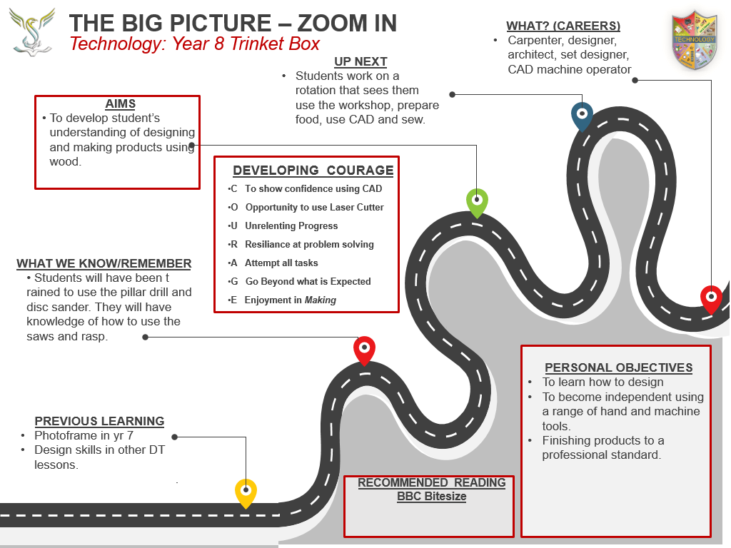

Slide 25
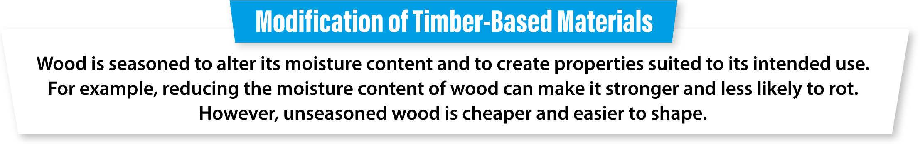
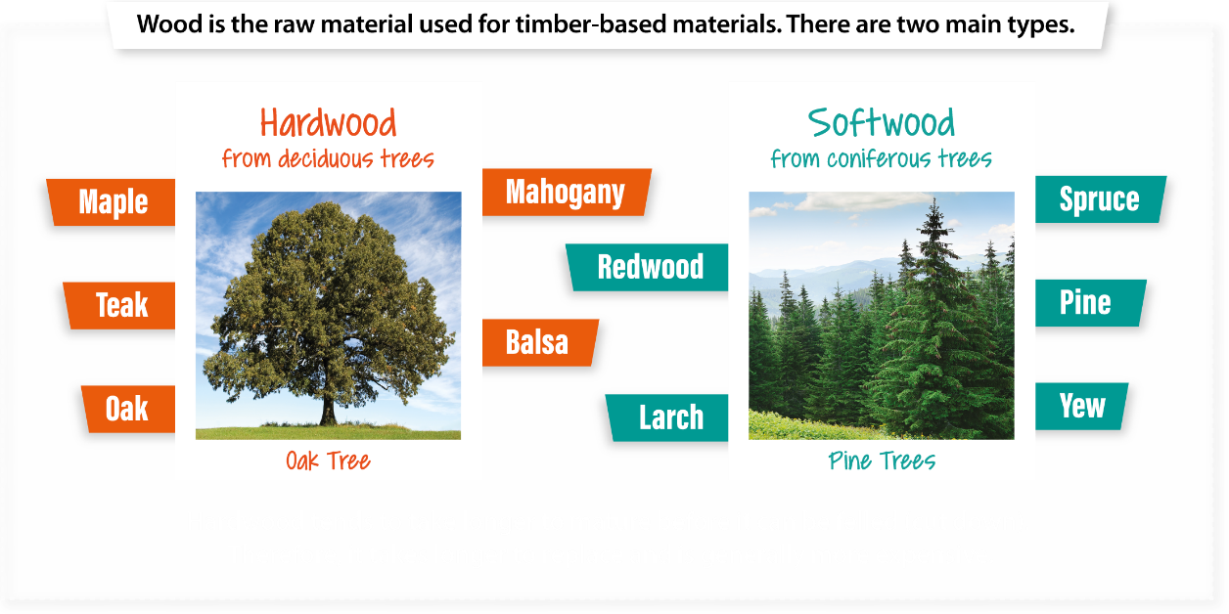
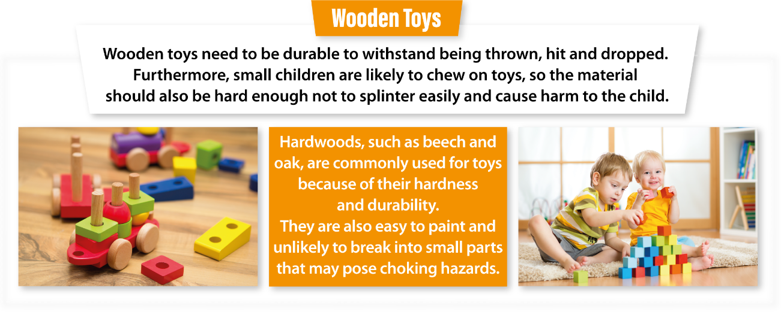
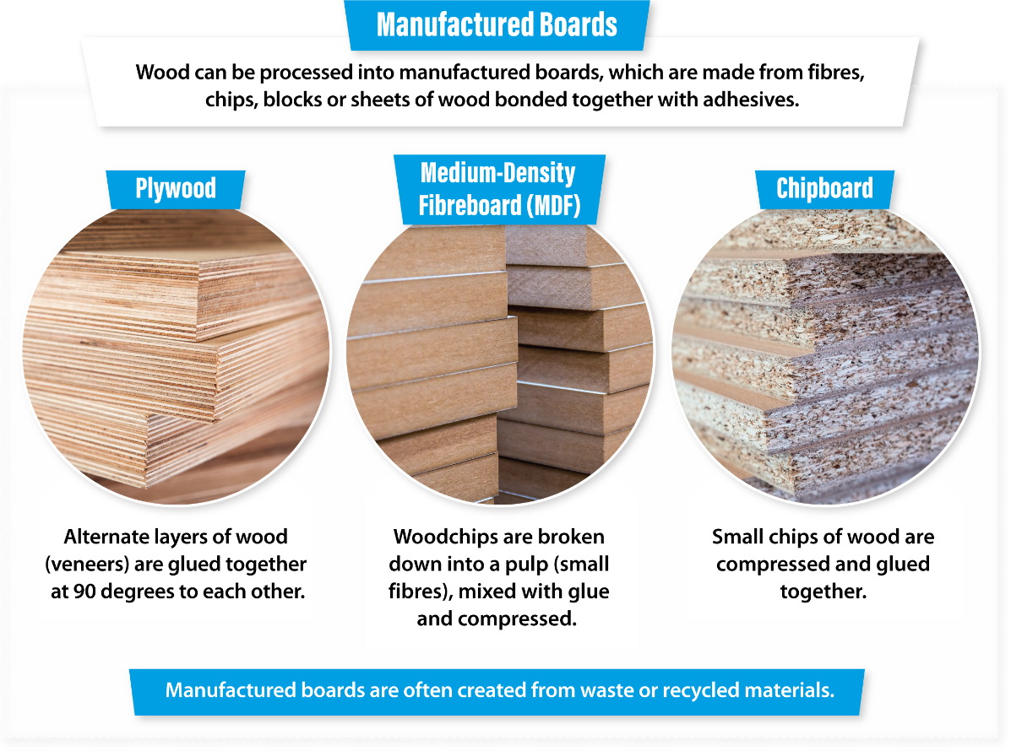
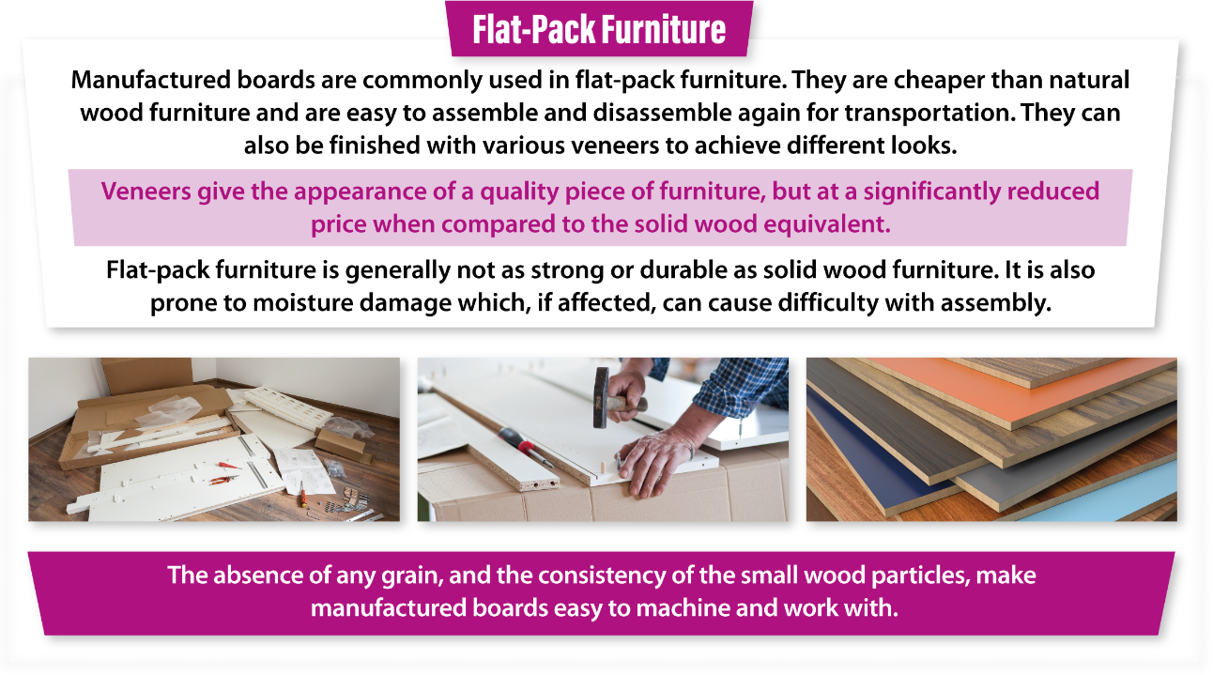
Knowledge Organiser

Slide 26
Assessment Ladder | TRINKET BOX
 | Knowledge and Understanding | Skills
Yellow Plus | Produces independent projects to a high standard. Understands how to design in colour and to annotate designs to a high standard. Knowledge of tools, materials, and processes is used to predict the time needed to complete the project. Evaluation shows ability for self criticism | Can analyse and evaluate research Uses research to help design work. Produces 4 good quality designs, annotated and can develop designs and produce a final design. Able to create a making plan Selects and uses a range of tools and equipment with accuracy to produce high quality products. Can evaluate research, designs and making.
Yellow | Good knowledge of how to research to find quality images. Annotation shows understanding of how products are made Knowledge of tools, materials and processes help to make good quality products. Evaluation shows understanding of how to improve work. | finds a variety of unusual research images, analyses them and evaluates research. Produce 4 good designs from the research and 1 final design in colour and annotated. Able to work out the sequence of a making plan Chooses the correct tools, uses them accurately and creates quality products Can evaluate work Understands and can set up cadcam in 2design
Blue | Has sound knowledge of tools and workshop safety Understands how designs come from research and imagination. Understands how to do a simple evaluation. | Can find useful research images and evaluate research Can make 3 design ideas, annotated and in colour, 1 final design Can follow a simple plan Selects and uses a range of tools and equipment safely, 3 www and 3 EBI’s. Can create sophisticated designs using 2ddesign
Green | Understands the information and explains ideas and concepts with limited support. Explains ideas and suggest ways to make them better. | Can research independently and print out images to help designs Can create 2 design ideas and improve one final design Selects and uses tools, machines and processes safely, taking into consideration the health and safety aspects with little supervision. Can use a variety of tools in 2ddesign well
White | Remembers information with help. Identifies likes and dislikes of products. | Research information with help. Draws or demonstrates a simple idea with help. Can be helped to use simple tools and equipment safely. Can use basic tools and colour in 2d design with help

Slide 27

Trinket Box - Design Brief
LI: Complete a relevant design brief
On this project you will design a trinket box to hold a ring, a necklace, a small coin or other precious object.
You will make it using the workshop tools and machines.
You will paint it using acrylic paint and put some material inside. You can then take it home.
Numeracy Challenge
If each letter of the alphabet has a value according to its position (i.e.. A=1 B=2 C=3 and Z=26).
What is the Total of
JEWELLERY = ……………….
DIP
Key Words from the TASK
Deeper thoughts?
Design Brief - Success Criteria
Demonstrate that you can write a clear design brief and plan all your relevant research.
Demonstrate that you can write a design brief and how to plan research.
Demonstrate that you can write a basic design brief.
Who? What? Where? When? Why How?? Why?
Next Steps…
Add more detail to your Design Brief regarding Customer, Material and the Shape of your product. Use ACCESS FM to help you. What else could you add?
I am going to research, design and manufacture a…..
Write your Brief here…
Literacy Target Area: | Action(s)
Spelling: | Make use of a dictionary
 | List and learn corrections
Punctuation: | Use the punctuation pyramid
 | Write in FULL sentences
Vocabulary: | Use Key Words for this subject
Grammar: | Correct Non-Standard English

Slide 28
Mind Map
Investigation – Success Criteria
You have analysed past and present professionals in depth and drawn relevant conclusions of key points.
You have analysed past and present professionals and identified some key points.
You have analysed past and present professionals in a basic fashion with little relevance to your project.
LI: Generate ideas to produce your product
DIP
Next Steps…
Ensure that the products you have found inform your next steps and that you use some of the designs in your own work. Use parts of other designs to come up with something new
Mind mapping increases your creativity and productivity because it's an excellent tool to let you generate more ideas, identify relationships among the different data and information, and effectively improve your memory and retention. Making a mind map is an excellent way for you to be able to sort through your thoughts and ideas. This activity allows you to quickly generate creative and even unique ideas in less time. It gives you the freedom you need when brainstorming so that the flow of ideas is not blocked or hampered like linear thinking does.
Trinket box
What conclusions have your drawn from your mind-map?
DART

Slide 29

Existing Products
Initial product research will help you evaluate your idea for a new product and service and see if there is a need for it and what it is that your potential customers are looking for. If your product already exists, product research will tell you whether the available options on the market are meeting the needs and expectations of existing customers. This way you can learn what you can do differently, to meet the needs and expectations but also to exceed the competition.
Investigation – Success Criteria
You have analysed past and present professionals in depth and drawn relevant conclusions of key points.
You have analysed past and present professionals and identified some key points.
You have analysed past and present professionals in a basic fashion with little relevance to your project.
Use the space below to help you generate ideas for your cushion. You can use any form of investigation e.g. Internet, magazines, newspapers or books. Look for key aspects that you could use in your designs.
DART
What is a business competitor?
Next Steps…
Ensure that the products you have found inform your next steps and that you use some of the designs in your own work. Use parts of other designs to come up with something new
Your Image Here
DIP
Your Image Here
Your Image Here
Your Image Here
l like this because:
.................................................................................................................................................................................................................This can be improved by:
...............................................................................................................................................................................................................
l like this because:
.................................................................................................................................................................................................................This can be improved by:
...............................................................................................................................................................................................................
l like this because:
.................................................................................................................................................................................................................This can be improved by:
...............................................................................................................................................................................................................
l like this because:
.................................................................................................................................................................................................................This can be improved by:
...............................................................................................................................................................................................................

Slide 30
Investigating the project: Materials
Pine wood comes from pine trees that grow in the cool and temperate regions of the northern hemisphere. There are vast pine forests in Europe, North America and Siberia
LI: Obtain knowledge on pine wood and it’s appearance
Fill in the missing words. The word bank is at the bottom
Pine Wood
Trees and the wood they give us are divided into two categories, soft and hardwood. It is the size of the …….. that make up the trees which makes them hard or soft. However, not all softwoods are soft and not all ……………..are hard. Confusing isn't it?
Pine wood is a softwood, and it is one of the easy ones as it is easy to cut and sand.
Pine wood trees look like Christmas trees. They have thin needle-like leaves to stop them losing water. They grow for ……...years before they are cut down and sawn up.
Every year all trees add an extra layer on the outside of the tree just under the …….... So, the oldest part of the tree is the centre at the bottom. When we cut down a tree, we can see the growth rings and scientists can tell if there was a warm, long …………...or a short cold one, through the size of the growth ring.
In Canada and USA, trees are cut down and floated down the river in huge numbers to the lumber mill or …….... Here, they are processed into many different products.
Sawmills waste very little of the original tree. They use the bark for fertilizer, they use the main part of the tree to make …….. of wood and they use the wasted chips of wood to make …………. and MDF.
Word bank: Sawmill, Growth, chipboard, 30-50, planks, summer, Cells, hardwoods, bark,
DART

Slide 31
Investigating the project: Pine
Draw a typical pine tree in this box.
Make sure it is in colour
Draw in colour a cross section of a tree in the box. Make sure you label;
Growth rings
Bark
Branch
Draw a typical softwood branch and leaves in this box.
Label the drawing.
Draw it in colour
DIP

Slide 32
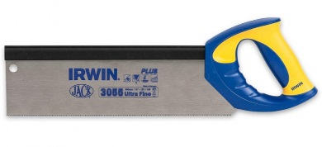
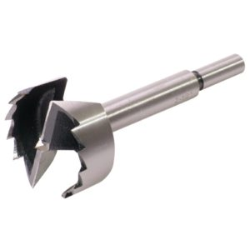
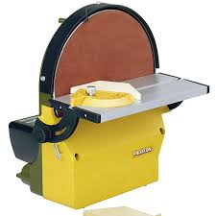
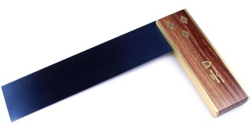
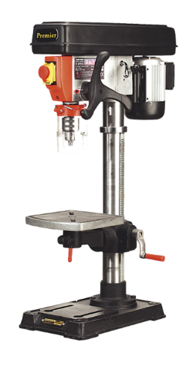
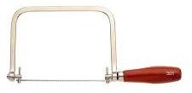
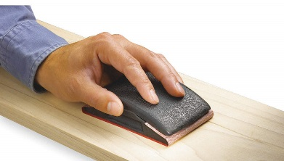
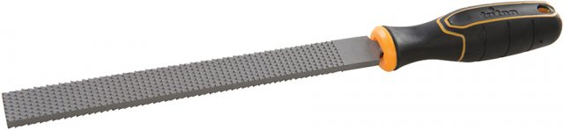
Manufacturing Tools
LI: Recognise all workshop tools
DIP
1. Unscramble the names of the tools you have used before,
the new tools have not been scrambled. They are the forsner bit,
the rasp and the try square
2. Write them by the photograph of the correct tool or machine
try square
neont was
rasp
ginands cklob
scid sneard
forsner bit
praill llird
cogpin was
trinket box

Slide 33
Specification
Specification – Success Criteria
You can write a fully justified specification which helps design innovative, functional and appealing products.
You can write a specification, which is justified in parts, and helps design appealing products.
You can write a specification
Specifications are detailed statements prescribing materials, dimensions, and quality of work for something to be designed or built.
DIP
LI: Understand how a specification can be used to refer to when designing
Next
Steps…
*Ensure that the points you mention are measurable and you can easily see whether your design work meets these points. *Remember you will evaluate your final product around the Specification at the end.
Aesthetics
Consumer
Cost
Environmental
Sizing
Safety
Function
Material

Slide 34
Initial Ideas
DART
LI: Evaluate during the design process to improve
Before you cut your first board, you must have a design to achieve the results you're after. To create a workable design, you must understand important properties of the wood you will be using, methods for joining that wood, typical construction techniques that are appropriate for the type of project you are building, styles of craftsmanship that will enhance and compliment the environment where this project will be used, and finally how to think through and plan a project.
DIP
What is in-depth labelling called?
Idea 1
Idea 2
Idea 3
Idea 1
Idea 2
Idea 3
Peer evaluation
…………………………………………………………………………………………………………………………………………………………………………………………………………………....................................................................................................................................................
Teacher evaluation
…………………………………………………………………………………………………………………………………………………………………………………………………………………....................................................................................................................................................
Self Evaluation
…………………………………………………………………………………………………………………………………………………………………………………………………………………....................................................................................................................................................
Start creating your initial ideas. Reflect on them after the evaluations and improve the next one.

Slide 35
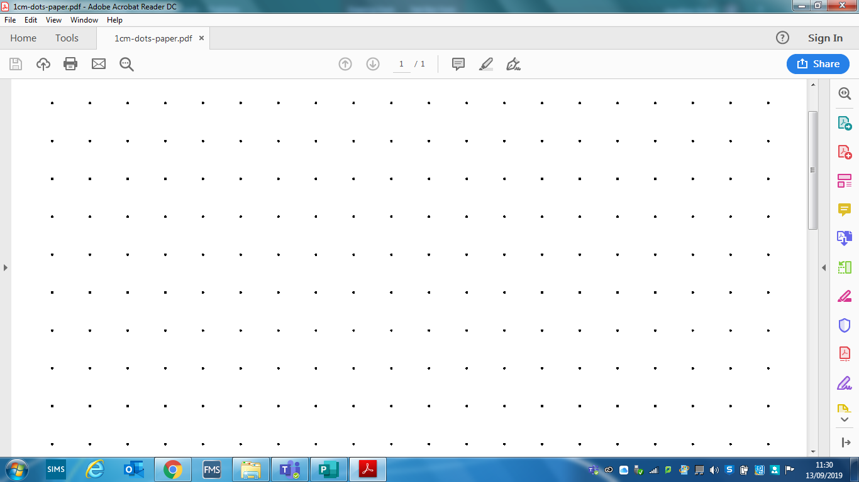
Design 1
LI: Complete designs to a high standard
Use a ruler to draw the outline shape of the trinket box. When you have done this think of 2 designs and draw them as neatly as you can in colour. Think about what you might want to store in your box. If it is plectrums for a guitar, you could make your box guitar shaped. Try to make a relationship between the shape of the box and what is kept inside. Or alternatively you might want to use an initial of your name. You are free to decide.
Design 2
DIP

Slide 36
Design Design 3
Design 3
LI: Reflect and evaluate your peer’s work
Peer Evaluation
Ask someone in the class to evaluate your best design.
Their name is
The best design is design
Why?
Can you see any problems in making this trinket box?
DIP

Slide 37
Final Design
Use Isometric paper to draw an isometric drawing of your finished design.
LI: Learn how to draw in isometric.
DIP

Slide 38
Production Diary
pillar drill, coping saw, sand paper,
try square, paint, steel rule, paint brush, vice, scissors
LI: Remember the step by step process of making a product
At the end of each lesson you need to record what you have done.
You need to include any mistakes or things that went wrong.
DIP
Lesson 3
Mark out
Start cutting
Lesson 4
Finish cutting
Drill forstner bit
Lesson 5
Sand box
Drill second hole
Lesson 6
Finish sanding
Screw hinge
Lesson 7
Paint
Fit material

Slide 39


Evaluation
LI: Reflect and evaluate on your project
Print an image of your finished product and glue it in the space provided. Then review your product against your specification points, say what went well and, most importantly, how you would improve it.
DIP
Your Image Here
Literacy Target Area: | Action(s)
Spelling: | Make use of a dictionary
 | List and learn corrections
Punctuation: | Use the punctuation pyramid
 | Write in FULL sentences
Vocabulary: | Use Key Words for this subject
Grammar: | Correct Non-Standard English

Slide 40
Make your own ideas come to life!
z
Stewards Academy
DESIGN & TECHNOLOGY
Energy Generation and Storage
z
“Imagine it, Design it, Make it”
My target level................................

Slide 41


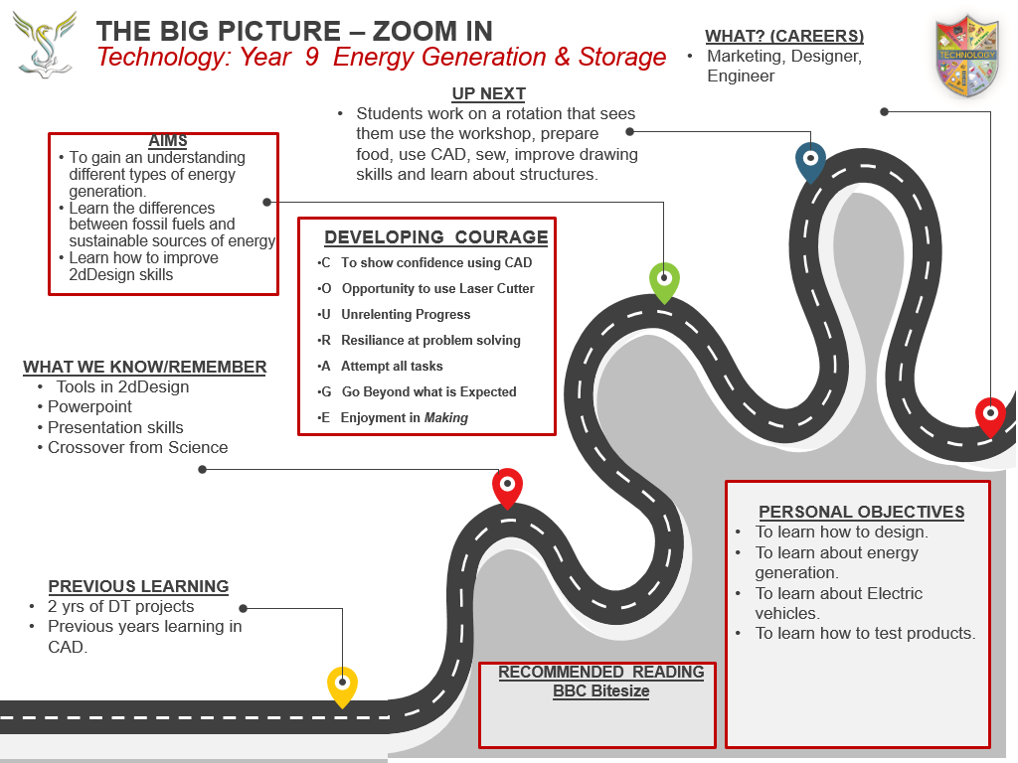
THE BIG PICTURE – ZOOM IN
Technology: Year 8 Energy Generation and Storage
WHAT? (CAREERS)
AIMS
UP NEXT
DEVELOPING COURAGE
C Confidence in using
O Opportunity to sublimation print
U Using smart materials
R Resiliance at problem solving
A ...........................................
G ...........................................
E Evaluating to improve
WHAT WE KNOW/REMEMBER
PERSONAL OBJECTIVES
PREVIOUS LEARNING
.
RECOMMENDED READING
Eduqas GCSE Technology

Slide 42
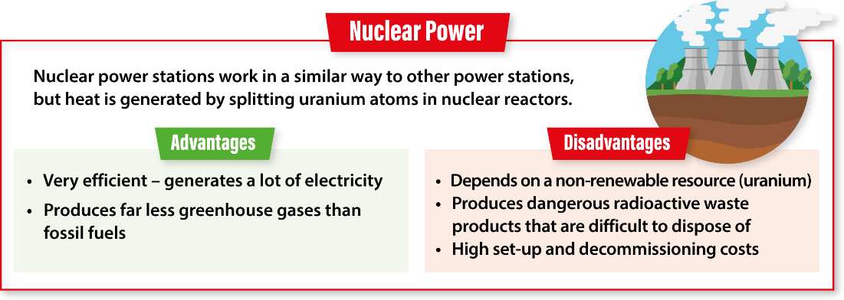
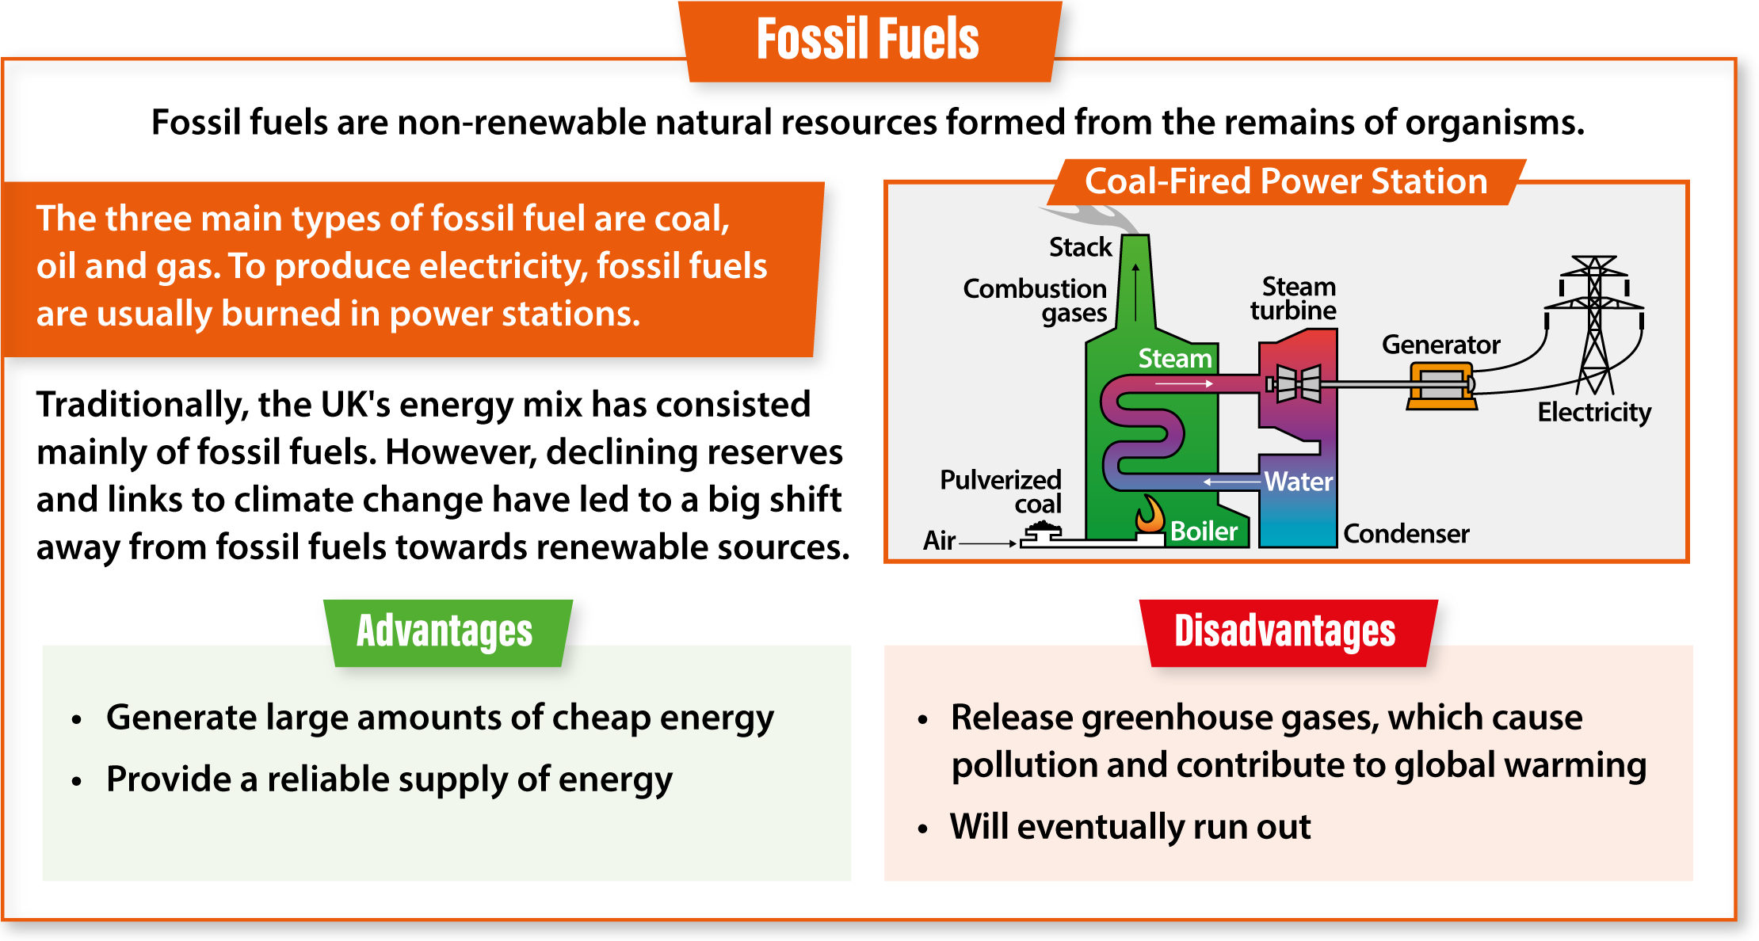
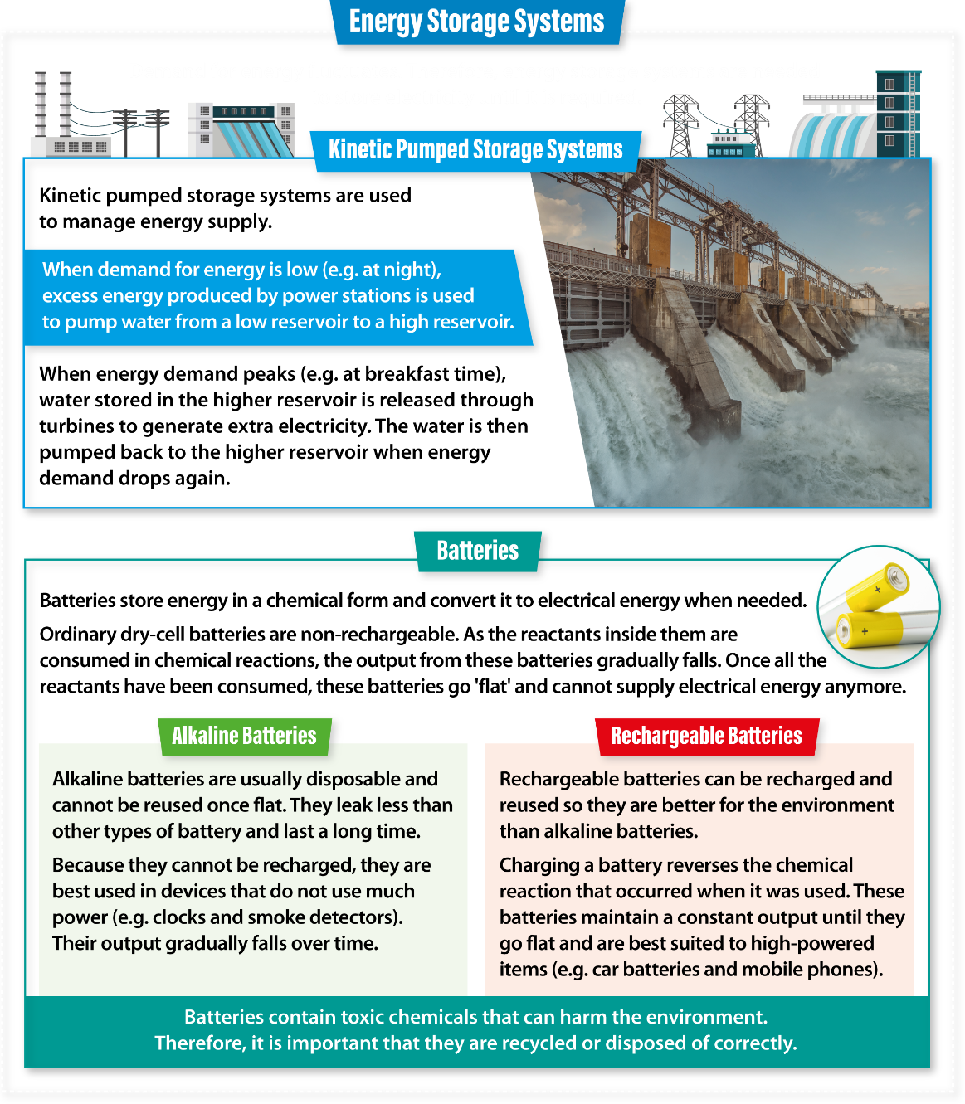
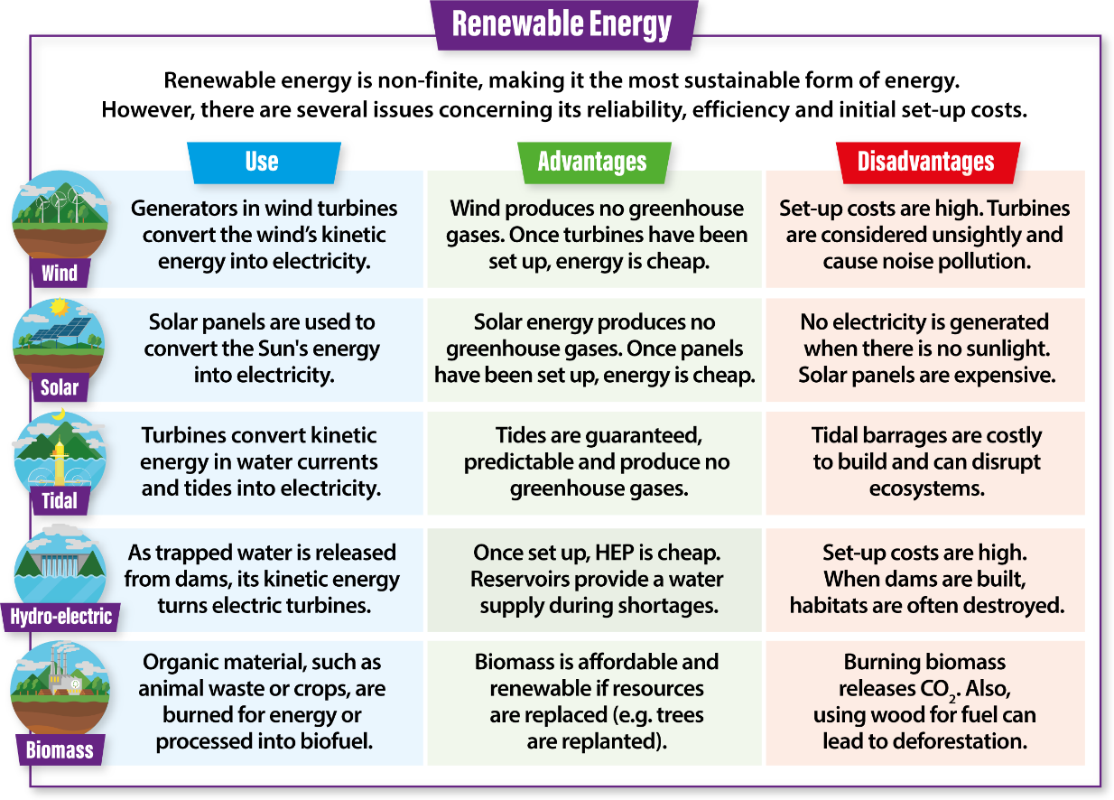
Knowledge Organiser

Slide 43
Assessment Ladder | ENERGY GENERATION AND STORAGE PROJECT
 | Knowledge and Understanding | Skills
Yellow Plus | Understands all aspects of fossil fuels and thermal energy Understands the pros and cons of all types of renewable energy Creates a well designed and made propeller that functions well Understands how to market electric vehicles | Presents work to a high standard Team leader and does most of the work in the group. Skilful in the use of 2ddesign learning all the new tools Can use scissors accurately to cut out and create a wind turbine blade that works well Can lead the presentation Can write an extended, thoughtful evaluation
Yellow | Understands the pros and cons of fossil fuels and thermal energy Can identify all types of renewable energy Understands how the shape of a propeller affects its performance and designs accordingly Understands the pros and cons of Electric vehicles | Can present work well Makes good decisions in the team. Has designed 3 propellers and chosen the best one to make Can use scissors accurately to cut out and create a wind turbine blade that works well Can research and design using powerpoint Can write a self-critical evaluation of the project
Blue | Can describe fossil fuels and thermal energy Can identify different types of renewable energy Understands how the shape of a propeller affects its performance Understands how Electric vehicles can help society | Works well in a team Has designed at least 2 propellers using 2ddesign Can create a working wind turbine blade can design using powerpoint Can write an evaluation of the project
Green | Can describe some fossil fuels Can identify some aspects of renewable energy Understands that different propellers work differently Can identify the good points of electric vehicles | Contributes to the team Has designed a propeller using 2ddesign Contributes to the powerpoint presentation Can write part of an evaluation
White | Can do some of the above | Can be helped to work in a team Can be helped to design Can be helped to contribute to the presentation With help can write a simple evaluation.

Slide 44
Design Brief
Energy generation and storage have a huge global impact on our lives - from decisions about the use of fossil fuels and their effect on our environment, to the development of cleaner, more-modern ways to create and store energy. We will be inventing our own wind turbine to contribute positively to the environment. The younger we start making a change, the better our future will be.
DART
LI: Create a brief
Numeracy Challenge
If each letter of the alphabet has a value according to its position (i.e.. A=1 B=2 C=3 and Z=26).
What is the Total of
ENERGY= ……………….
How does a wind turbine generate energy?
Key Words from the TASK
Deeper thoughts?
DIP
Design Brief - Success Criteria
Demonstrate that you can write a clear design brief and plan all your relevant research.
Demonstrate that you can write a design brief and how to plan research.
Demonstrate that you can write a basic design brief.
Who? What? Where? When? Why How?? W
hy?
Write your Brief here…
I am going to research, design and manufacture a…..
Next Steps…
Add more detail to your Design Brief regarding Customer, Material and the Shape of your product. Use ACCESS FM to help you. What else could you add?
Literacy Target Area: | Action(s)
Spelling: | Make use of a dictionary
 | List and learn corrections
Punctuation: | Use the punctuation pyramid
 | Write in FULL sentences
Vocabulary: | Use Key Words for this subject
Grammar: | Correct Non-Standard English

Slide 45
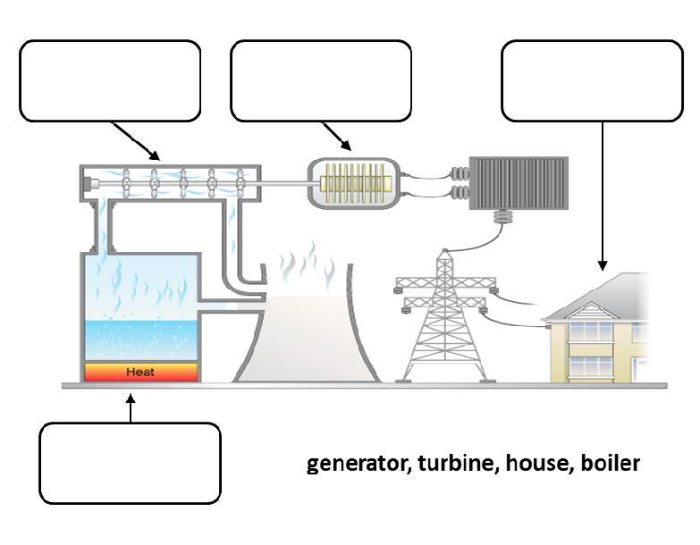
Energy Generation & Storage
Fossil fuels is a term that is used to describe a range of energy sources that were formed from ancient plants and organisms during the ……………………………Period which was approximately 320 million years ago, before the age of the dinosaurs. At that time, the world was covered with …………… which were filled with organisms and plants. As they died, they sank to the bottom of swamps and oceans where they decomposed and were covered with more dead organic material, and later on, layers of sand and silt. Over time different types of fossil fuels were formed, depending on the differing conditions, which included the different types of plants and animals, the temperature, the length of time and the pressure of layers of rock above the fossil fuel.
There are 3 major types of fossil fuels, Coal, Oil and Gas.
Coal is formed from ferns and plants and trees which have been hardened due to…………………………...
Oil is formed from small animals such as zooplankton and algae. Pressure from surrounding rock causes the animals to decompose.
Natural Gas is formed from the same conditions as Oil, but greater pressure and heat has turned the liquid into gas.
Fossil fuels have been very useful to us as they contain lots of energy. They are the world’s dominant energy source. Fossil fuels have a variety of applications from …………………………. to transport fuels. They can also be used to create a variety of common products, from plastics to cosmetics and even some medicines.
These resources have powered …………………………………. throughout history. Fossil fuels can be an abundant and cheap or in some cases an expensive and scarce form of energy, depending on their geographical location. Fossil fuels are beneath the earth and often cross the boundaries of countries. For example, the Norwegian and British oil fields in the North Sea. This can cause political tensions between countries.
Fossil fuels are considered non-renewable resources because they take millions of years to form, which means that once they are used, they are not replaceable within……………………….
The gradual depletion of the most accessible ……………………………has forced companies to develop technologies to extract more challenging or unconventional reserves. In many cases this has meant additional safety and environmental concerns as well as higher costs.
Fossil fuels are also the highest emitters of carbon dioxide, a ………………………….. that causes climate change. In addition, their production causes environmental as well as human health issues. These concerns have prompted societies to look at ……………………sources of energy that are more sustainable and renewable.
Wordbank
fossil fuel reserves - pressure and heat - greenhouse gas - Carboniferous - a human lifetime - electricity generation - industrialisation - swamps- alternative
DART
Fuels such as …………., …………. and …………. are burnt to produce energy.
Heat energy makes the water boil to produce ………………
Steam drives the ……………… , making it…………………..
The spinning turbine turns a ……………………… which produces ……………………….
The electricity travels through a national grid for use in our …………………..
Homes, oil, steam, turbine, gas, spin, coal, electricity, heat, generator
LI: Recognise different fossil fuels

Slide 46

Investigation
Investigation – Success Criteria
You have analysed past and present professionals in depth and drawn relevant conclusions of key points.
You have analysed past and present professionals and identified some key points.
You have analysed past and present professionals in a basic fashion with little relevance to your project.
LI: Analyse the different types of renewable energy
Write the definitions in all the boxes below.
DIP
Tidal Power
Nuclear Power Station
Next Steps…
Ensure that the products you have found inform your next steps and that you use some of the designs in your own work. Use parts of other designs to come up with something new
Batteries
Hydro electrical power
Fossil Fuels
Alkaline Batteries
Wind Power
Solar power is the conversion of …………… from ………… into electricity, either directy using…………….., indirectly using concentrated solar power, or a combination. Concentrated solar power systems use…………. Or mirros and tracking systems to focus a large area of sunlight into a small ………….
Tenses, sunlight, energy, photovoltaics, beam
Rechargeable batteries
Biomass fuel

Slide 47
Specification
Specification – Success Criteria
You can write a fully justified specification which helps design innovative, functional and appealing products.
You can write a specification, which is justified in parts, and helps design appealing products.
You can write a specification
Specifications are detailed statements prescribing materials, dimensions, and quality of work for something to be designed or built.
DIP
LI: Understand how a specification can be used to refer to when designing
Next
Steps…
*Ensure that the points you mention are measurable and you can easily see whether your design work meets these points. *Remember you will evaluate your final product around the Specification at the end.
Aesthetics
Consumer
Cost
Environmental
Sizing
Safety
Function
Material

Slide 48

Existing Devices
Initial research will help you evaluate your idea for a new invention and service and see if there is a need for it and what it is that your potential customers are looking for. If your idea already exists, the research will tell you whether the available options on the market are meeting the needs and expectations of existing customers. This way you can learn what you can do differently, to meet the needs and expectations but also to exceed the competition.
Investigation – Success Criteria
You have analysed past and present professionals in depth and drawn relevant conclusions of key points.
You have analysed past and present professionals and identified some key points.
You have analysed past and present professionals in a basic fashion with little relevance to your project.
Use the space below to help you generate ideas for your wind turbine. You can use any form of investigation e.g. Internet, magazines, newspapers or books.
Look for key aspects that you could use in your designs.
DART
Next Steps…
Ensure that the products you have found inform your next steps and that you use some of the designs in your own work. Use parts of other designs to come up with something new
DIP
Your Image Here
Your Image Here
Your Image Here
Your Image Here
l like this because:
.................................................................................................................................................................................................................This can be improved by:
...............................................................................................................................................................................................................
l like this because:
.................................................................................................................................................................................................................This can be improved by:
...............................................................................................................................................................................................................
l like this because:
.................................................................................................................................................................................................................This can be improved by:
...............................................................................................................................................................................................................
l like this because:
.................................................................................................................................................................................................................This can be improved by:
...............................................................................................................................................................................................................

Slide 49
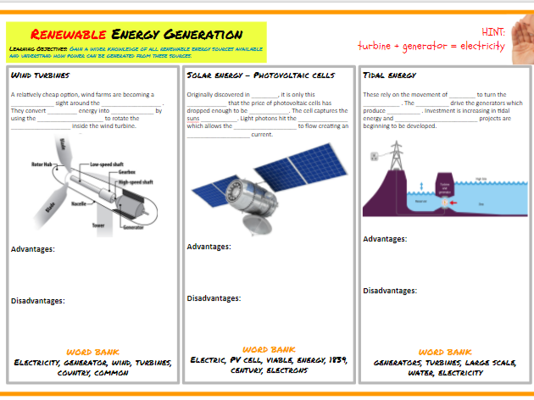
Renewable Energy Generation
DIP
LI: Recognise and differentiate renewable energy
Wind Turbines
A relatively cheap option, wind farms are becoming a ………………….. Sight around the ……………….. They convert …………………….. energy into ………………………by using the ………………. to rotate the …………………….. Inside the wind turbine.
Wordbank: Generator, wind, electricity, turbines, country, common
Advantages:
Disadvantages:
Solar Energy:
Originally discovered in………………., it is only this……………………….. That the price of photovoltaic cells has dropped enough to be …………………… The cell captures the suns…………………… Light photons hit the……………………. Which allows the …………………… to flow creating a ……………….. current.
Wordbank: Electric, PV Cell, viable, energy, 1839, century, electrons
Advantages:
Disadvantages:
Tidal Energy:
These rely on the movement of ………… to turn the ……………… The ………………… drive the generators which produce……………………. Investment is increasing in tidal energy and …………………………. projects are beginning to be developed
Wordbank: Generators, turbines, large scale, water, electricity
Advantages:
Disadvantages:

Slide 50
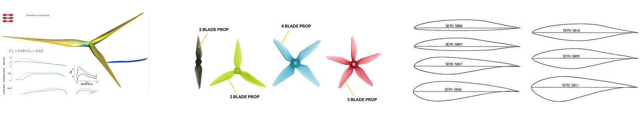
Energy Generation & Storage
LI: Gain confidence in 2D Design
Propellers can be of different shapes and sizes. They can have 2 or more blades, Your task is to design a propeller for a wind turbine and test it using 2ddesign. Once you have mastered the art of rotating a shape in the program, you can create a wind turbine blade that has two three, four, five or even six blades.
Question:
Are 6 blades more efficient than three or four?
Design your propeller blades in 2dDesgin and stick your designs on this page.
Keep one print out and stick it onto some card and test it.
DIP

Slide 51
Energy Generation & Storage
Nissan Leaf
Stick in your PowerPoint slide about Nissan Leaf’s good and bad points on this page
Then when you have made your advertising presentation stick the pages on here as well.
DIP

Slide 52
LI: Reflect on entire project and evaluate
Propeller length:
Propeller width at widest point:
Number of blades:
Rate your accuracy in making your blade out of 10:
Name your testing group:
Record the length of time your propeller spins when left to idle:
Count the number of times the propeller spins in a minute when:
Placed 30cm from blower:
Compare with data from other members of your group:
Evaluation
Testing and evaluating are not just a ‘tick box’ exercises at the end of manufacture. Testing and evaluation should be continually carried out and used to modify a designer’s ideas throughout the whole iterative design process, with models, as opposed to 2D drawings, used to demonstrate the functionality of the product. It is important for a designer to test and evaluate their prototype and finished product against the design specification by conducting a variety of tests under realistic conditions. This ensures that the product is fit for purpose and responds to wants and needs of the user. Feedback may be asked from the client, target market and other experts in the market. Allowing these groups of people to physically test the product, by handling and using it, will help in gathering useful feedback for improvements to be made.
DART
Your Image Here
Evaluation – Success Criteria
You have tested, evaluated and refined or developed your ideas against your specification.
You have evaluated and refined your ideas against your specification.
You have evaluated your ideas against your specification.
Next
Steps…
*Use more technical detail in identifying what you have learnt (WWW/EBI) e.g. tools, processes and equipment
*Take a photograph of your work to show what you have made

