Slide 1

Year 8 devising
The Power of Social Media

Slide 2

The Power of Social Media
Learning Intentions: Lesson one
To consider the pros and cons of Social Media
To use different materials as a stimulus for devising including; photographs, videos, poems, music and scripts
To apply different drama strategies to performance including;
Improvisation, Role-play, Still Image, Cross Cutting, Flashback/Forward, Narration, Choral work, and Thought Tracking.

Slide 3

ACTIVATE: Have a look at this photo. What can you see? Is this relevant to our world? How does this make you feel? What do you think is meant by ‘Family Togetherness?’? Why do you think ‘togetherness’ is in italics?

Slide 4
The Power of Social Media
CONNECT:
As a class, make a list of the pros and cons of Social Media. Here are some examples.
Pros
Good for professional
networking
Cons
Strangers can find your details

Slide 5
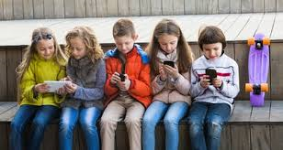
DEMONSTRATE
20 minutes
In groups of 6, using the photograph as a stimulus, create two still images communicating your idea of ‘Social Media’ and how it might affect families negatively and positively.
Remember to use clear facial expressions and strong gestures. How does your first still image differ from your second?
Consider the use of levels and how you can show the status and emotions of the characters involved.
EXTENSION:
Use your still images to develop a scene with dialogue.
Use cross-cutting to show the difference between the
‘positive’ family and the ‘negative’ family.

Slide 6
CONSOLIDATE
Perform your images as a class.
Split the class in half and watch again.
Which images stood out and why?
What was the message they were communicating?
How did they use their facial expressions and gestures effectively to communicate meaning?
Do you feel differently about social media after this lesson?

Slide 7
The Power of Social Media
Learning Intention: Lesson 2
Respond to a poem as stimulus
Use choral work and music to produce stylised theatre.

Slide 8

social media: ACTIVATE
NOUN
1. websites and applications that enable users to create and share content or to participate in social networking.
Have a look at the above definition of social media. Do you think this is an accurate description of social media? Why or why not? How would you describe it?

Slide 9

The Power of Social Media
CONNECT: Today you are going to perform together with your group as a chorus using a poem as a stimulus.
Can you remember what techniques a chorus use?
As a class we are going to tell a nursery rhyme around the circle. Every fourth person must repeat the same word as the third person.
How does the echo add to the telling of the rhyme?

Slide 10

The Power of Social Media
Listen carefully to the poem we are about to watch by writer and director Gary Turk.
It discusses social media and how, if we are glued to our phones all the time, we may miss important times in our lives.
Do you agree or disagree with the poem? Why?
This poem received a lot of feedback (more than 12 million views on YouTube), why do you think that is?
Why is it important that we socialise and communicate with others personally?
http://garyturk.com/portfolio-item/lookup/
Notes:
http://digitalsynopsis.com/inspiration/look-up-digital-detox-poem/

Slide 11
DEMONSTRATE
30 minutes
Individually read through the poem and highlight words and phrases that interest you. Be prepared to share these with your group in 10 minutes.
In groups of six you are going to take parts of the poem that interest you to create a piece of physical theatre using choral techniques. You must all speak in unison and attempt to use cannon and shared dialogue or gesture where appropriate.
Consider the message you want to communicate with your audience. Is your message positive or negative and how do you show this through rhythm, pace and tempo?
https://www.youtube.com/watch?v=XlAKW_tr4xA&list=PLC772F42251C6522B&index=12

Slide 12
CONSOLIDATE
Perform your movement piece to another group and give feedback taking the following questions into consideration:
What was their theatrical intention?
How did they use the choral techniques effectively to convey meaning?
What emotions did the piece evoke from you?
Discuss: How would you use todays movement sequence along with your still images from last lesson to create a piece of theatre?

Slide 13

The power of social media
Learning Intentions: lesson 3
Respond to music as a stimulus
Use flashback/narration or thought tracking effectively.

Slide 14

The Power of Social Media
ACTIVATE:
Listen to the song by Shimona Kee. Discuss these points in small groups:
What is the feeling and the mood of the song?
Is it upbeat and happy or slow and sad?
https://www.youtube.com/watch?v=Atma1Mqd8oY
Notes:
https://www.youtube.com/watch?v=Atma1Mqd8oY

Slide 15

The power of social media
CONNECT: Individually, use your ‘role on the wall’ sheet to answer these questions. You can annotate what is affecting them externally around the person and their emotions and feelings inside.
Think about the character singing the song.
What are they like?
What has made them feel this way?
What is her story?

Slide 16
The Power of Social Media
DEMONSTRATE
In your groups devise a short scene using the mood, the central character and the music/ words of the song.
You may or may not want to use the song itself in your performance.
You will also need to include one of the following techniques in this scene; thought tracking, flashback/forward or narration.

Slide 17
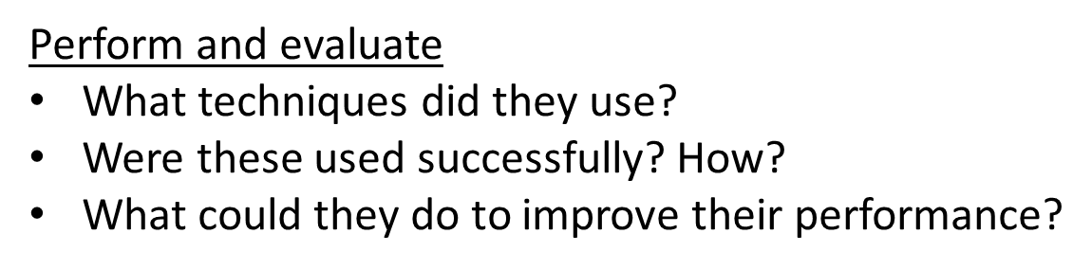
CONSOLIDATE
Over the next series of lessons you will use the ideas and techniques we have explored to create a 2-5 minute piece of theatre based around Social Media.

Slide 18

The Power of Social Media
Assessment
Activate: Consider the negative impact social media can have. https://www.itv.com/thismorning/pledge-to-share-our-anti-bullying-message
How does this make you feel?

Slide 19
The Power of Social Media
In your groups decide what the message of your devised piece is.
(Dramatic intention.)
You will use a technique called ‘breaking the fourth wall.’
This means you will need to address the audience directly.
(Bertolt Brecht.)
Draw on all of the previous lessons and
decide how you want to structure your
piece.
Will you use music, poetry or
physical theatre? You decide.

Slide 20

‘The Power of Social Media’
Rehearsal &
Final Performance

