Slide 1
Ethics and Values
Year 7 Blended Booklet – Autumn 2

Slide 2
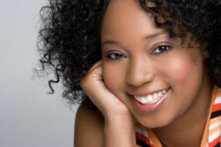


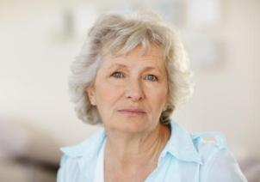

Ethics and Values – Year 7
Lesson 4: Periods
Learning intent: To understand periods and understand what the menstrual cycle involves
Connection phase Who gets periods? Why should girls learn about periods? Why should boys learn about periods? | Activation phase L/O I can describe what a period is I can discuss what is involved in the menstrual cycle I can explain the symptoms and what things to suggest to help these What have this girl, teenager and the ladies all got in common with one another? All of them currently have, have had, or will have periods at some time For girls this is another time when they will notice changes and when we all need to support one another But what is a period? A flow of blood and other material from the lining of the uterus, lasting for a few days and occurring in sexually mature women who are not pregnant at intervals of about one lunar month until the menopause.

Slide 3


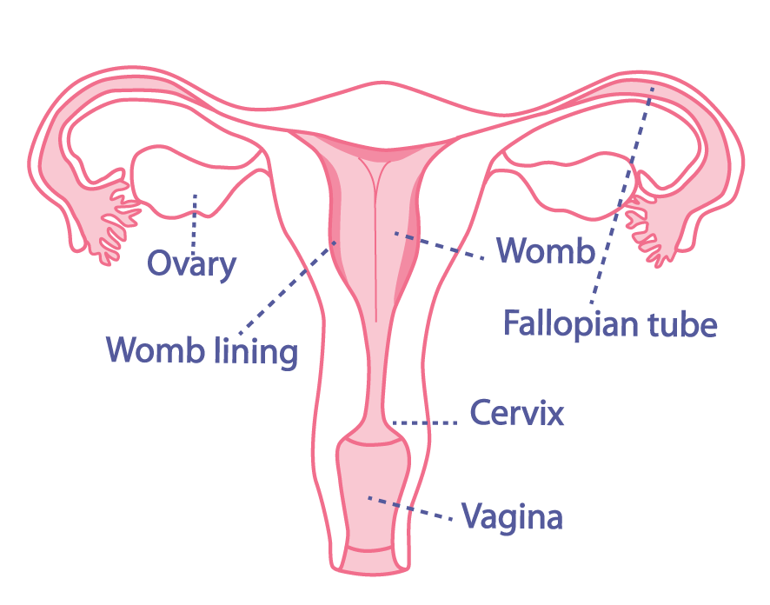


New Information
Although all women and girls have periods they can be different for everyone! Differences include:
Starting at different ages – you will start when your body is ready, there is no right or wrong time for your period to start.
Period flow can be heavy, medium or light and the flow changes from the beginning to the end of the period.
Some periods may only last a few days, others longer. They usually last between 3-7 days.
https://www.youtube.com/watch?v=z9fgxzfbYMQ

Slide 4
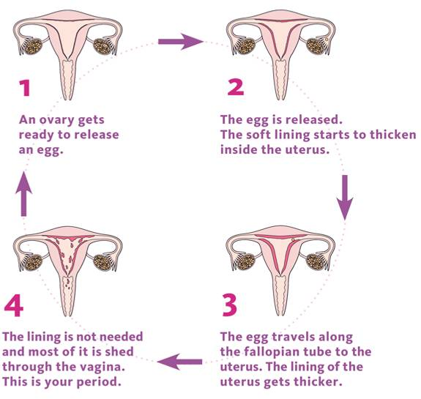
New Information
Days 1-7 are the beginning of the cycle when the lining of the womb comes away (Period).
Days 7-14 are when the egg is being produced within the ovary. It is then released into the fallopian tube to make its way down to the womb to wait to be fertilised.
Days 14-28 are when the lining of the womb becomes thicker in blood supply.
If the egg is not fertilised by the sperm then the cycle starts all over again.

Slide 5
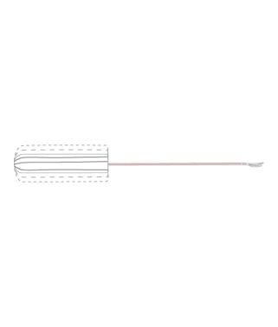
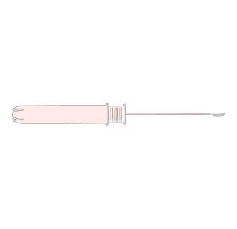


What can we use to protect ourselves
when having a period?
Sanitary Towels
Tampons
Pantliners
DISCUSS: What symptoms do you think girls go through when they have a period?
Tender breasts
Headaches
Mood swings
Stomach cramps
Tiredness
Spots
Food cravings
Difficulty concentrating
DISCUSS: How you can relieve these symptoms?
Have a warm bath
Massage your stomach
Have a nice warm drink
Use a hot water bottle or use a heat pad.
Eat a well balanced diet.
Exercise
The lower your score the more positive your self esteem is.
A score of 30 or more would suggest you have low self esteem

Slide 6

Demonstration phase Design an advice sheet for someone who has just started their period Include: What a period is? How long can a period last? How regularly are periods? What symptoms they someone experience? How they someone relieve these symptoms? What can they use? Any other advice e.g. like talking to an adult, a period is a normal thing to happen, it is a natural process etc. | Consolidation phase What a period is? How long can a period last? How regularly are periods? What symptoms they someone experience? How can someone relieve these symptoms? What can they use? Any other advice e.g. like talking to an adult, a period is a normal thing to happen, it is a natural process etc. Create a multiple choice question based on your learning. Write your question on your post it note. Your teacher will read out a few and get different people to answer them.
Multiple Choice Questions

Slide 7
Check your answers
What a period is? a flow of blood and other material from the lining of the uterus, lasting for a few days and occurring in sexually mature women who are not pregnant at intervals of about one lunar month until the menopause.
How long can a period last? They usually last between 3-7 days.
How regularly are periods? One a month or 28days
What symptoms they someone experience? Tender breasts/Headaches/Mood swings/Stomach cramps/Tiredness/Spots/Food cravings/Difficulty concentrating
How can someone relieve these symptoms? Have a warm bath/Massage your stomach/Have a nice warm drink/Use a hot water bottle or use a heat pad/Eat a well balanced diet/Exercise
What can they use? Sanitary towel/pantiliners/tampons
Any other advice e.g. like talking to an adult, a period is a normal thing to happen, it is a natural process etc.

Slide 8
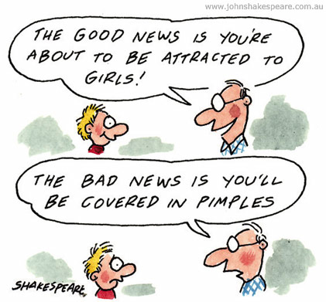
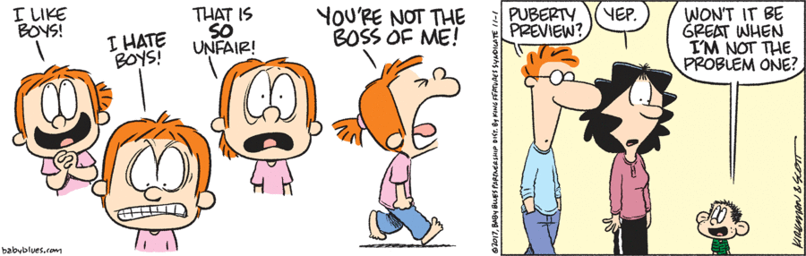
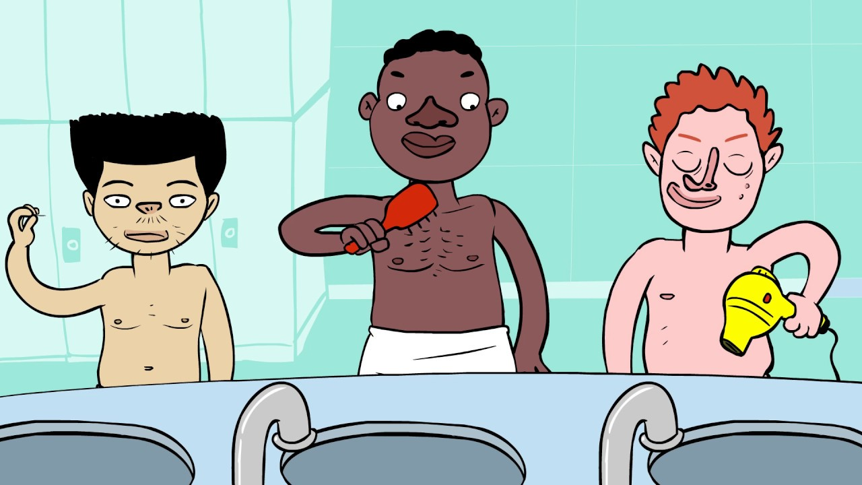
Ethics and Values – Year 7
Lesson 5: Puberty
Learning intent: To develop understanding of and strategies to manage the physical and emotional changes of puberty
Connection phase How long does a period last Name one symptom of a period Name one way to relieve a symptom | Activation phase L/O I can recognise how a person might feel about these changes and describe strategies for managing those feelings; I can identify ways of telling the difference between myths, opinions and facts about growing and changing; I can describe how to manage physical and emotional changes during and after puberty; Look at the pictures on this slide – discuss what you think is happening to these individuals

Slide 9
New Information
What Changes happen to girls
Get taller and heavier
Bones grow bigger and heavier
Hips get wider and more curvy
Face changes shape
Voice gets a little deeper
Hair grows under the armpits, around the genitals (pubic hair)
Hair on arms and legs grows darker
Breasts and nipples get larger
Body sweats more
Internal and external sex organs grow
May have mood swings, sexual thoughts and feelings
What Changes happen to boys
Grow taller and heavier
Bones grow bigger and heavier
Nose and jaw get bigger and face gets longer
Get more muscles
Hair and skin can become oily and you may get spots
Body sweats more
Hair grows on the face, under the armpits, around the genitals (pubic hair).
May get more hair on arms, legs and chest.
Voice gets deeper
Penis and testicles grow bigger and longer
May have mood swings, sexual thoughts and feelings

Slide 10
New Information
Puberty is the time when your body changes from being a child to a young adult.
Physical changes happen because the body starts to produce chemicals called sex hormones; oestrogen, progesterone and testosterone.
Puberty happens anywhere between 8 and 18 years of age.
The female body mainly produces progesterone and oestrogen which start the changes of puberty. Usually starts between 8-13 years.
The male body mainly produces testosterone which start the changes of puberty. Usually stars between 10-15 years.
https://www.youtube.com/watch?v=j_mFJ2d0qxQ
https://www.youtube.com/watch?v=Yvw7QGytgNQ

Slide 11

Demonstration Phase
Write the changes that you think happen in
girls, boys and both in your Venn diagram –
we will add to this later
Changes in boys
Changes in girls
Changes in both

Slide 12

Demonstration Phase
Can you add to your Venn Diagram?
Remember to use a blue pen!
Self/Peer Assessment
What Changes happen to girls
Get taller and heavier
Bones grow bigger and heavier
Hips get wider and more curvy
Face changes shape
Voice gets a little deeper
Hair grows under the armpits, around the genitals (pubic hair)
Hair on arms and legs grows darker
Breasts and nipples get larger
Body sweats more
Internal and external sex organs grow
May have mood swings, sexual thoughts and feelings
What Changes happen to boys
Grow taller and heavier
Bones grow bigger and heavier
Nose and jaw get bigger and face gets longer
Get more muscles
Hair and skin can become oily and you may get spots
Body sweats more
Hair grows on the face, under the armpits, around the genitals (pubic hair).
May get more hair on arms, legs and chest.
Voice gets deeper
Penis and testicles grow bigger and longer
May have mood swings, sexual thoughts and feelings

Slide 13
Consolidation phase
Answer the following question and remember to add some information from what you have learnt in todays lesson
The hardest thing about growing up is… because…
and
The thing I am looking forward to about growing up is… because…

Slide 14
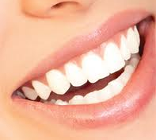
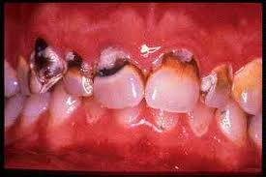
Ethics and Values – Year 7
Lesson 6: Hygiene
Learning intent: To learn about personal hygiene and its importance for young people
Connection phase Recall a puberty change for both a girl and a boy Recall a puberty change for a girl Recall a puberty change for a boy | Activation phase L/O I can understand how puberty affects personal hygiene needs; I can explain why personal hygiene is also important for self-esteem and affects how people feel about themselves; Which one would you kiss?

Slide 15
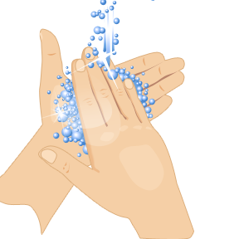
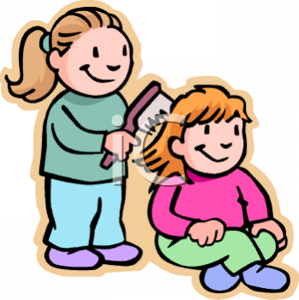
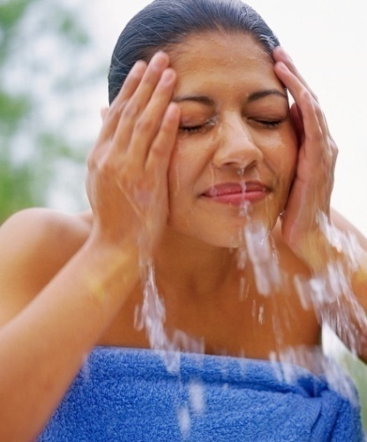
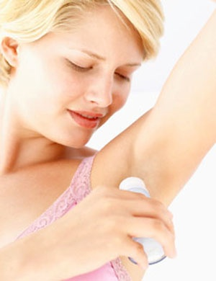
New Information
Also don’t forget as you get older… people tend to sweat more!
Sweat is your body’s natural way of helping you to cool down.
Sweat can also some times become smelly when the chemicals it contains mixes with bacteria that live naturally on your skin.
Personal Hygiene: What do we do?

Slide 16
New Information
What is personal hygiene?
Personal hygiene is how you care for your body. This practice includes bathing, washing your hands, brushing your teeth, and more.
Every day, you come into contact with millions of outside bacteria and viruses. They can linger on your body, and in some cases, they may make you sick. Personal hygiene practices can help you and the people around you prevent illnesses. They can also help you feel good about your appearance.
Learn more about why hygiene is so important, the best ways to practice it, and how you can change your habits to make yourself feel and look better.
Types of personal hygiene
Each person’s idea of personal hygiene differs. These main categories are a useful place to start for building good hygiene habits:
Toilet Hygiene
Shower Hygiene
Nail Hygiene
Teeth Hygiene
Sickness Hygiene
Hands Hygiene
https://www.youtube.com/watch?v=jQ2e0KH5WrI

Slide 17
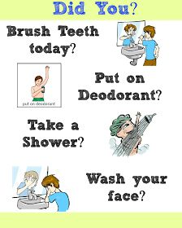
Demonstration phase Produce a Personal Care Plan. I will do the following things everyday as part of my daily routine. Doing these things will help me to develop good personal hygiene. | Consolidation phase Read the descriptions below and guess the correct word to match each description. Each item is something we must use in the morning to keep good daily personal care This is something I should use to wash myself, along with warm water. It will keep me smelling fresh! S________ This product is sprayed under my arms. It stops me from sweating a lot and stops me from getting smelly. D____________ I should use these if I have a runny nose or when I sneeze. These catch help to catch the microbes. T_______________ We use this to wash our hair. It cleans our scalp, gets rid of the grease in our hair and makes our hair shiny. S__________ We need both of these things to clean the plaque from our teeth and to freshen our breath. T______________ and T________________. We should have one of these every day. It’s very important for teenagers especially, to wash themselves daily. This gets rid of dead skin cells, sweat, dirt and bad smells. S___________ or B_________. I must change this item of clothing every morning. This item needs to be washed each time it is worn. U____________. If we do each of these things every day, we will have very good personal h__________.

Slide 19

Self-assessment
Check you answers
Soap
Deodorant
Tissue
Shampoo
Toothbrush
Toothpaste
Shower or bath
Underwear
hygiene
TASK
Consolidation phase (Assessment for Learning)
With the person next to you complete the 1,2,3,4,5 task below:
Name 1 thing you learned today
Say 2 points to this lesson
Identify 3 things you would do tomorrow morning following this lesson
List 4 keywords
Summarise this lesson in 5 words

