Slide 1
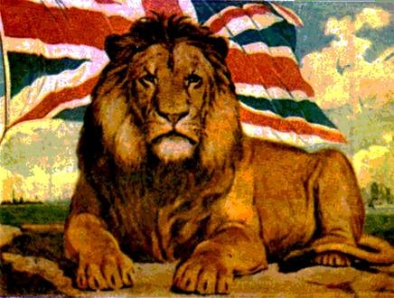
History Year 7 KS3 Summer 2 Blended Learning Booklet
Empire and Trade
Name:
Form:
Aim to complete one lesson each week. Write out the title and LI and then complete the tasks.
All video links are online using the ClassCharts link.
The Knowledge Organiser on page 3 has all the key information and vocabulary to help you with this unit.

Slide 2


ZOOM IN...
CAREERS
Journalist reporting on events
Archaeologist
History Teacher
MY LEARNING JOURNEY:
Subject: History Year:7 Unit 6: Empire and Trade
UP NEXT
Y8 Causes of WW1
AIMS
1. To understand the origins of the British Empire.
2. To explain what benefits the Empire brought to Britain.
3. To explain how the industrial revolution started in Britain.
4. To justify whether the Empire was a force for good.
DEVELOPING COURAGE
C To confidently share opinion with class on the benefits of Empire.
O Given the opportunity to work on extended writing.
U Teamwork to compare views about Sources.
R Showing Resilience when completing extended pieces of writing ​
A Learning to appreciate the past
G Being generous with Historical detail in writing
E Finish a History essay.
PREVIOUS LEARNING
Why William won at the Battle of Hastings.
How the Normans changed England
The Reformation
Tudor Kings and Queens
Tudor Life
.
WHAT WE KNOW/
REMEMBER
How Elizabeth begun the British Empire.
PERSONAL OBJECTIVES
.......................................
.......................................
.......................................
.......................................
.......................................
.......................................
.......................................
.......................................
.......................................
.......................................
.......................................
RECOMMENDED READING
BBC learning zone
YouTube Documentaries
History Learning Site

Slide 3
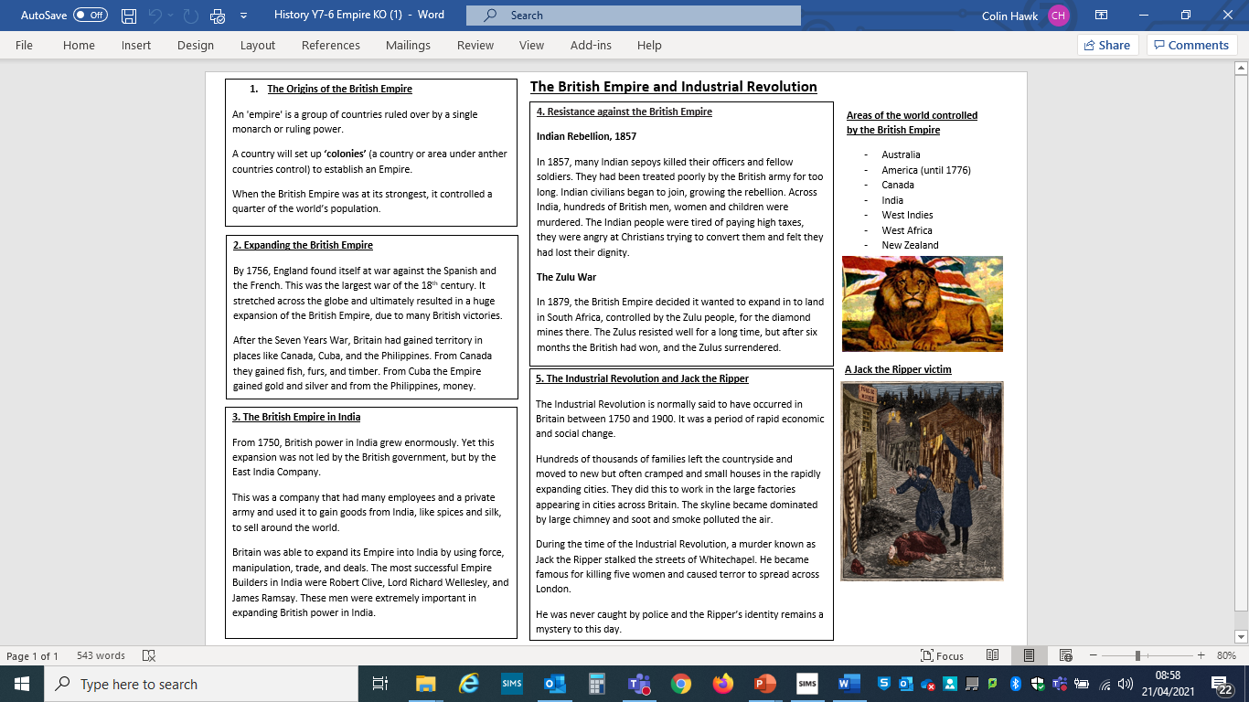

Slide 4
What do you already know about the British Empire?
Write below any prior knowledge you might have on the British Empire:
_____________________________________________________
_____________________________________________________
_____________________________________________________
_____________________________________________________
Examine the map on the next page. Write down any further factual information you did not know about the Empire.
____________________________________________________________________________________________________________________________________________________________________________________________________________________________

Slide 5
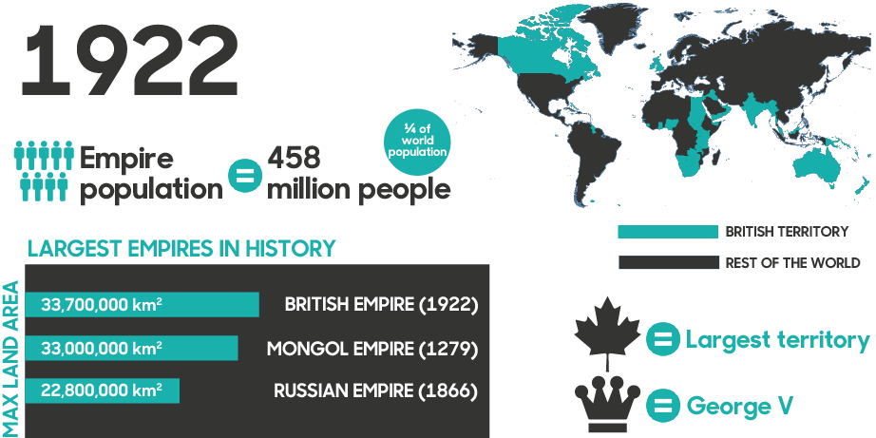

Slide 6
What is an Empire?
An 'empire' is a group of countries ruled over by a single monarch or ruling power.
A country will set up ‘colonies’ (a country or area under anther countries control) to establish an Empire.
Try to name as many parts of the world controlled by the British Empire, as you can.

Slide 7
Early English colonies in America
Write your answers on a piece of paper using the last two pages to help you.
What was the name of the first successful English colony in America, when was it created and what did it grow?
What was England’s second colony, when was it set up and what were they sending to Britain?
By 1732, how many people had come over to America from Britain and how many colonies had been created?
Extension – What people were taken to America without a choice and how many were there? Why were they taken?

Slide 8
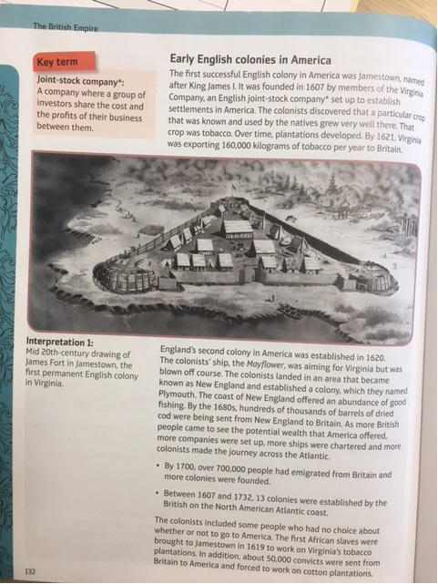

Slide 9
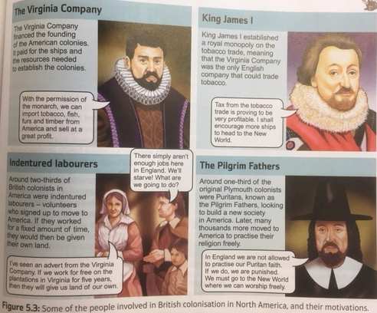

Slide 10
The people involved in British colonisation of America
The Virginia Company
What did they do to set up colonies?
Why did they want American colonies?
King James I
What did he do to set up colonies?
Why did he want American colonies?
Indentured labourers
What did they do to set up colonies?
Why did they want American colonies?
The Pilgrim Fathers
What did they do to set up colonies?
Why did they want American colonies?

Slide 11
Why was having an Empire so important for Britain? You must give reasons to support you answer.
Try to use the following in your answer:
Spain
Profit
Tobacco
Extension – Explain why the Pilgrim Fathers wanted to escape Britain and move to America. Try to give an example of why they didn’t like living in Britain.

Slide 12
________________ _____________________________________ __________ ____ ____ ____ ____ ____ ____ ____ ____ ____ ____ ____ ________________ ___________________________________________ ____ __________ ______________________________________________________________________________________________________________

Slide 13
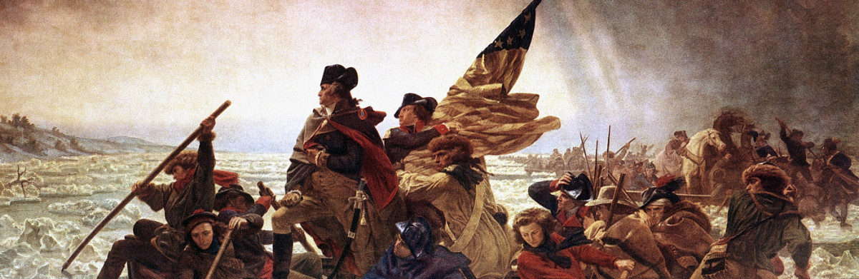
Eighteenth-century gains and losses
L/I: To understand the importance of the eighteenth century for the British Empire

Slide 14
1. Origins of Empire
  Explain what an Empire is.
2. Explain what colonies are.
3. At it’s largest, how much of the worlds population did the British Empire control?

Slide 15
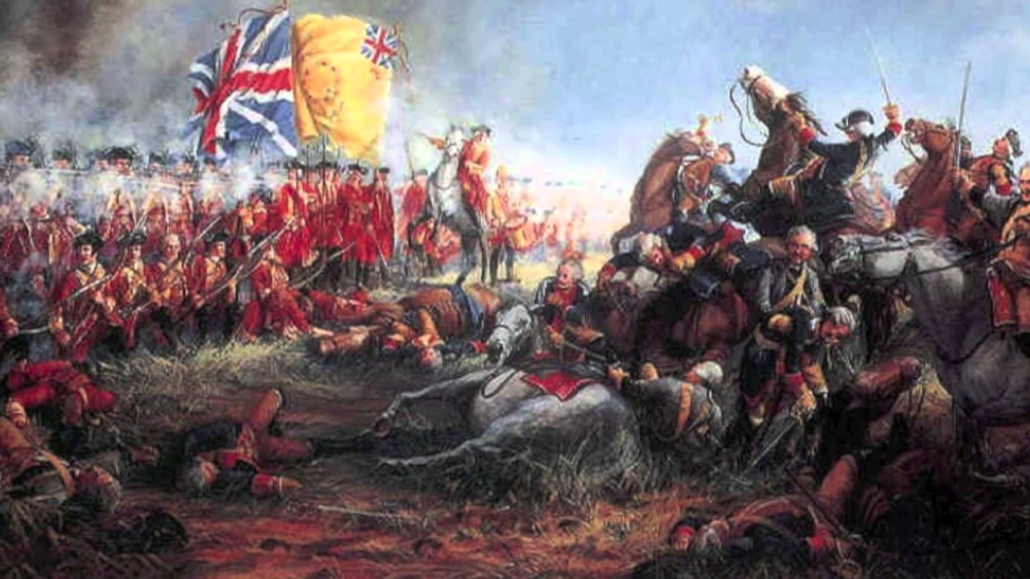
The Seven Years War (1756-1763)
By 1756, England found itself at war against the Spanish and the French.
This was the largest war of the 18th century. It stretched across the globe and ultimately resulted in a huge expansion of the British Empire.

Slide 16
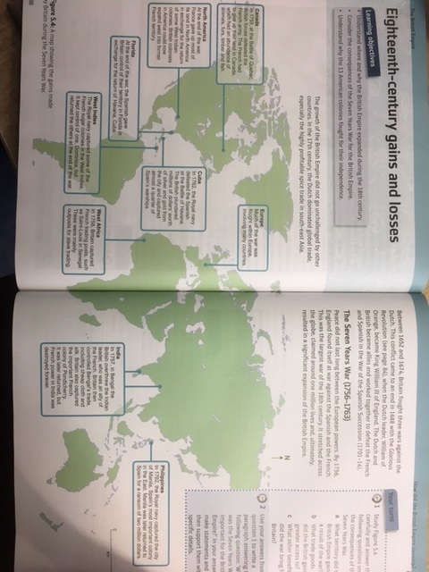
Using the information on this page, answer the questions on the following sheet.

Slide 17
What Territory did Britain gain in:
Canada –
North America –
West Indies –
West Africa –
Philippines –
What did Britain gain from:
Canada –
Cuba –
Philippines –

Slide 18
Why was the Seven Years War important for the British Empire? Explain your answer.
Using your answers from your sheet, to create a paragraph answering this question.
In your answer, make clear why it was important and then back up with evidence from your sheet.
Challenge – What was the most valuable territory that the British Empire gained from the Seven Years War? Why?

Slide 19
________________ _____________________________________ __________ ____ ____ ____ ____ ____ ____ ____ ____ ____ ____ ____ ________________ ___________________________________________ ____ __________ ______________________________________________________________________________________________________________

Slide 20
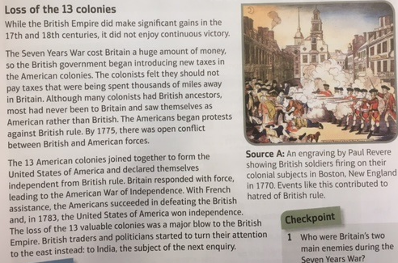
Video for after - https://www.youtube.com/watch?v=BWtW0gmh3kg

Slide 21
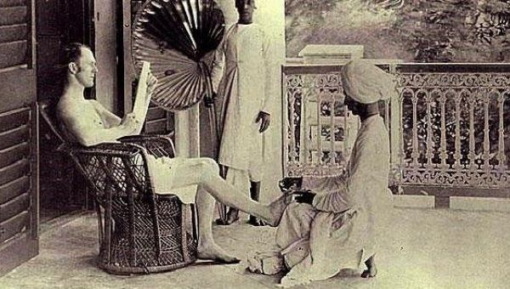
The British Empire in India
L/I: To understand how the British took control in India.
What can we learn from this photo about the relationship between British people and Indian people, during the time of the British Empire?
__________________________________________________________________________________________________________________________________________________________________________________________________________________________________________________________________________________________________________________________________________________________________________________________________________________________________________________________________

Slide 22
2. Expanding the British Empire
Explain in your own words, how the British Empire expanded in the 1700’s.
In your answer use the following:
Seven Years War
Spanish and French
Canada, Cuba and the Philippines
________________ _____________________________________ ________________________ ________________ ____ _______ ____ _______ ____ _______ ____ _______ ____ _______ ____ _______ ____ _______ _______ _______ ____ _______ ____ _______ __________________________________________________________ ______________________________________________________________________________________________________________________________________________________________________________________________________________________________________________________________________________________________________________________________________________________________________________

Slide 23
British Expansion in India
The Mughal Empire
One of the most significant Empires to control India before Britain, was the Mughal Empire. The Mughals were Muslim rulers who invaded India from Afghanistan in the early 1500’s. The invasion was bloody and brutal, killing countless people.
Over time, Mughal power grew meaning beautiful mosques, palaces and forts were built all over India. The Taj Mahal was built during the time of the Mughal Empire. The Mughal Empire was extremely wealthy. It had a good system in place to collect money from the people the Empire controlled and traded a lot with the outside world.
During the 1600’s, small numbers of British, French, and Dutch traders began to arrive in India, keen to get their hands-on Indian spices and textiles.
The Decline of the Mughal Empire
Between 1618-1707, Emperor Aurangzeb destroyed Hindu temples and placed extra taxes on non-Muslims. These actions caused people to fight against the Emperor and the Empire became less stable.
In 1739, the Emperor of Persia (modern day-Iran), Nader Shah, took advantage of the weaknesses of the Mughal Empire and invaded. His armies caused destruction across India, including the Capital city of Delhi.
The Mughals never recovered, and India became divided into regions at war with one another. This meant India could now be taken advantage of, by European powers.

Slide 24
The East India Trading Company
From 1750, British power in India grew enormously. Yet this expansion was not led by the British government, but by the East India Company.
This was a company that had a large number of employees and a private army and used it to gain goods from India, like spices and silk, to sell around the world.

Slide 25
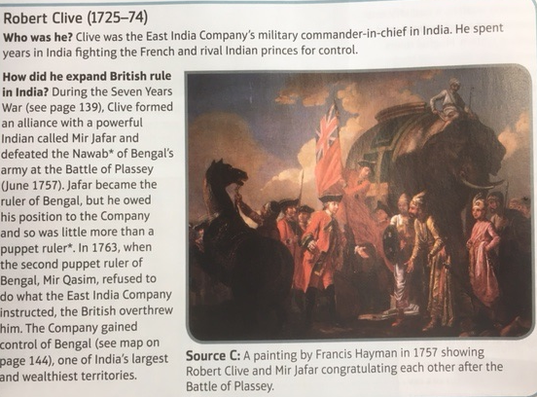
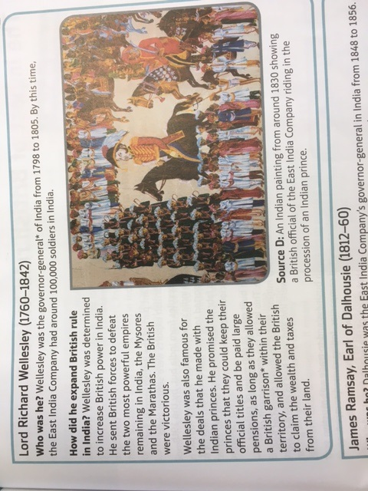
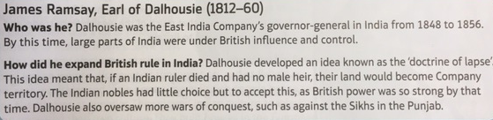

Slide 26
List the different methods these three men used to increase British power in India.
____ ____ ____ ____ ____ ____ ____ ________________ ___________________________________________ ____ __________ ______________________________________________________________________________________________________________

Slide 27
How did the British Empire gain control of India? You must explain your answer.
To answer this question properly:
A few sentences or a paragraph on how Robert Clive and Richard used force.
A few sentences on how James Ramsay didn’t use force.
A small conclusion
Extension – Which of the three Empire Builders did the most to expand British power in India? Explain your answer.

Slide 28
________________ _____________________________________ __________ ____ ____ ____ ____ ____ ____ ____ ____ ____ ____ ____ ________________ ___________________________________________ ____ __________ ______________________________________________________________________________________________________________

Slide 29
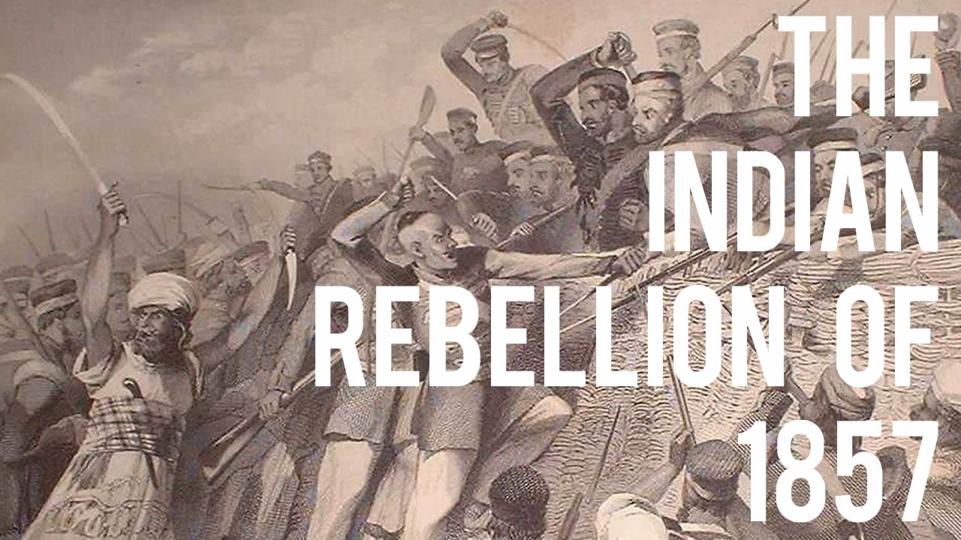
Resistance to the British Empire
L/I: To understand why people resisted the British Empire

Slide 30
3. The British Empire in India
True or False? Why? One mark for True or false, one mark for explaining why.
The British government controlled India during the 1700’s.
The East India Company had a private army it used to control India.
From India, the British Empire gained mainly animal furs to sell.
The most successful Empire Builders in India were Robert Clive, Lord Richard Wellesley, and James Ramsay.

Slide 31
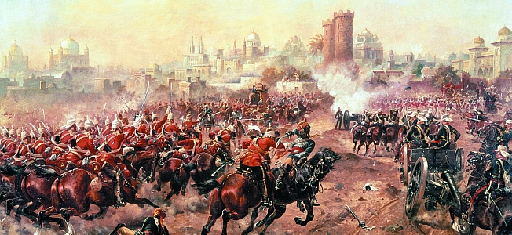
The Indian Rebellion of 1857
In 1857, the Rebellion began and many Indian sepoys killed their officers and fellow soldiers. Indian civilians began to join, growing the rebellion.
Across India, hundreds of British men, women and children were murdered.
The Indian people were tired of paying high taxes, they were angry at Christians trying to convert them and felt they had lost their dignity.

Slide 32
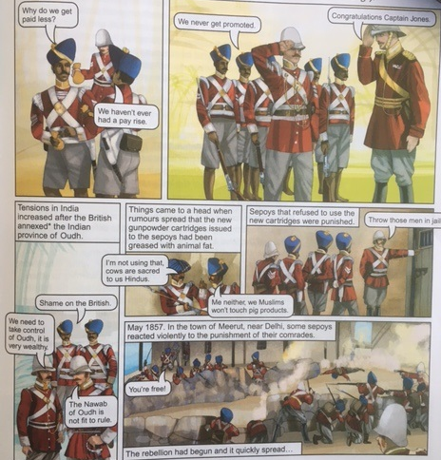
Sepoy: An Indian soldier in the British army.
Identify the following:
Economic cause of the Indian rebellion:
____________________________________________________________________
Political cause:
____________________________________________________________________
Religious cause:
____________________________________________________________________

Slide 33
Consequences of the Indian Rebellion
How did the British get their revenge on the Indian rebels?
Why did the British want their revenge?
How did the people of Britain feel about this revenge?
What major consequence did the Rebellion have for India and the East India Trading Company?

Slide 34
Positive or Negative impact? Why?
Decide whether or not the point is a positive or Empire or a negative.
Explain your judgment in writing in the space on the card.

Slide 35
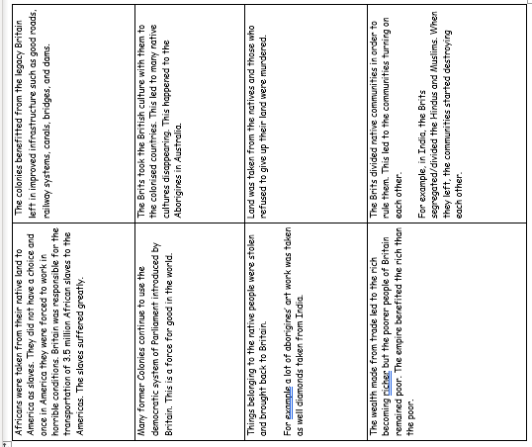

Slide 36
Was the British evil a force of good or evil in the world? You must explain your answer.
How was the British Empire a force for good in the world? Give examples of good the British Empire did.
How was the British Empire a force for evil? Give examples of the negative impact the British Empire had. Try to use India as an example.
A small conclusion. In your opinion, was the British Empire a force for good or a force for evil?
Challenge - Should the British Empire be celebrated by British people today? Explain your answer.

Slide 37
The Industrial Revolution
L/I: To understand how the Industrial Revolution changed Britain.
Starter - Match the Industrial Revolution keywords to the correct definition.
Write them down in your book.
Industrial
Rapid and dramatic change
Revolution
Materials used to make other materials,
e.g. wood, wool and coal.
Raw Materials
Making goods to sell
Manufacturing
The use of machines to manufacture goods on a large scale

Slide 38
4. Resistance against the British Empire
Explain with as much detail as possible, the Indian Rebellion of 1857.
_____________

Slide 39
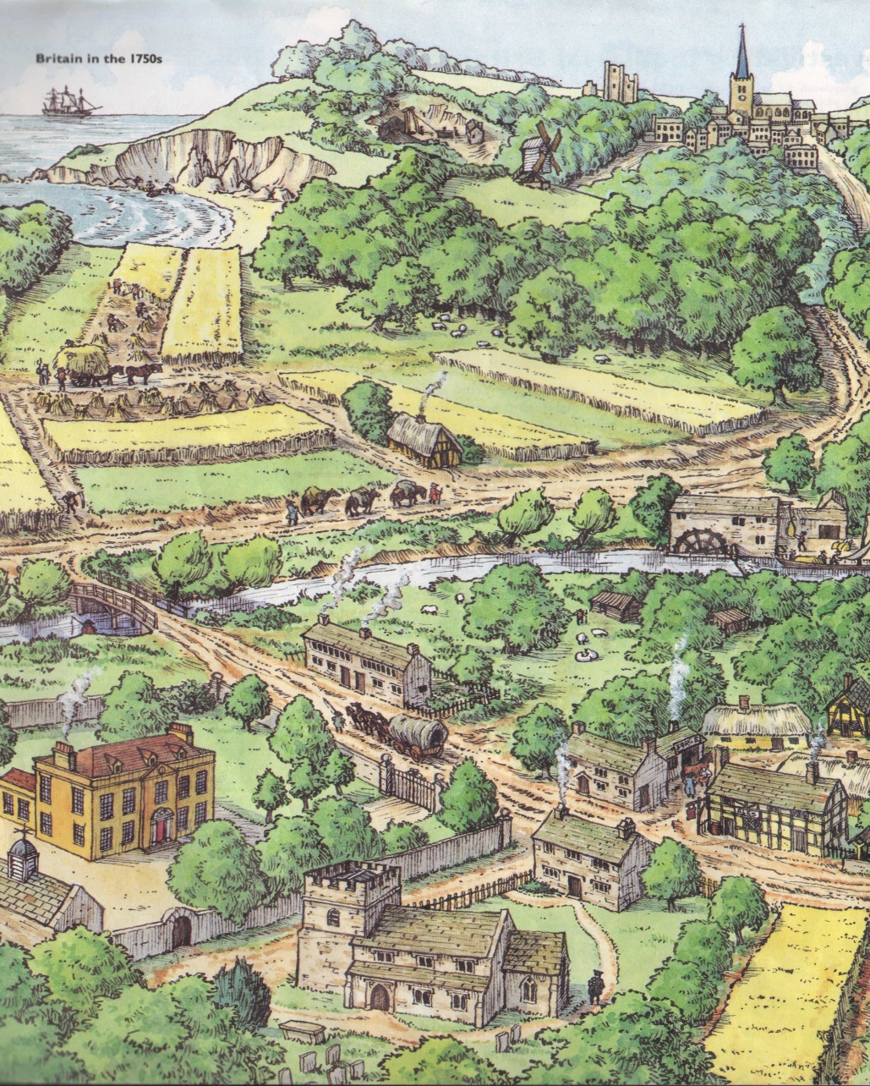
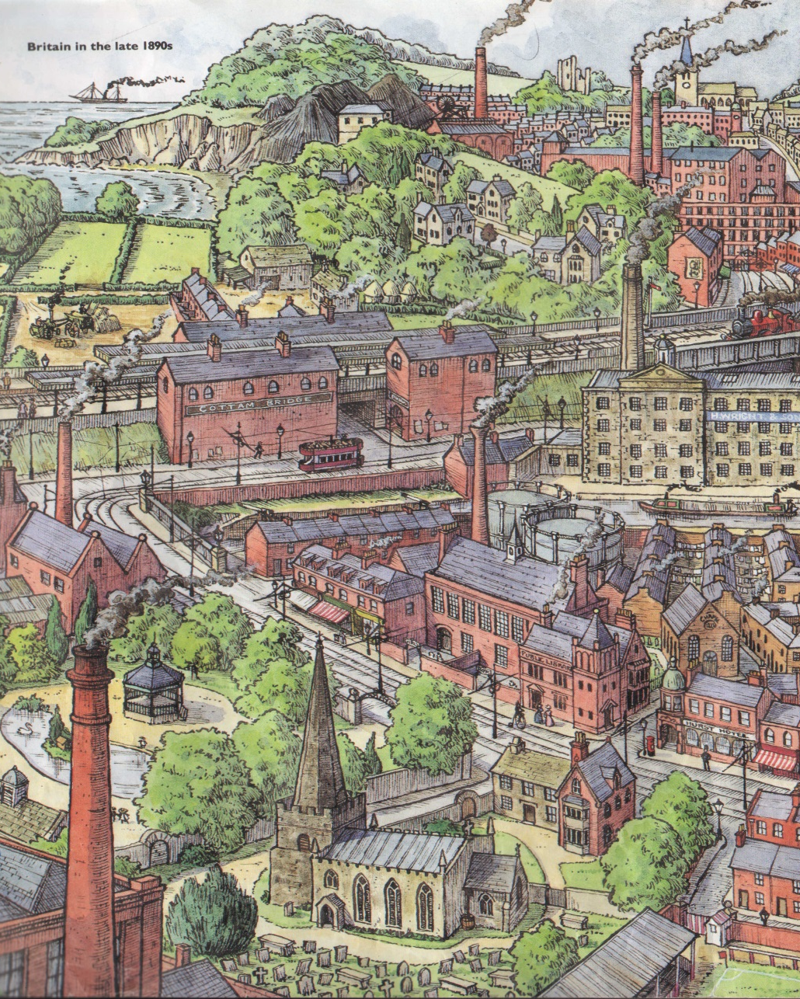
Examine the images in front of you.
1750
1900
What changes do you notice?
What has caused them?
What might the consequences be?

Slide 40
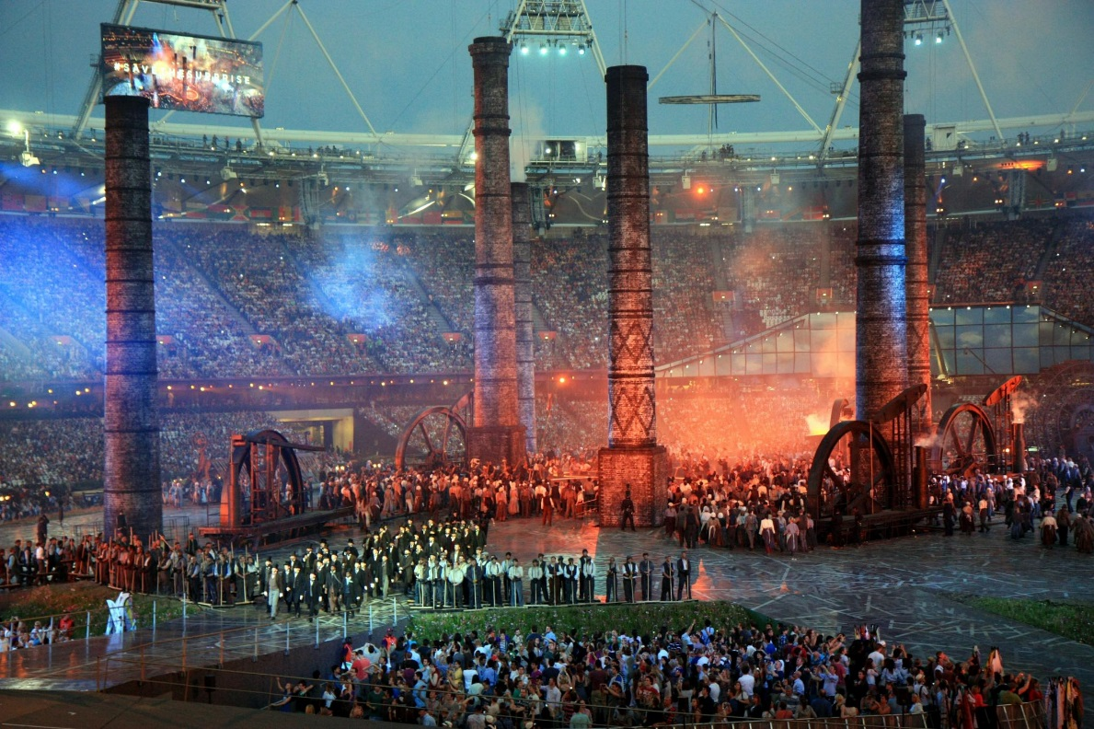
Carefully watch the video and complete the grid with as many observations as you can.
https://www.youtube.com/watch?v=HBITyBdRv_Q
Notes:
https://www.youtube.com/watch?v=HBITyBdRv_Q – if link is broken search for ‘Industrial Revolution London Olympics Opening Ceremony’

Slide 41
What did you see take place?
Environment | Rich and poor | Industry | Events | Individuals
The countryside ‘retreated’ and was replaced with industry. The skyline was dominated by huge factories and chimneys. | Two very distinct classes. Two very different ways of dressing. Two different levels of activity/manual labour. | New wealth Smoke Burning coal Factories Mass production. | Suffrage movement (right to vote) First World War Jarrow March | Brunel (The engineer/industrialist in the top hat) Emily Davidson (The suffragette who is run down by the Kings’ horse)

Slide 42
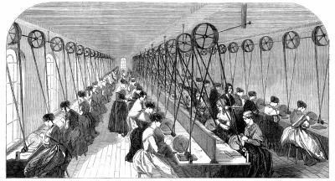
On the following pages you will see a series of statements about the Industrial Revolution.
Read them and add any new information you learn from them to your tables. Try to get as many new details and facts as you can.

Slide 43
The Industrial Revolution – what was it?
The Industrial Revolution is normally said to have occurred in Britain between 1750 and 1900. It was a period of rapid economic and social change. It was made up of many different factors which all interlinked.
  Agriculture. New methods allowed farmers grow much more food than ever before. For example ‘Turnip’ Townshend introduced the Norfolk four-course rotation of farm land and Robert Bakewell used selective breeding to develop the New Leicester sheep.
  Industry. New methods of manufacturing using large factories made thousands of basic products like clothes and tools easier to build and cheaper to buy. Richard Arkwright's Mill at Cromford heralded 'the Factory Age' of the textile industry, production of iron increased 30-fold, and production of coal increased 20-fold.

Slide 44
The Industrial Revolution – what was it?
  Cities: Hundreds of thousands of families left the countryside and moved to new but often cramped and small houses in the rapidly expanding cities. The skyline became dominated by large chimney and soot and smoke polluted the air.
  Transport and communications. Quicker ways of traveling were developed and they changed the world forever. Thomas Telford built roads and canals in the 1700s, and George Stephenson and Isambard Kingdom Brunel oversaw the 'Railway Mania' of the 1800s.

Slide 45
The Industrial Revolution – what was it?
  Science and technology: At the same time there occurred a long list of scientific discoveries and technological inventions that changed society and industry.
  Society: Women and children began to enter the workforce and receive a salary the relationships that had held societies together began to change. Factory owners often became ‘super rich’ and challenged the old Lords for control over the country.

Slide 46
Explain three important changes that took place during the Industrial Revolution.
You will need to write three paragraphs to answer this question.
Each paragraph must be about a different change.
Challenge – What was the most important change of the Industrial Revolution? You must explain your answer.

Slide 47
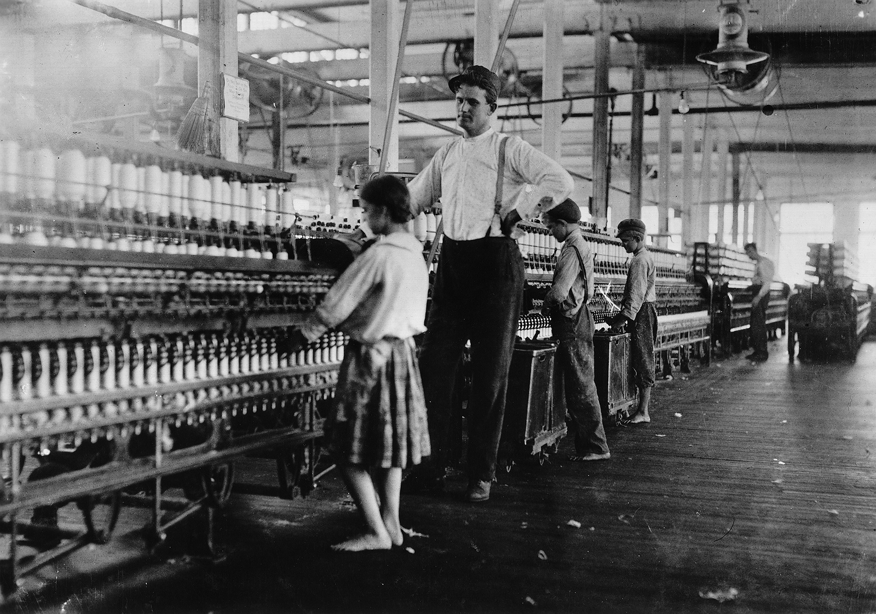
Children labour during the Industrial Revolution
L/I: To look at the children of the Industrial Revolution.

Slide 48
5. The Industrial Revolution
Answer the following.
What was the Industrial Revolution?
What was life like for families that moved in to new Industrial cities and why did they move there?
Who was Jack the Ripper?

Slide 49
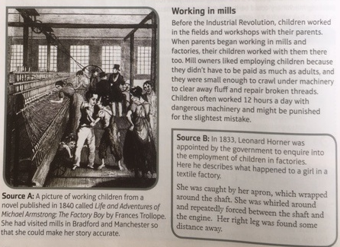

Slide 50
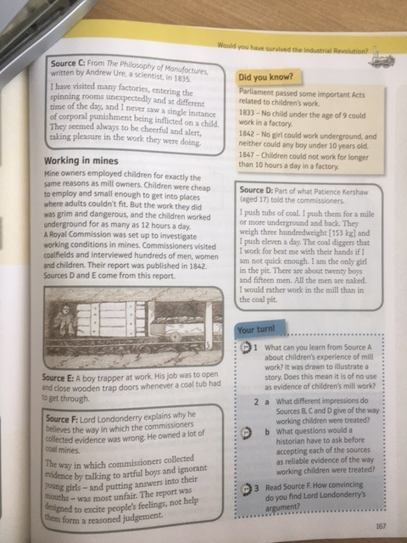
Working in mills
Explain, in your own words, what it was like for children that were working in the mills.
Include where they worked before, the conditions and why mill owners liked hiring children.
______________________________________________________________________________________________________________________________________________________________________________________________________________________________________________________________________________________________________
Working in mines
Explain, in your own words, what it was like for children that were working in the mills.
Include where they worked before, the conditions and why mill owners liked hiring children.
______________________________________________________________________________________________________________________________________________________________________________________________________________________________________________________________________________________________________

Slide 51
Children and the Industrial Revolution - Sources
Pick one of the Sources and explain what the Source tells us about children’s experiences during the Industrial Revolution. Include what the Source is, when it was written and who wrote it.
________________________________________________________________________________________________________________________________________________________________________________________________________________________________________________________________________________________________________________________________________________________________________________________________________________________________________________________________________________________________________________________
Extension – How reliable is the source? What makes it reliable to you?

Slide 52
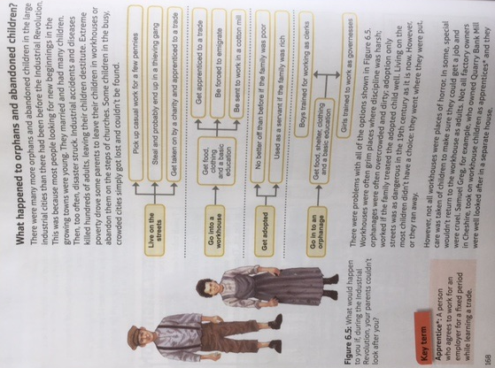

Slide 53
Laws relating to children’s work
1833 – No child under the age of 9 could work in a factory.
1842 – No girl could work underground and neither could any boy under 10 years old.
1847 – Children could not work for longer than 10 hours a day in a factory.
1870 - Gradually, every child in Britain was introduced to schooling. They were going to school instead of work.

Slide 54
Explain what life was like for children during the Industrial Revolution.
This answer needs three paragraphs.
Each paragraph should be on something we have studied today. E.g. Mines, factories and the laws.
State clearly what each paragraph is about and then explain your point.
Challenge – Was life difficult for children during the Industrial Revolution? You must explain your answer.

Slide 55
________________ _____________________________________ __________ ____ ____ ____ ____ ____ ____ ____ ____ ____ ____ ____ ________________ ___________________________________________ ____ __________ ______________________________________________________________________________________________________________

Slide 56
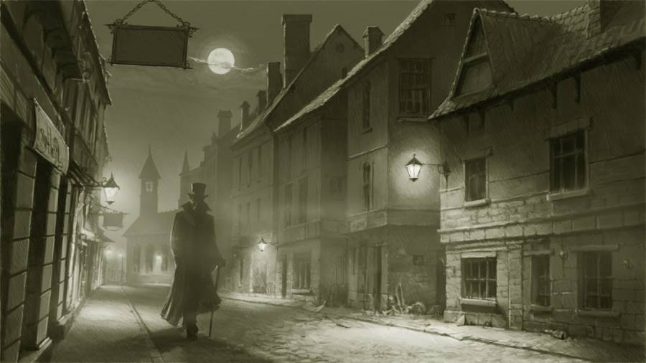
Who was Jack the Ripper?
L/I: – To identify the most likely suspect in the Whitechapel murders.

Slide 57

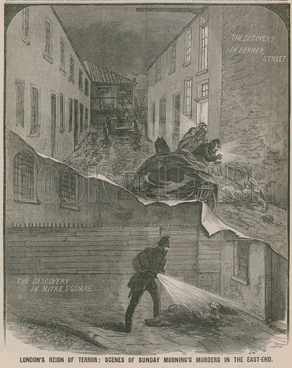
SOURCE A: JACK THE RIPPER was an unknown murderer who terrorized London in 1888. From August 31 to November 9 that year, five prostitutes were killed and horribly mutilated. The murderer was called Jack the Ripper because a knife was used to cut the victim’s throats and slash their bodies.
The murderer was never caught in spite of the efforts of police, citizen patrols, bloodhounds, and even fortune-tellers. Scotland Yard, the headquarters of the London Metropolitan Police, identified three principal suspects. All were men known to be insane. However, the police failed to prove that any of them had committed the murders. Widespread charges of police incompetence caused the commissioner of Scotland Yard, Sir Charles Warren, to resign on November 8, the day before the fifth murder.
The London Police received hundreds of letters from people who claimed to be the murderer. Only one of the letters seemed to be authentic. The sender’s address was “From Hell,” and part of a kidney of one of the victims was enclosed.
By Donald Rumbelow

Slide 58
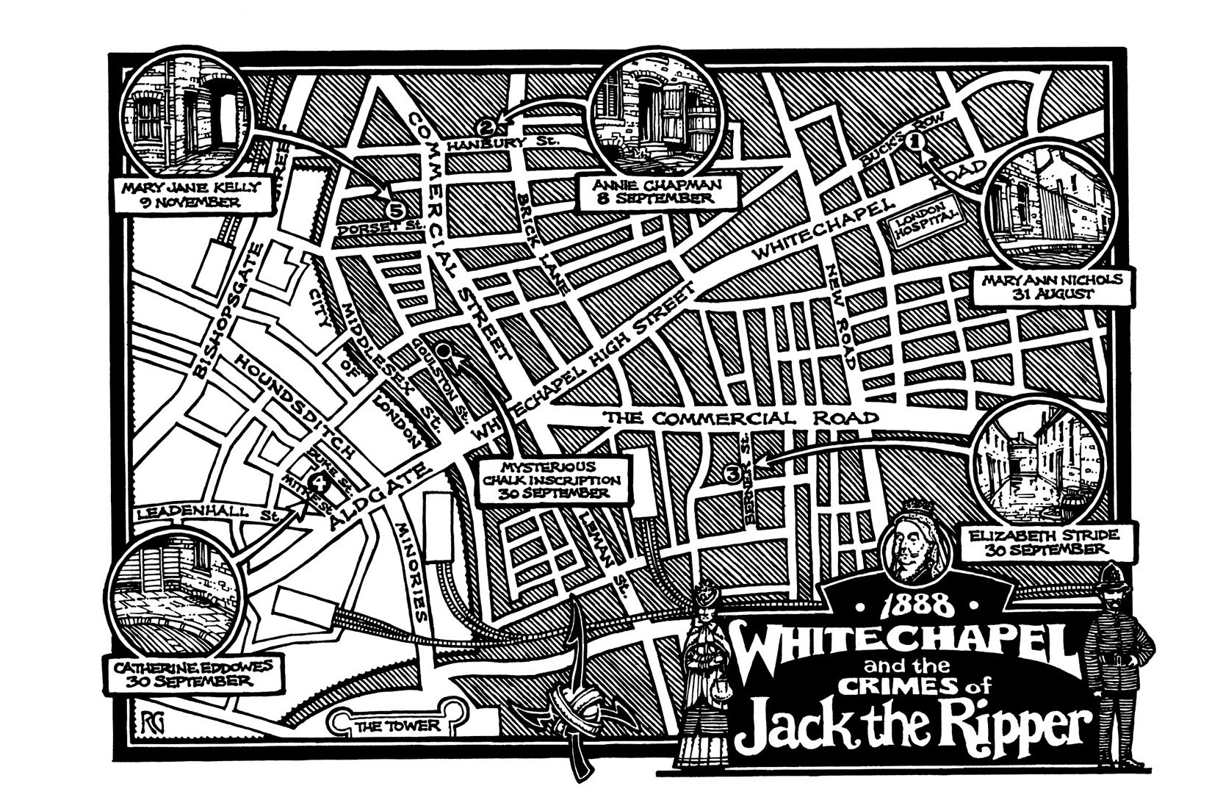
SOURCE C: Jack the Ripper, name given to the unknown murderer of at least seven women, all prostitutes, in or near the Whitechapel district of the East End of London, from Aug. 7 to Nov. 10, 1888. One of the most famous unsolved mysteries of English crime; the case has retained its hold on the popular imagination. All but one of Jack’s victims was killed while soliciting customers on the street. In each instance the throat was cut, and usually the body was mutilated in a manner indicating that the murderer had considerable knowledge of human anatomy. On one occasion half of a human kidney, which may have been extracted from a murder victim, was mailed to the police. The authorities also received a series of taunting notes from a person calling himself Jack the Ripper and purporting to be the murderer. Strenuous and sometimes curious efforts were made to identify and to trap the killer; the eyes of one of the murdered women were photographed in the belief (later discredited) that the assailant’s image might be recorded on the retinas.
From a modern Encyclopaedia
SOURCE D: Locality of the 5 ‘canonical’ murders.

Slide 59
SOURCE E: One of the alleged Ripper letters
Dear Boss,
I keep on hearing the police have caught me but they wont fix me just yet. I have laughed when they look so clever and talk about being on the right track. That joke about Leather Apron gave me real fits. I am down on whores and I shant quit ripping them till I do get buckled. Grand work the last job was. I gave the lady no time to squeal. How can they catch me now. I love my work and want to start again. You will soon hear of me with my funny little games. I saved some of the proper red stuff in a ginger beer bottle over the last job to write with but it went thick like glue and I cant use it. Red ink is fit enough I hope ha. ha. The next job I do I shall clip the ladys ears off and send to the police officers just for jolly wouldn't you. Keep this letter back till I do a bit more work, then give it out straight. My knife's so nice and sharp I want to get to work right away if I get a chance. Good Luck.
Yours truly
Jack the Ripper Dont mind me giving the trade name
PS Wasnt good enough to post this before I got all the red ink off my hands curse it No luck yet. They say I'm a doctor now. ha ha
(Letter is reproduced with original grammatical and spelling mistakes)

Slide 60
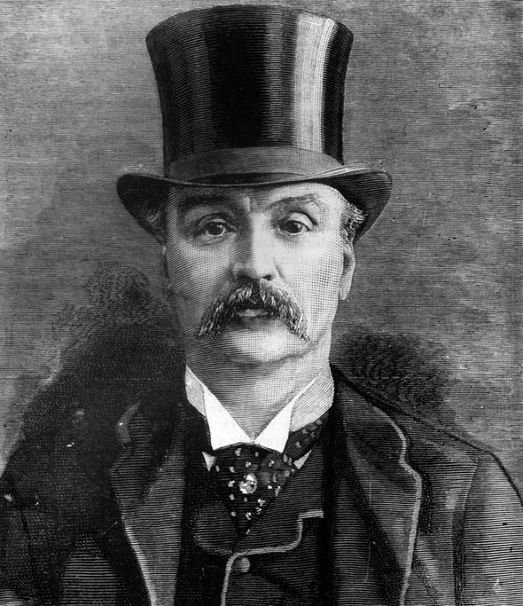
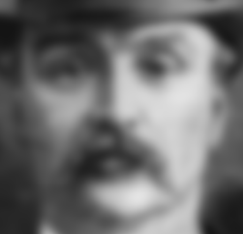

What did Jack the Ripper look like?
Appearance:
Poor personal hygiene.
Unlikely that he looked like a gentleman.
Would probably appear dirty/unwashed.
If he worked it was probably a very low position where he had little contact with the public.
Certainly not a professional.
?

Slide 61
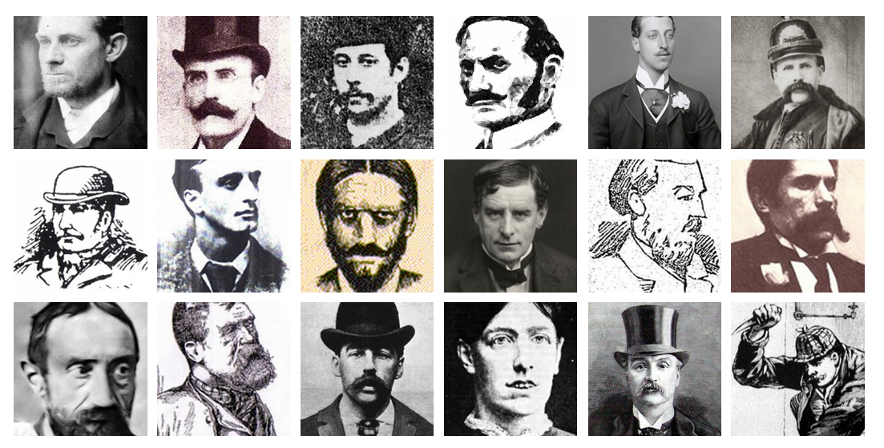
Who was Jack the Ripper?
More than 50 men have been linked to the Jack the Ripper killings. We have narrowed down the search to the 6 most popular suspects.

Slide 62

Who was Jack the Ripper?
Well done on finding so much information on Jack’s victims. Your work has led us onto a number of possible suspects….
We now need to start investigating who Jack the Ripper might have been.
TASK: You have been given information on the Jack the Ripper suspects. You must create a small spider diagram to record the key information about your suspects.

