Slide 1
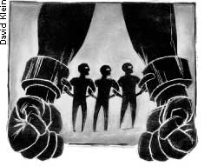
History Year 7 KS3 Summer 1 Blended Learning Booklet
The Transatlantic Slave Trade
Name:
Form:
Aim to complete one lesson each week. Write out the title and LI and then complete the tasks.
All video links are online using the ClassCharts link.
The Knowledge Organiser on page 3 has all the key information and vocabulary to help you with this unit.

Slide 2


ZOOM IN...
CAREERS
Journalist reporting on events
Archaeologist
History Teacher
MY LEARNING JOURNEY:
Subject: History Year:7 Unit 5: The Transatlantic Slave Trade
UP NEXT
The British Empire
AIMS
1. To understand the Slave Trade Triangle.
2. To explain why slavery was allowed to happen.
3. To explain the hardships slaves faced on plantations.
4. To comeple an assessment on the Slave Trade.
DEVELOPING COURAGE
C To confidently share opinion with class on how Tudor life in England.
O Given the opportunity to work on extended writing.
U Teamwork to compare views about Tudor Sources.
R Showing Resilience when completing extended pieces of writing ​
A Learning to appreciate the past
G Being generous with Historical detail in writing
E Finish a History essay.
PREVIOUS LEARNING
Why William won at the Battle of Hastings.
How the Normans changed England
The Reformation
Tudor Kings and Queens
Tudor Life
.
WHAT WE KNOW/
REMEMBER
How Elizabeth begun the British Empire.
PERSONAL OBJECTIVES
.......................................
.......................................
.......................................
.......................................
.......................................
.......................................
.......................................
.......................................
.......................................
.......................................
.......................................
RECOMMENDED READING
Battlefield Britain
History Learning Site

Slide 3
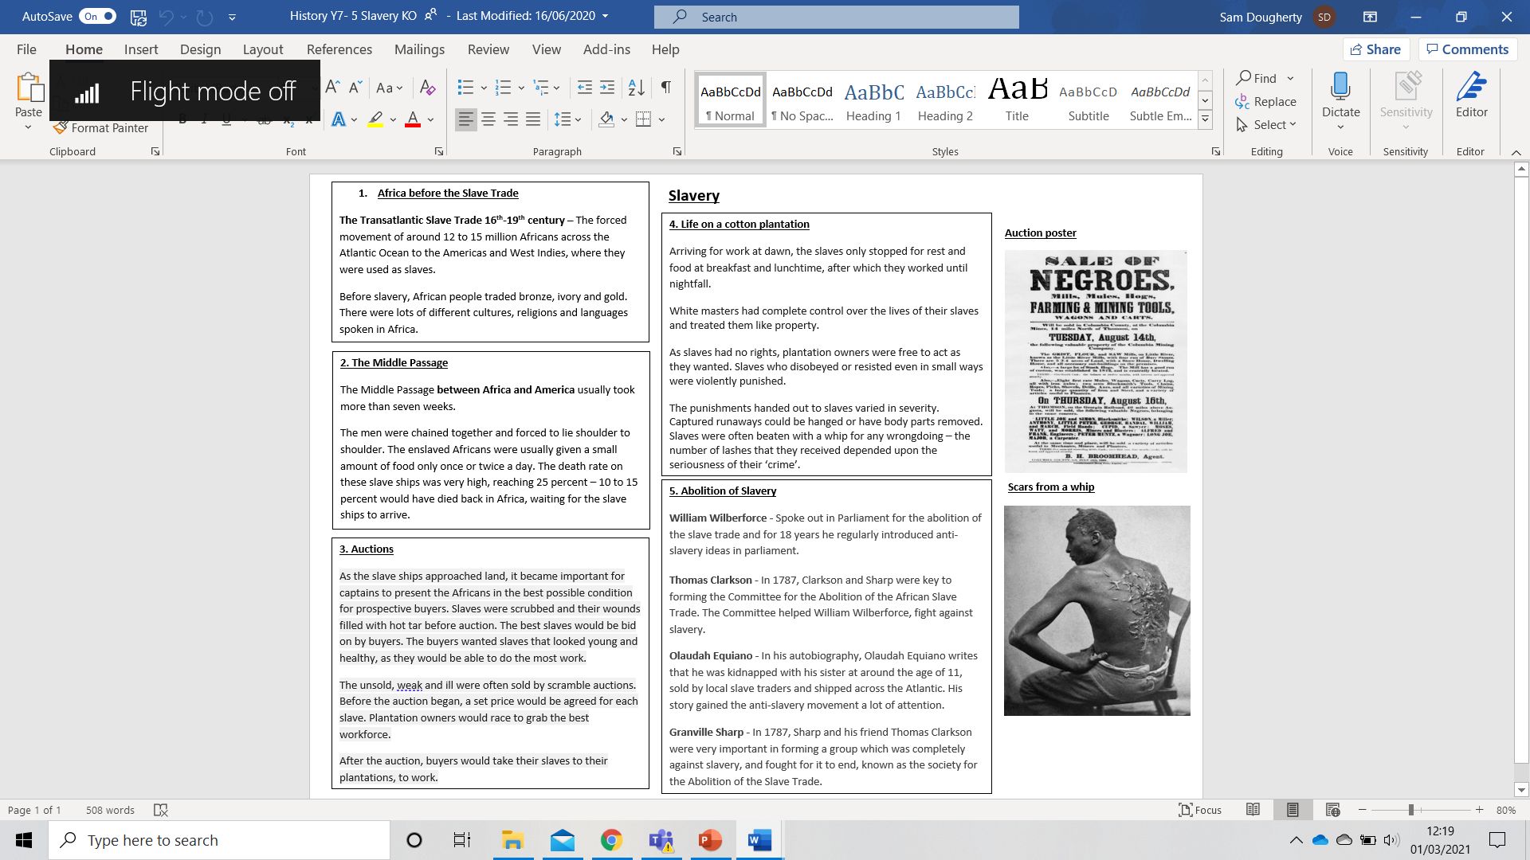

Slide 4
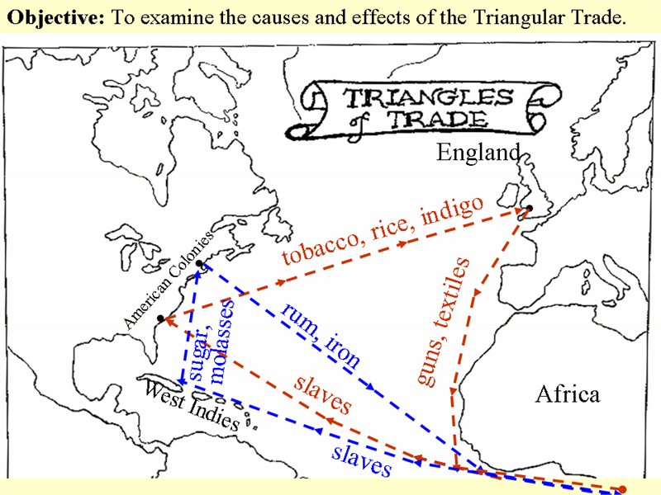
The Slave Trade Triangle
L/I: To understand how slaves were captured and what the slave trade triangle was.

Slide 5
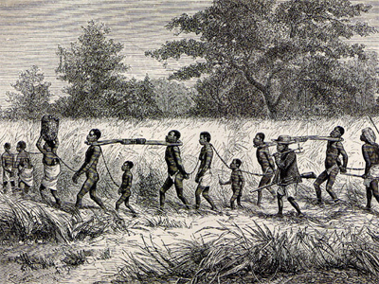
What can you see in this image?
What do you think is happening?
Write your thoughts below:

Slide 6
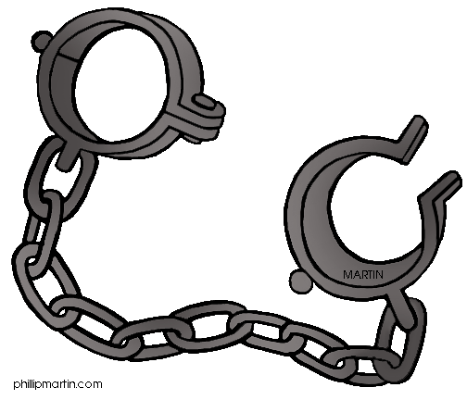
What is Slavery?
A slave is someone who is owned by another person. A slave has:
No choice No freedom No money

Slide 7
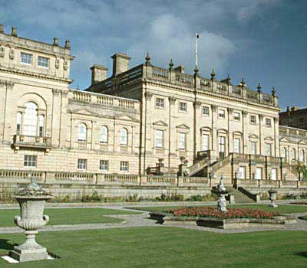
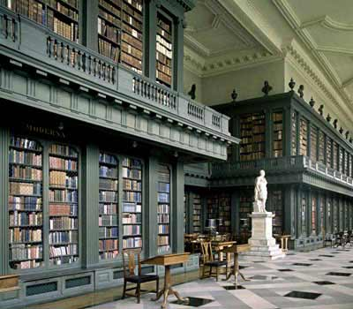
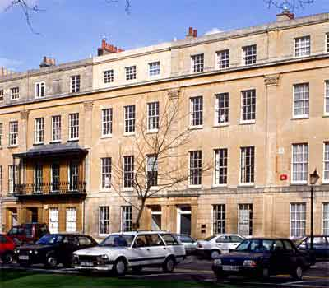
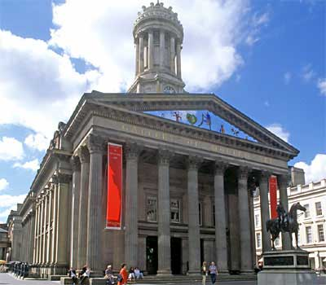
Britain’s involvement in the slave trade made a huge amount of money! They used slaves to grow tea, sugar and tobacco, which was sold to make a huge profit. These buildings were built using the money made from the salve trade.

Slide 8
The Slave Trade Triangle
For over 300 years, slaves were captured along the west coast of Africa, often with the active help of African kings and merchants. Slaves were traded for beads, textiles, brandy, horses, and guns. Britain was the main slave trading nation after 1555.
https://www.bbc.co.uk/bitesize/clips/zspk2hv
Watch the video and explain what the slave trade triangle was:

Slide 10
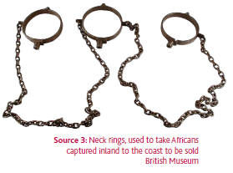
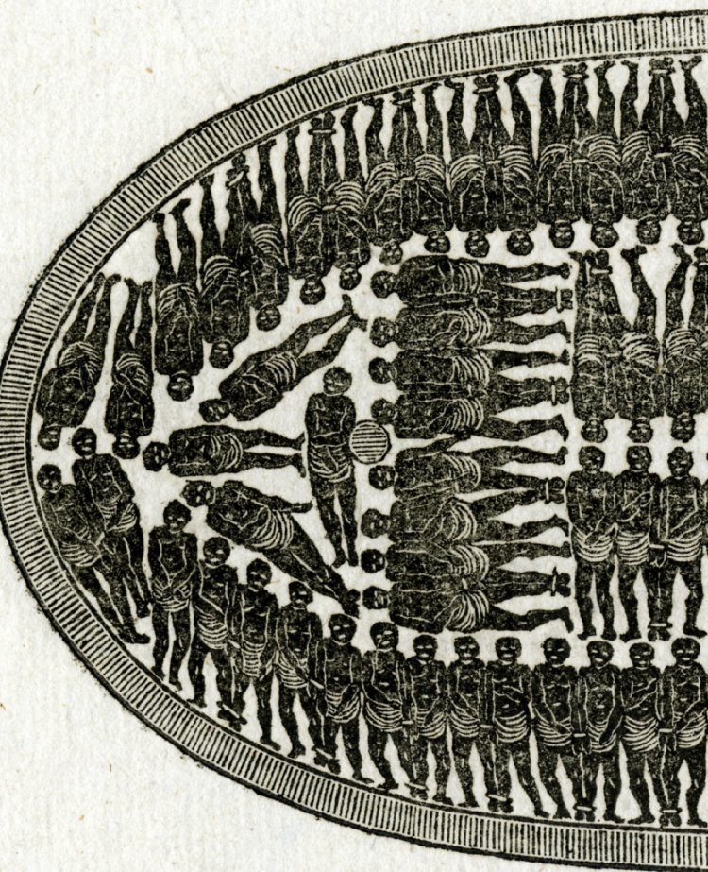
What do sources 1 and 2 tell you about the slave trade?
Source 1 – Chains used to take captured slaves away from their homes.
Source 2 – A diagram of part of a slave ship.

Slide 11
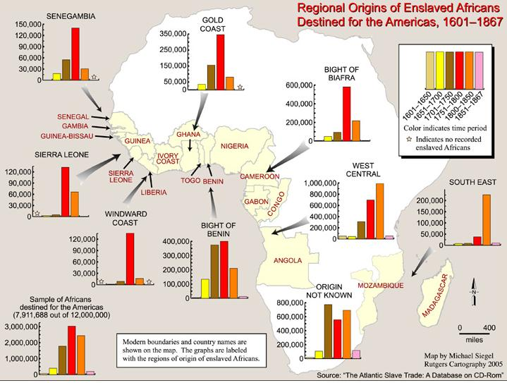
The major African countries where slaves where captured

Slide 12
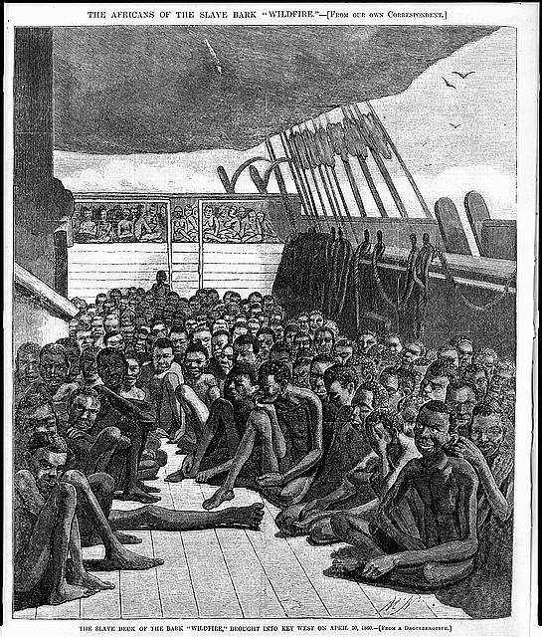
The Middle Passage
L/I: To understand what the Middle Passage was.

Slide 13
The Middle Passage
The Middle Passage between Africa and America usually took more than seven weeks.
The men were chained together and forced to lie shoulder to shoulder.
The enslaved Africans were usually fed only once or twice a day.
The death rate on these slave ships was very high, reaching 25 percent – 10 to 15 percent would have died waiting for the slave ships to arrive.

Slide 14
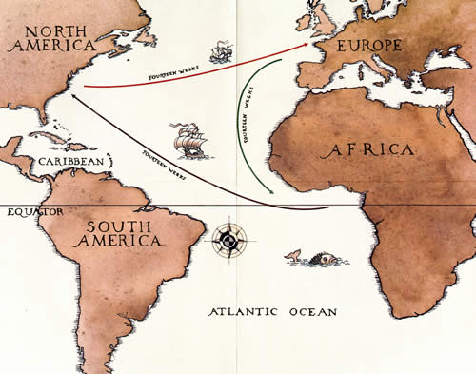
The Middle Passage was between Africa and the Americas.

Slide 15
Use the video to make notes on what the Middle Passage was like for slaves, below:
https://www.youtube.com/watch?v=T4ctPavmVuc

Slide 16
Read through the information about the Middle Passage, below:
Source 1
Quote from “An Account of the Slave Trade on the Coast of Africa” by Alexander Falconbridge, 1788. Falconbridge was a surgeon aboard slave ships making the journey through the Middle Passage between Africa and America.
“The deck, that is the floor of their rooms, was so covered with the blood and mucus that it resembled a slaughter-house. It is not in the power of the human imagination to picture a situation more dreadful or disgusting. Numbers of the slaves having fainted they were carried upon deck where several of them died and the rest with great difficulty were restored. It had nearly proved fatal to me also. The climate was too warm, I was so overcome with the heat, stench and foul air that I nearly fainted; and it was only with assistance that I could get on deck. The consequence was that I soon fell sick of the same disorder from which I did not recover for several months.”
Source 2
Quote from a book written by Olaudah Equiano in 1789 a slave who was taken on board a slave ship in the Middle Passage.
“The closeness of the place, and the heat of the climate added to the number in the ship, which was so crowded that each had scarcely room to turn himself, almost suffocated us. This produced copious perspirations, so that the air soon became unfit for respiration, from a variety of loathsome smells, and brought on a sickness among the slaves, of which many died. This wretched situation was...aggravated by the galling of the chains...the filth of the necessary tubs...the shrieks of the women, and the groans of the dying, rendered the whole scene of horror almost unbearable.”

Slide 17
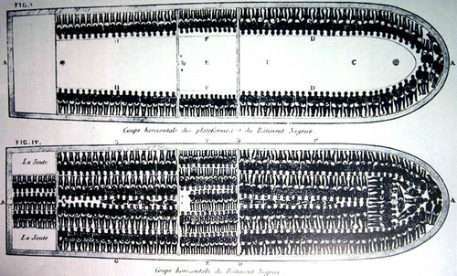
What can we learn from Source 4 below, about conditions on the Middle Passage voyage?
Source 4
Extension - Why might this picture be used to convince the government to end slavery?

Slide 18
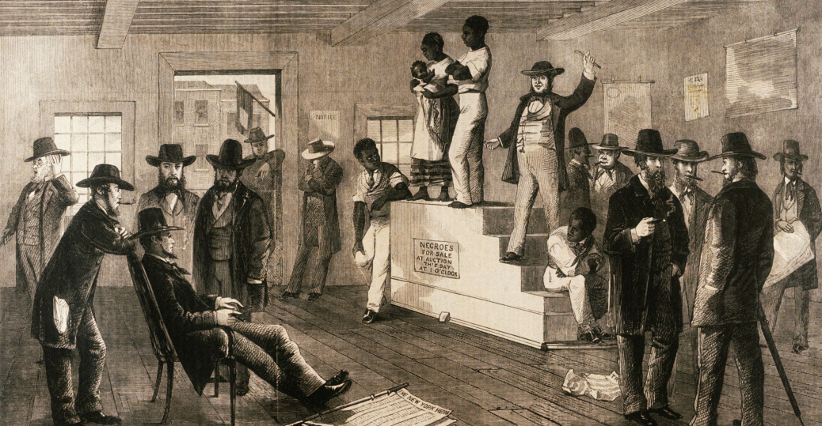
Slave auctions
L/I: To understand how slaves were bought and sold

Slide 19
Slave auctions
When slaves had reached the Americas, after surviving the Middle Passage they were sold at auction to the highest bidder, where they would then be taken to work on a plantation as a slave owned by whoever bought them.
There were two methods of sale – auction & scramble

Slide 20
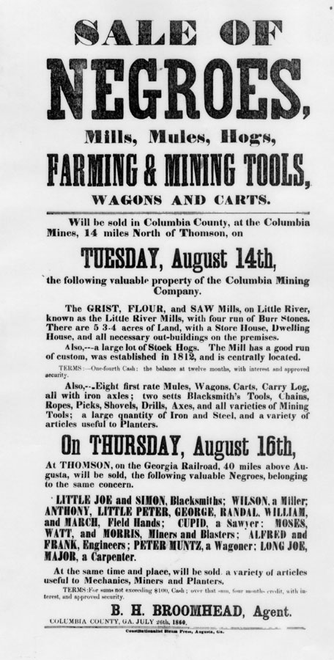
How were slaves prepared for auction?
Washed with water
Rubbed with oil
Gunpowder, hot tar or rust rubbed into wounds
Teeth inspected
Brutal remedies, e.g. for diarrhoea
Two methods of sale – auction & scramble

Slide 21

1. What can we learn about how buyers think of slaves, from this poster?
2. How important is this poster when learning about the way slaves were treated? Explain your answer.
Notes:
https://www.youtube.com/watch?v=b2lwAd0qrWo
https://www.youtube.com/watch?v=bfw9mLjh7YM

Slide 22
Watch the two clips on slave auctions and answer the questions below.
https://www.youtube.com/watch?v=b2lwAd0qrWo
https://www.youtube.com/watch?v=bfw9mLjh7YM
Clip One
What does the drumming mean?
Why might slave buyers want their slaves to have children?
What do the slave buyers mean by, ‘not being close to broken?’
Why would an African man be helping out at the auction?
Clip Two
How did people know a slave ship was arriving?
Where could a sale take place?
Why would buyers inspect the slaves?
How much would a slave cost today?

Slide 23
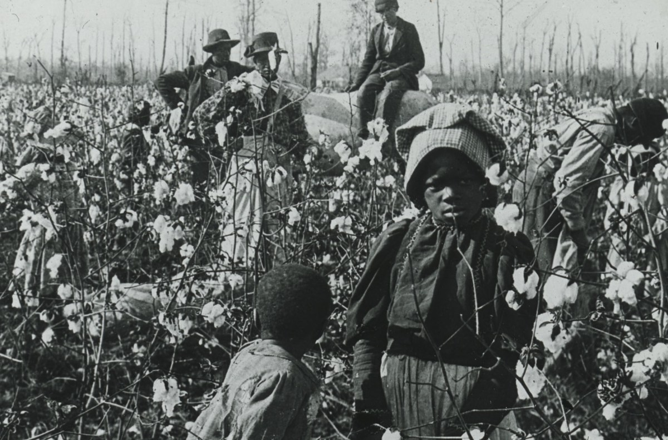
Life on a plantation for a slave
L/I: To understand what life was like for a slave working on a cotton plantation.

Slide 24
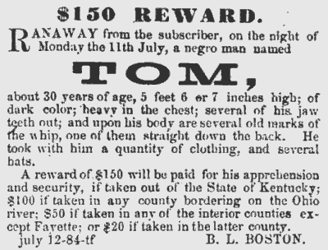
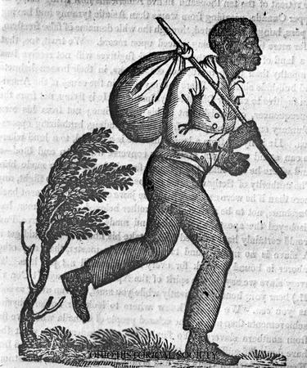
What is this advert for?
What does it tell us about the value of slaves?
Does this tell you something about the importance of the cotton industry?

Slide 25
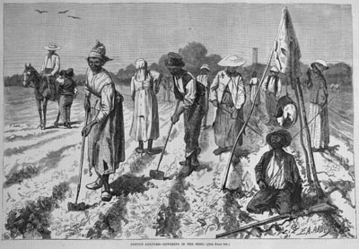
Being a field slave was not at all easy. A field slave worked from sunrise to sunset, but during harvest, they worked an eighteen-hour day.
A field worker was out in the field when the first sign of light shone until it was too dark to see. Women field workers worked the same hours as men. Pregnant women were expected to work until the child was born, and after the child's birth the woman worked in the field with the child on her back. At about the age of twelve a child's work became almost the same as an adult's.
Children as young as 6 worked in the fields!
What hours did field slaves work?
Were women treated any differently?
What about the children?
Cotton Cultivation, U.S. South, 1875

Slide 26
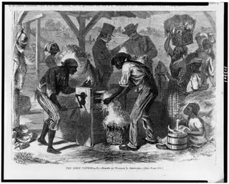
After a day on a cotton plantation the slaves got in a line to have their cotton weighed and receive their daily food. The minimum amount of cotton to be picked in one day was 200 pounds.
One slave, West Turner, remembered after a long day working on the plantation, he and other slaves were required to clean a shoe full of cotton before they were allowed to go to bed. Turner wore a size 14 shoe! Each night he was still cleaning his pile of cotton long after the rest of the slaves had finished. To stop this situation getting worse, he wrapped his feet up very tightly in rags, to prevent them getting any bigger!
What jobs did people do on a cotton plantation
What upset West Turner?
Why might West Turner have enjoyed the invention of the cotton gin?
This is a picture of slaves using a cotton gin.

Slide 27
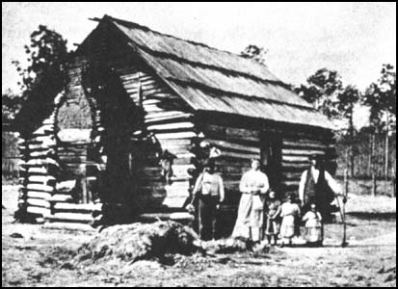
The accommodation provided for slaves usually consisted of wooden shacks with dirt floors. According to Jacob Stroyer they were built to house two families: "Some had partitions, while others had none. When there were no partitions each family would fit up its own part as it could; sometimes they got old boards and nailed them up, stuffing the cracks with rags; when they could not get boards they hung up old clothes."
Another slave, Josiah Henson wrote that "Wooden floors were an unknown luxury. In a single room were huddled, like cattle, ten or a dozen persons, men, women, and children. We had neither bedsteads, nor furniture of any description. Our beds were collections of straw and old rags, thrown down in the corners and boxed in with boards; a single blanket the only covering."
What were slaves homes like on plantations? According to Jacob Stroyer?
Does Josiah Henson agree with Jacob about living conditions for the slaves?

Slide 28
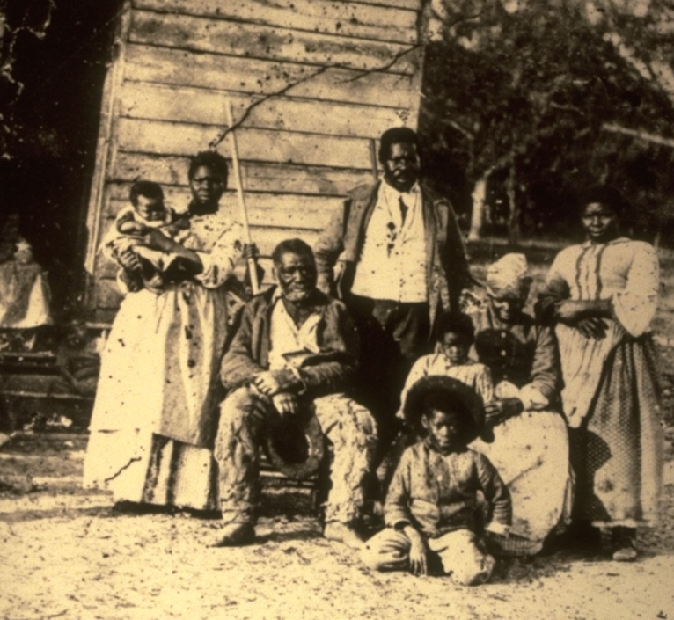
Plantation owners in America had complete freedom to buy and sell slaves. State laws gave slave marriages no legal protection and so husbands could be separated from their wives and children from their mothers.
The owner of Harriet Jacobs used the threat of selling her children as a means of controlling her behaviour. Jacobs described how one mother, who had just witnessed seven of her children being sold at a slave-market said 'Gone! All gone! Why don't God kill me?' I had no words wherewith to comfort her."
A study of slave records revealed that over 32 per cent of marriages were dissolved by masters as a result of slaves being sold away from the family home.
State 2 reasons why families were separated
What affect would separation have on the families?

Slide 29
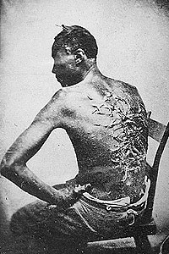
Slave Punishment:
According to his testimony, the injuries sustained from a whipping by his overseer kept Peter, a slave, bedridden for two months.
What does this photograph show?
Why do you think slaves were punished so harshly?
What does this tell us about attitudes towards slaves?

Slide 30
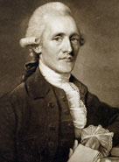
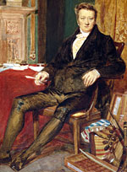
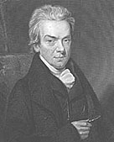
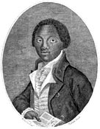
The abolition of slavery
L/I: To understand how slavery ended in the British Empire.
Abolish (abolition) – To end and put a stop to something

Slide 31
William Wilberforce
William was fighting for an end to the trade in which British ships were carrying black slaves from Africa, in terrible conditions, to be bought and sold.
Wilberforce spoke out in Parliament for the abolition of the slave trade and for 18 years he regularly introduced anti-slavery ideas in parliament.
The campaign was supported by many other abolitionists who raised public awareness of their cause with pamphlets, books, rallies and petitions.
What did William Wilberforce do to help end slavery?

Slide 32
Thomas Clarkson
Ending slavery was Clarkson’s passion for 61 years of his life.
In 1787, Clarkson and Sharp were key to forming the Committee for the Abolition of the African Slave Trade. The Committee helped William Wilberforce, fight against slavery.
He devoted his time and energy to travelling around Britain, particularly to the ports of Liverpool and Bristol, gathering evidence about the slave trade from eyewitnesses, especially from sailors who had worked on slave trading ships. This evidence was then taken to Parliament.
What did William Wilberforce do to help end slavery?

Slide 33
Granville Sharp
His interest in slavery began in 1765 after he befriended Jonathan Strong, a slave who had been badly beaten by his master. When Strong's former owner attempted to sell him back into slavery in the Caribbean, Sharp defended Jonathan Strong and the slave was freed.
He was involved in winning the famous 1772 court ruling which concluded that slave owners could not legally force slaves to return to where they were slaves once they were in Britain.
In 1787, Sharp and his friend Thomas Clarkson were very important in forming a group which was completely against slavery, and fought for it to end, known as the society for the Abolition of the Slave Trade.
What did William Wilberforce do to help end slavery?

Slide 34
Olaudah Equiano
In his autobiography, Olaudah Equiano writes that he was born in the Eboe province, in the area that is now southern Nigeria. He describes how he was kidnapped with his sister at around the age of 11, sold by local slave traders and shipped across the Atlantic to Barbados and then Virginia.
In Virginia he was sold to a Royal Navy officer, Lieutenant Michael Pascal, who renamed him 'Gustavus Vassa' after the 16th-century Swedish king. Equiano travelled the oceans with Pascal for eight years, during which time he was baptised and learned to read and write.
Pascal then sold Equiano to a ship captain in London, who took him to Montserrat, where he was sold to the prominent merchant Robert King. While working as a deckhand, valet and barber for King, Equiano earned money by trading on the side. In only three years, he made enough money to buy his own freedom. Equiano then spent much of the next 20 years travelling the world, including trips to Turkey and the Arctic.
In 1786 in London, he became involved in the movement to abolish slavery. He was a prominent member of the 'Sons of Africa', a group of 12 black men who campaigned for abolition.
In 1789 he published his autobiography, 'The Interesting Narrative of the Life of Olaudah Equiano or Gustavus Vassa, the African'. He travelled widely promoting the book, which became immensely popular, helped the abolitionist cause, and made Equiano a wealthy man. It is one of the earliest books published by a black African writer.

Slide 35
The abolition of slavery
Britain
1807 – Abolition of the Slave Trade Act abolishes slave trading in the British Empire. Captains fined £120 per slave transported.
1833 – Slavery Abolition Act bans owning slaves in the British Empire.
USA
1861-1865 – The American Civil War, fought over ending slavery, takes place.
1863 – The Emancipation Proclamation is issued by Abraham Lincoln, freeing all slaves in the USA.
Use google to research what life was like for black people in the USA, after slavery ended

