Slide 1
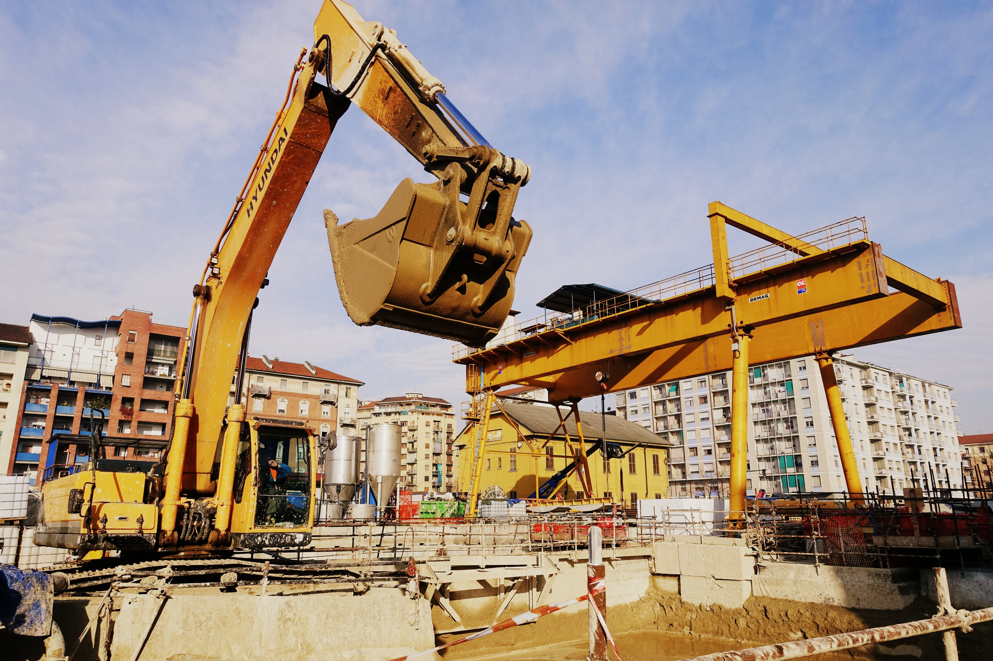
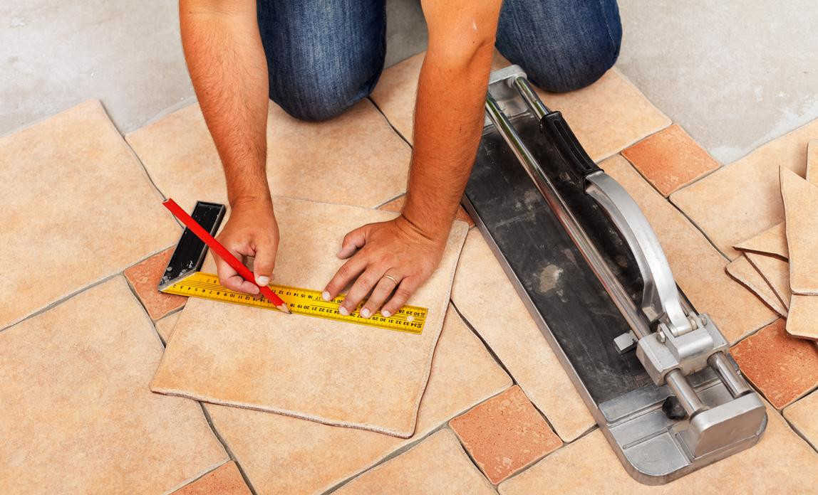
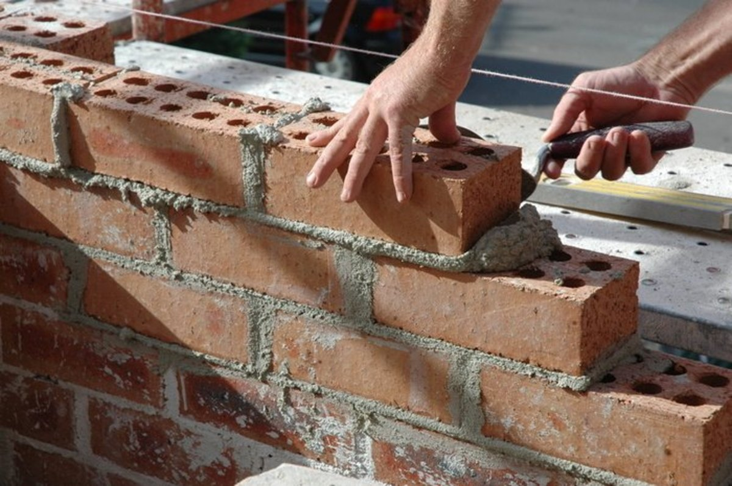



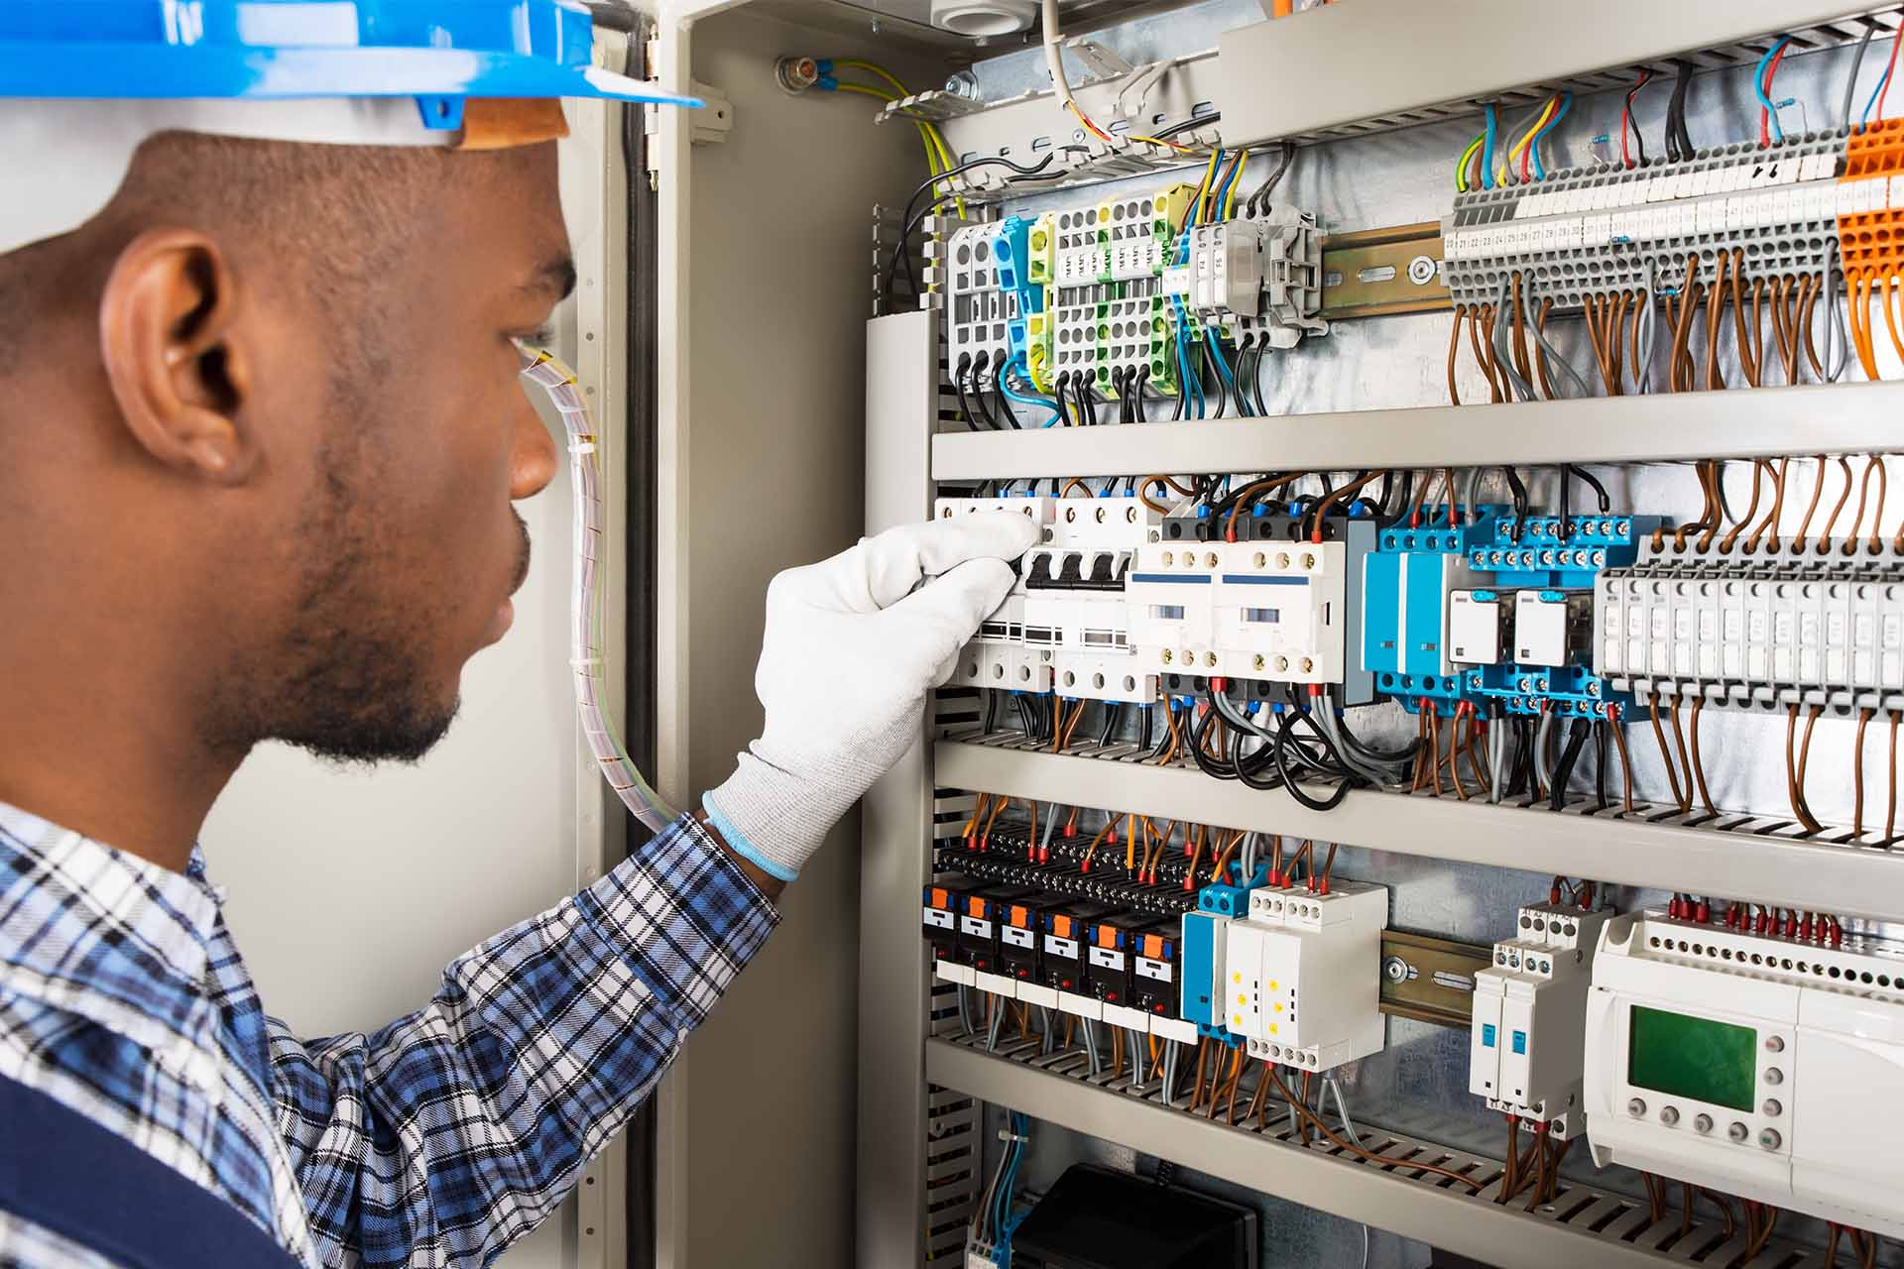
Y10-11: Construction
Electrics
Varnishing
Final exam
Revision
Method statements
Evaluations
Planning
Joints
Plumbing
Electrics
Exhibitions
Tiling
NEA intro
Tiling
Plumbing
Roles and responsbilities
Y11
Brick-laying
Health and safety
Structures
Painting/Decorating
Key skills in Construction
Exam prep
Introduction to the course
Y10
Planning
Measuring

