Slide 1
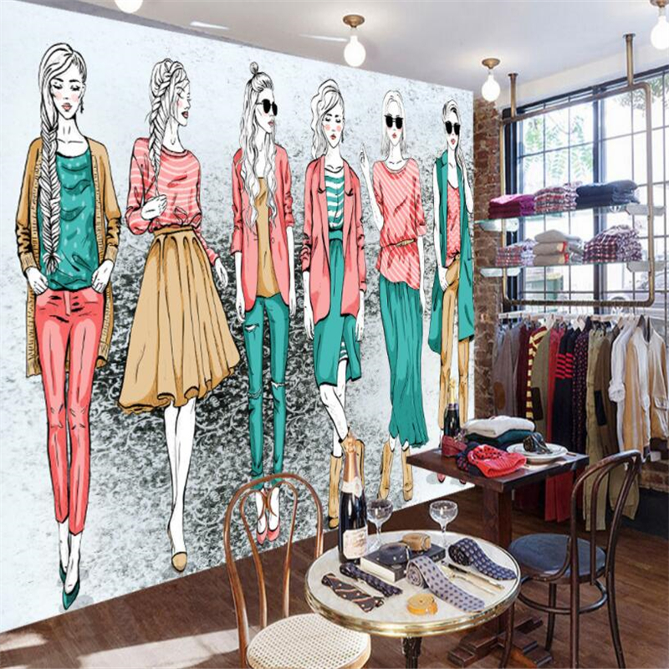






Y10-11: FASHION AND TEXTILES
Final piece
Fabric swatches
10-HOUR EXAM
Designs
Experiments
Experimentation
Exam themes released
Research and preparation
Exhibitions
Research
Sustained project final piece
Designs
Annotation
Around the world
Y11
Keywords
Fashion politics
Sustained project
Designer research
Environment project
Paper garment
Key Skills
An introduction and recap of sewing and decorative skills
Y10
Moodboards
Illustrations

