Slide 1



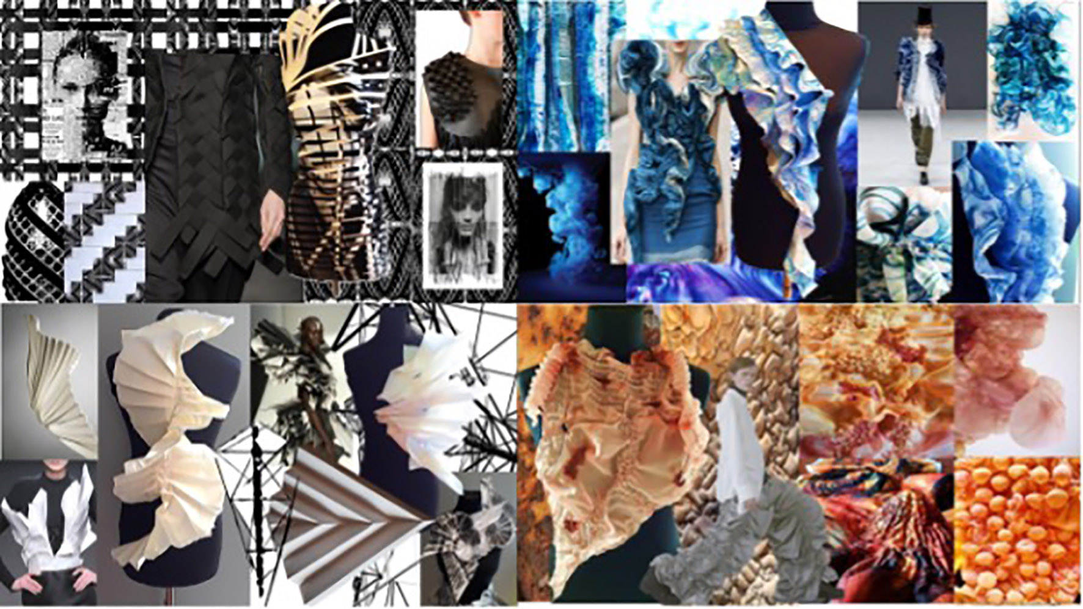
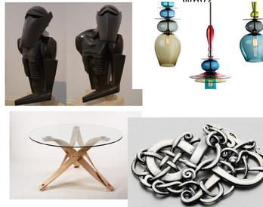
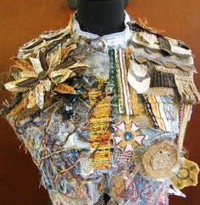
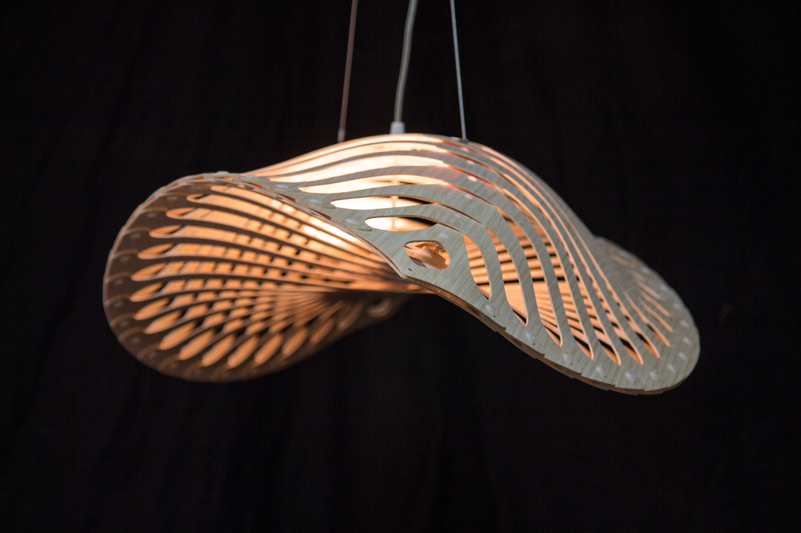
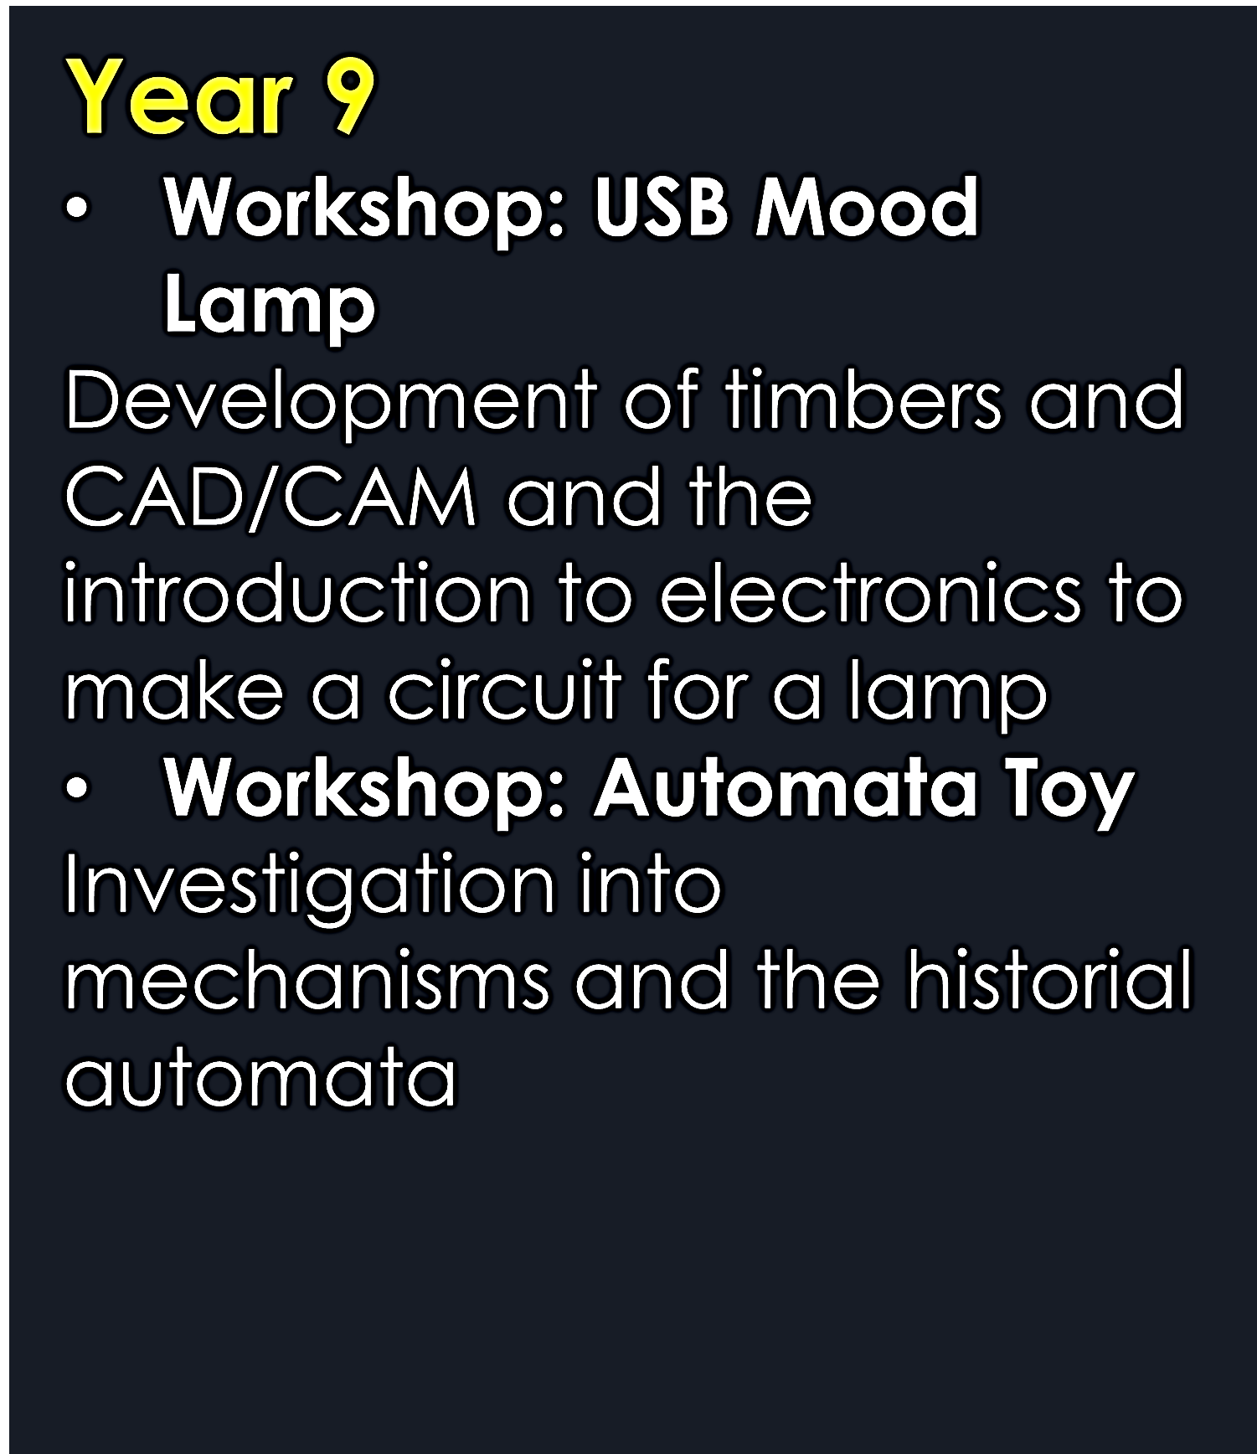
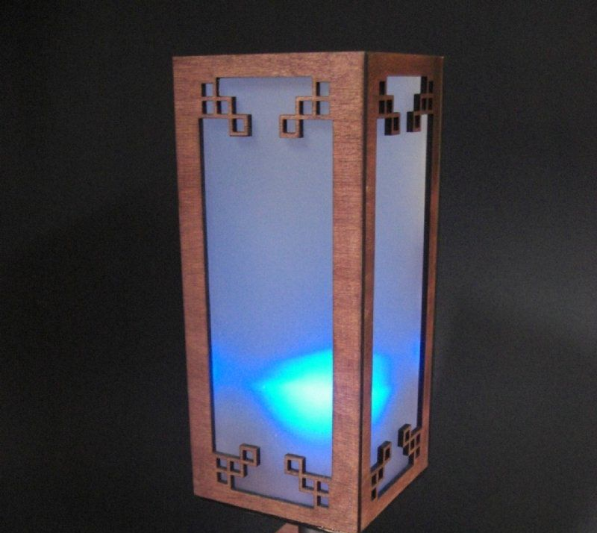
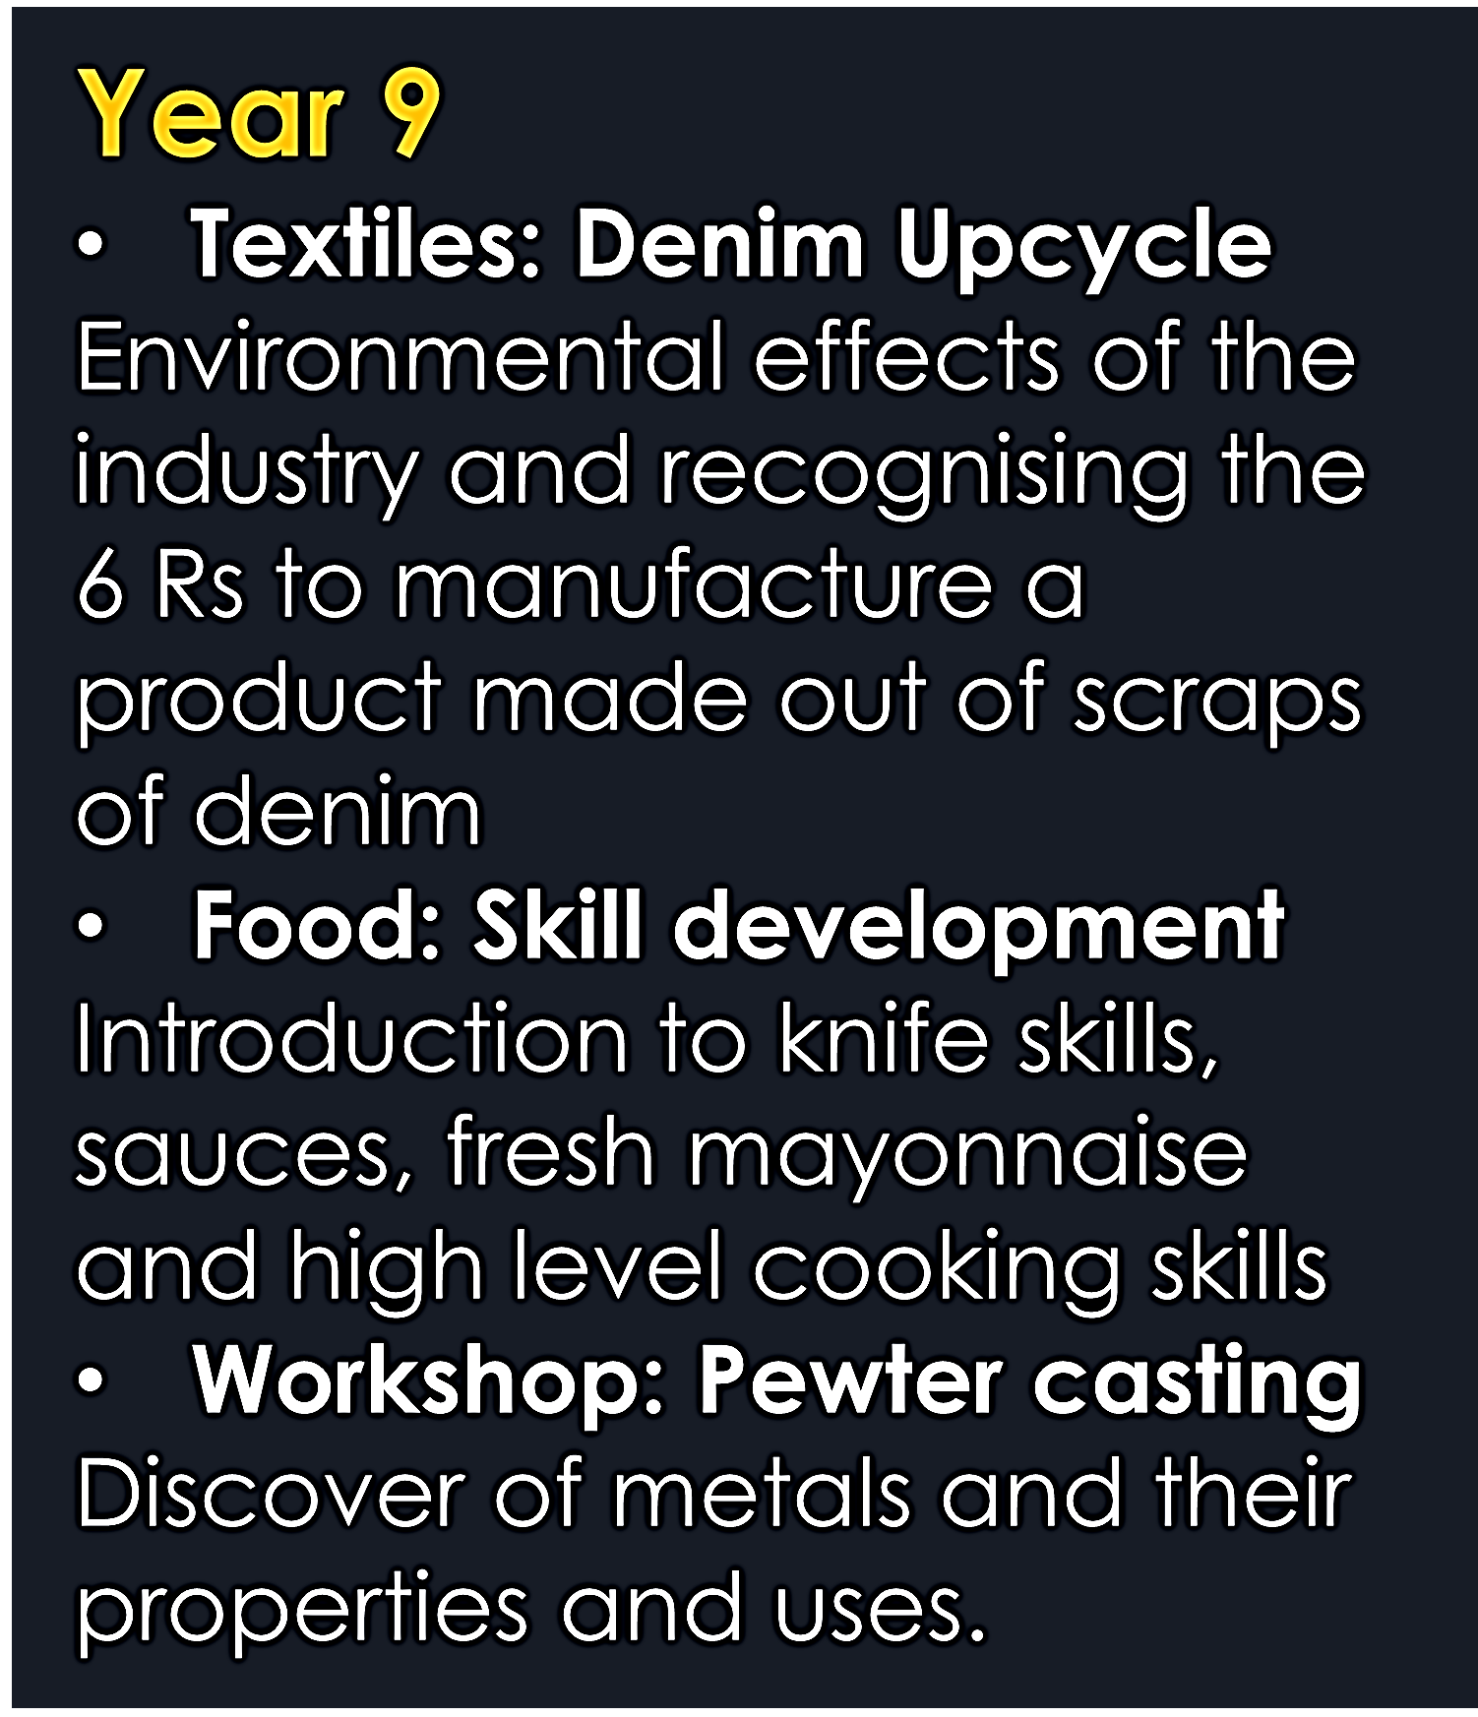
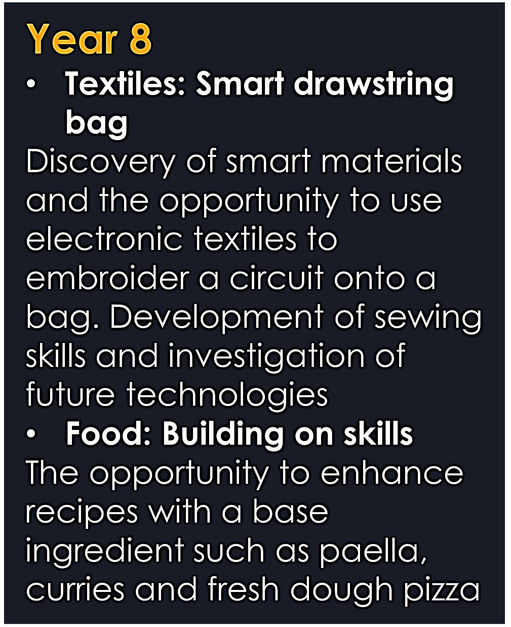
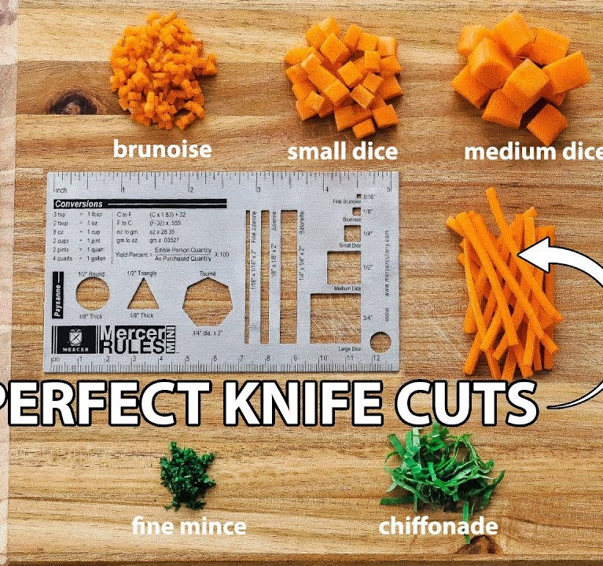
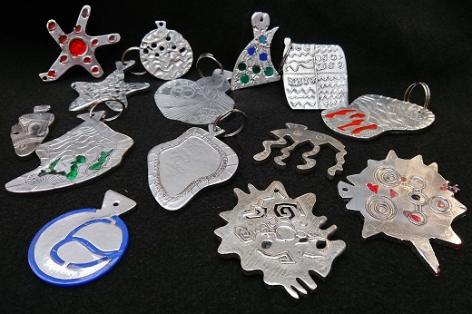
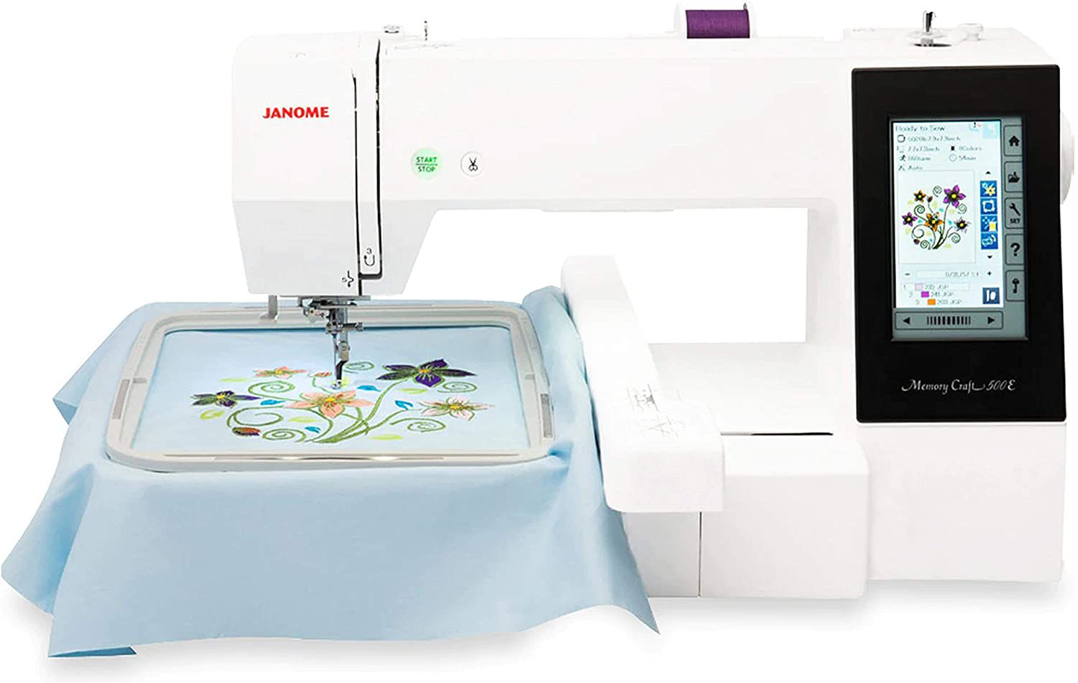
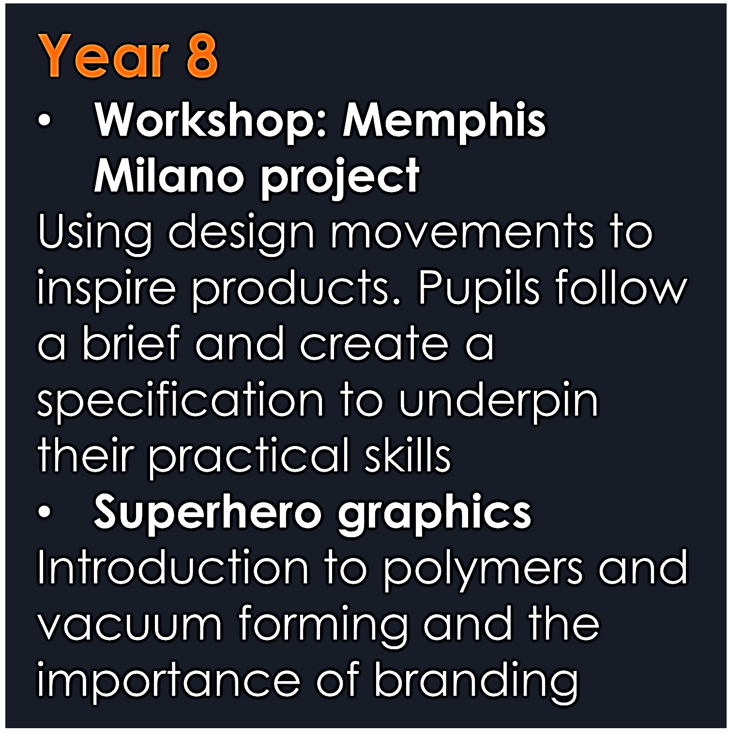
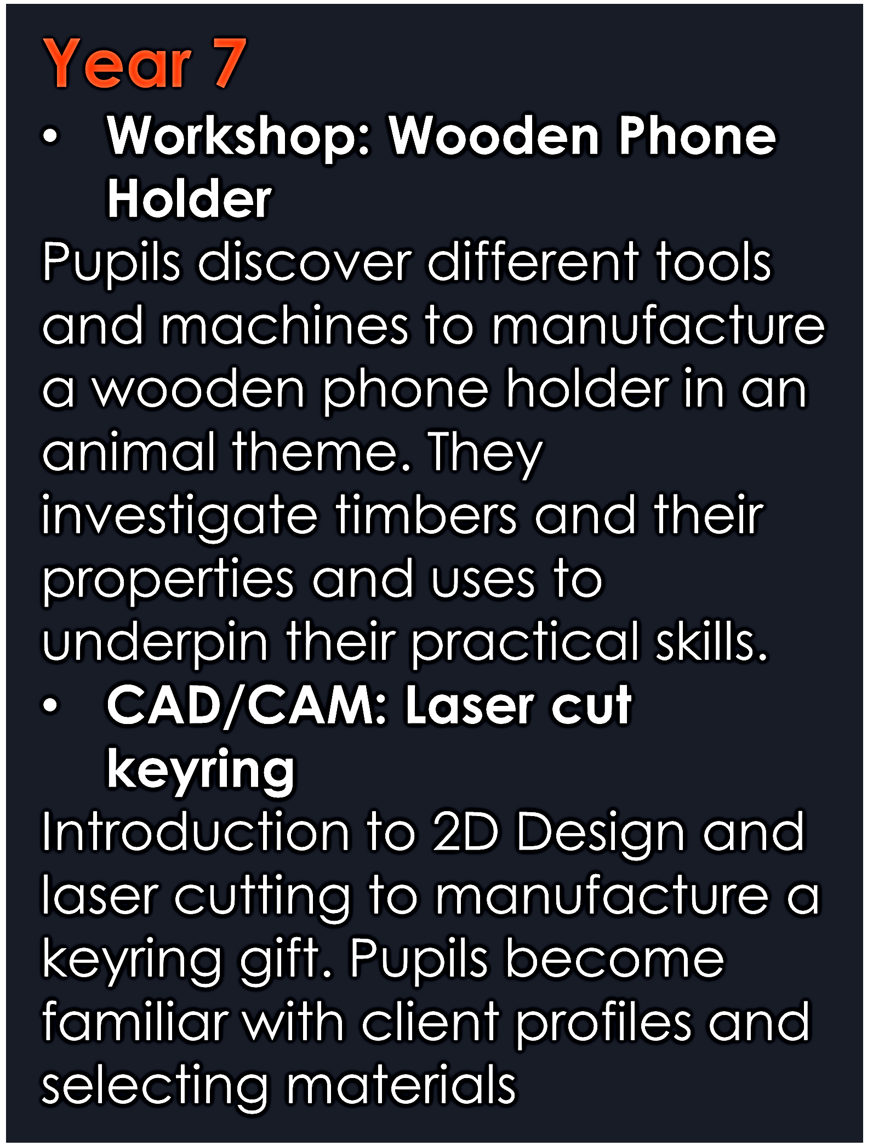
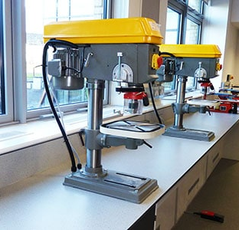
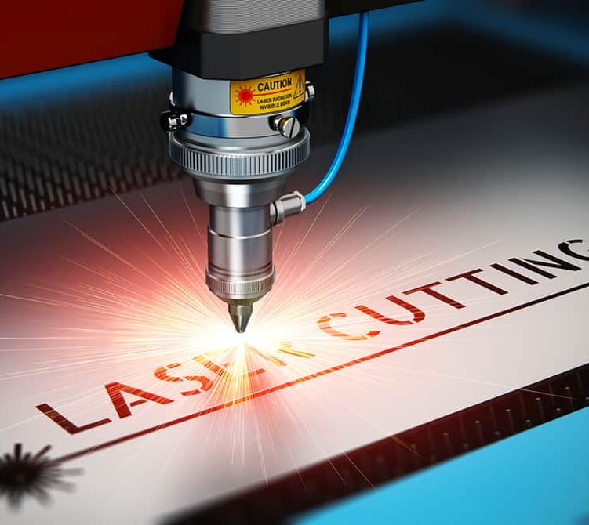
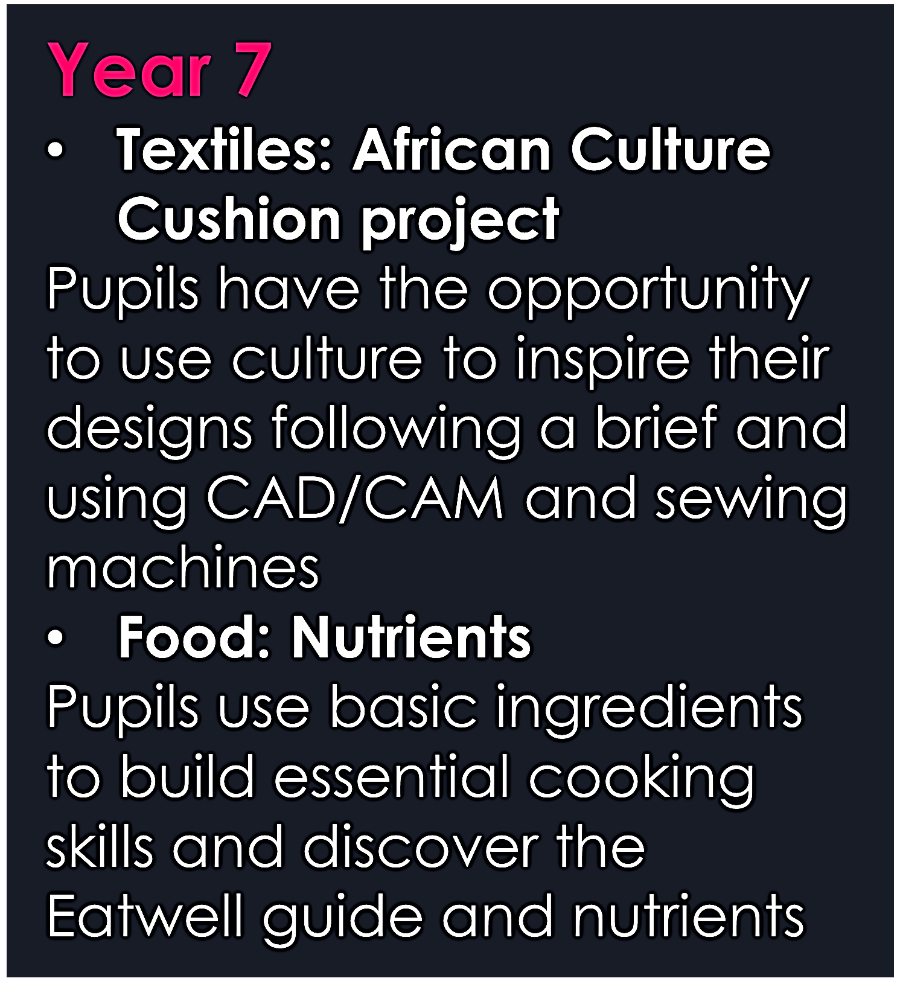

Design & Technology
5 Year Overview
Y11: WJEC
Pupils will complete their practical assessments throughout the year in controlled conditions and then begin revision for their final theory exam
Y11
Y11 Plan: AQA
January of Y11 – pupils are handed their exam brief an;d choose a theme to follow for their preparatory period before their 10-hour exam for a final piece/product They need to ensure Moodboards, designer research, experiments and designs are complete by Easter holidays.
WJEC Construction/Hospitality & Catering
Y10
Pupils are introduced to the Level ½ Course which involves a 60% non exam assessment and 40% written exam at the end of Y11. The coursework will consist of building knowledge on practical skills and theory while working on coursework to be submitted in Y11.
Y10 AQA: 3D Design/Textiles
Pupils are introduced to the course which is broken down into two components.
Component 1 will consist of an initial key skills project, alongside a mini project surrounding a brief and a large sustained project in preparation for coursework
Revision
Pupils undertake core knowledge revision based on Y10 theory learning in preparation for exam
BIG PICTURE
NEA
Introduction to briefs
Research and investigation
Client profiles
Specifications
Designing
Manufacturing
Portfolio Evidence
Photographic evidence
Evaluations
Year 9
Textiles: Denim Upcycle
Environmental effects of the industry and recognising the 6 Rs to manufacture a product made out of scraps of denim
Food: Skill development
Introduction to knife skills, sauces, fresh mayonnaise and high level cooking skills
Workshop: Pewter casting
Discover of metals and their properties and uses.
Year 8
Workshop: Memphis Milano project
Using design movements to inspire products. Pupils follow a brief and create a specification to underpin their practical skills
Superhero graphics
Introduction to polymers and vacuum forming and the importance of branding
Year 7
Workshop: Wooden Phone Holder
Pupils discover different tools and machines to manufacture a wooden phone holder in an animal theme. They investigate timbers and their properties and uses to underpin their practical skills.
CAD/CAM: Laser cut keyring
Introduction to 2D Design and laser cutting to manufacture a keyring gift. Pupils become familiar with client profiles and selecting materials
Year 7
Textiles: African Culture Cushion project
Pupils have the opportunity to use culture to inspire their designs following a brief and using CAD/CAM and sewing machines
Food: Nutrients
Pupils use basic ingredients to build essential cooking skills and discover the Eatwell guide and nutrients

