Slide 2

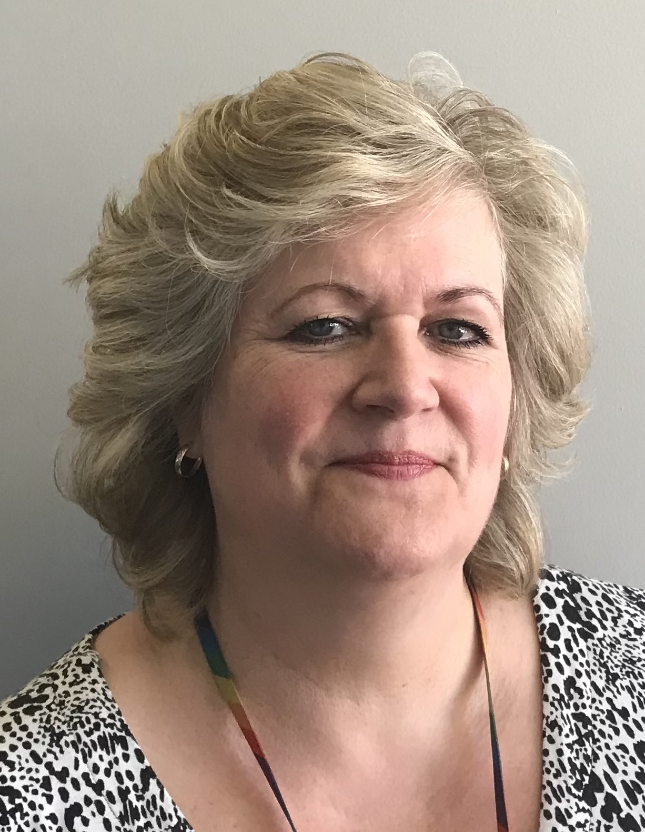
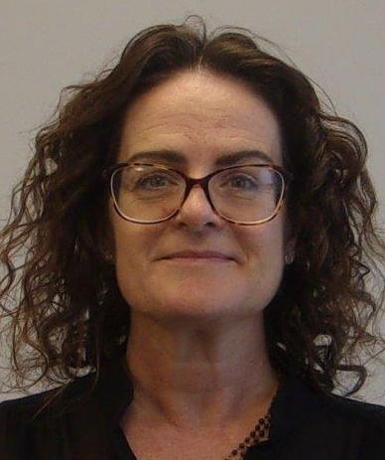
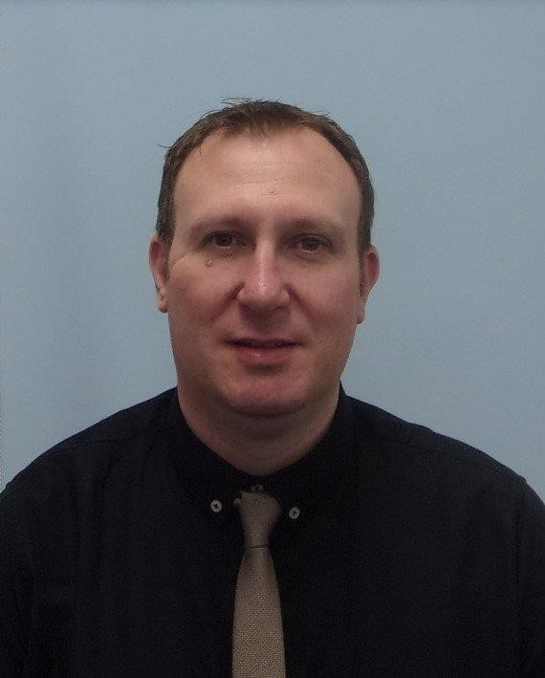
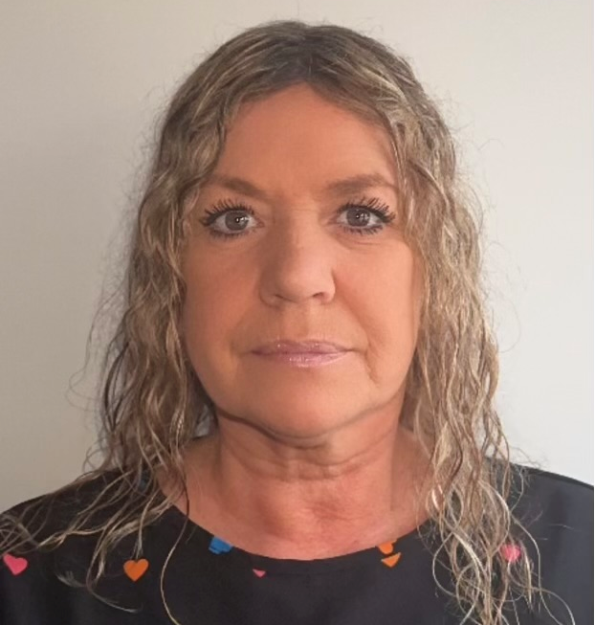
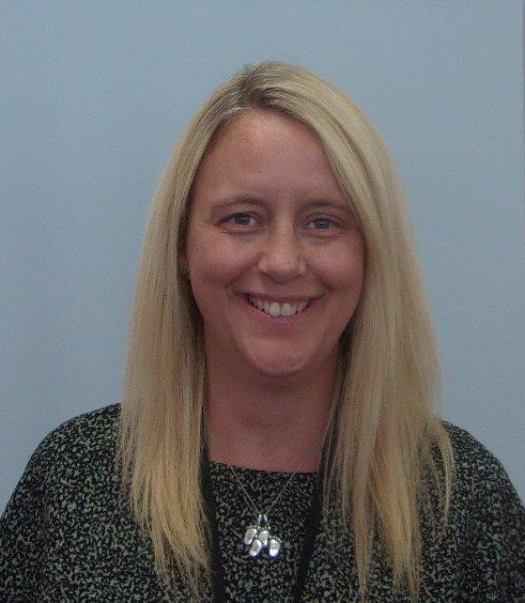
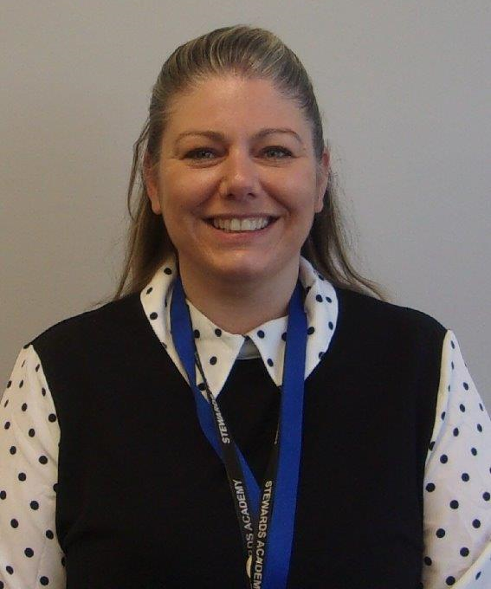
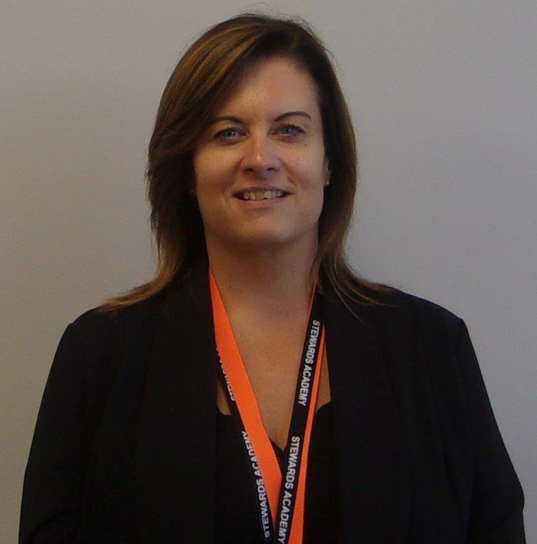
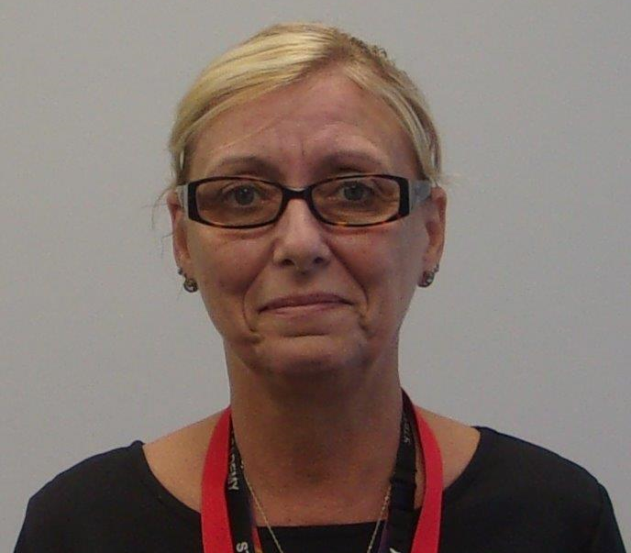
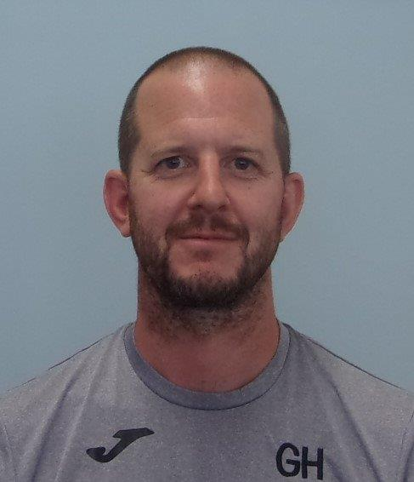



Designated Safeguarding Lead
safeguarding@stewardsacademy.org
If you have any worries about your safety or wellbeing, speak to a member of the Safeguarding team, or any adult in the School
Deputy Designated Safeguarding Leads
Mrs Atkinson
(Safeguarding V Office)
Miss Blake
Mr Myatt
(V Office / Admin Office)
Assistant Heads of House & Safeguarding Officers
Ms Morley
Mrs Bolt
Mrs Ali
Mrs Coulson
Mrs Coates
Mr Hughes
(AHT/Maths Office)
For Safeguarding updates and information please visit:

